Slide 1
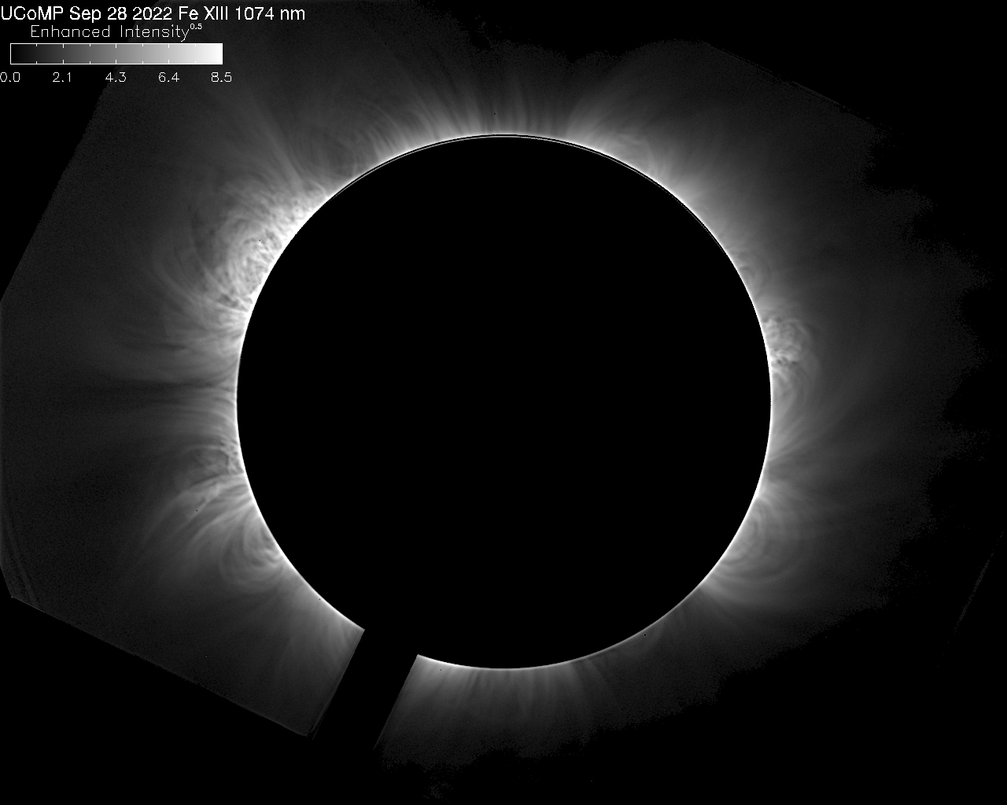
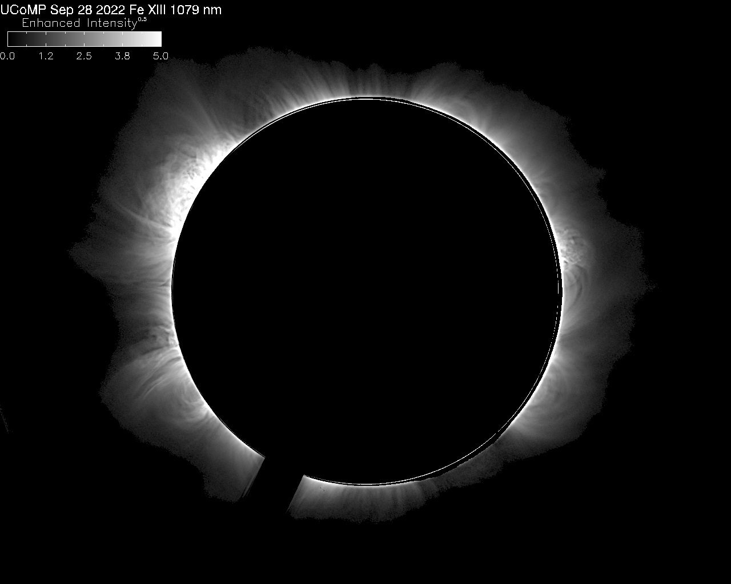
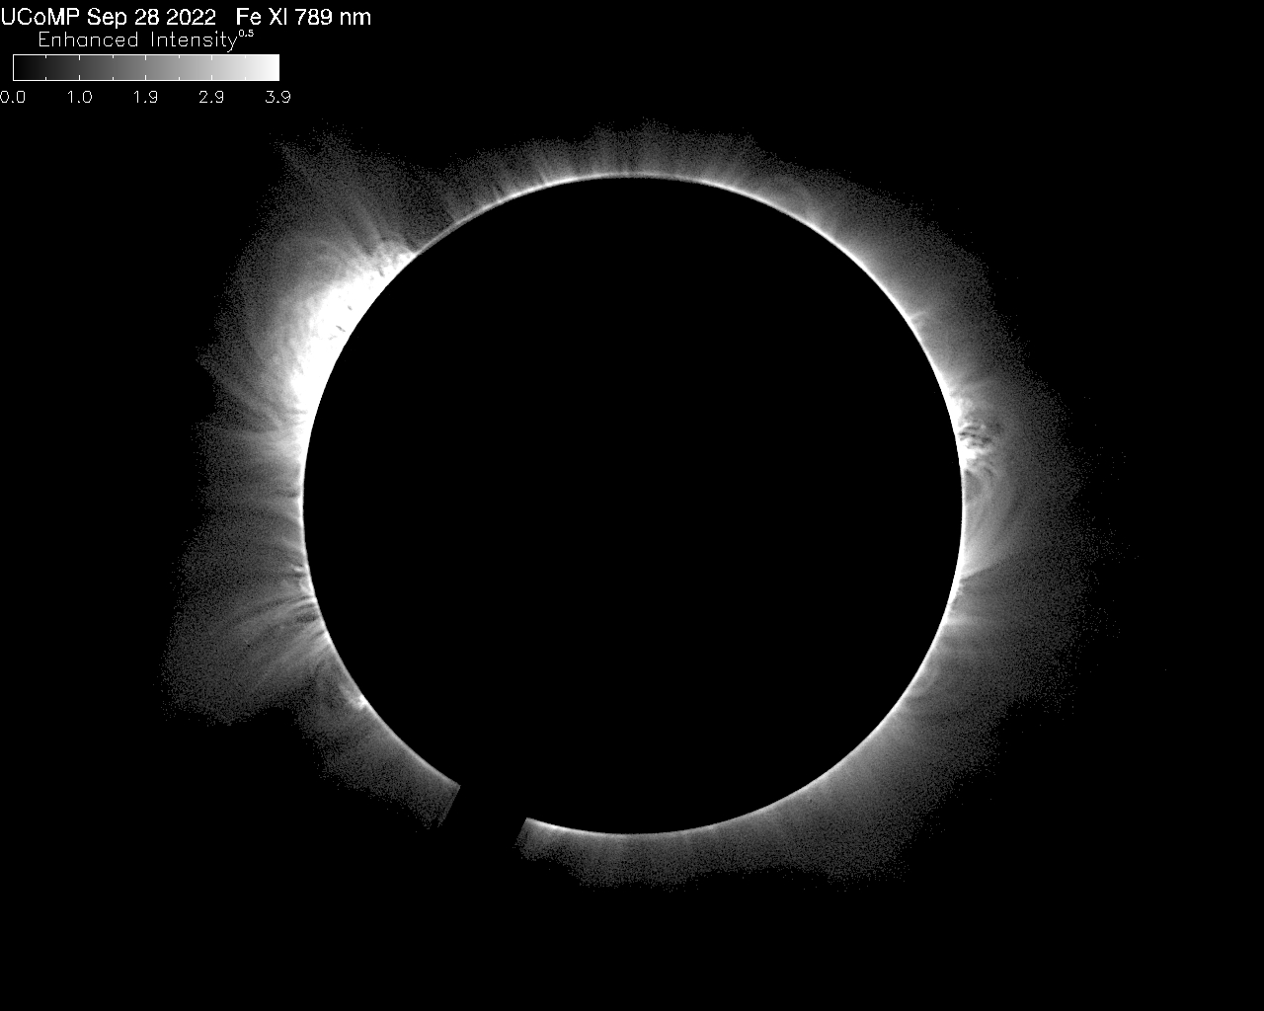
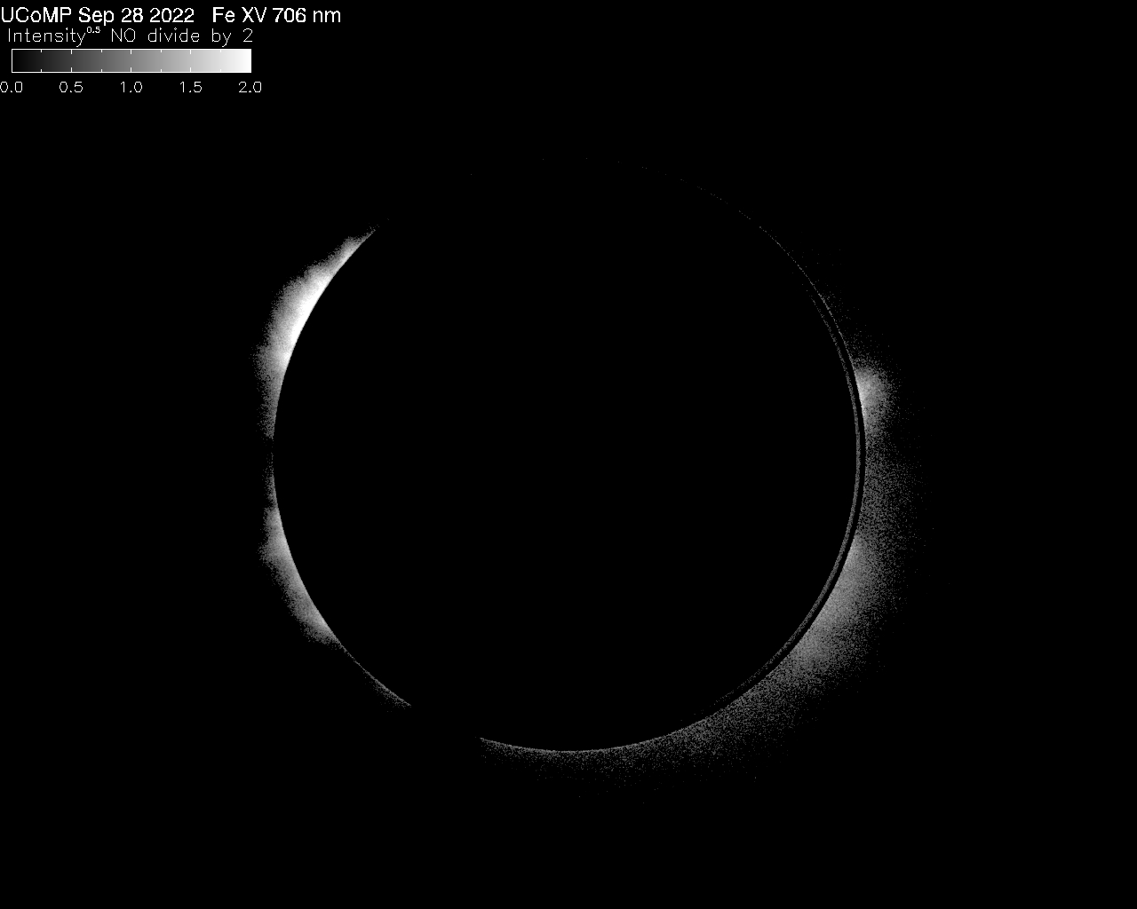
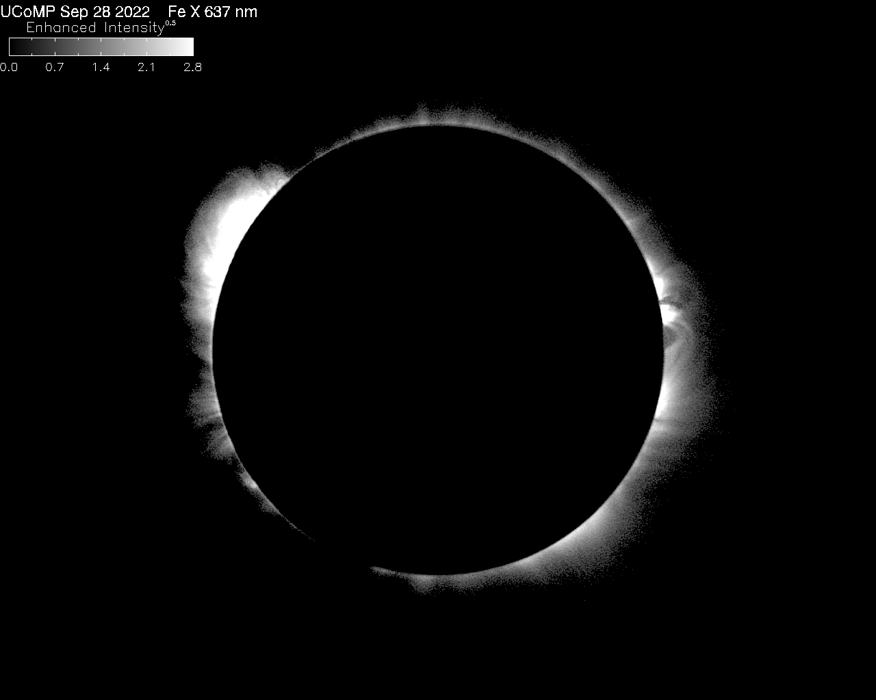
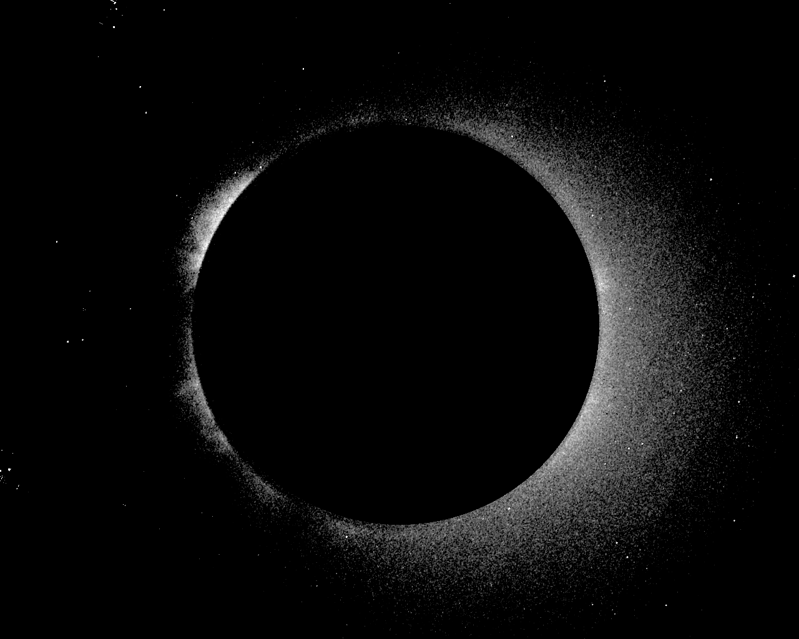
The Upgraded Coronal Multi-Channel Polarimeter (UCoMP) is a 20 cm aperture imaging spectropolarimeter with a field-of-view (FOV) from 1.04 to ~2 solar radii and 3 arcsec pixels. UCoMP observes full Stokes polarimetry in 9 spectral lines covering a broad range of coronal and chromospheric temperatures. It provides diagnostics on the coronal magnetic field and plasma properties including electron density, ion temperatures from thermal line widths and ratios of Fe lines of varying ionization states, line-of-sight Doppler motions, and coronal MHD wave diagnostics. It is designed to explore the magneto-thermal conditions in active regions, streamers and coronal holes. It was deployed to the Mauna Loa Solar Observatory and is completing commissioning.
FeXIII 1074 nm Enhanced Intensity
FeXIII 1079 nm Enhanced Intensity
FeXI 789 nm Enhanced Intensity
At LEFT:
Examples of UCoMP Coronal Intensity Images on Sept 28, 2022
FeXV 706 nm Enhanced Intensity
FeX 637 nm Enhanced Intensity
FeXIV 530 nm Intensity

Slide 2
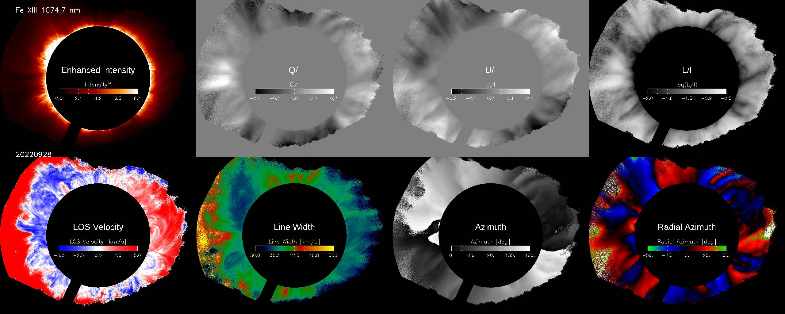
Examples of UCoMP Fe XIII 1074 nm Data Products from Sept 28, 2022
The upper row from left to right: Stokes I (Intensity); Stokes Q/I and U/I that correspond to the percent linear polarization horizontally and at 45 degrees, respectively; ratio of L/I where L is the linear polarization = sqrt (Q2 + U2). The bottom row from left to right: line-of-sight (LOS) Doppler velocity (the rotation of the corona is visible as the blue to red variation); Line Width that includes the instrumental profile; Azimuth of the magnetic field which is measured CCW from horizontal and is subject to a 180-degree ambiguity; Radial Azimuth of the magnetic field which is the azimuth measured CCW from the local radial direction. Zero-degree Radial Azimuth corresponds to magnetic field pointing in the radial direction.

Slide 3
Qualitative temperature maps from UCoMP on Oct 15, 2022. LEFT: map is composed of UCoMP FeXV, FeXIII and Fe XI limb observations. RIGHT: map is composed of UCoMP FeXIII, FeXI, and FeX data. The hottest region in the corona above the solar limb are colored white; mid range temperatures are green and the coolest coronal regions are blue.

Slide 4
Current Upgraded Coronal Multi-Channel Polarimeter (UCoMP) Observing Program
Six Coronal wavelengths: FeXIV 530 nm; Fe X (637 nm); Fe XV (706 nm); FeXI (789 nm); FeXIII (1074 & 1079 nm). UCoMP currently samples 3 points across each emission line.
UCoMP instrument is optimized for observing 1074 nm. Instrument transmission decreases at shorter wavelengths. Sky brightness and instrument scatter increase at shorter wavelengths. Signal-to-noise is highest in FeXIII 1074 nm followed by FeXIII 1079, FeXI 789, FeX 637, and Fe XV 706. Signal is lowest in FeXIV 530.
All sequences obtain Stokes I, Q, U & V. Only the FeXIII 1074 nm linear polarization has good signal-to-noise.
Daily observations: (weather permitting)
30 minutes of flats in all the coronal wavelengths
~1.5 hours of coronal observations in all the coronal wavelengths
~30 minutes of flats
~1 hour of 1074 data (coronal waves program)
~45 minutes of polarization calibrations
The rest of the day spend in the following loop:
~30 minutes of flats in all the coronal wavelengths
~1.5 hours of coronal observations in all the coronal wavelengths
Average observing day is ~5 hours; can obtain 10 hours of data on good weather days.

