Slide 1
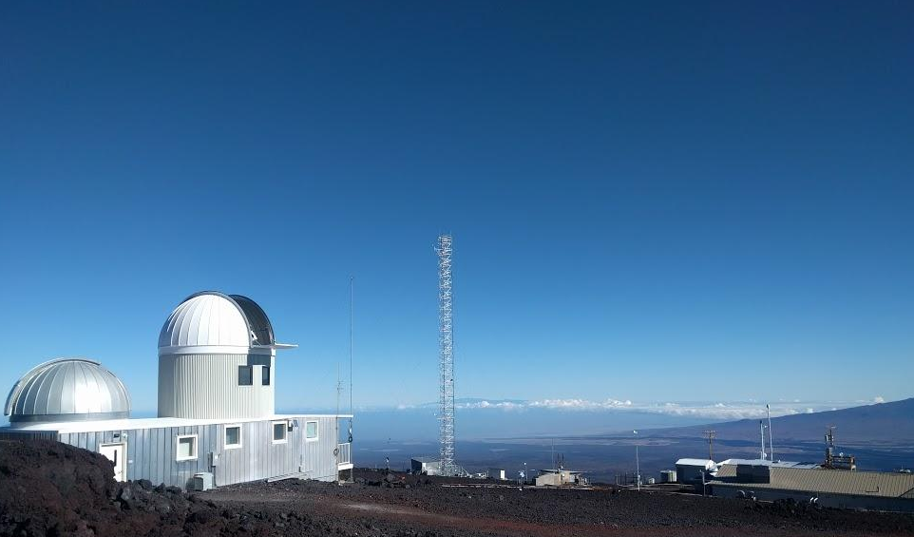
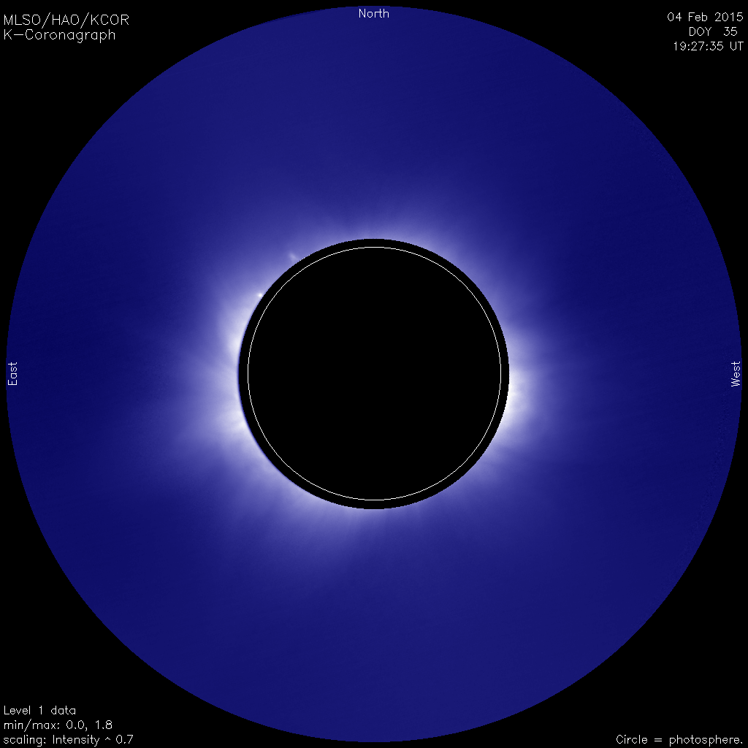
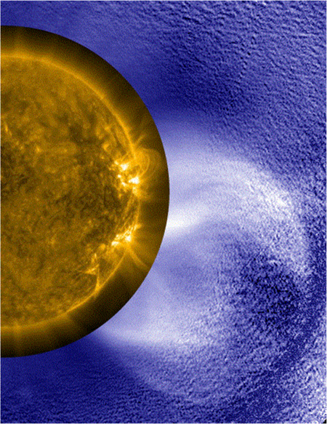
NCAR
UCAR
The Mauna Loa Solar Observatory Observations To Increase Capability in Space Weather
The Mauna Loa Solar Observatory (MLSO) performs observations of the solar corona ~300 days per year.
KCor fully processed images and movies on web within 10 minutes of acquisition for space weather forecasting and realtime CME detection
CoMP provides unique routine observations of coronal magnetic field diagnostics and Doppler from coronal emission lines
CoMP Doppler Fe-XIII
SDO / KCor / LASCO

Slide 2
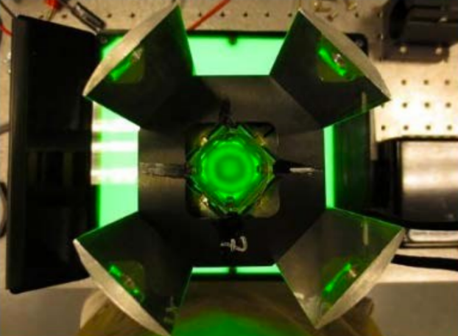
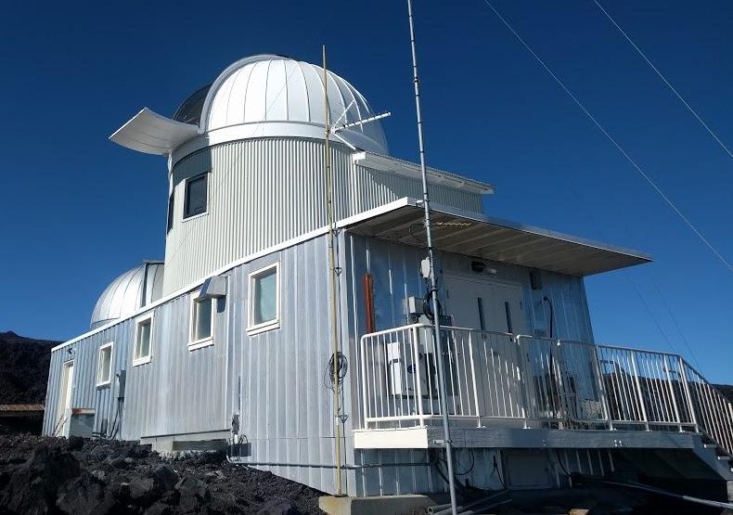
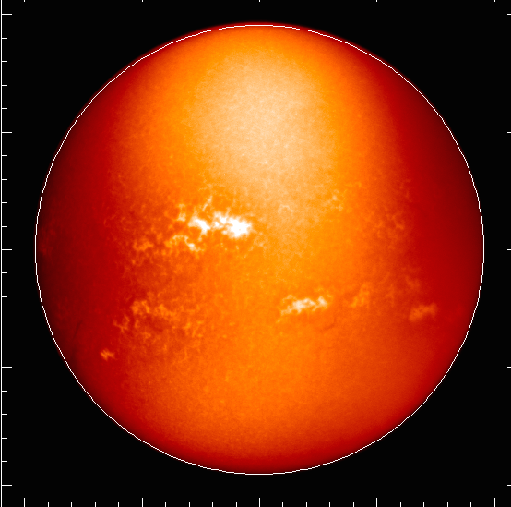
NCAR
UCAR
The Mauna Loa Solar Observatory Observations To Increase Capability in Space Weather
Major renovations to MLSO completed in April 2016 including a new dome, new interior walls, wiring, internet upgrades, and much more.
ChroMag
KCor / ChroMag
CoMP helium 1 intensity and linear polarization will be available early summer 2016
Observational Research and Facilities Theme | 2-4 May 2016

