Slide 1
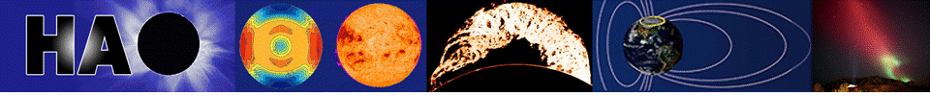
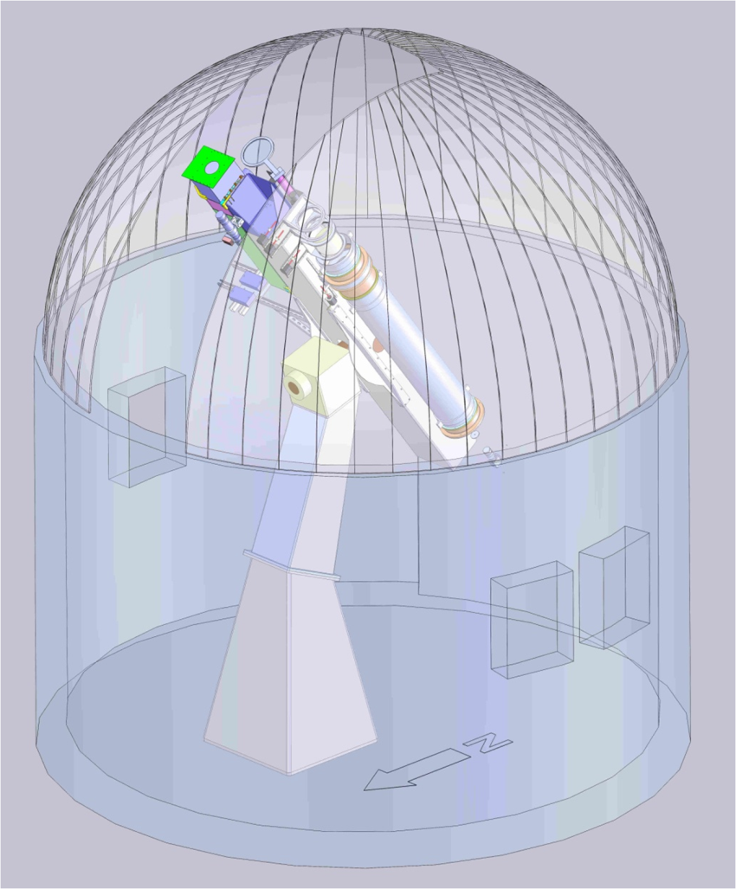
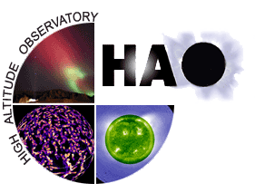


COSMO
K-Coronagraph
Science Requirements
An Introduction to Space Weather
Joan Burkepile
J. Burkepile
High Altitude Observatory / NCAR
http://www.cosmo.ucar.edu/kcoronagraph.html

Slide 2
Science Goals
Understand the formation of Coronal Mass Ejections (CMEs) and their relation to other forms of activity (flares, prominence eruptions, and shock waves)
Identify Earth-directed CMEs (halos) in realtime
Determine the density distribution of the corona over solar cycle time scales
Measure the radial brightness profiles out to and beyond 1.5 Rסּ in magnetically open regions.

Slide 3
Science Goals formulated by COSMO Science Advisory Panel, Mauna Loa User Committee and HAO scientists
Science Advisory Panel
Thomas Zurbuchen, Univ. of Michigan (Chair)
David Alexander, Rice Univ.
Spiro Antiochos, NASA GSFC
Jean Arnaud, Université de Nice, France
Phil Judge,HAO/NCAR
Matt Penn, NSO
John Raymond, Harvard CfA
Aad VanBallegooijen, Harvard
Mauna Loa User Committee
David Alexander, Rice Univ. (Chair)
Nick Arge, Air Force Res. Lab.
Tim Bastian, NRAO
Terry Forbes, Univ. of N. H. Holly Gilbert, NASA GSFC
Shadia Habbal, Univ. of Hawaii Jerry Harder, Univ. of Colorado
Alex Pevtsov, NSO
Chris St.Cyr, NASA GSFC

Slide 4
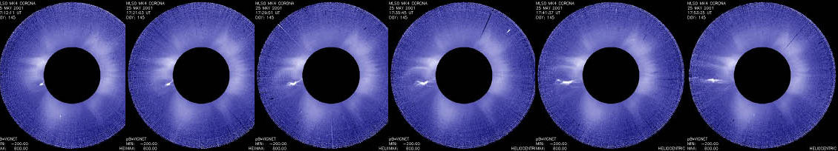
Why build a new coronagraph?
Mauna Loa Solar Observatory Mk4 images of CME on May 25, 2001 at 3 minute cadence
Most of the mass and magnetic free energy of the corona resides in the first scale height (< 0.1 solar radii). Most CMEs form in this region, particularly the fastest events. High cadence observations of the very low corona are essential for studying the formation of CMEs and their relation to other forms of solar activity such as prominence eruptions, flares and solar energetic particle events.

Slide 5
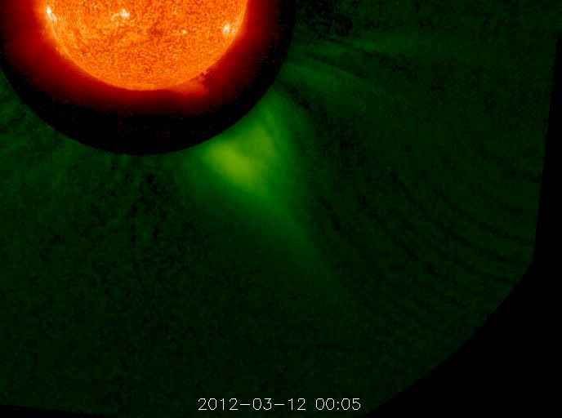
Why build a new coronagraph?
Far left: STEREO composite of EUV1 and COR1 on Mar 12, 2012.
Near Left: LASCO C2 images of CME on Jan 4, 2002
No existing white light coronagraph views the very low corona or has the high time cadence required to meet science goals. LASCO C2 views the corona down to 2.0 solar radii and STEREO COR1 views down to 1.50 solar radii. Most CMEs form below these heights.
The COSMO K-coronagraph is specifically designed to view the corona into the first scale height (down to 1.05 solar radii) with a high enough cadence (15 seconds) to study the birth and evolution of CMEs at a fraction of the cost (~5%) of a space-based coronagraph.

Slide 6
Design Flow-Down from Science Requirements
The COSMO K-coronagraph design was driven by the primary science requirement to view the very low corona (FOV: 1.05 to 3 solar radii) at high temporal cadence (15 seconds)
20 cm aperture uncoated singlet objective lens
Internally occulted
Pass band: ~720 to 750 nm
out-of-band rejection <= 1 part in a million
4-state polarization modulation
Lyot stop
Dual beam polarization ; 2 cameras to simultaneously record polarization states

Slide 7
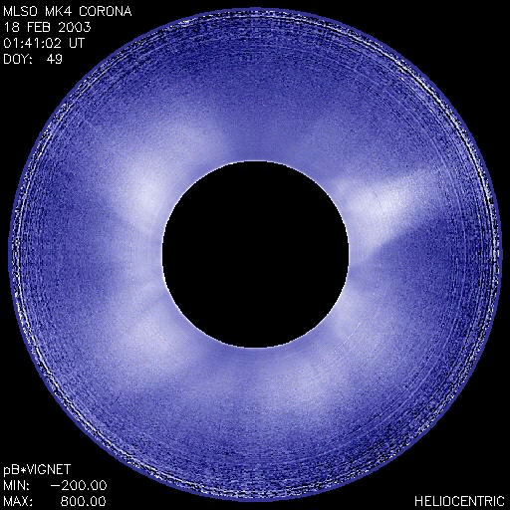
Science Goals:
1) Understand the formation of CMEs
Understand the nature and magnitude of the forces acting on CMEs by measuring rate of change of acceleration, brightness and morphology changes, location and timing to other forms of solar activity
CME acceleration is greatest below 3.0 solar radii
Requirement FOV: down to 1.05 Rsun

Slide 8
Acceleration Greatest in Low Corona
1.0
0.5
0.0
Decelerating
Accelerating
INNER CORONA
Mauna Loa 1.12-2.8
1.12 to 2.8R_{sun}
Avg accel. =302 m/s²
1.0
0.5
0.0
MIDDLE CORONA
Solar Max Mission
1.8 to 5
1.8 to 5 R_{sun}
Avg accel. = 68 m/s²
Fraction of Total
1.0
0.5
0.0
OUTER CORONA
LASCO 2 to 32
2 to 32 R_{sun}
Avg accel. = 0.4 m/s²
1 to 10
>1000
Need high time cadence (15 seconds) to get rate of change of acceleration
<-1000
-10 to -1
11 to 100
-100 to -11
101 to 1000
-1000 to -101
meters/sec²

Slide 9
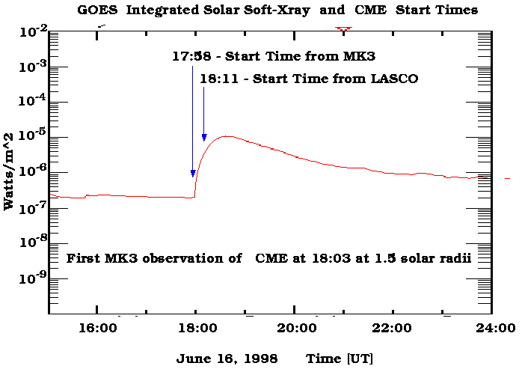
High time cadence and lower field-of-view provides more accurate CME start times

Slide 10
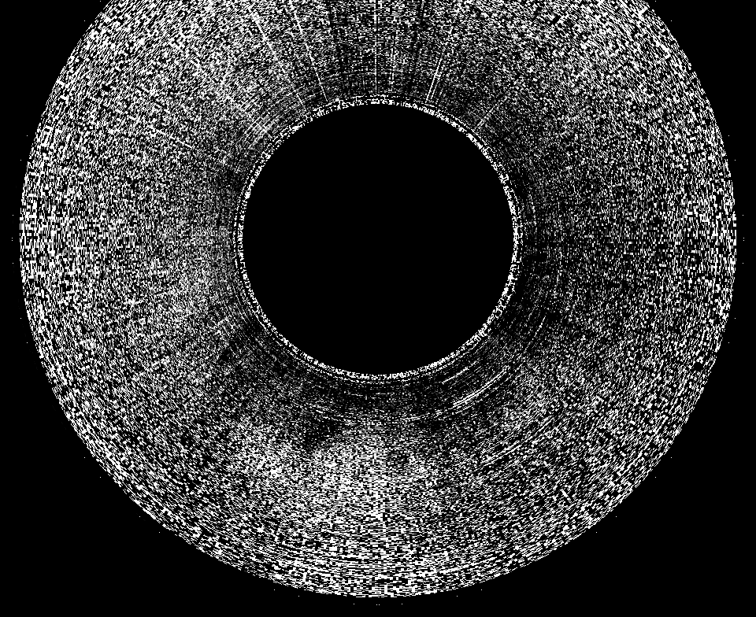
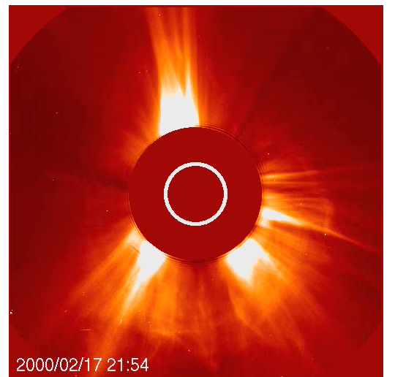
Science Goals:
2) Detecting Halo CMEs
A typical LASCO Halo occurred on Feb 17, 2000 and was detected in Mk4 at a brightness level of 4 x 10⁻⁹ B_{סּ}
20:40 UT
Need to detect brightness levels < 10⁻⁹ B_{סּ}

Slide 11
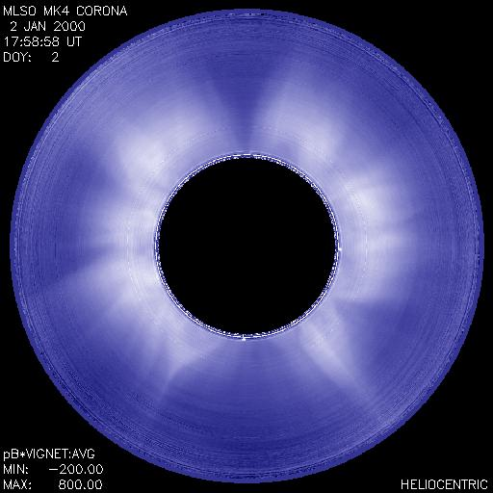
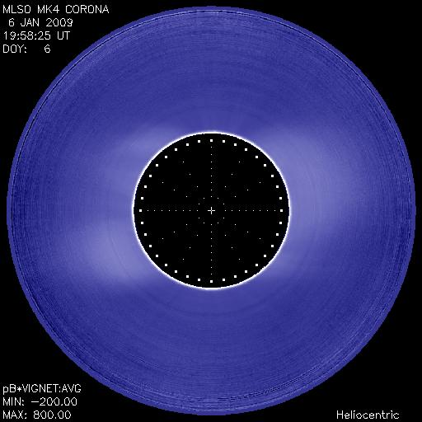
Science Goals:
3) Track Density Distribution of Corona over time scales of days to decades
Solar Maximum: Mk4 image from Jan 2, 2000
Solar Minimum: Mk4 image from Jan 6, 2009
Instrument must be robust, easy to maintain and easy to calibrate

Slide 12
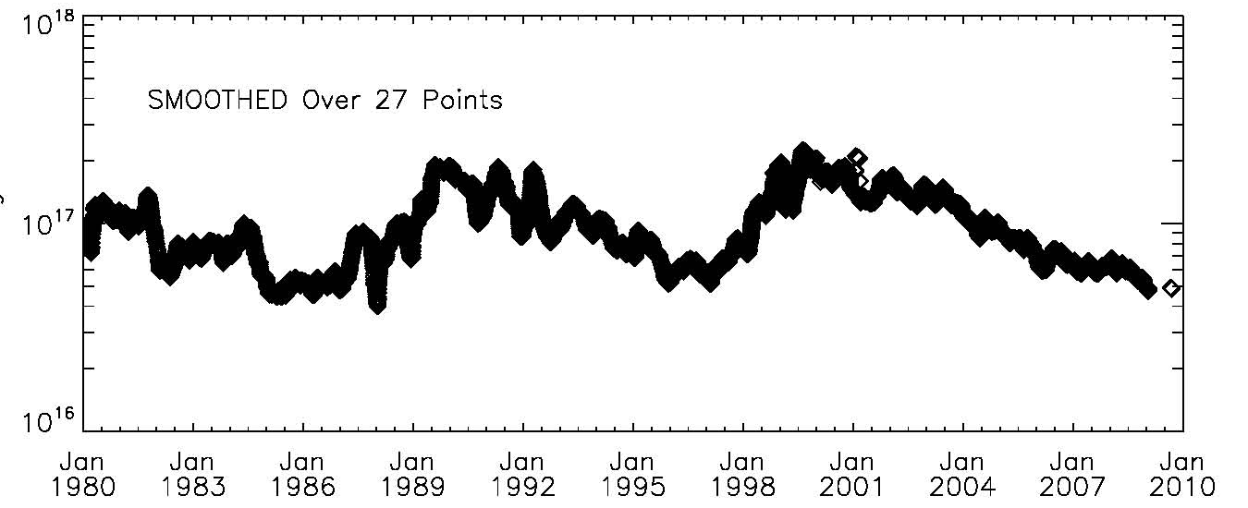
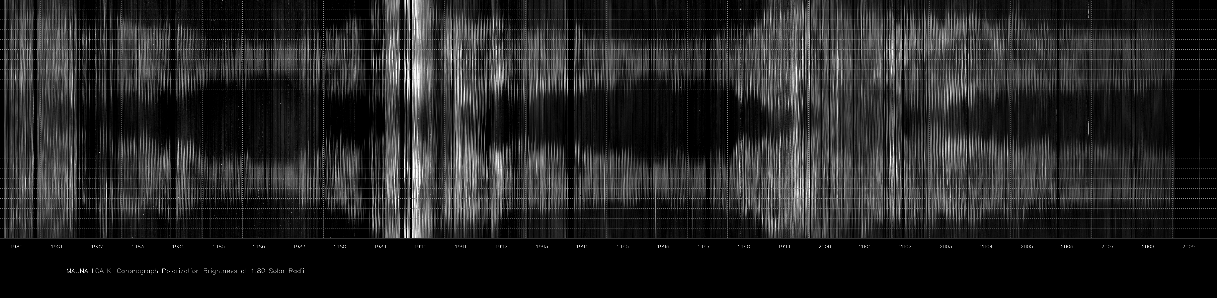
White Light (pB) 1980 to Jan 2009
MASS (grams)
1980 1983 1986 1989 1992 1995 1998 2001 2004 2007
NORTH POLE
SOUTH POLE
NORTH POLE
1.8 Solar Radii

Slide 13
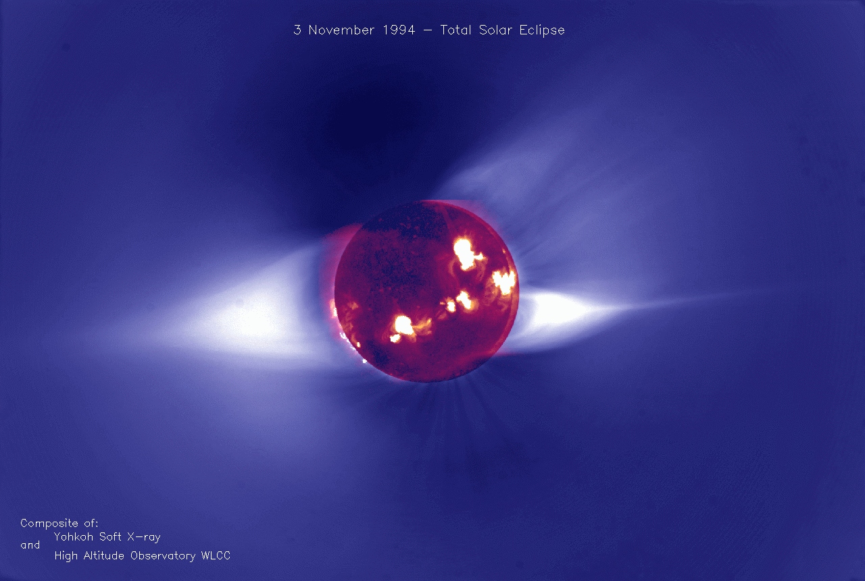
Science Goals:
4) Measuring Radial Brightness in coronal holes out to and beyond 1.5 Rsun
Energy deposited into the corona heats closed field regions and accelerates plasma to form solar wind. Radial density profiles in coronal holes provide scale height information that can be used to derive temperature profiles.
There are very few measurements of coronal hole density profiles. SOHO/Sumer has provided measurements out to ~1.3 Rsun.
Routine observations are needed to understand the processes responsible for solar wind acceleration.
Need to measure brightness levels at a few x10⁻¹⁰ B_{סּ}

Slide 14
Importance of Reliable Calibration
Quantitative information:
Platescale: Measure absolute positions of CMEs, measure relative brightness changes as function of height and position (stable photometry)
Absolute brightness calibration:
CME masses: (energetics)
Radial density profiles and masses of coronal features: provides constraints on coronal temperature, energy deposition into corona, acceleration of solar wind
Absolute calibration is critical to getting maximum scientific return

Slide 15
Scattered Light Requirements
Minimizing scattered light is the single greatest design driver of coronagraphs.
  An uncoated singlet objective lens is used (lens scatters 4 times less light than a mirror)
  Microroughness requirements for objective lens: <= 7 Angstroms RMS over spatial frequencies 40 microns to 3.2 mm
  Hepa system to keep objective lens clean. Scattered light level is dominated by dust particles on the objective lens.
  Bafflings, coatings, out-of-band rejection filters

Slide 16
Summary of instrument requirements
Quantity | Units | Requirement | Goal | Comparison to MLSO Mk4
Field of view (FOV) | D_{סּ} | 3 | 4 | 2.9
Lower Limit of FOV | Arcsec | 50 | 25 | 120
Spatial Sampling | Arcsec | 6 | 3 | 5 x 9 to 5 x 23
Noise Level | pB₀ / √Hz | 3.9 x 10⁻⁹ | 1.3 x 10⁻⁹ | 5.4 x 10⁻⁸
Map Time | sec | 15 | 8 | 180
Pointing | Arcsec | <6 over 15 sec | <3 over 15 sec

Slide 18
K-Coronagraph Optical Design
High Quality Fuse Silica
Objective Lens
AFT OPTICS
2734 mm total optical track

Slide 19
K-coronagraph Imaging Assembly

Slide 20
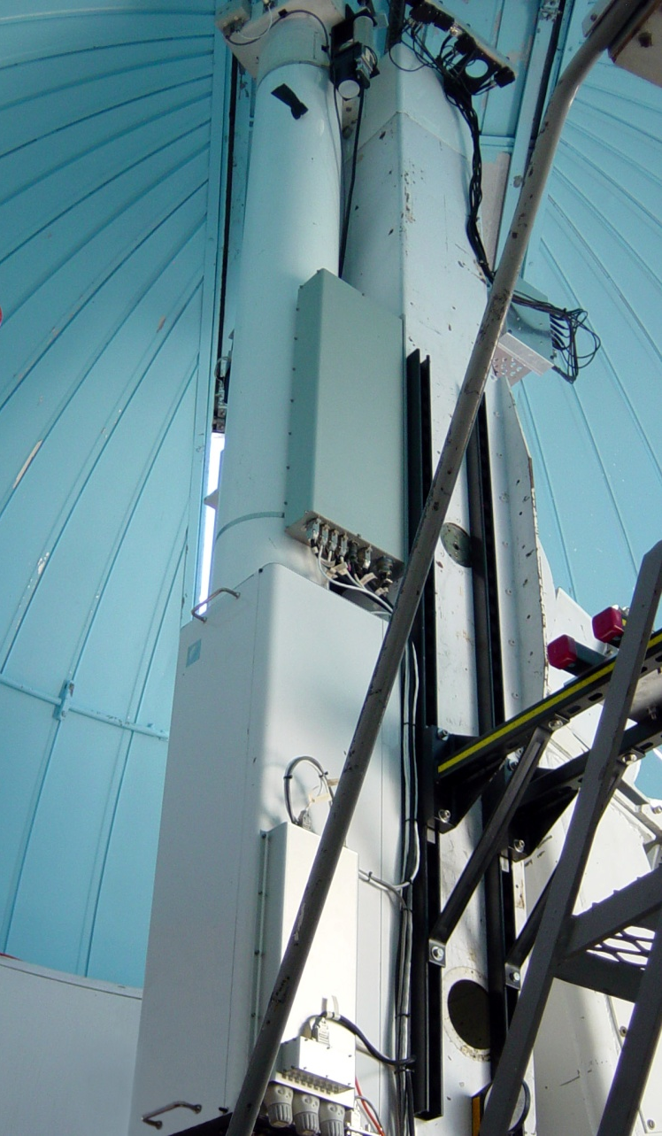
K-coronagraph status
Mauna Loa installation completed Sept 6, 2013
Began operating in engineering mode Sept 9, 2013
Science data expected before end of 2013
All data provided on MLSO website:
http://mlso.hao.ucar.edu

Slide 21
Future
Welcome Observing Campaigns (high time cadence)
  First request by A. Kiplinger (University of Colorado) to study flares strongly associated with energetic particles and CMEs
Data products
  Fully calibrated polarization brightness plus contrast enhanced images and movies
  Synoptic Maps
  Composite Images
  CME alerts
  CME listings and more
Network
  MLSO observing window is 17 to 02:30 UT, weather permitting. Additional sites would greatly increase duty cycle

