Slide 1
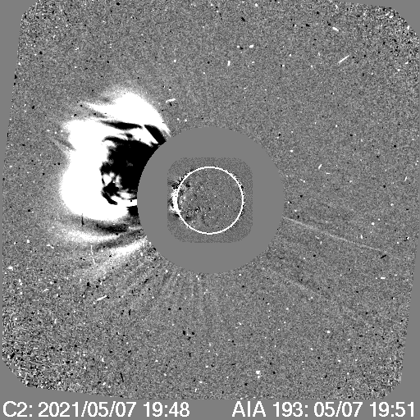
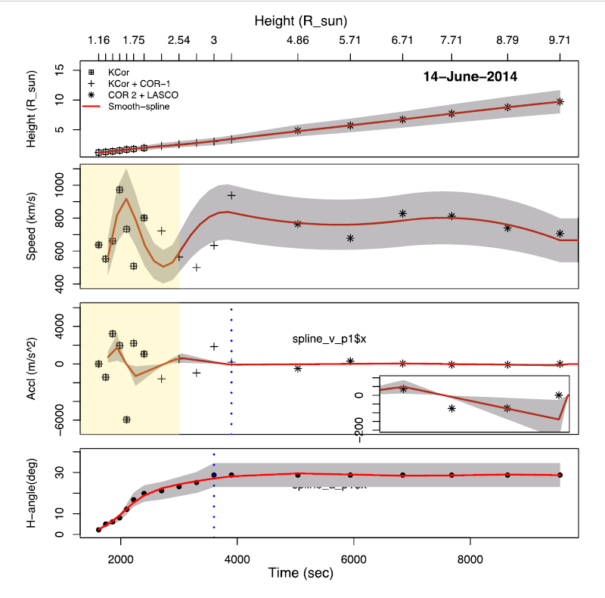
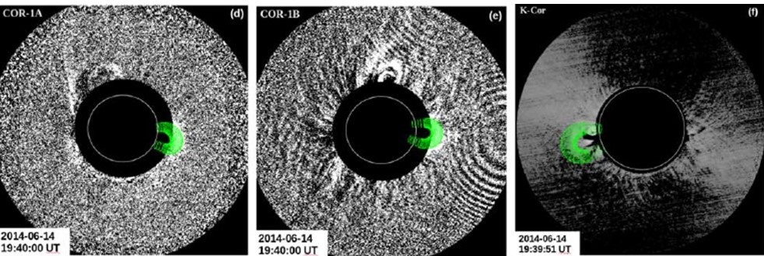
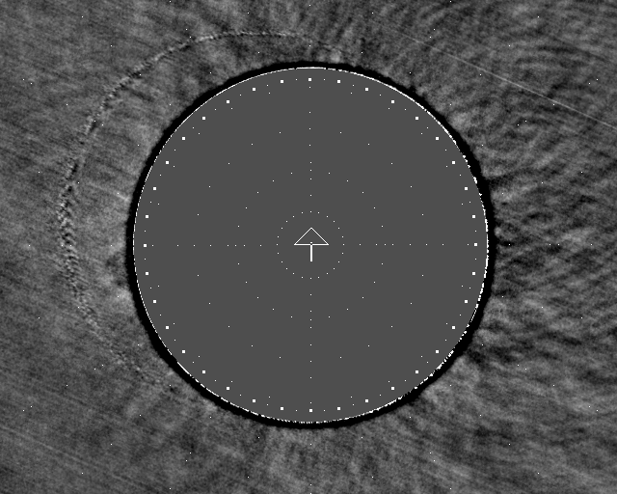
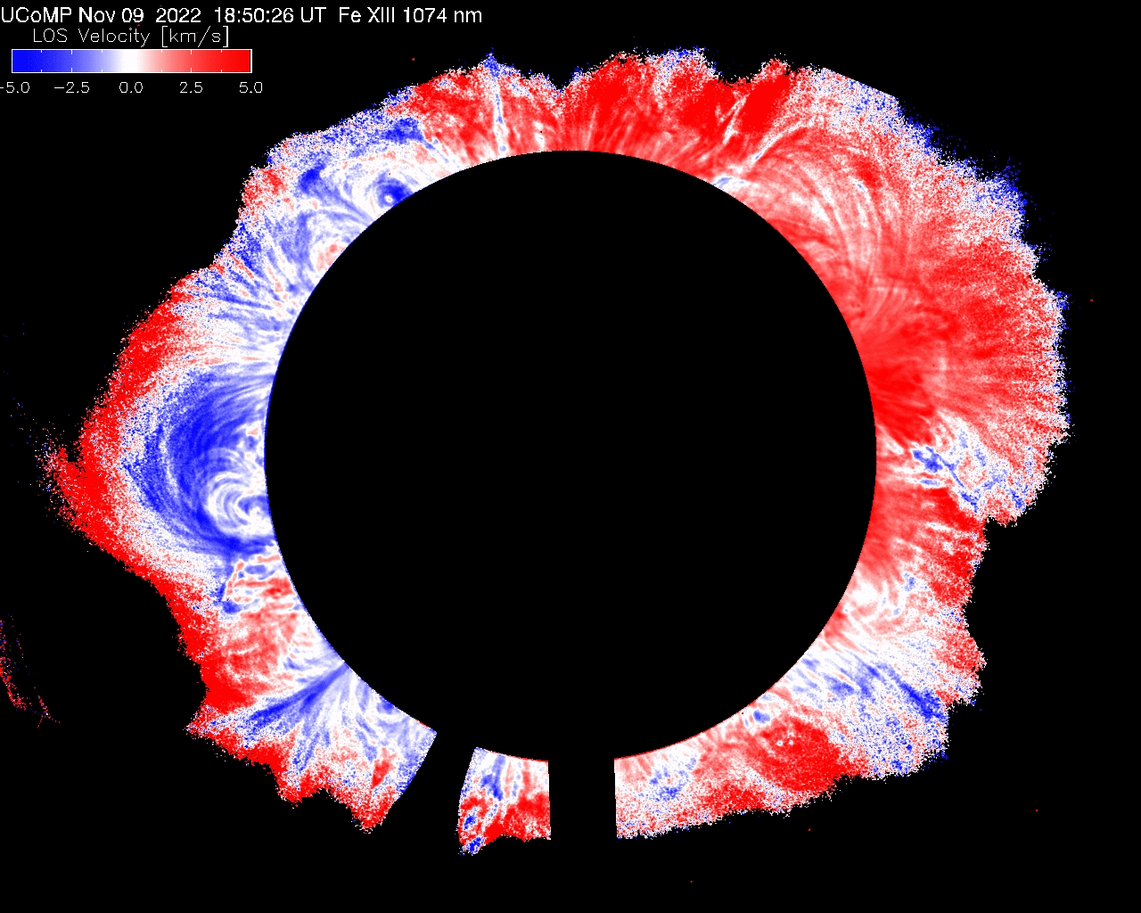
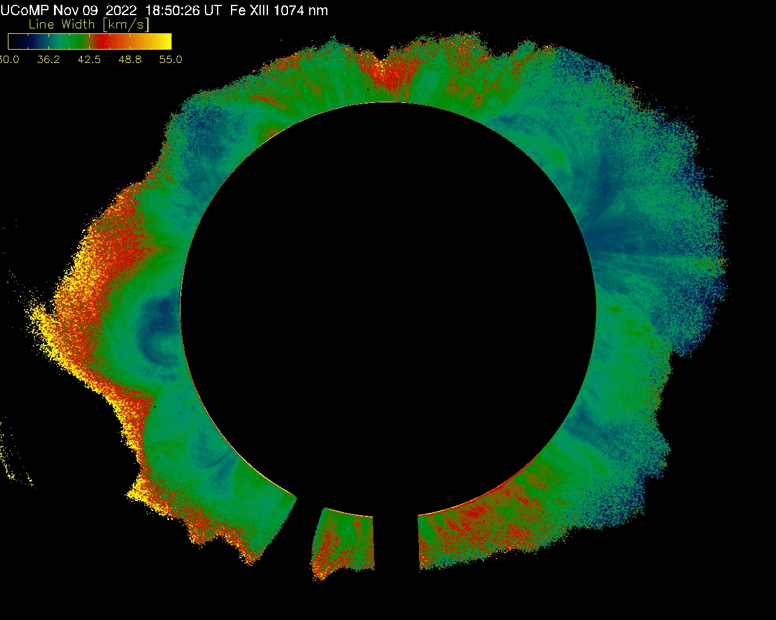
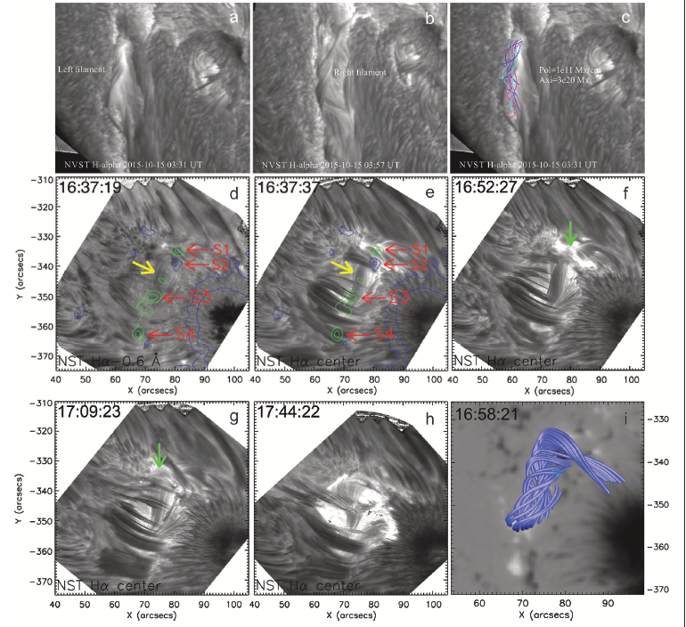
PUNCH Objective 2A: CME 3D Trajectory, Structure, and Evolution
Objective 2C: Shock 3D Dynamics & Morphology
CME Acceleration profiles and 3D Volume from K-Cor and STEREO (Majumdar, Patel, Pant 2022)
MLSO KCOR
MLSO KCOR
LASCO C2
Fast CME May 7, 2021: changing morphology of CME front in low corona: indicative of possible shock formation
Pre-CME flux rope magnetic structure from hi-res at BBSO, GREGOR, and NVST at Fuxian Obs. (Wang et al. 2015)
UCoMP
LOS Doppler
UCoMP
Line Width
Nov 9, 2022 CME. MLSO K-Cor (left); UCoMP (ctr & right). CME lateral expansion visible in all data; Doppler shows structured motion within CME; increase in line width within CME may be due to enhanced flow turbulence (see Tian et al. 2013

Slide 2
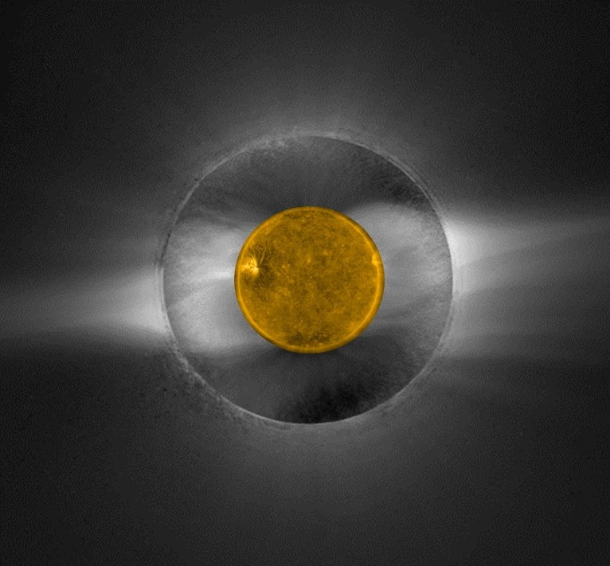
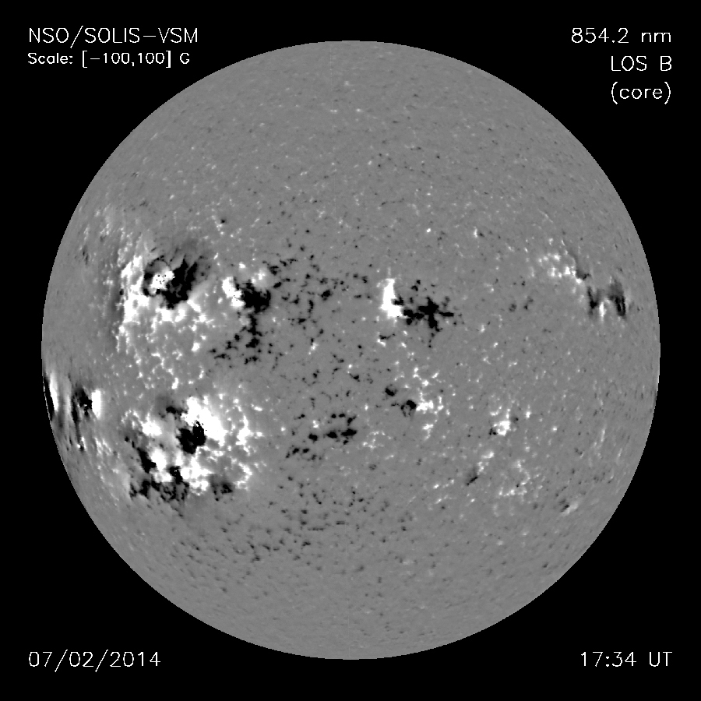
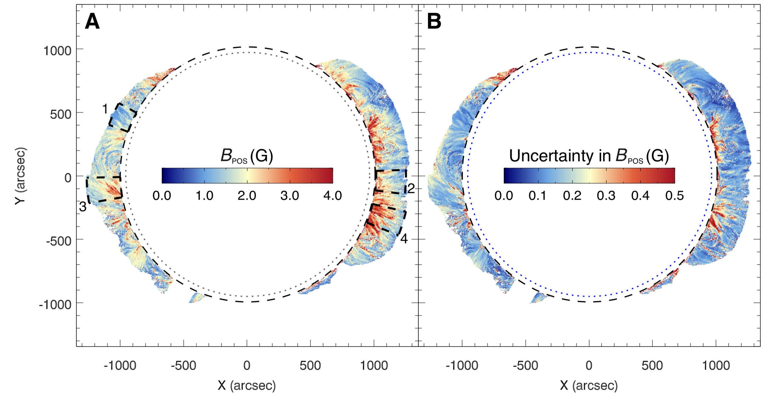
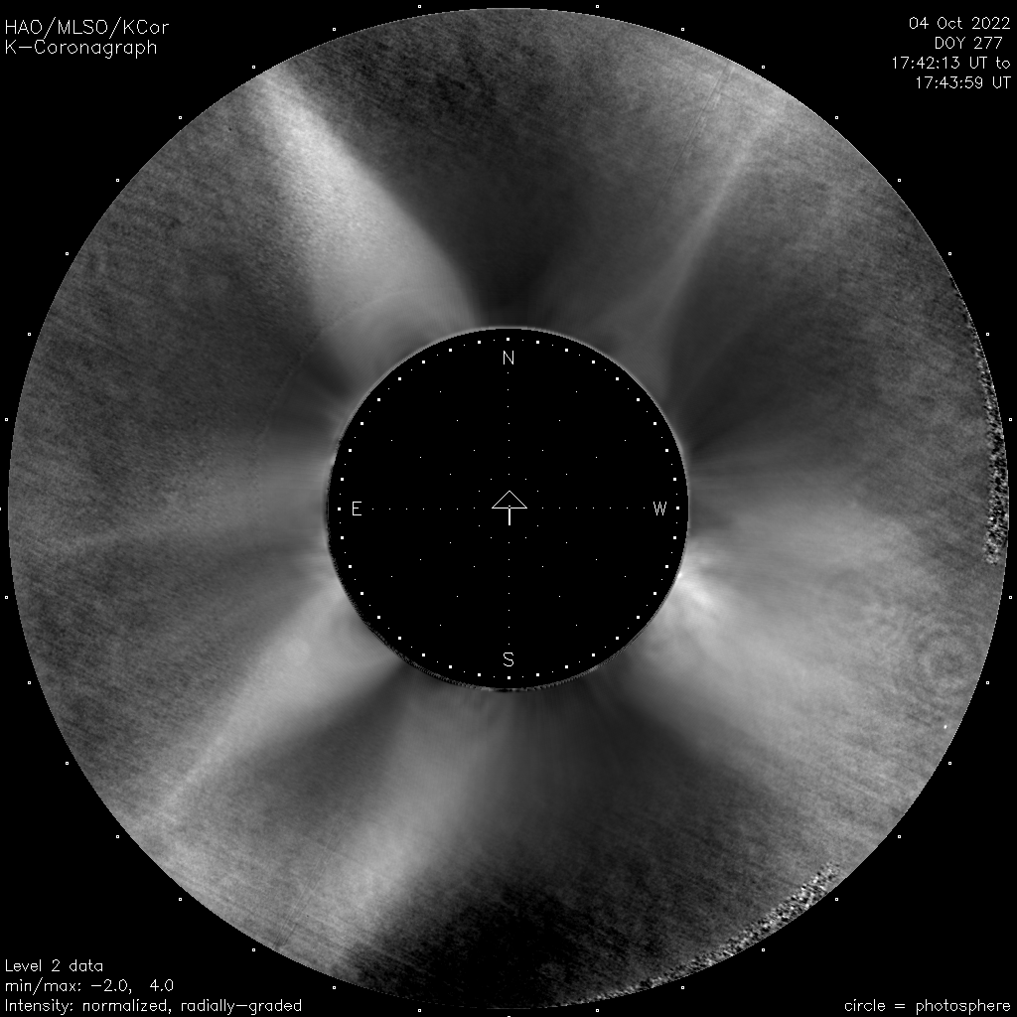
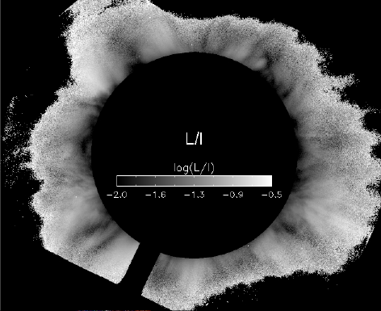
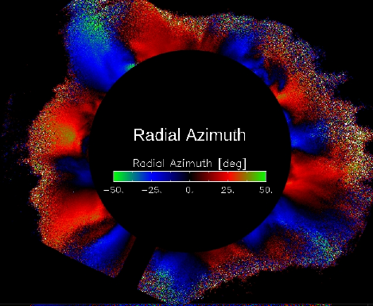
Objective 1A: Global solar wind flow
Structures and boundaries in the corona must ultimately give rise to features in the solar wind.
Better magnetic boundary conditions for coronal models to connect to PUNCH / solar wind
Chromosphere magnetic field maps from SOLIS (shown at right), ChroMag (full disk), CRISP, MAST
POS coronal magnetic field maps from UCoMP (Yang et al. 2020)
Connect low/middle corona to PUNCH
Helmet streamer (current sheet; slow solar wind) Pseudo-streamer (no current sheet / hybrid solar wind
MLSO provides diagnostics for identifying coronal magnetic topologies and plasma conditions for understanding conditions observed in the solar wind
Helmet
Helmet
PS
Helmet
PS
Pseudo-streamer
‘PS’
K-Cor
UCoMP
UCoMP

