Slide 1
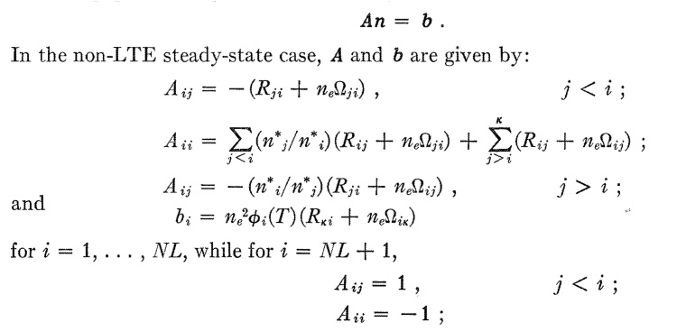
Curious Case of the Solar Temperature Minimum: Dimitri Tribute Tom Ayres (CASA)
BSD
Mar 2014

Slide 2
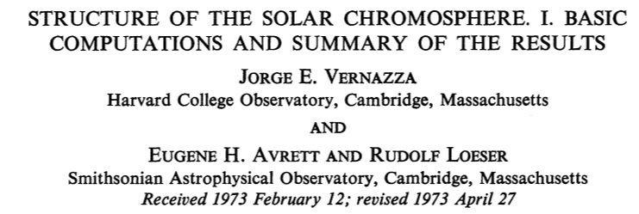
The Problem
Solar chromosphere exhibits nonclassical temperature inversion; excess radiated luminosity
~ L {ΔΤ/Τ} τ
τ is very small in chromosphere, where ΔΤ is big; τ is much larger at T_{min}; although ΔΤ is smaller; still huge amount of energy radiated from T_{min} (“follow the cooling”); possibly even more from photosphere:
what is ΔΤ at T_{min}?
Photosphere
Chromosphere
Tmin
ΔT
Radiative
Equilibrium

Slide 3
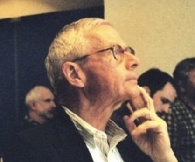
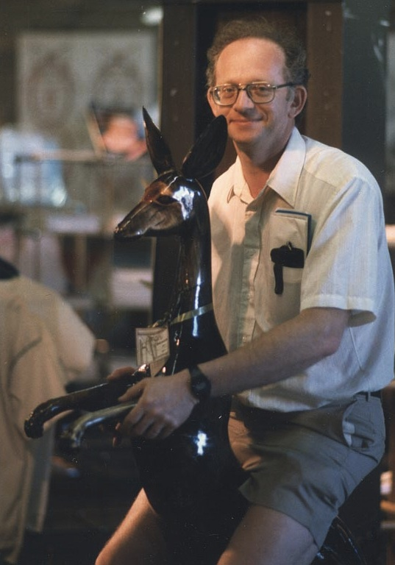
The Players*
G
E
N
E
A
V
R
E
T
T
E
DI
MI
T
R
I
J
E
F
F
L
I
N
S
K
Y
T
O
M
A
Y
R
E
S
*Not shown : L. Auer, J. Heasley, R. Shine , R. Milkey

Slide 4
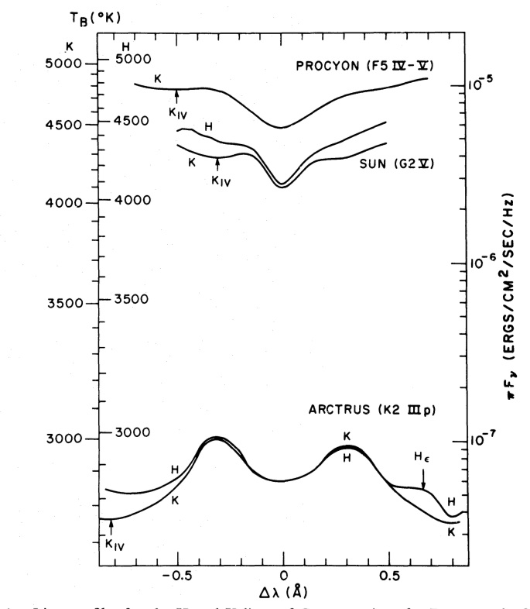
The Dilemma
The classical UV/OIR/FIR continuum diagnostics of SAO team suggested a T_{min} of about 4100 K, but with large uncertainties because of difficulty of cross-calibrating the widely separated spectral regions. Focus shifted at JILA to Ca II and Mg II resonance lines (395 nm and 280 nm) because of narrow spectral region spanned by each doublet, easing calibration uncertainties; and taking advantage of exponential T sensitivity of UV thermal emission. (also: stars) However, new issue arose because of subtilty of radiation transport in these resonance lines: “Partial Redistribution.” Here’s where Dimitri came into the picture.

Slide 5
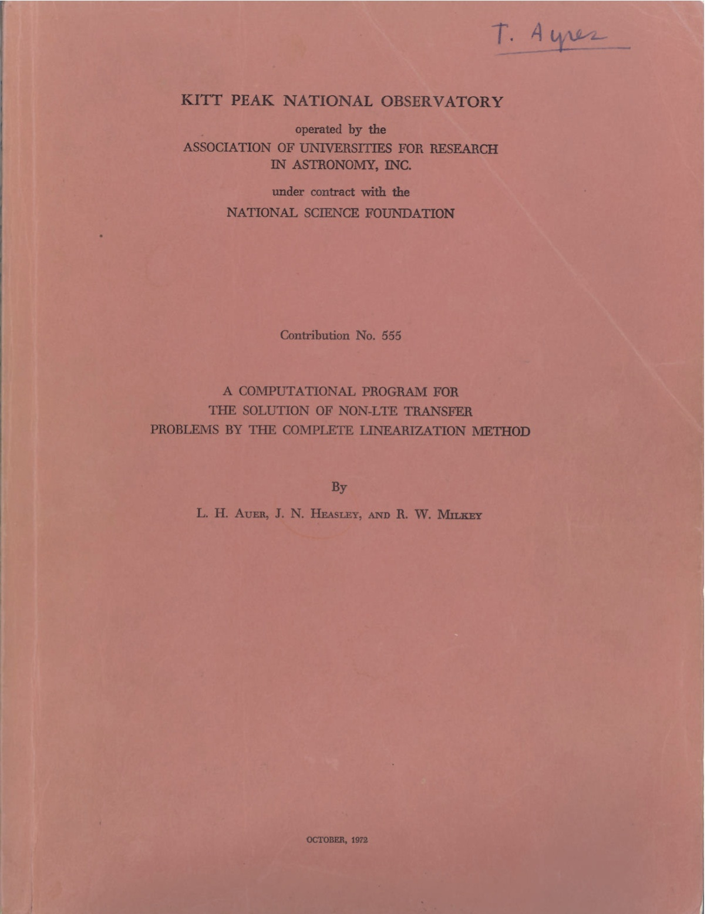

Slide 6
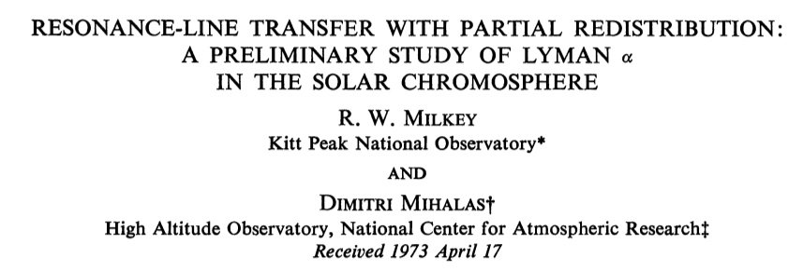
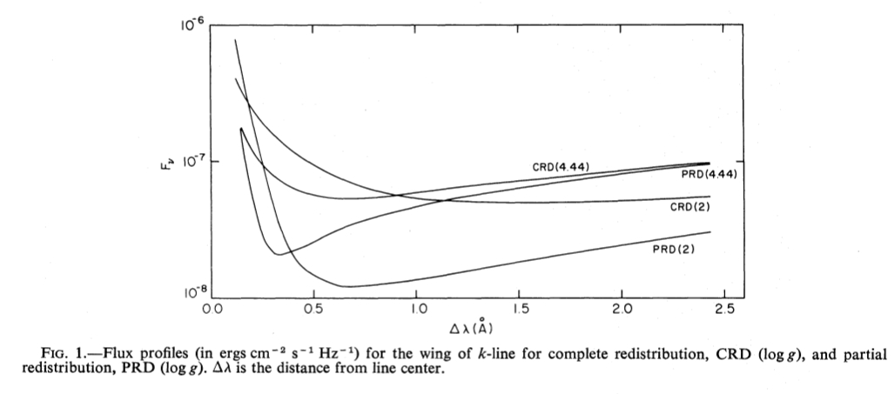
Ca II lines in conventional models indicated T_{min} consistent with continuum diagnostics, but…

Slide 7
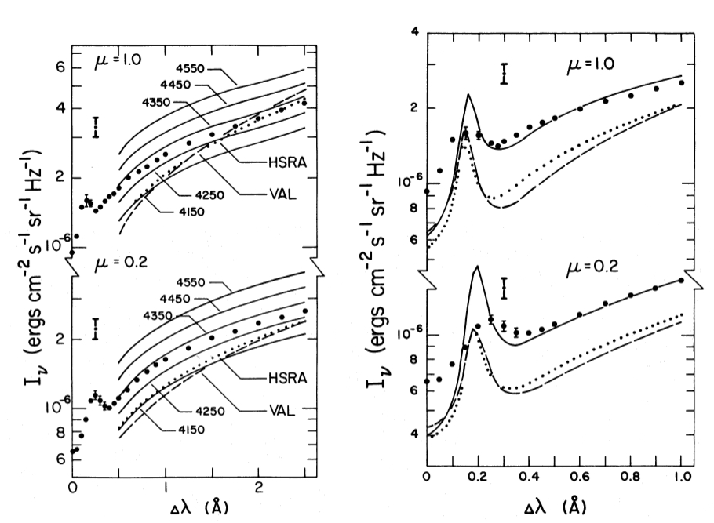
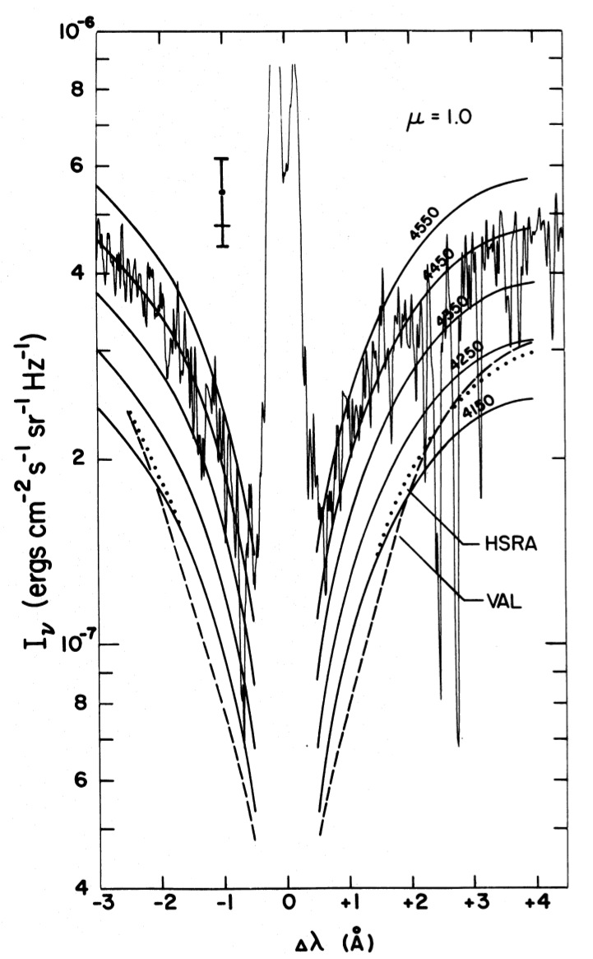
The solar Ca II and Mg II lines indicated a much (!) higher T_{min} …more rad cooling/heating…thanks Dimitri !!

Slide 8
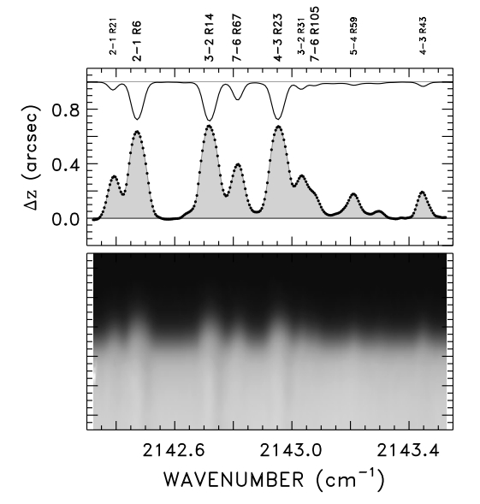
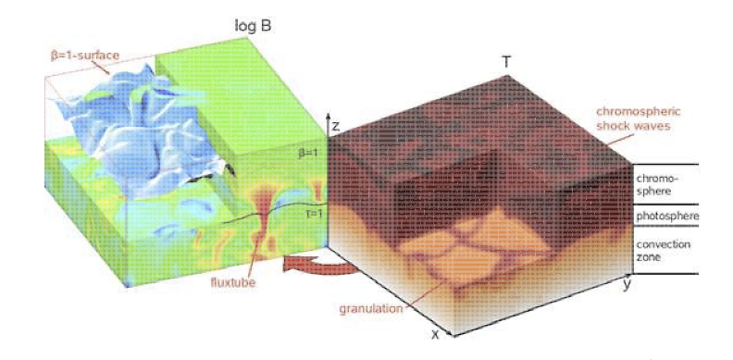
Contemporary View
The solar chromosphere is amazingly more complex than we tried to simulate in the 1970’s; cold & hot gas intermixed due to molecular cooling and penetrative convection: yet, the early attempts to understand to the radiation transport and energy balance still inform our efforts today…thanks again Dimitri !!

