Slide 1
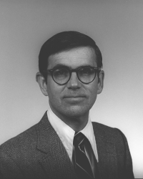
Cantata for Six Lives and Continuo: Remembering Dimitri Mihalas
Thomas J Bogdan
UCAR/March 18, 2014
BoulderSolarDay

Slide 2
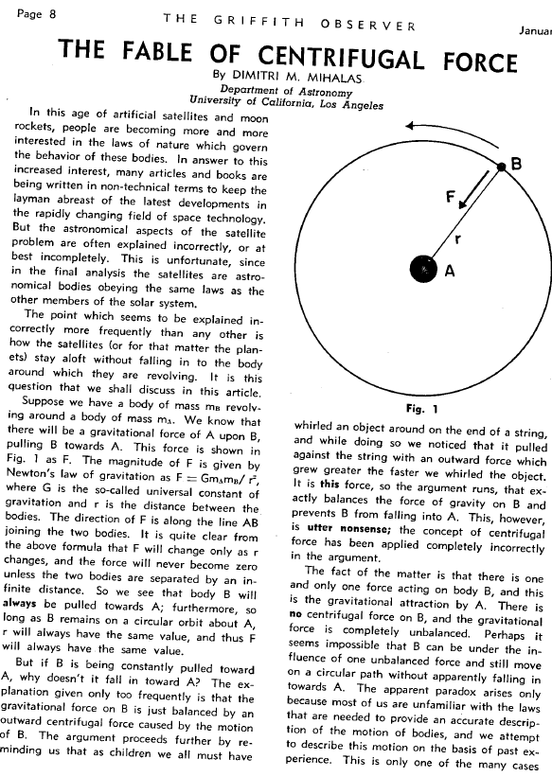
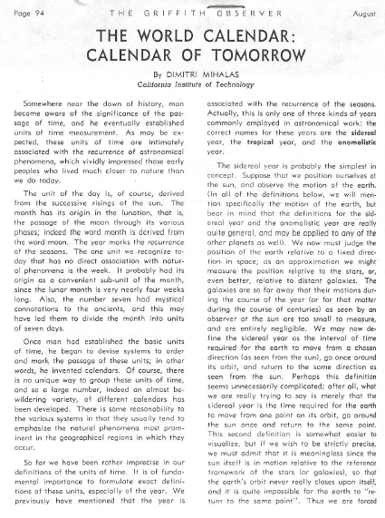
January 1959
August 1960
BoulderSolarDay

Slide 3
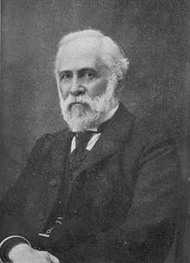
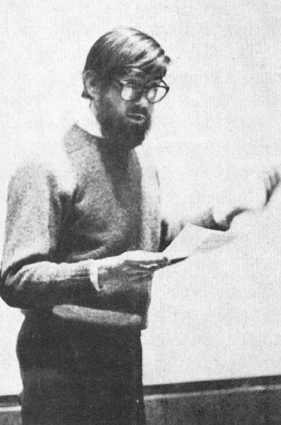
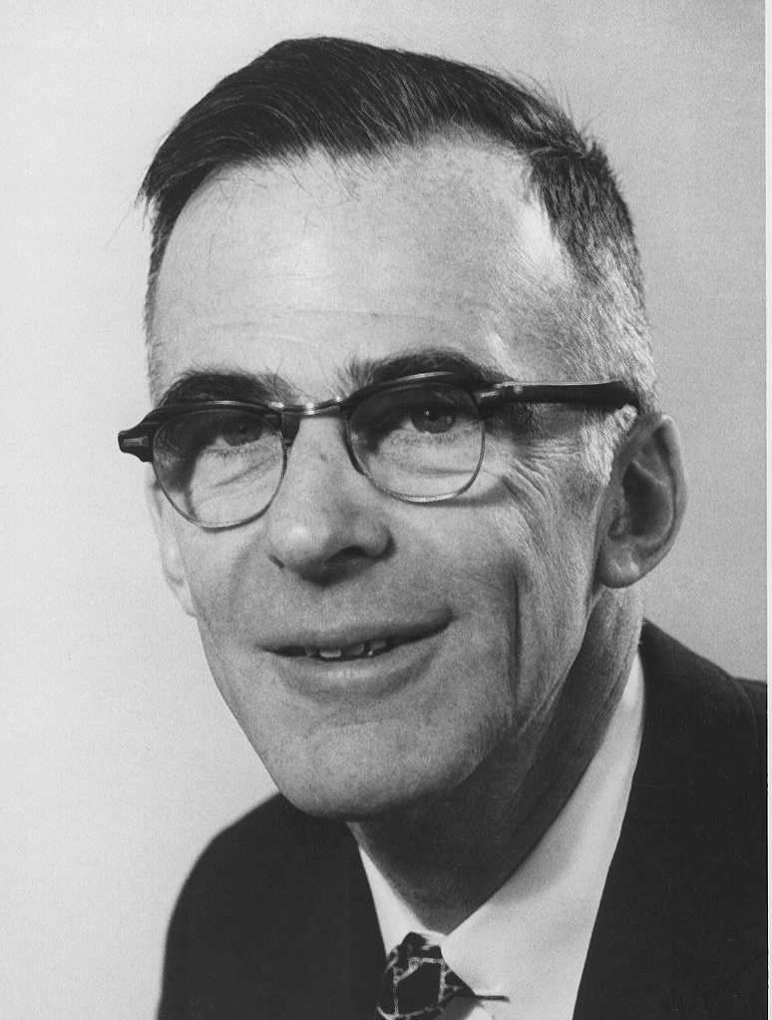
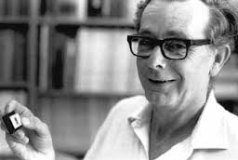
Charles Augustus Young
15.XII.1834-3.I.1908
B.A. Dartmouth 1853
Henry Norris Russell
25.X.1877-18.II.1957
D.Sc. Princeton 1900
Lyman Spitzer Jr
26.VI.1914-31.III.1997
Ph.D. Princeton 1938
John Beverley Oke
23.III.1928-2.III.2004
Ph.D. Princeton 1953
Dimitri Manuel Mihalas
20.III.1939-21.XI.2013
Ph.D. Cal Tech 1964
BoulderSolarDay

Slide 4
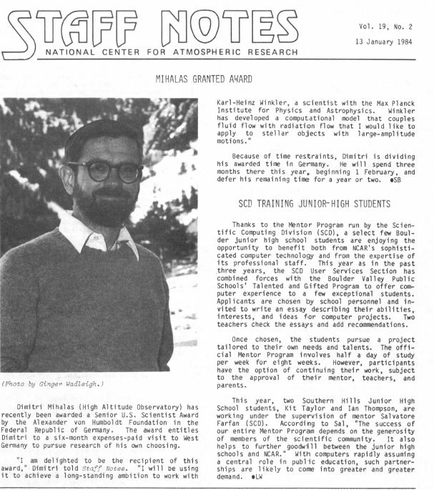
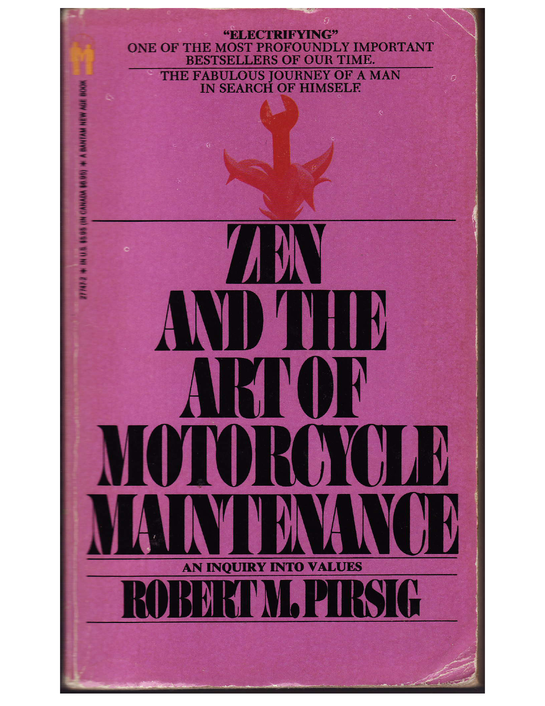
BoulderSolarDay

Slide 5
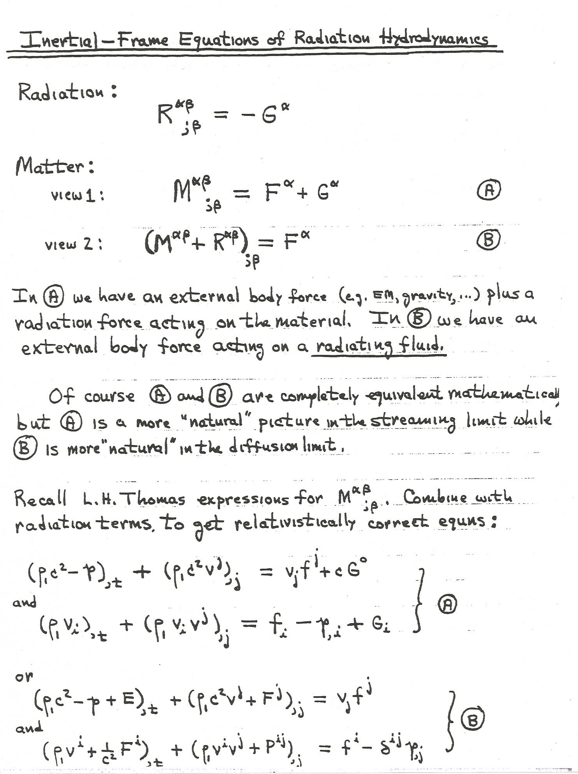
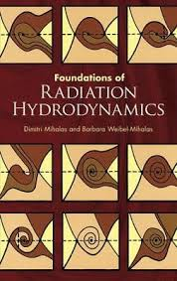
Carry out the calculations of the radiative emission, scattering and absorption in the co-moving plasma frame and then solve the conservation equations (mass, momentum, energy, radiative transfer) in the fixed laboratory frame.
BoulderSolarDay

Slide 6
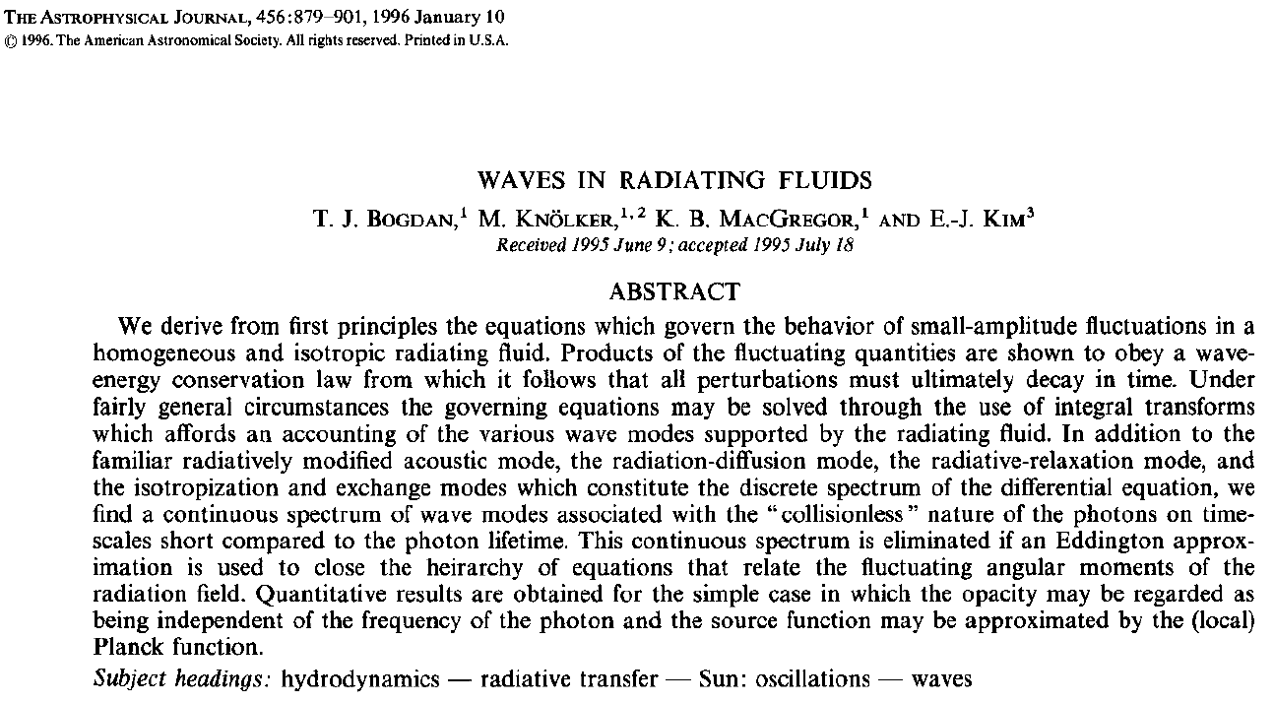
The co-moving plasma frame is generally not an inertial frame!
BoulderSolarDay

Slide 7
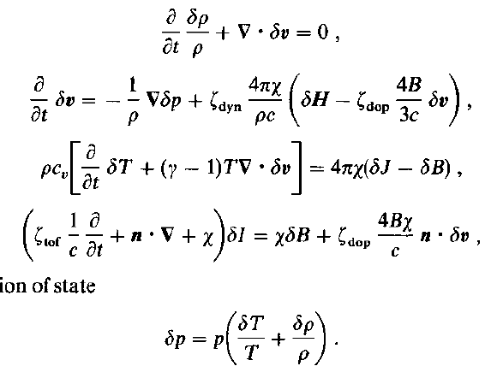
Conservation of Mass
Conservation of Material Momentum
Conservation of Material Internal Energy
Grey Radiative Transfer Equation
Moment Closure: Matter
Conservation of Radiation Energy
Conservation of Radiation Momentum
Moment Closure: Radiation [?] NO
BoulderSolarDay

Slide 8
Wave Energy Density
Wave Momentum Flux
Conservation of Wave Energy
BoulderSolarDay

Slide 9
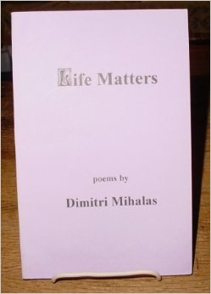
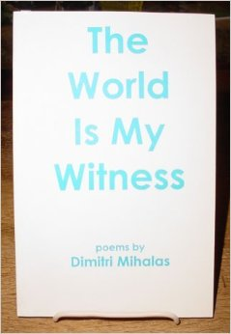
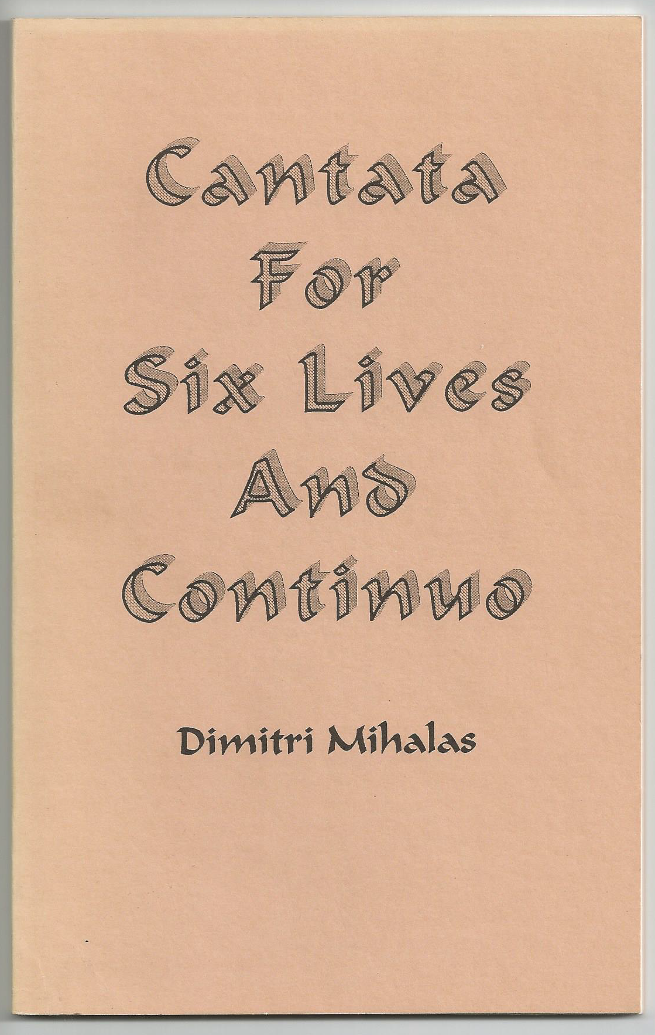
Trilogy in a Minor Key. Poems on Depression and Manic Depression (1991)
[with Alex Sawyer & Lucia Wainwright]
Cantata for Six Lives and Continuo (1992)
If I Should Die Before I Wake (1993)
The World is My Witness (1993)
Dream Shadows (1994)
Life Matters (1995)
Coming Back From the Dead (2000)
BoulderSolarDay

Slide 10
Master’s Hand
Apart from the music on the stereo,
it is almost silent;
just a few crickets chirping outside.
Baroque harpsichord concertos
on the radio
create the right mood.
for precise work
for cutting deep.
I have been working on this problem
for weeks, attacking it in pieces
It is beginning to look
as if my persistence
may pay off.
Yesterday I failed to get
the result I need.
But I got far enough to see
I will get it, if at all,
only by a fresh approach
or a mathematical trick.
Physics problems
are like uncut diamonds;
tap them ever so lightly
at the right place
and they cleave flawlessly
to reveal a magnificent jewel.
But hit them in the wrong place
and you get nothing but useless shards.
I try a fresh start
recasting the equations into a form
I have used before.
For three more hours
I wade through hard algebra.
Finally I get a glimpse
of what lies ahead:
the formulae will simplify,
most likely giving
the result I need.
In fifteen minutes it is done!
I sit in a warm glow
of deepened insight
into how the world works.
This is not a breakthrough.
It’s more like slipping into place
a piece
of a perfectly articulated puzzle.
Nevertheless
by careful work
I have been able to weed out
unwanted complexity,
to distinguish
some richness
of nature’s design.
A design one instantly recognizes
as coming from the hand of a master.
Middle of August
late at night.
I am in my study
high in the hills over Boulder.
My favorite place
at a favorite time.
I have been working for hours
on the last part
of a mathematical analysis
needed for a research project
in astrophysics.
It has been a typical summer day:
blinding sun
blazing hot by noon
cumulus building high overhead.
Long buffalo grass
so recently verdant
sun-bleached to honey blonde.
It rained hard from three to seven
quenching the day’s heat.
Now cool air
scented with pine
and the odor of wet grass
pours in the window
from blackness outside.
BoulderSolarDay

Slide 11
Master’s Hand
I feel privileged to labor
at such satisfying work.
I end my working “day”
more deeply in awe
of what is out there:
stars strewn through the Galaxy like dust;
galaxies swarming by the billions
through space.
And pervading all of it:
order.
Subtle
graceful
powerful
order.
Set the best minds we have
in the next thousand years
the task of fathoming
the inner structure
of the cosmos,
and they
will barely scratch it surface;
Barely glimpse
this beautiful world
which comes to us
moment by moment
fresh from the hand of God.
It would take only minutes
to check the result.
But my discipline collapses
in the face of victory,
and I step outside for a break.
God it is beautiful tonight!
Very dark!
Only feeble points of light
in the valley.
The summer triangle:
Vega, Deneb, Altair,
has already passed the meridian.
Vaulting the dome of the sky
is the pearly glow
of summery Milky Way.
Fireflies on black velvet
I see the sky
with astronomer’s eyes.
Just over the southern horizon:
Sagittarius rich with clouds of ancient stars
which compose the nucleus of the Galaxy.
These stars existed billions of years
before the Sun was born.
Higher up, young stars are forming
in loose clusters from dust and gas.
I also know about
the complex orbital mechanics in play.
Here I am on a dust-speck planet
circling a pedestrian star –
one of a hundred billion in the Galaxy –
hurtling around the Galactic center
at half a million miles an hour!
The distances
speeds
time-scales
are mind-boggling.
It is hard to make the connection
between my dry, abstract equations
and vivid reality before me.
Mozart’s Exultate Jubilate
drifts out through the window.
Perfect.
With a shock I realize how late it is.
If I stay much longer
I will get to watch the dawn!
I turn toward the door,
a brilliant meteor
streaks across the sky.
Probably a Perseid,
Perhaps a good omen as well.
BoulderSolarDay

Slide 12
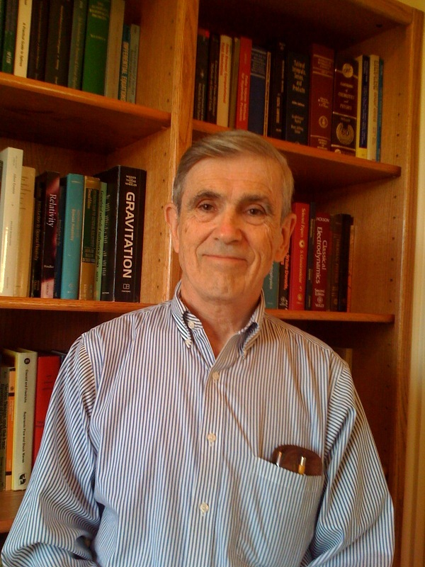
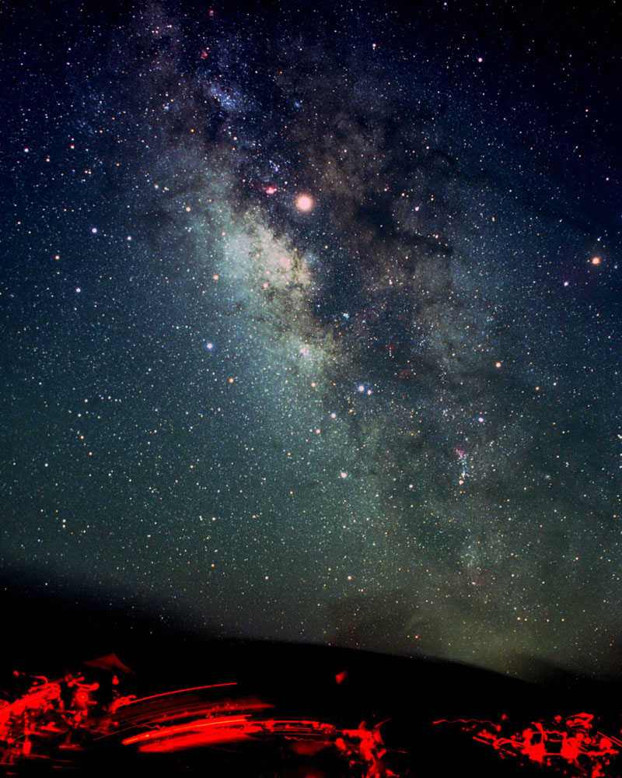
BoulderSolarDay

