Slide 1
1978: In the old HAO building on campus, before a donut run with undergrad intern Klimchuk.

Slide 2
1984: Trying to lower the Murphy bed at the condo in Vail at 3:00 am, after drinking far too many Long Island Iced Teas! (We made our 7:00 am tee time.)

Slide 3
1984: Traditional dinner at David Sime’s house to cap off the golf weekend (Richard Moncayo, Tod Woods, Peter Cargill, Vic). Who knew they could look so good in hot pants!

Slide 4
2003: On the first tee: Sime, Pizzo, Klimchuk, Tisone, Woods

Slide 5
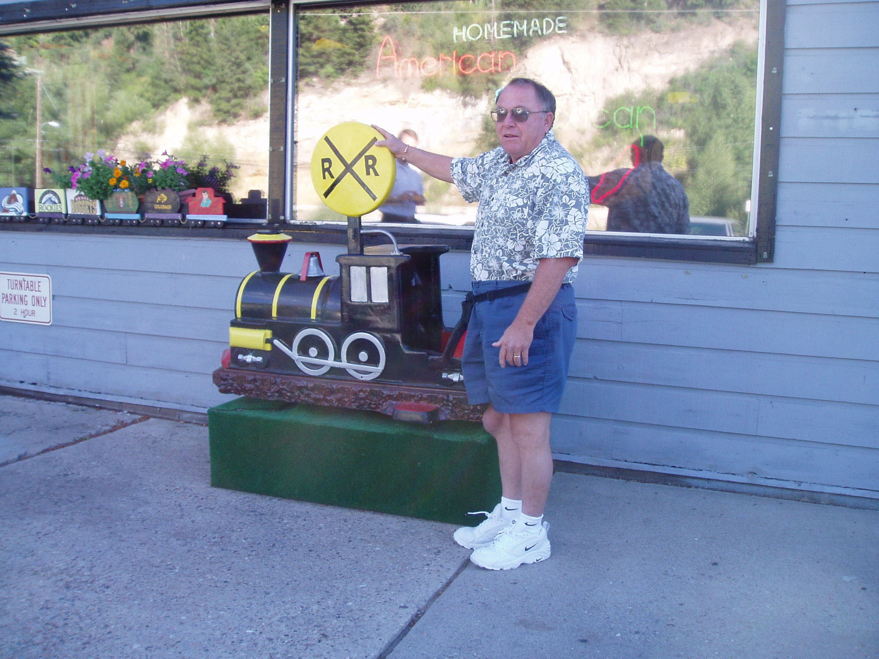
Vic’s gout knee was acting up that year!
2003: Wanting a kiddy ride after our traditional breakfast at the Turntable Restaurant in Minturn.

Slide 6
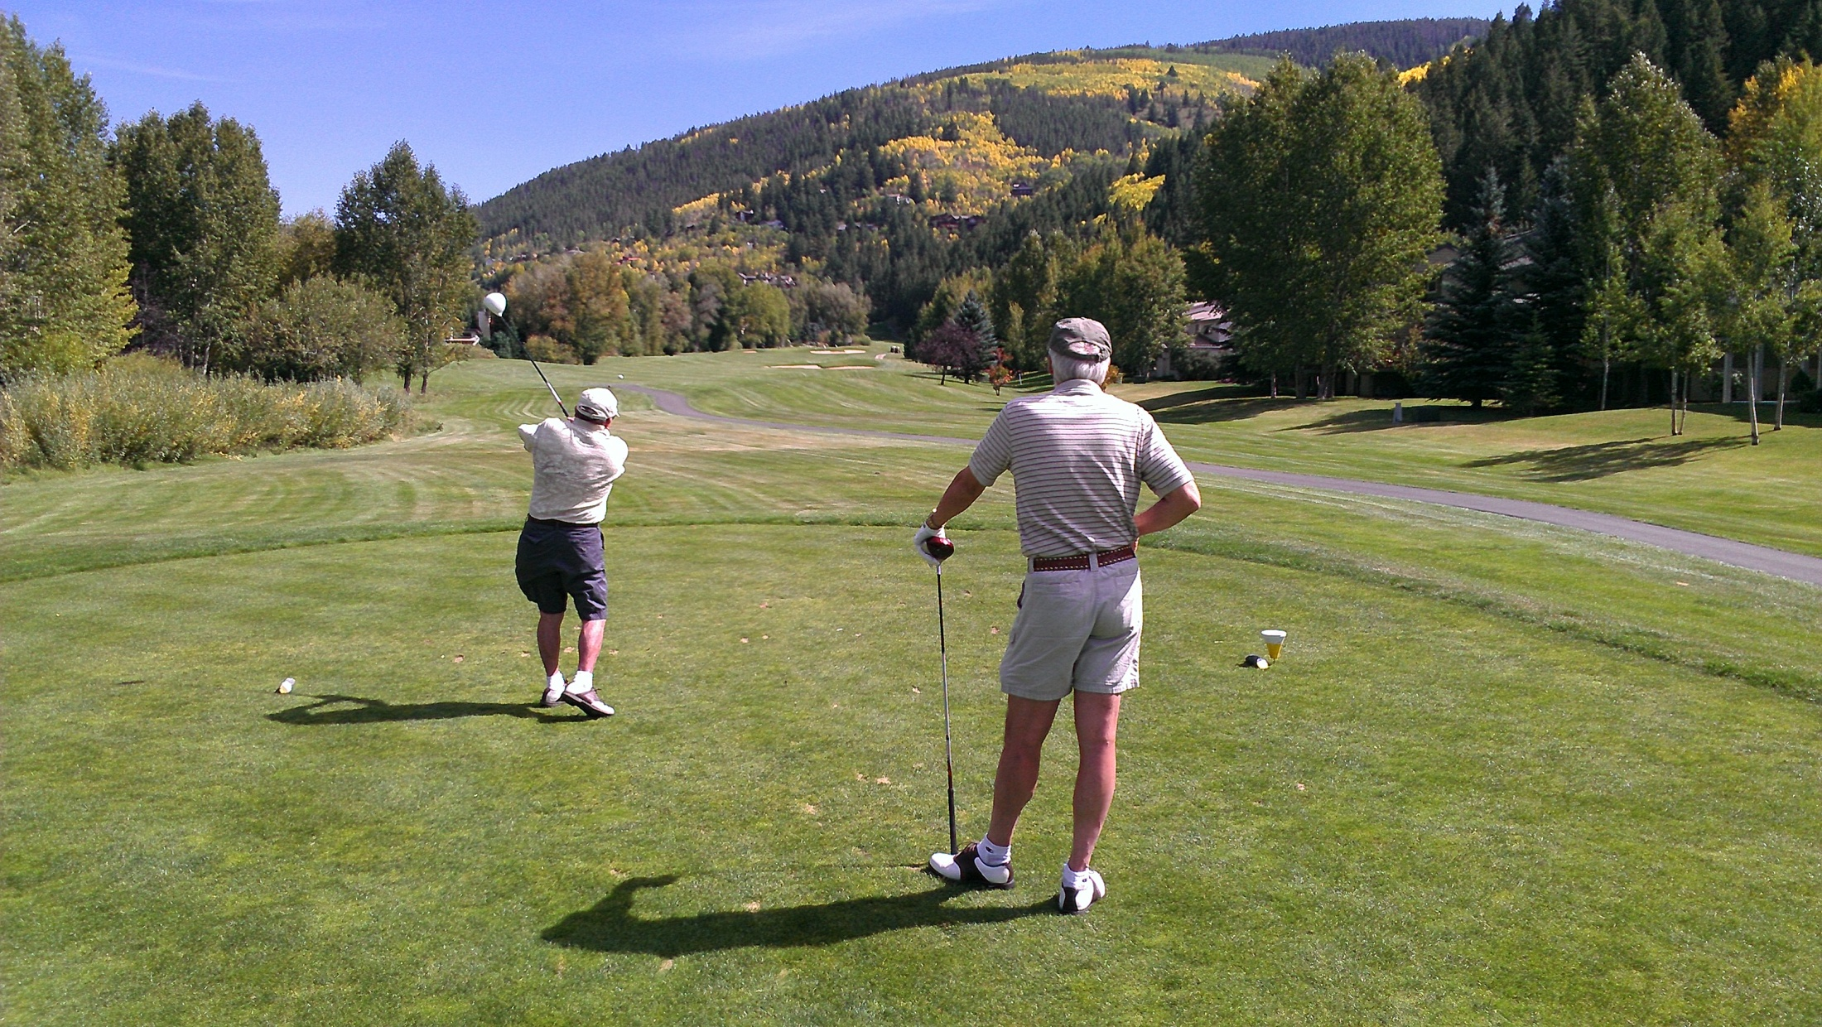
2012: Crushing another drive, with Dale Gary watching enviously!

Slide 7
2014: %*&#^@! …..but they don’t always go as planned!

Slide 8
Vic, buddy, you’ve had one heck of a run. It’s hard to exaggerate what a huge positive impact you’ve had on so many people’s lives, especially mine. You taught me not only how to write FORTRAN 77 code, but how to live life the right way. Many of my fondest memories involve you. Enjoy your highly deserved retirement….and let’s go make some more great memories!

