Slide 1
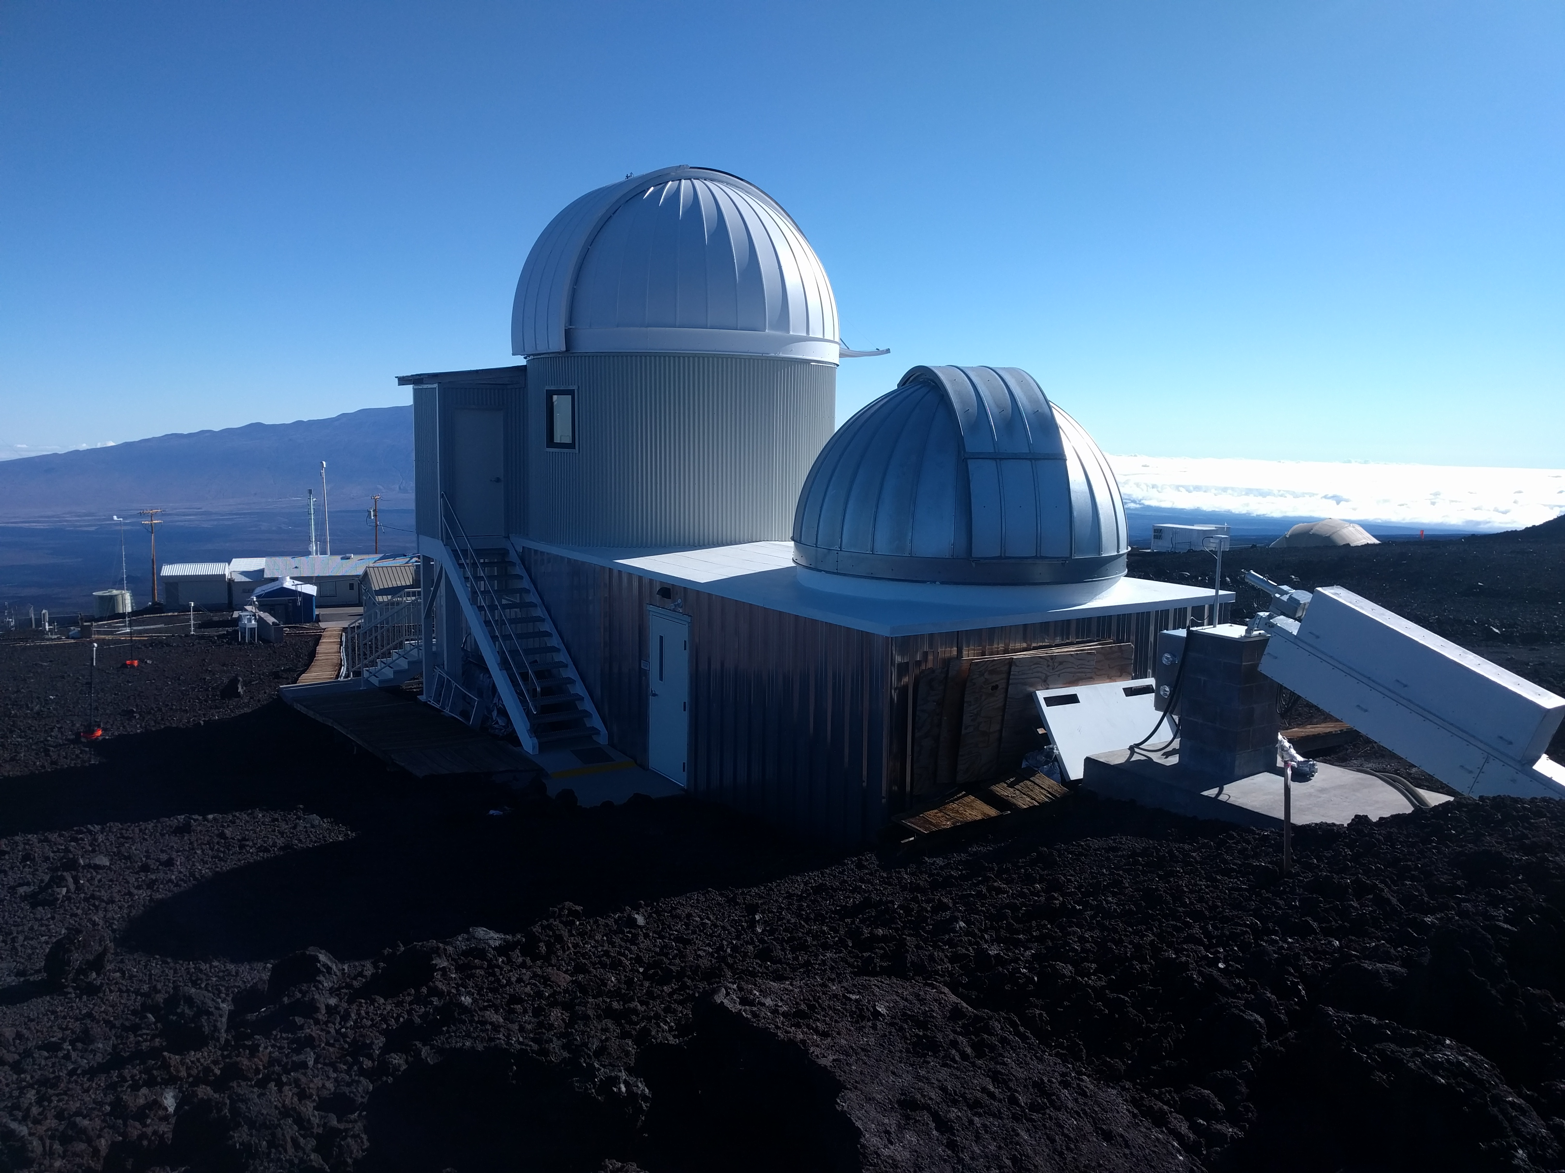
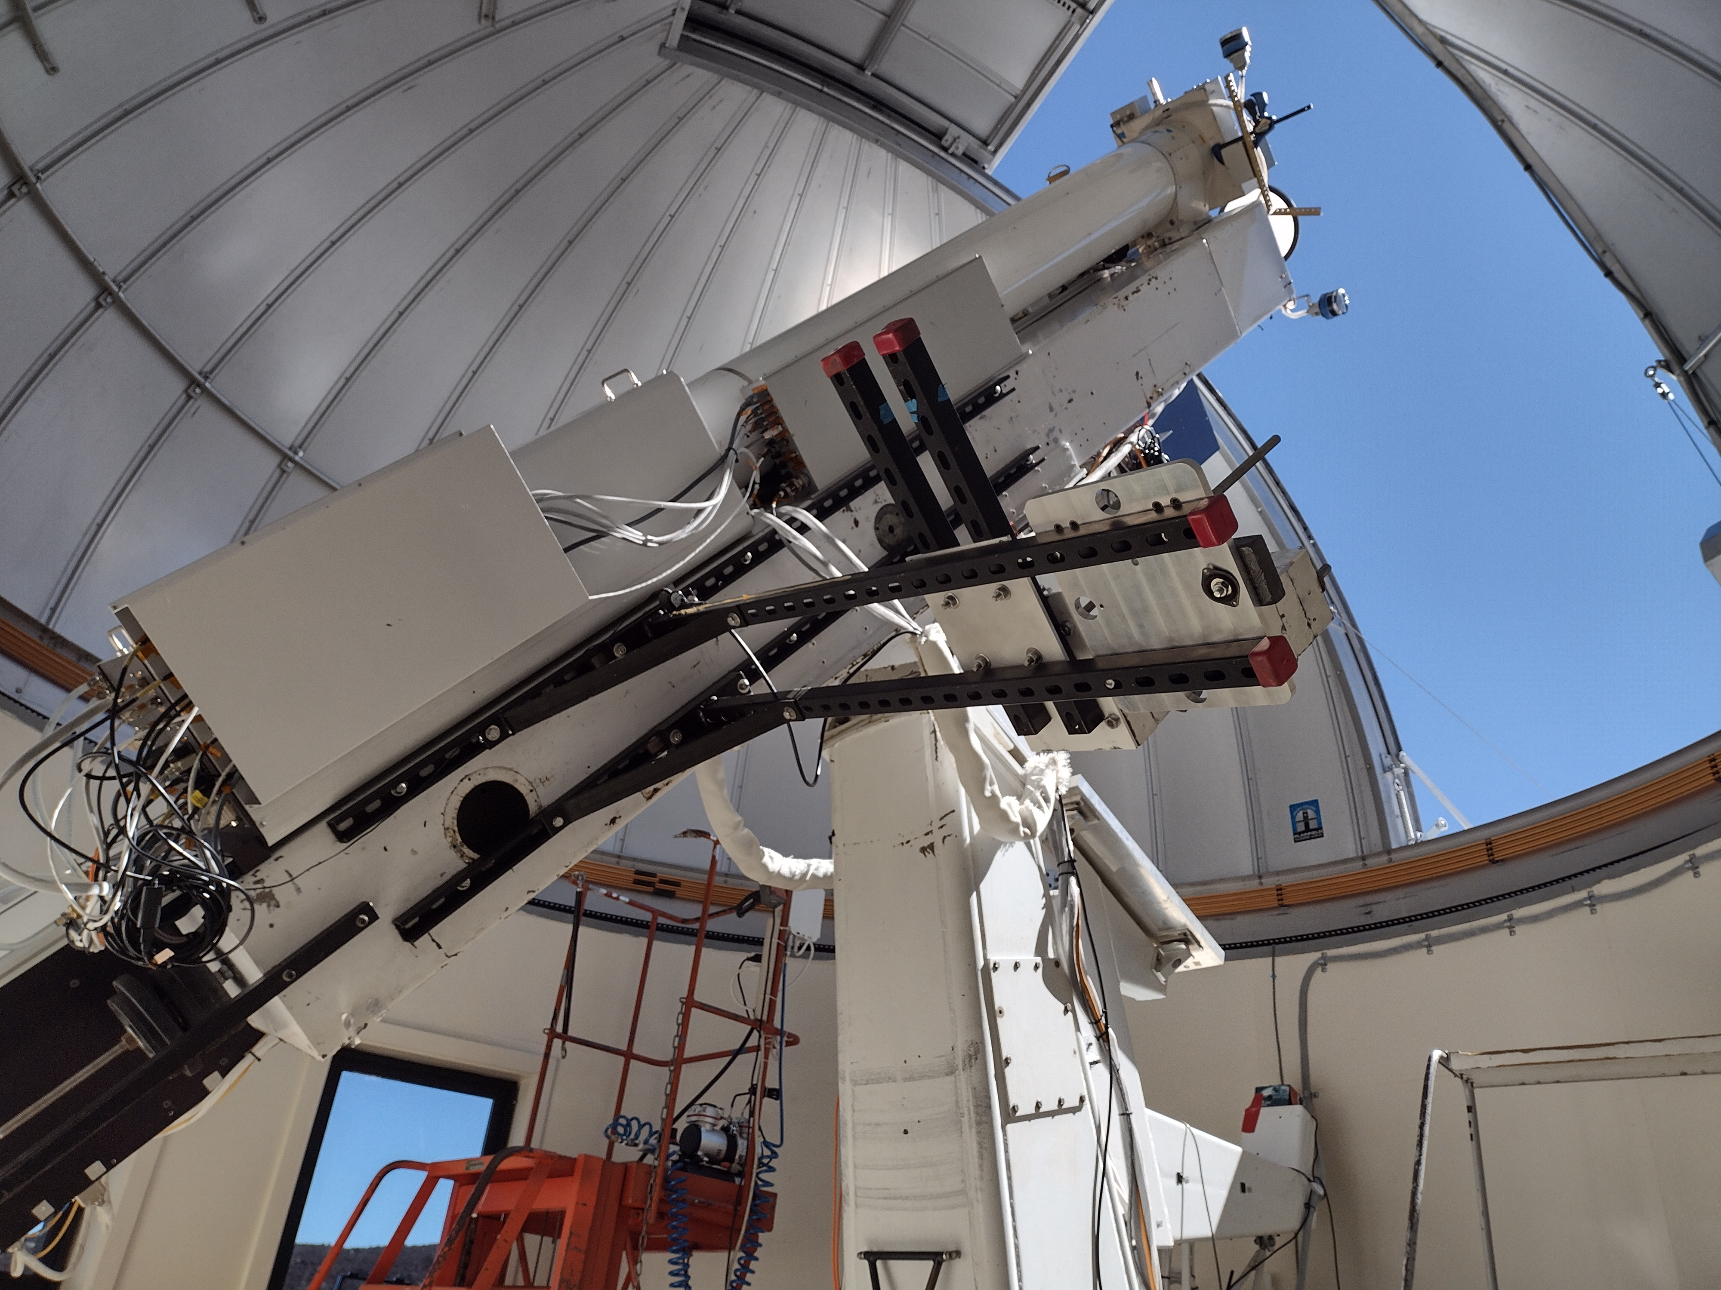
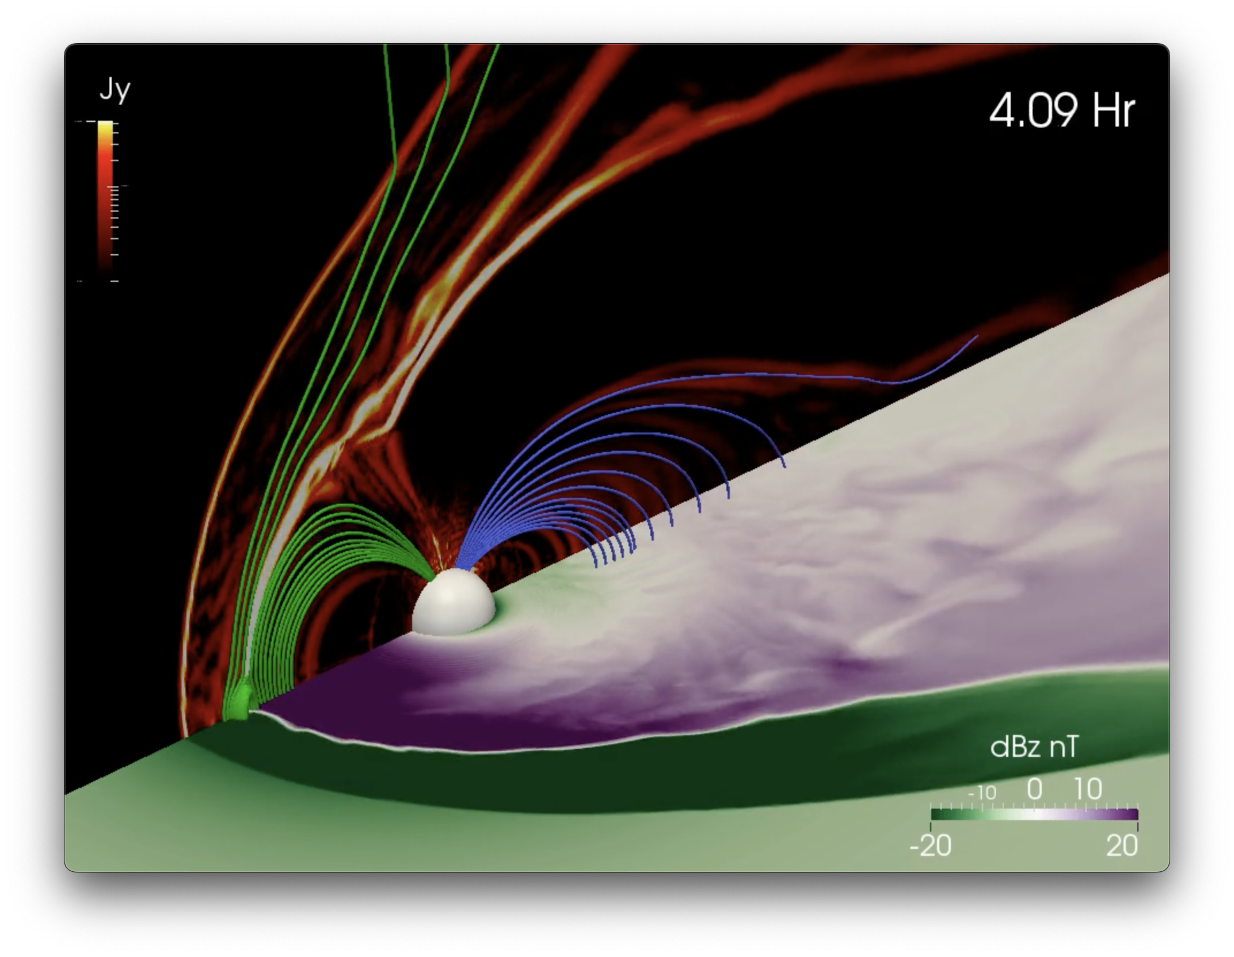
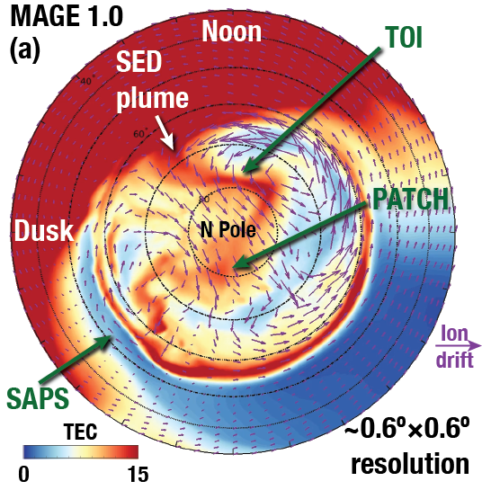
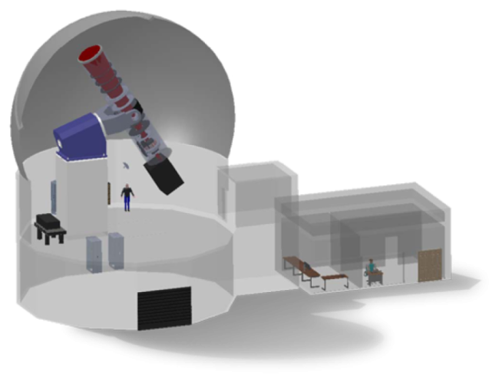
The High Altitude Observatory
NCAR’s Solar-Terrestrial Lab
Mauna Loa Solar Observatory
Building community capability
Enabling world-class science
Serving observations & modeling to the community
Building innovative instrumentation
Geospace Modeling
COronal Solar Magnetism Observatory
Notes:
HAO staff have a broad range of expertise from instrumentation (we have an engineering group), to data experts (serving and analyzing), to managing facilities (MLSO), to modeling (analytical and numerical). Our science priorities include solar variability and activity with heavy expertise in chromosphere and coronal physics. We have some of the leading experts in the world in spectropolarimetry. We study how the activity on the Sun impacts our upper atmosphere and also forcing of the ionosphere from below. We study coupling of the magnetosphere and ionosphere and gravity waves. Although not an exhaustive list, this hits on many important areas of research.
The Mauna Loa Solar Observatory is a key piece of our portfolio in service to the community.
Mauna Loa data fill observational gap between EUV and space-based coronagraphs.
We are a synoptic facility but we also provide the community with special data requests and often participate in Community Observing Campaigns
Over 470 registered users
Over 40 years of solar images, movies, and other data products
Near-Real time CME alerts
Solar activity logs (1973 to present)
Our geospace section is building the next generation of space weather models to conduct cutting edge space science and provide the community with essential capabilities
We are very involved with postdocs and students and have hosted summer schools in spectropolarimetry and space weather
COSMO is the next generation observatory that will have the capability to obtain line-of-sight AND plane-of-sky coronal magnetic field measurements- a current gap in our community’s capabilities!
We support space based missions

