Slide 1


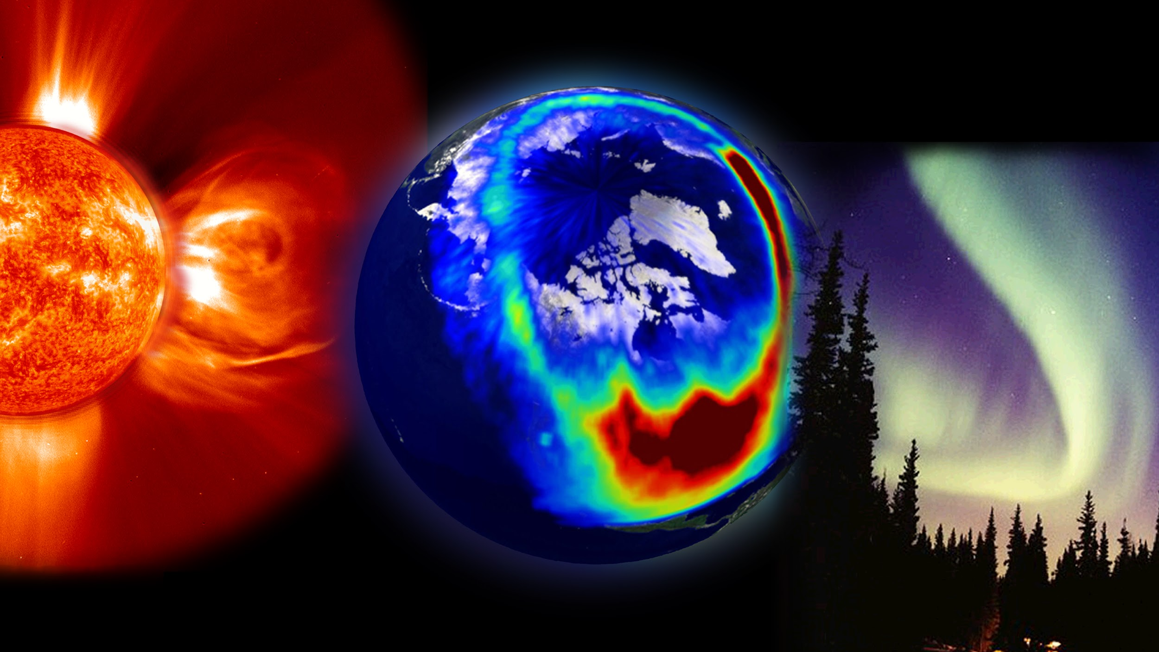
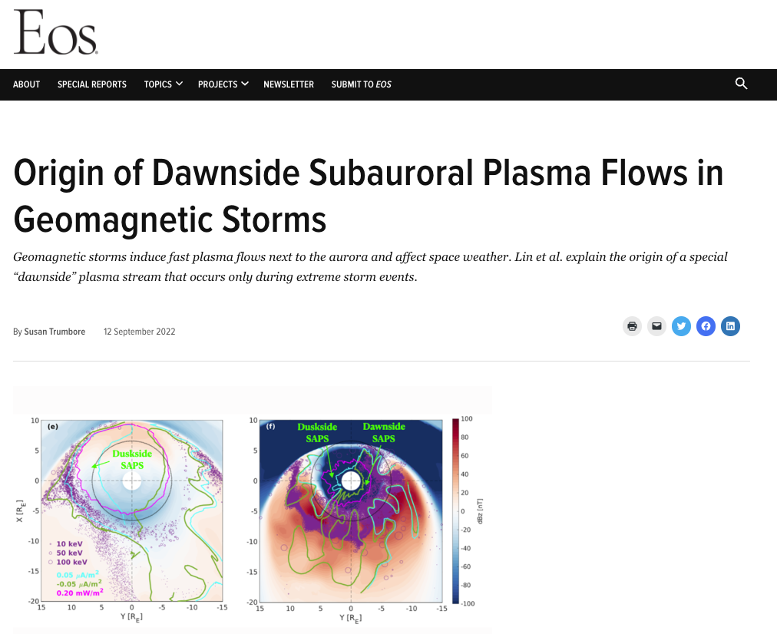
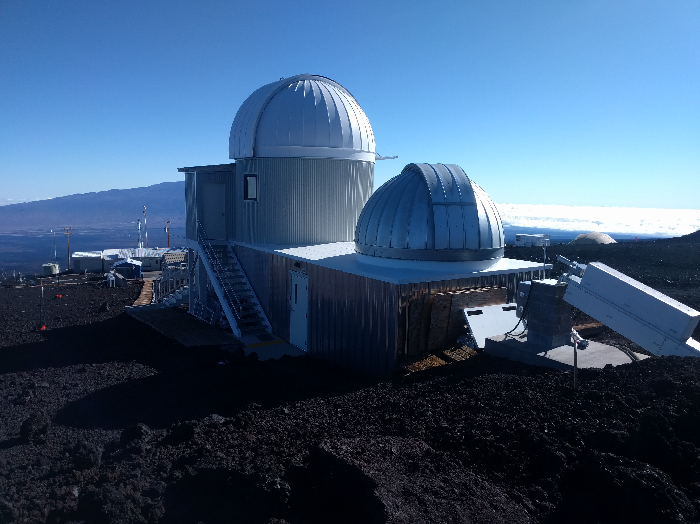
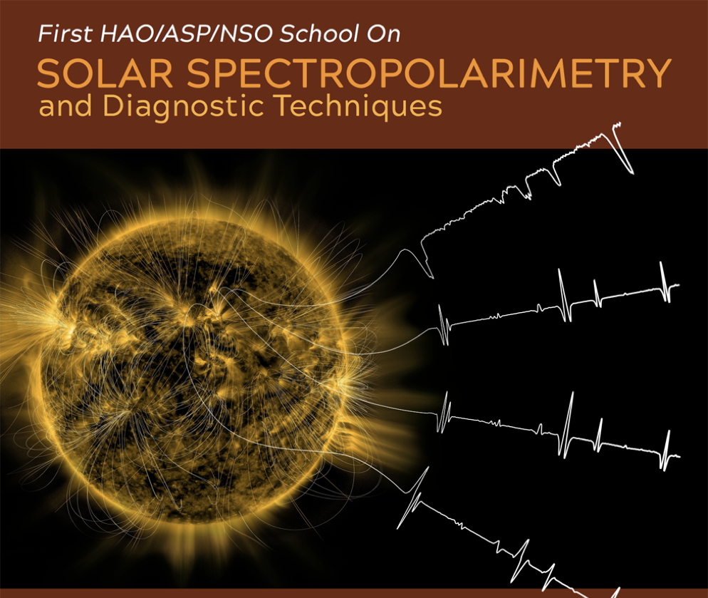
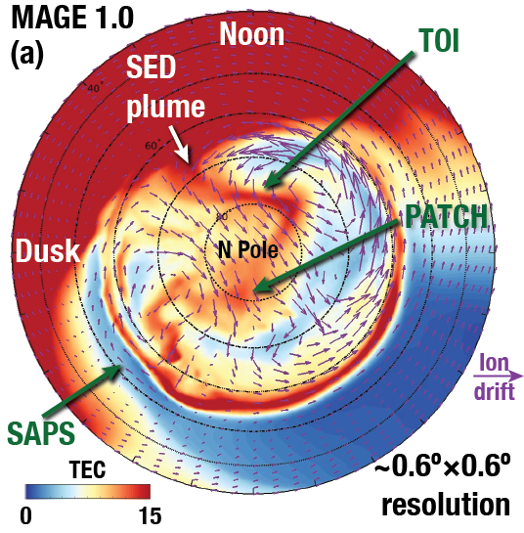
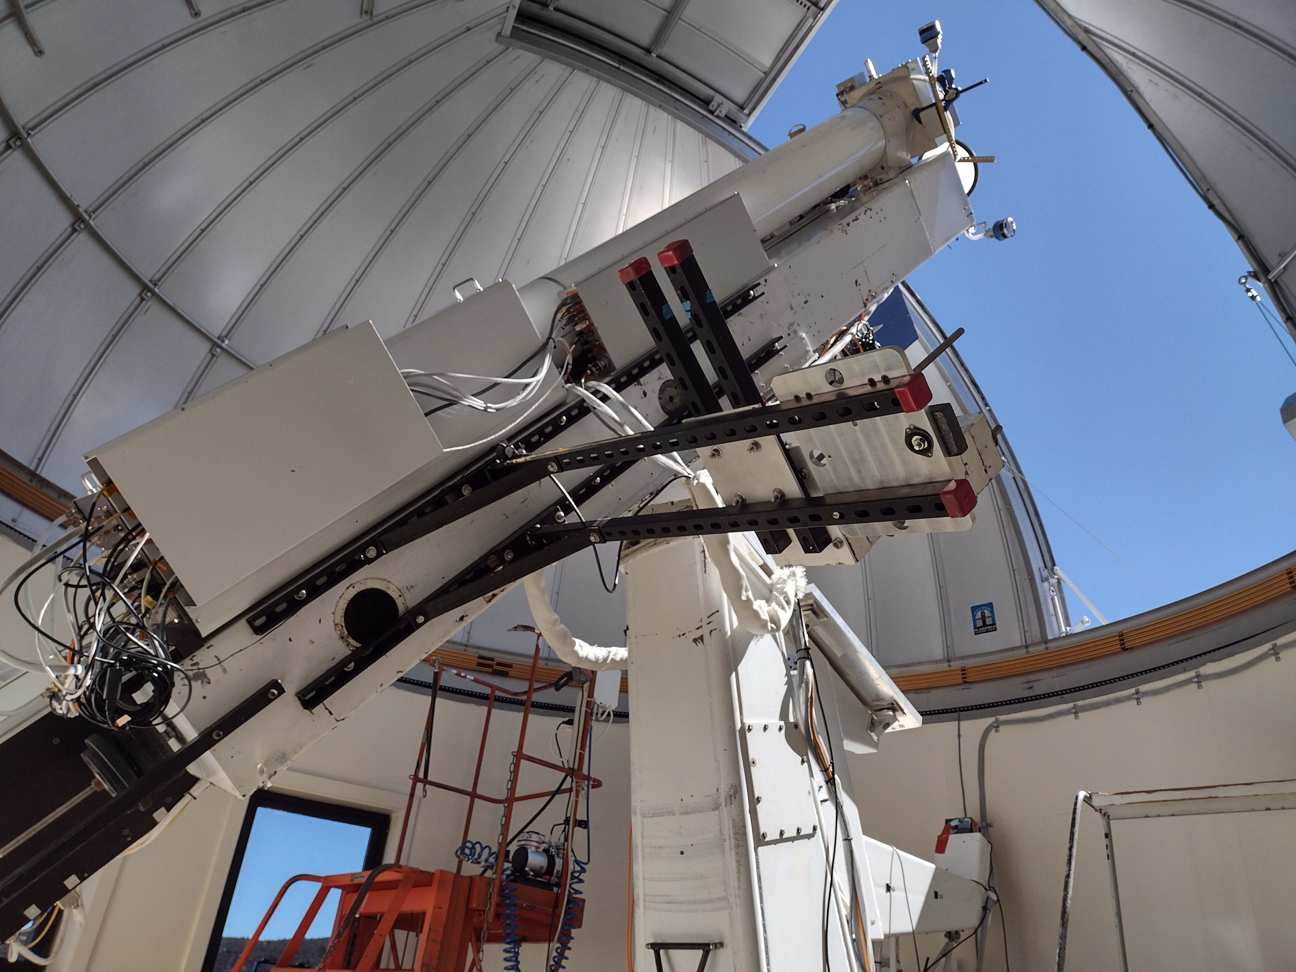
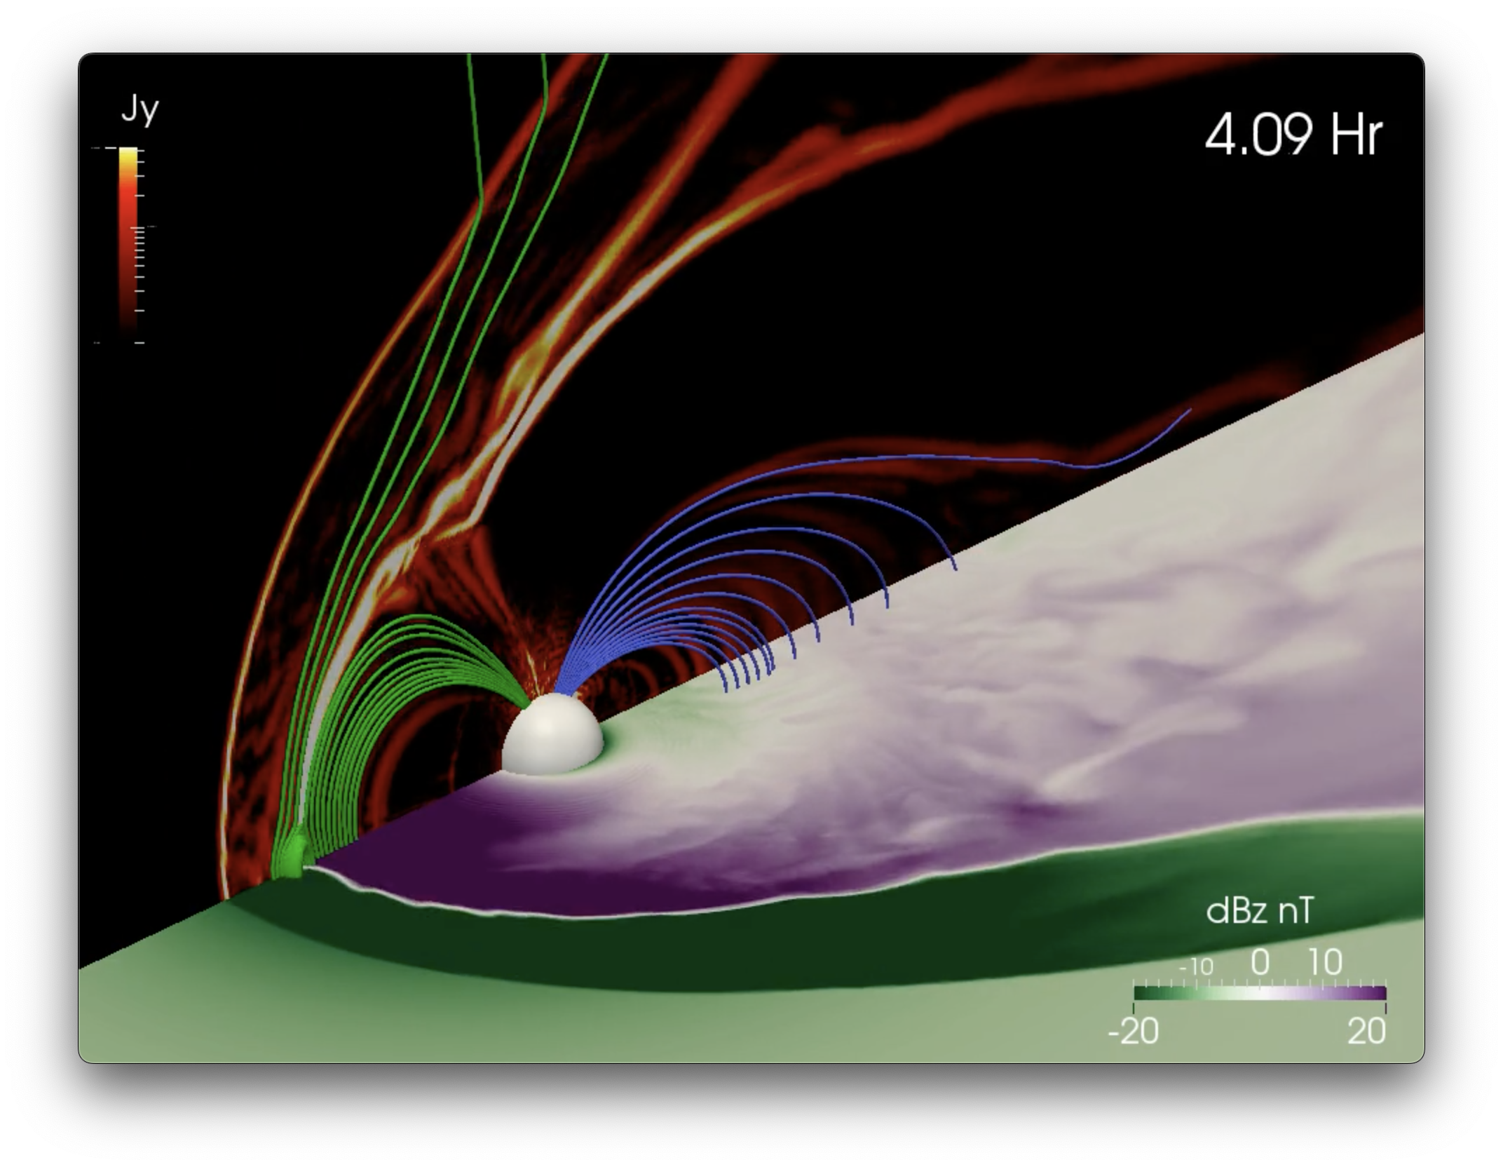
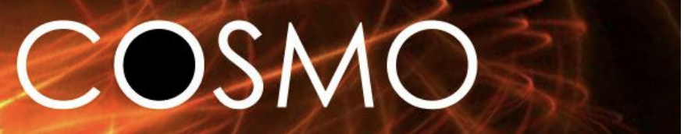
The High Altitude Observatory:
NCAR’s solar-terrestrial Lab
Enabling world-class science
Serving observations & modeling to the community
Building innovative instrumentation
Mauna Loa Solar Observatory
Building community capability
Geospace Modeling
COronal Solar Magnetism Observatory
Notes:
HAO staff have a broad range of expertise from instrumentation (we have an engineering group), to data experts (serving and analyzing), to managing facilities (MLSO), to modeling (analytical and numerical). Our science priorities include solar variability and activity with heavy expertise in chromosphere and coronal physics. We have some of the leading experts in the world in spectropolarimetry. We study how the activity on the Sun impacts our upper atmosphere and also forcing of the ionosphere from below. We study coupling of the magnetosphere and ionosphere and gravity waves. Although not an exhaustive list, this hits on many important areas of research.
The Mauna Loa Solar Observatory is a key piece of our portfolio in service to the community.
Mauna Loa data fill observational gap between EUV and space-based coronagraphs.
We are a synoptic facility but we also provide the community with special data requests and often participate in Community Observing Campaigns
Over 470 registered users
Over 40 years of solar images, movies, and other data products
Near-Real time CME alerts
Solar activity logs (1973 to present)
COSMO is the next generation observatory that will have the capability to obtain line-of-sight AND plane-of-sky coronal magnetic field measurements- a current gap in our community’s capabilities!
We are very involved with postdocs and students and have hosted summer schools in spectropolarimetry and space weather
We support space based missions

Slide 2
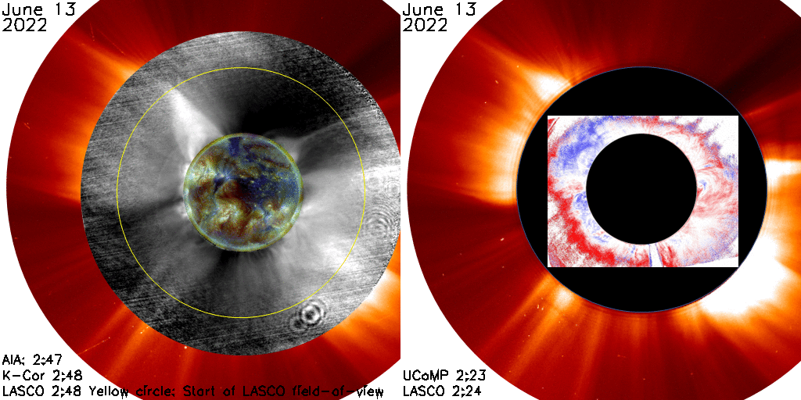
Mauna Loa Solar Observatory
https://www2.hao.ucar.edu/mlso
High Altitude Observatory
2023
Notes:
NOTE: Background image can be used as is or changed for a particular presentation in the “Slide Master” button found under the “View” tab.

Slide 3
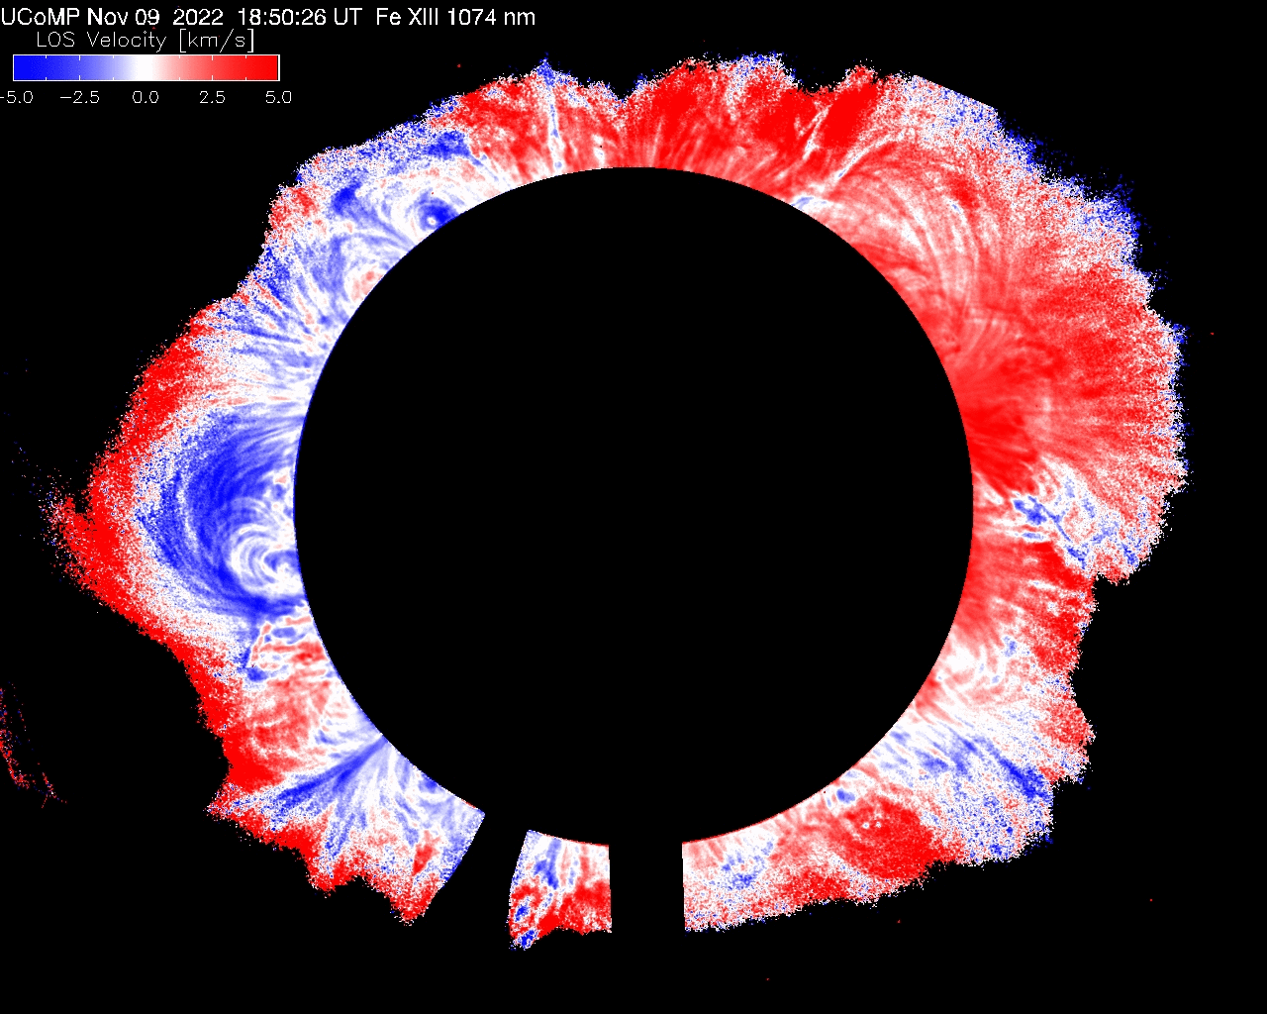
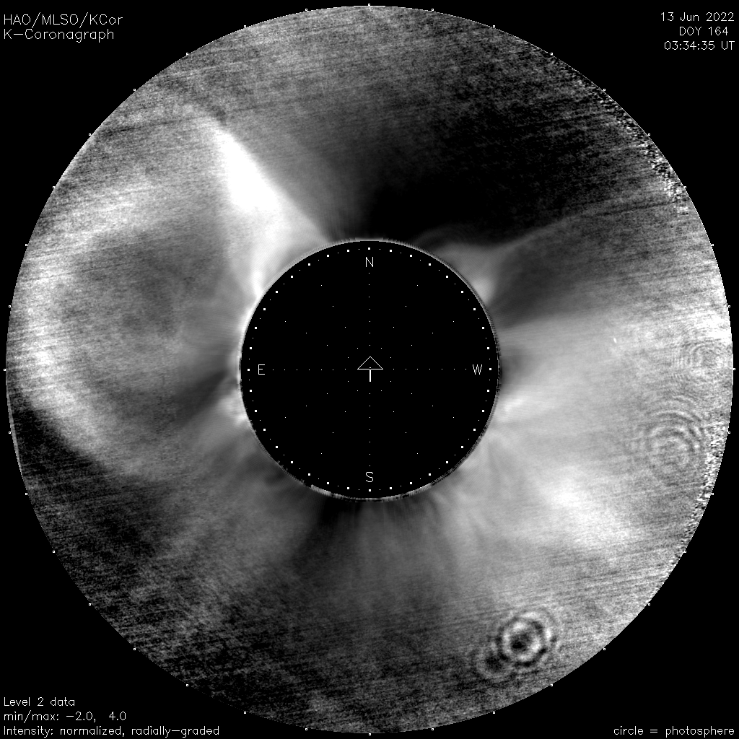
Current Instruments operating at MLSO
MLSO operates 2 coronagraphs
Upgraded Coronal Multi-Channel Polarimeter (UCoMP):
9 coronal emission lines in intensity and polarization
Provides magnetic field and plasma diagnostics needed to understand the formation of CMEs and the solar wind.
UCoMP CME Nov 9 2022: CME lateral expansion visible in doppler images
K-Cor Jun 13, 2022
COSMO K-Cor:
Onset and dynamics of coronal mass ejections (CMEs)
- Evolution of magnetically closed and open coronal structures over time scales of seconds to decades

Slide 4
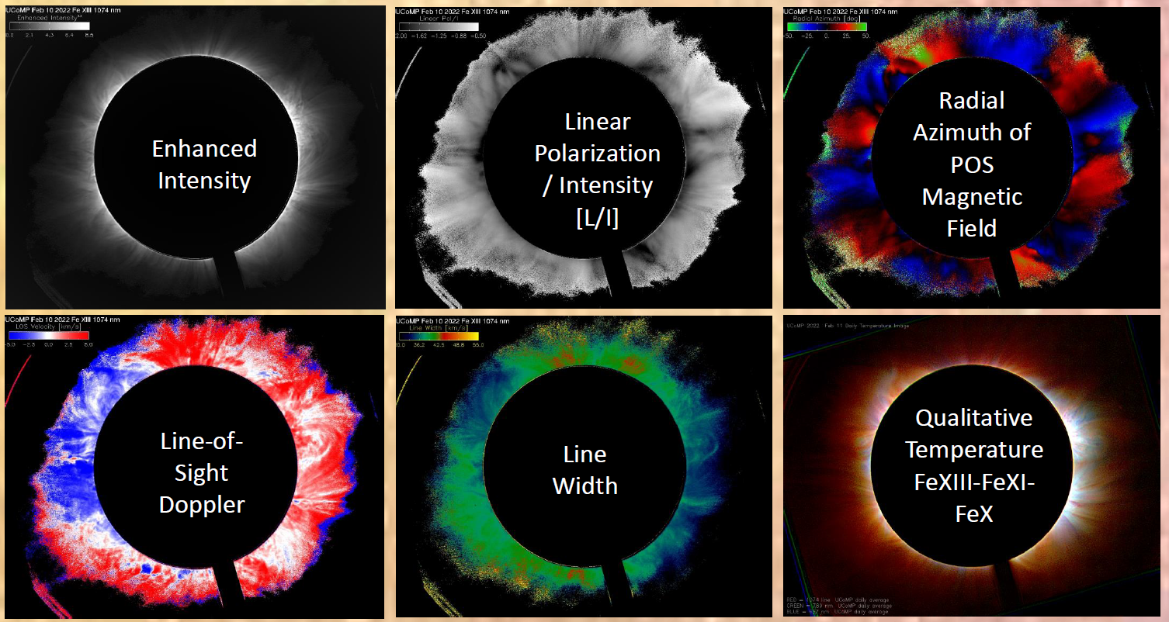
UCoMP emission line profiles and polarization provide diagnostics on magnetic field topology, plasma motions, MHD waves, density and temperature
FeXIII data products from Feb 10, 2022
Color image: Temperature Map
Notes:
UCoMP observes multiple emission lines to study the corona over a wide range of temperatures to understand energy transport, storage and release (e.g. CMEs)

Slide 5
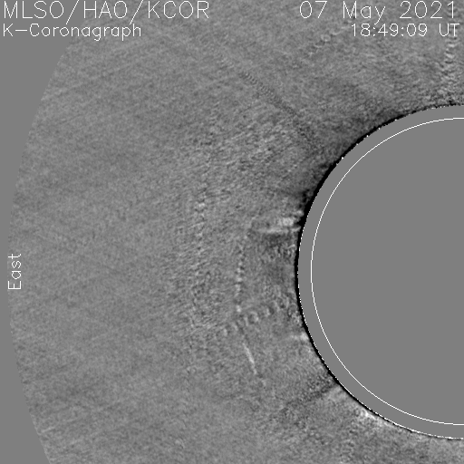
COSMO K-Coronagraph (K-Cor)
Observes the low and middle corona in white light
Gold image: AIA EUV; Blue image: K-Cor; Red image: LASCO white light
K-Cor: CME on May 7, 2021
Mauna Loa data fill observational gap between EUV and space-based coronagraphs
Connect the low corona magnetic structures and CMEs to the outer corona / heliosphere
Easier to track CMEs from the K-Cor white light to space-based white light: rather than EUV to white light.
Provides information on variation of energy input into corona and solar wind
Notes:
K-cor is Ideal for studying and tracking the onset of Coronal Mass Ejections and tracking solar cycle changes in the corona.

Slide 6
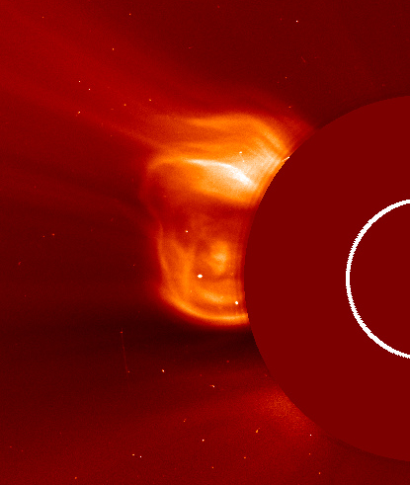
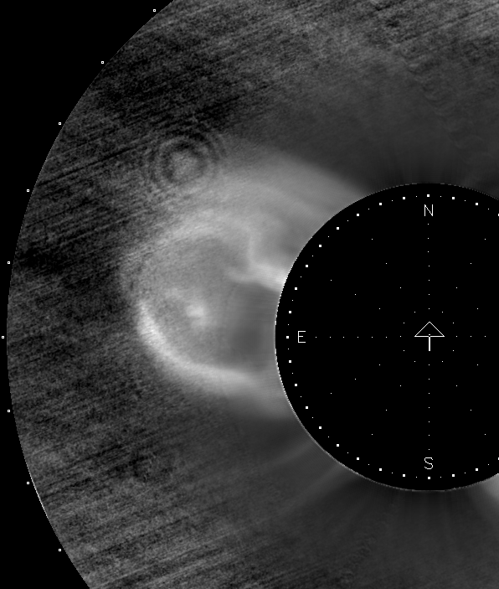
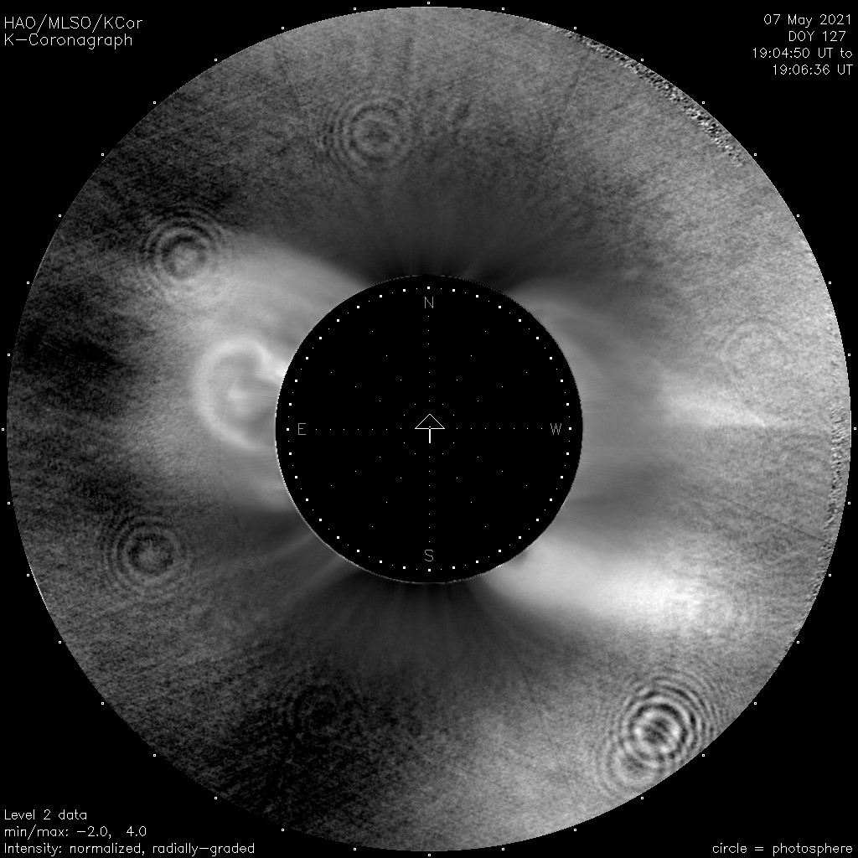
K-Cor near-real time CME alerts
K-Cor provides near-real time CME alerts to the NASA CCMC Solar Energetic Particle (SEP) forecast scoreboard in support of Artemis
Alerts provide first warning of an in-progress CME.
Most alerts are issued before the CME is visible in LASCO
K-Cor alerts for 20 SEP-CMEs were issued 55 min (avg) before CME was visible in available LASCO data (includes latency)
SEP-associated CME May 7, 2021
LASCO 19:36
K-Cor 19:12
K-Cor 19:04
Acceleration in K-Cor = 510 m/s²; Acceleration in LASCO = -10 m/s²

Slide 7
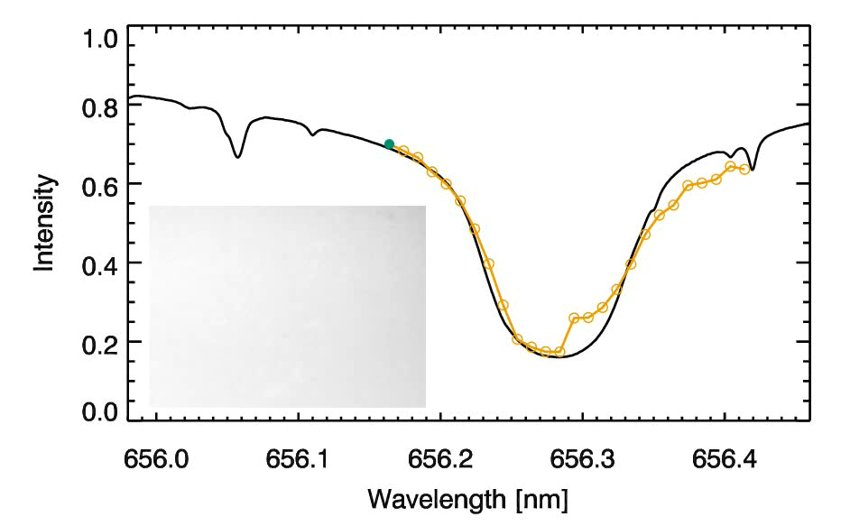
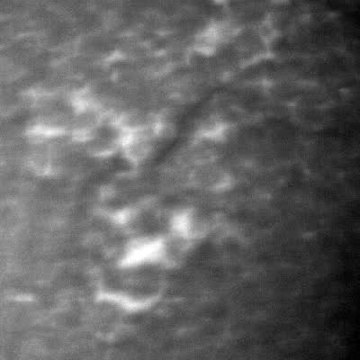
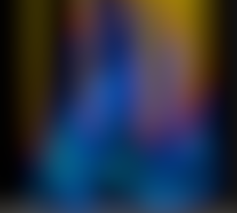
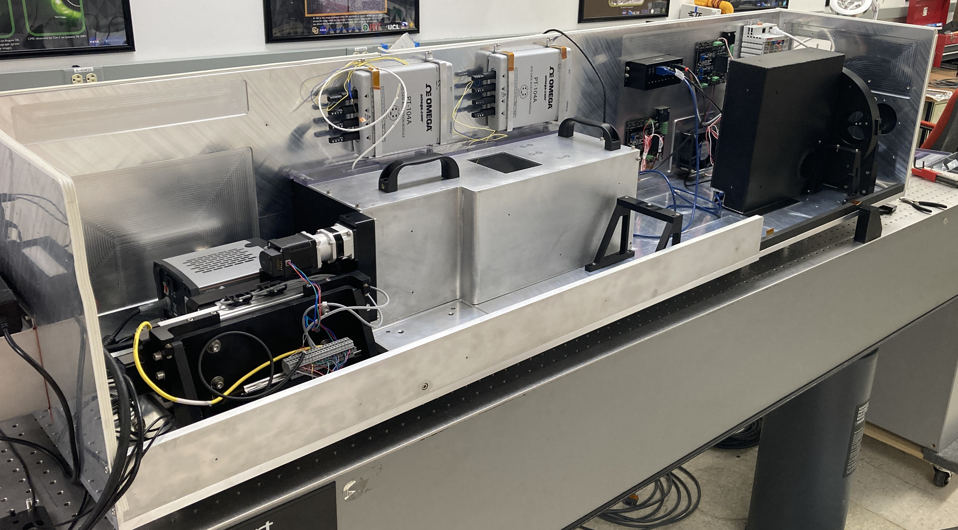
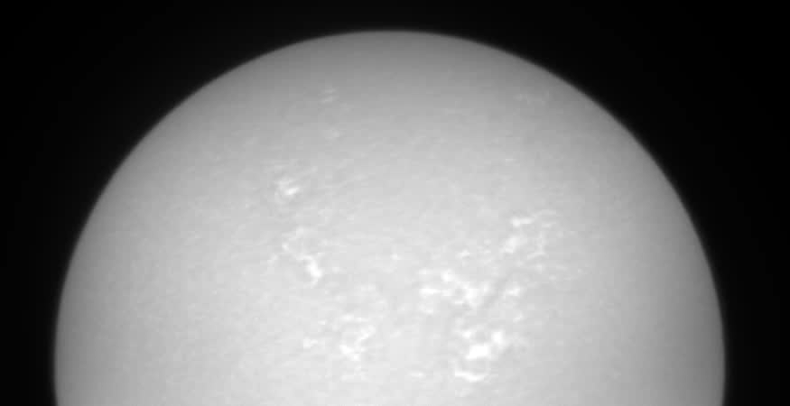
The Importance of the Chromosphere – Why ChroMag?
From Iijima and Yokoyama (2017)
Notes:
***NOTE: this slide requires to be in presentation mode due to several animation effects****
UCOMP and K-Cor observe the corona, off the limb of the sun. While EUV observations reveal the corona on the disk similar to what K-Cor observes, we do not have a good diagnostic of the coronal magnetic field on the disk. We have very good and regular diagnostics of magnetic field in the photosphere, shown in the bottom of this figure, but connecting it through the chromosphere to the corona is non-trivial. I’ve blurred the chromosphere here, and perhaps you tried to imagine what the magnetic field topology might be in this case. [click to unblur] As you can see, it is very complicated, and you probably wouldn’t have guessed that it looked like this. The chromosphere is where the gas and magnetic pressure are of similar magnitude, leading to a finely structured and highly dynamic plasma. The chromosphere is poorly observed, and consequently poorly understood. We have models, like this one, but they show discrepancies with what observations we have. The consensus is that the models poorly reproduce the magnetic field in the chromosphere. It is also widely recognized that the chromosphere is a critical region to understand in order to make progress on understanding the physical processes that drive flares and CMEs. Therefore, we have to improve our diagnostic capability of chromospheric magnetic field, and for this reason COSMO includes a full-disk imaging spectro-polarimeter specifically designed for magnetometry of the chromosphere.
These observations are difficult - it would have been done long ago if it was easy. We built a prototype instrument some years ago, and made some observations from Boulder that I’m showing here. The instrument was found to have several fatal flaws, which led to a complete re-design. This new instrument is nearing completion of construction and lab testing and calibration. We expect to deploy it to the spar in Boulder - which is a sister of the one at MLSO - in the next months, for more testing and initial operation while we wait to regain access to MLSO.

Slide 8
Mauna Loa Solar Observatory Broader Impacts
Community Engagement:
        Community-wide UCoMP special observing campaigns
        DKIST will use MLSO images for their coronal context imagery
        Chosen to support Parker Solar Probe and provide ground-based support for Solar Orbiter
        Collaborating with NSO on next-generation ground-based space weather solar observatories (ngGONG)- engaging the research and forecasting community via meetings at SHINE conference, NOAA SWPC, NSO and HAO
Space Weather Forecasting: MLSO is working with NASA JSC Space Radiation Analysis Group (SRAG) and GSFC CCMC. K-Cor CME alerts have been incorporated into the CCMC SEP forecasting scoreboard to help improve forecasts and ultimately mitigate space weather hazards for astronauts and at Earth
Education / Outreach: MLSO staff are active in education / outreach events in Hilo and Kona and provide tours of the MLSO facility

Slide 9
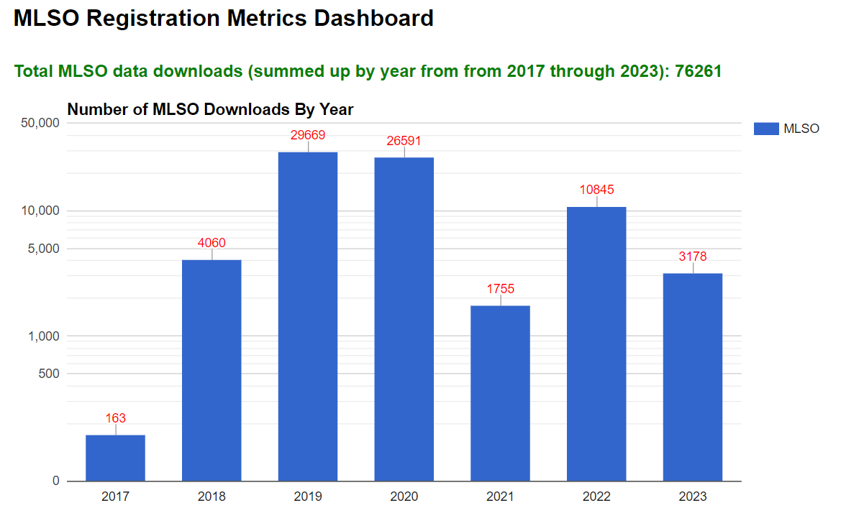
Mauna Loa Solar Observatory Broader Impacts

Slide 10
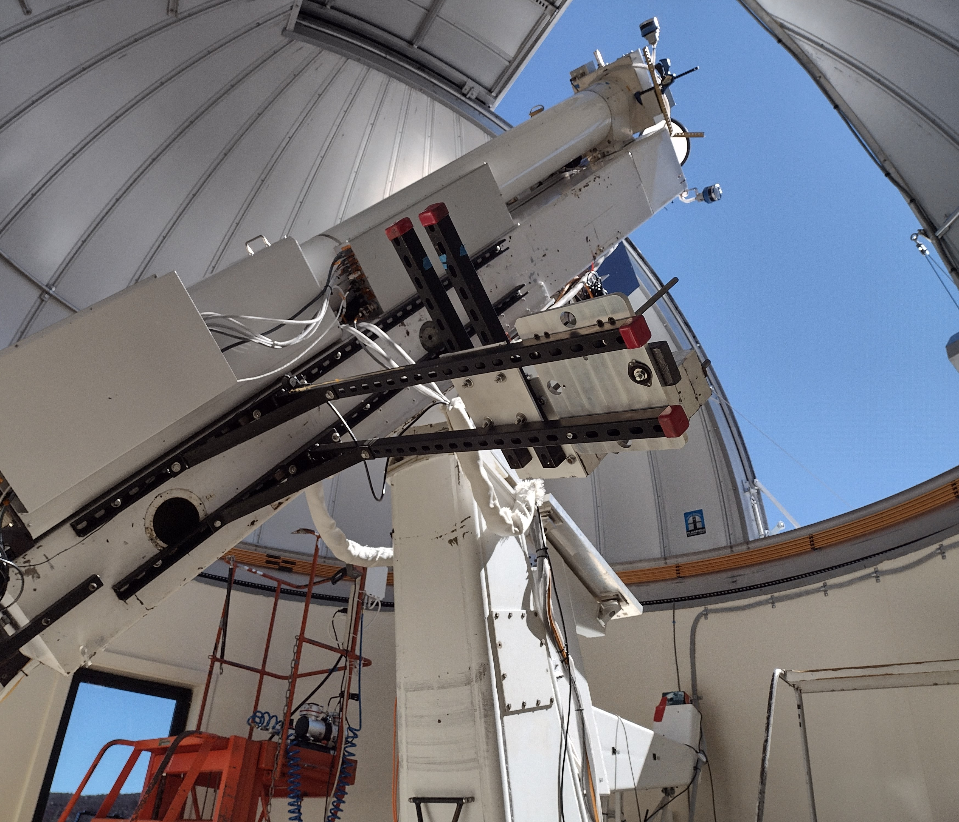
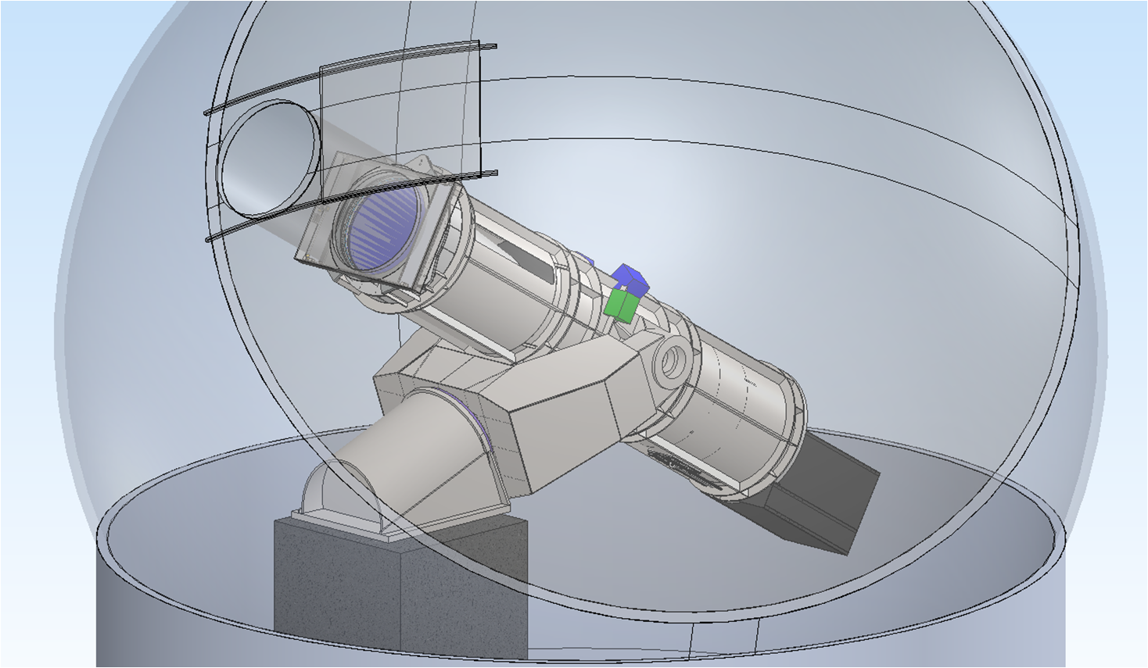


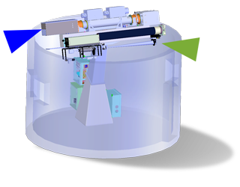

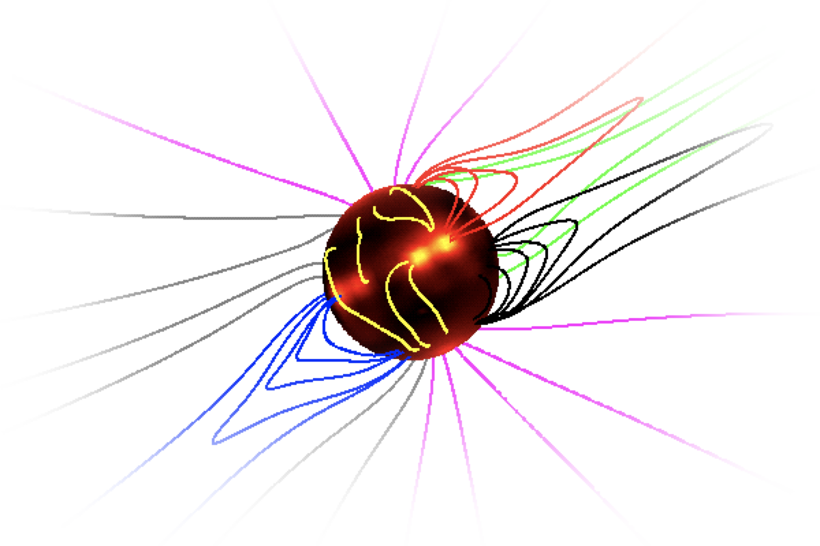
Mauna Loa Solar Observatory → COSMO
COSMO will include K-Cor and all its capabilities and data products
MLSO UCoMP → COSMO 1.5 meter Large Coronagraph (LC)
UCoMP is a technology demonstration of the COSMO LC. All data processing and analysis work on UCoMP is leveraged for the LC
The LC light-collecting will provide all current UCoMP data products but at a very high cadence needed to identify physical processes occurring within CMEs during eruption AND line-of-sight coronal magnetic field. This enables study of energy build-up and release in CMEs.
Notes:
Importance of the Coronal Magnetic Field:
The bulk of the energy in the corona resides in the magnetic field. The main source of energy driving CMEs is derived from the coronal magnetic field.
UCoMP provides plane-of-sky magnetic field maps and magnetic topology information to source of magnetic structures (e.g. flux ropes) that can lead to CMEs.
→ Connects the low corona to the heliosphere

Slide 11
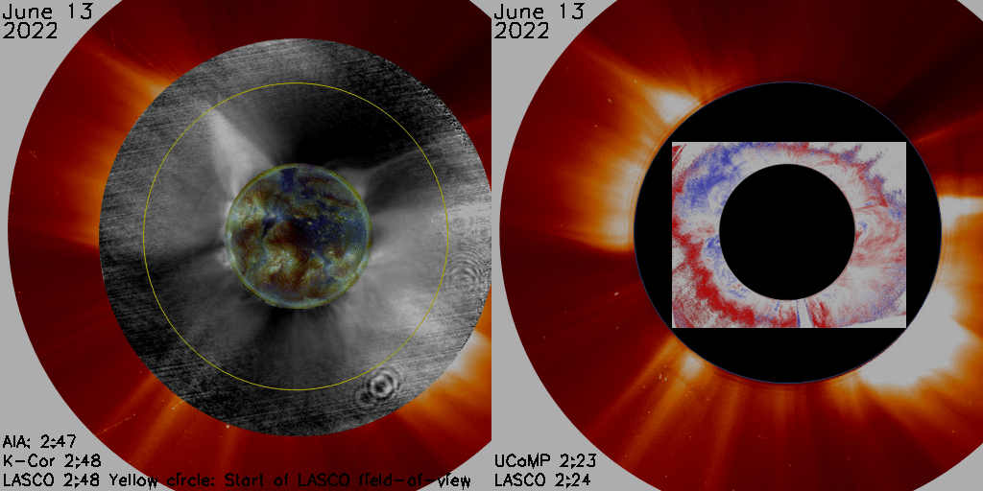
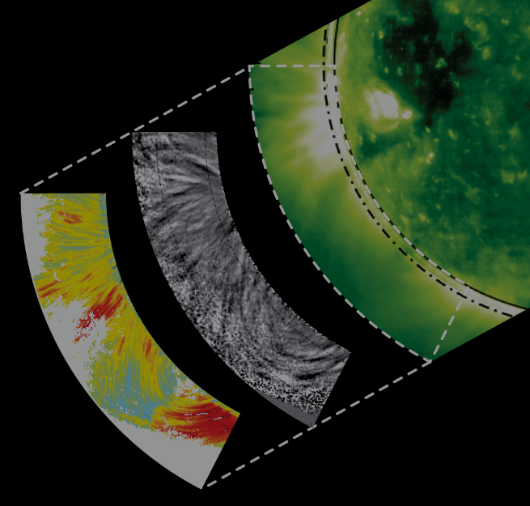
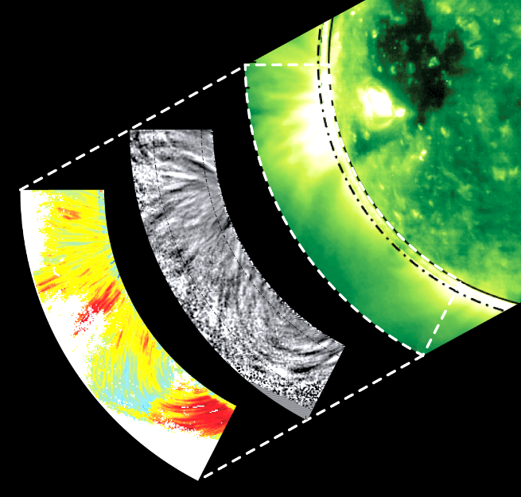
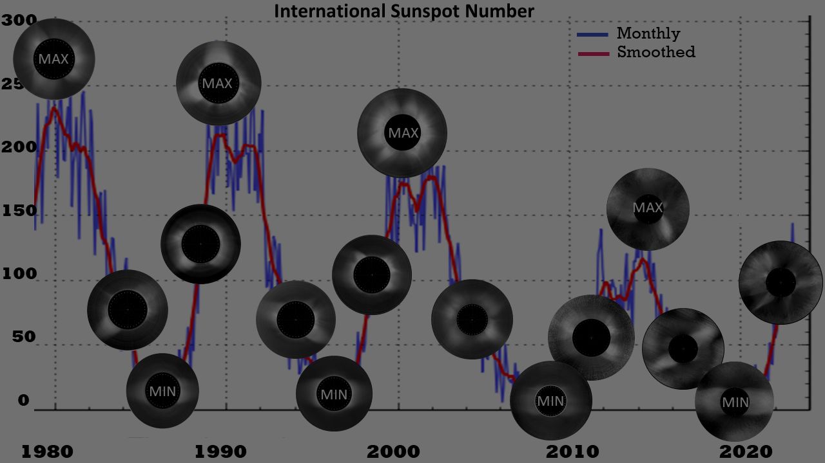
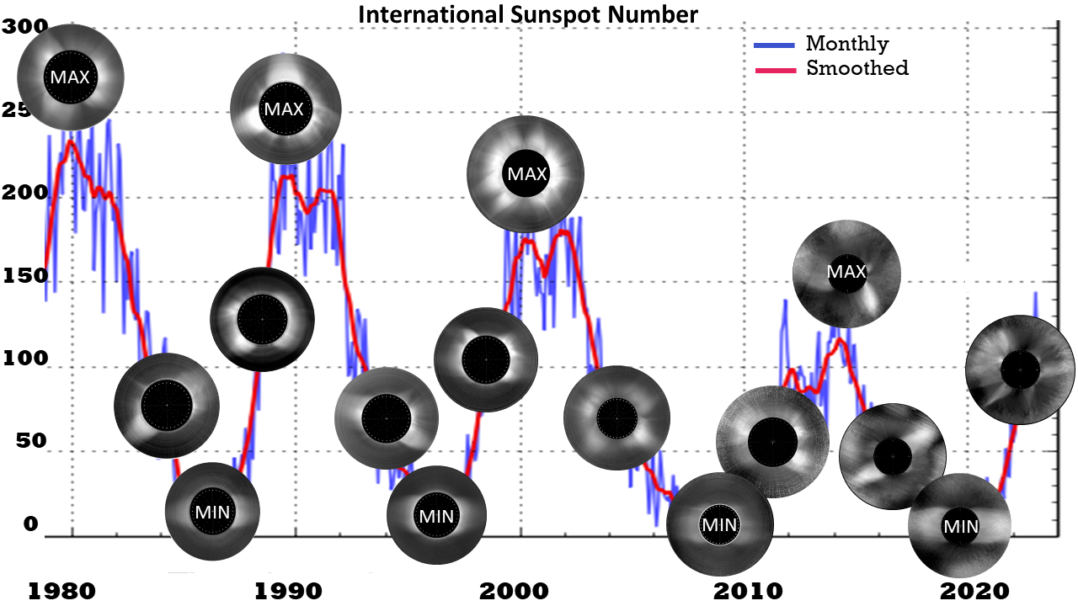
Science Enabled By COSMO Suite of Instruments
COSMO reveals global magnetism from photo/chromosphere through middle corona
K-Cor
CoMP
How does global B relate to the solar dynamo and evolving heliosphere on solar cycle timescales?
How is coronal magnetic energy stored and released? What drives CME acceleration and shock formation?
What is the role of waves in transferring magnetic energy to heat the solar corona and accelerate the solar wind?
NEED global, synoptic, chromospheric/coronal magnetic field measurements
NEED chromospheric/coronal wave sensitivity and connectivity
NEED global, synoptic, long-term coronal magnetic field measurements
60 yrs of MLSO coronal white light measurements (~45 yrs shown here)
Ratio of ingoing to outgoing wave power
Notes:
***NOTE: this slide requires to be in presentation mode due to several animation effects****
The scientific motivation for the suite of instruments at the heart of COSMO– which is the Coronal Solar Magnetism Observatory
COSMO science is fundamental and unprecedented, because it’s opening a new window on global magnetism from photosphere through chromosphere to the low and middle corona.
The low and middle corona matters because it’s where the storms brew -- where we can get warnings about crucial CME precursors, it’s where CME acceleration happens – where shocks can form, leading to Solar Energetic Particles, and where the global interfaces between open and closed magnetic fields lead to corotating interaction regions between fast and slow wind.
But as multiple white papers have indicated –the middle corona is generally under-observed! The observations that I’m showing here -- from the Mauna Loa Solar Observatory K-Coronagraph in the left-hand movie, and the Upgraded Coronal Multichannel Polarimeter, or UCoMP, in the blue-red Doppler movie on the right. You can see how these observations fill the gap between the EUV measurements of AIA and the white-light LASCO measurements. Thus, they represent rare examples of synoptic daily global observations of this middle coronal region.
And what we do see in these observations just makes us hungry for more, in particular, hungry for measurements of the chromospheric and coronal magnetic field. Our current understanding of this utterly crucial driver of solar activity is based on models extrapolating from only partially-observed photospheric magnetic fields.
[CLICK] so we are left wondering, How is coronal magnetic energy stored and released in CMEs, and what drives CME acceleration, expansion, and shock formation? To answer that question, we need [CLICK] a bigger-aperture telescope than UCoMP in order to obtain the Zeeman Stokes V (or circular polarization) that enables true quantification of the global 3D coronal field obtained in a dedicated synoptic fashion. We also need a better boundary condition on models that includes chromospheric magnetic fields.
[CLICK] Another key question– What is the role of waves in transferring magnetic energy to heat the solar corona and accelerate the solar wind? With current capabilities, as in the case of the CoMP waves shown in this image, we don’t have the resolution to put limits on the contributions of waves to coronal heating – because we don’t know how much of the wave power is spatially-unresolved. We also can’t analyze the contribution of waves to solar wind acceleration in the faint open-field coronal hole regions. [CLICK] Again we need a larger aperture telescope to increase our sensitivity to these measurements, as well as observations of wave connectivity from chromosphere to corona.
[CLICK] Finally, the coronal magnetic field represents both the the lower boundary on the evolving heliosphere AND the upper boundary on the solar dynamo. Historically, Mauna Loa Solar Observatory white-light coronal data has spanned more than six decades and has been able to show the variation of open and closed field structures in the corona as well as CME activity. If we can globally observe Stokes V in the corona we will have an utterly unique measurement of the Sun’s large-scale toroidal magnetic field (because, at the solar limb, the toroidal field is line-of-sight magnetic field, which Stokes V measures), and so we will be able to observe the evolution of the global coronal magnetic field on solar cycle time scales!
[CLICK]But again, this requires a larger aperture version of the UCoMP.

Slide 12
Back up slides

Slide 13
COSMO Instrument Suite
LC:1.5 meter spectropolarimetric Large Coronagraph
Coronal B-field measurements with 2” resolution: 1-min cadence for field topology/direction and 12-min cadence for B_{los} with 1 Gauss precision
Large field of view (1.03 to >2.0 Rsun)
LC is undergoing final design.
ChroMag: Full-disk/limb imaging spectropolarimeter
1-minute cadence photospheric and chromospheric magnetic field measurements with 2” resolution
Full-disk and above the limb out to 1.25 Rsun
ChroMag is nearing completion.
K-Cor: White-light K-coronagraph
15-second cadence measurements constraining coronal densities and CME dynamics and associated shocks that produce energetic particles
Global field of view (1.05 to 3.0 Rsun)
K-Cor is operational.
All three instruments observe the whole sun, every day (weather-permitting) with a synoptic program and community campaigns.
Notes:
Which brings us to COSMO, and its suite of three instruments, which have been designed to address these science` questions.
The primary instrument – the bigger aperture version of the UCoMP that I’ve been talking about, is the Large Coronagraph, or the COSMO-LC. It will be one and a half meters, and like UCoMP, an imaging spectropolarimetric coronagraph.
It will obtain coronal magnetic field measurements with 2” resolution, one minute cadence for field-topology/plane-of-sky magnetic direction measurements – which come from linear polarization which is easier to measure, and 12-minute cadence for line-of-sight magnetic field measurements with 1 Gauss precision – that comes from the Stokes V, circular polarization measurements. As we will discuss in more detail in response to your questions, the COSMO Large Coronagraph is currently undergoing its final design.
The second instrument, which is nearing completion, is the ChroMag. This imaging spectropolarimeter observes the full-disk and the limb out to 1.25 solar radii, with 1-minute cadence observations of the photospheric and chromospheric vector magnetic field with 2” resolution.
The third instrument is the white light K-coronagraph, or K-Cor – which is operational already – I showed you some movies from it already, along with from the UCoMP, which is the 20cm prototype for the COSMO Large Coronagraph, or LC.
All three of these instruments are designed to observe the whole sun, every day, weather permitting.
To get a sense of how many sunny days we might expect, we observe ~280-300 days per year at MLSO, more for chromosphere than corona (~300-330).
The program will be mostly synoptic, but there will be opportunities for community campaigns.

Slide 14
COSMO is Mature and Compelling
The COSMO suite of instruments are dedicated to obtaining global synoptic observations of the photosphere through the chromosphere through the corona at a high temporal cadence.
The analysis of COSMO’s powerful and unique set of observables makes use of techniques that are well understood and that have been demonstrated with prototype instruments.
The ongoing NSF-funded COSMO Site and Design Advancement (COSADA) effort significantly buys down risk through:
  COSMO-LC final design and construction cost development
  COSMO site survey and selection.
COSMO will finally answer crucial questions about solar eruptions, coronal heating/solar wind acceleration, and the solar dynamo, advancing space-weather predictive capability with clear societal benefits.
Notes:
So, to summarize – we’ve been working on the concept of COSMO for decades now with the help of a broad range of community members
It’s gotten to a point where the science argument, the instrument design and – for two of them – construction -- are truly mature.
The science we’re doing will synthesize observations from all three of these instruments – this is enabled by the global, synoptic nature of the measurements, their high temporal cadence, and their coverage from photosphere through chromosphere through corona
The way we’re going to analyze these powerful and unique set of observables is by using techniques like forward modeling and tomography that have matured over the past two decades along with the field of coronal seismology, and that have been demonstrated with prototype instruments
In a moment, we’ll be talking a bit more about the ongoing, NSF-funded COSMO Site and Design Advancement project, or COSADA, which is significantly buying down risk by completing COSMO-Large Coronagraph design and construction cost development, and by doing a COSMO site survey and initial down-select of these sites.
So to conclude, COSMO will finally answer crucial questions about solar eruptions, coronal heating/solar wind acceleration, and the solar dynamo – and in the process, will advance space-weather predictive capability – with clear societal benefit.

Slide 15
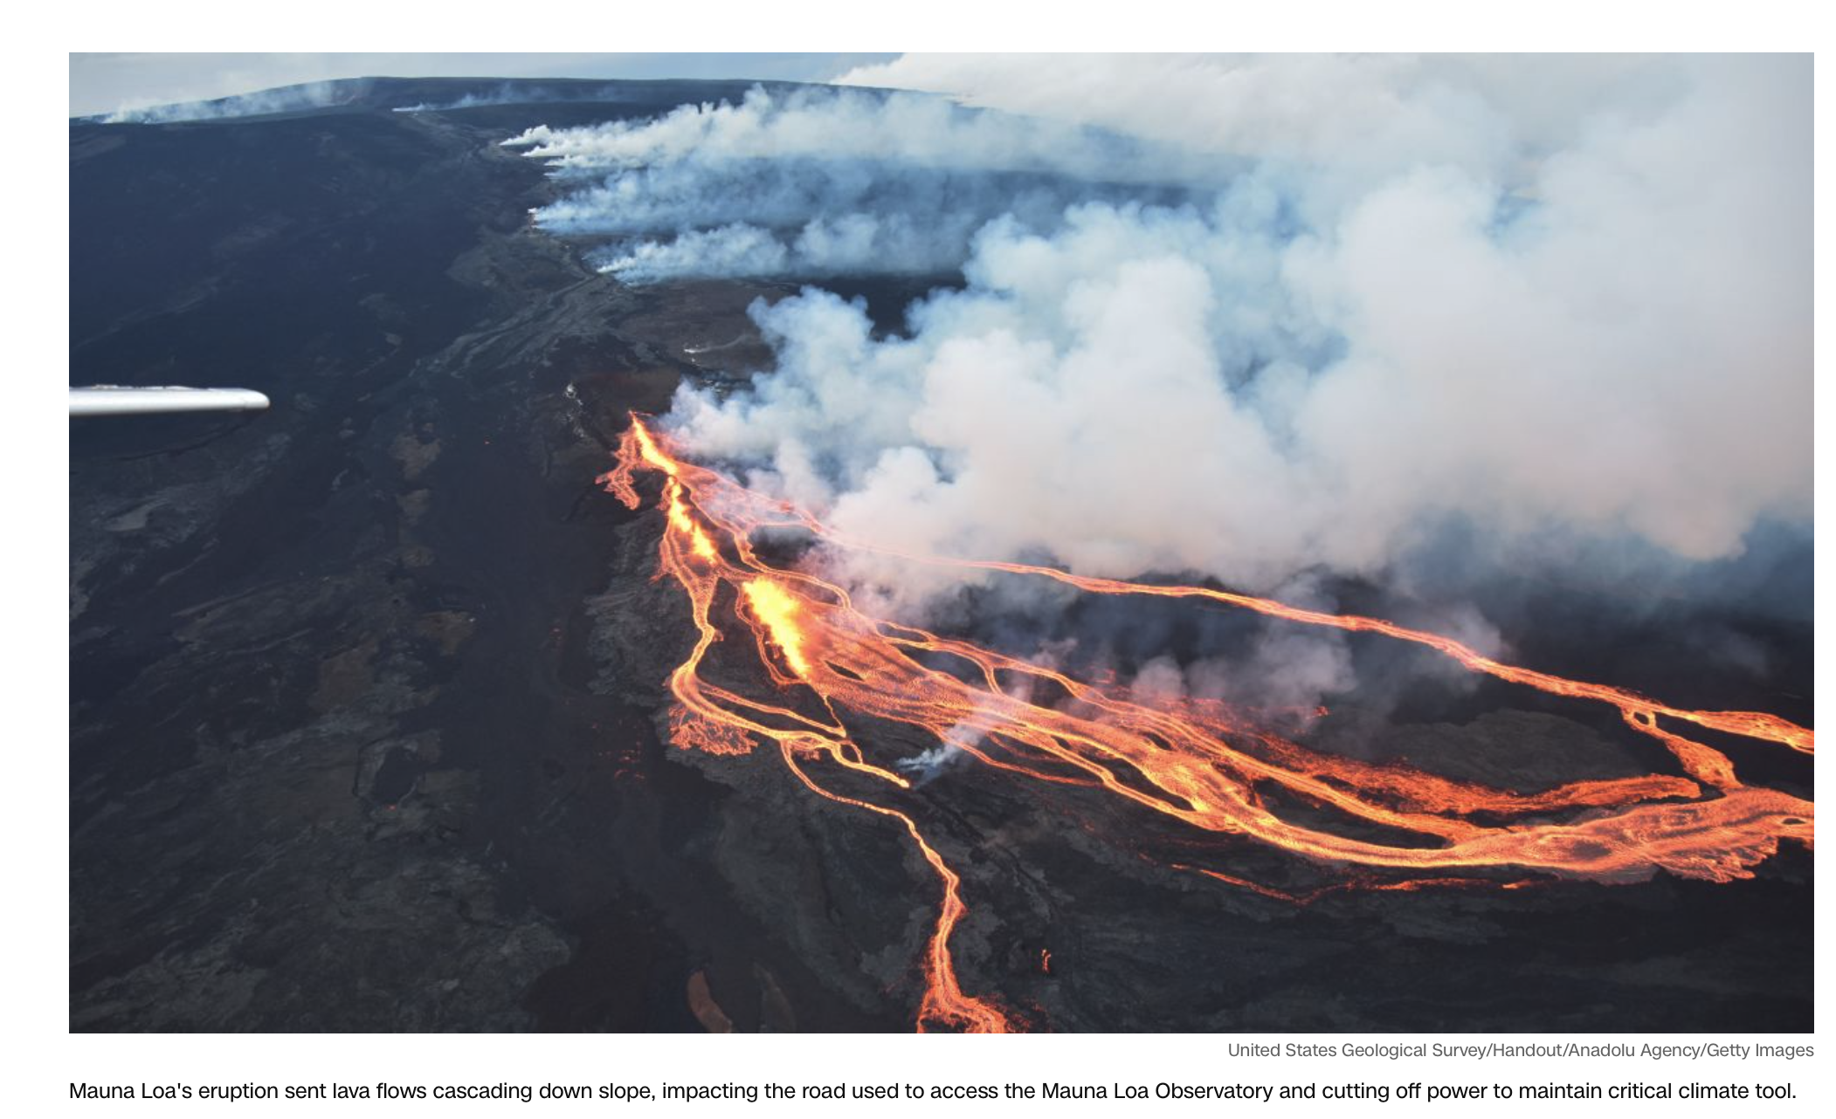
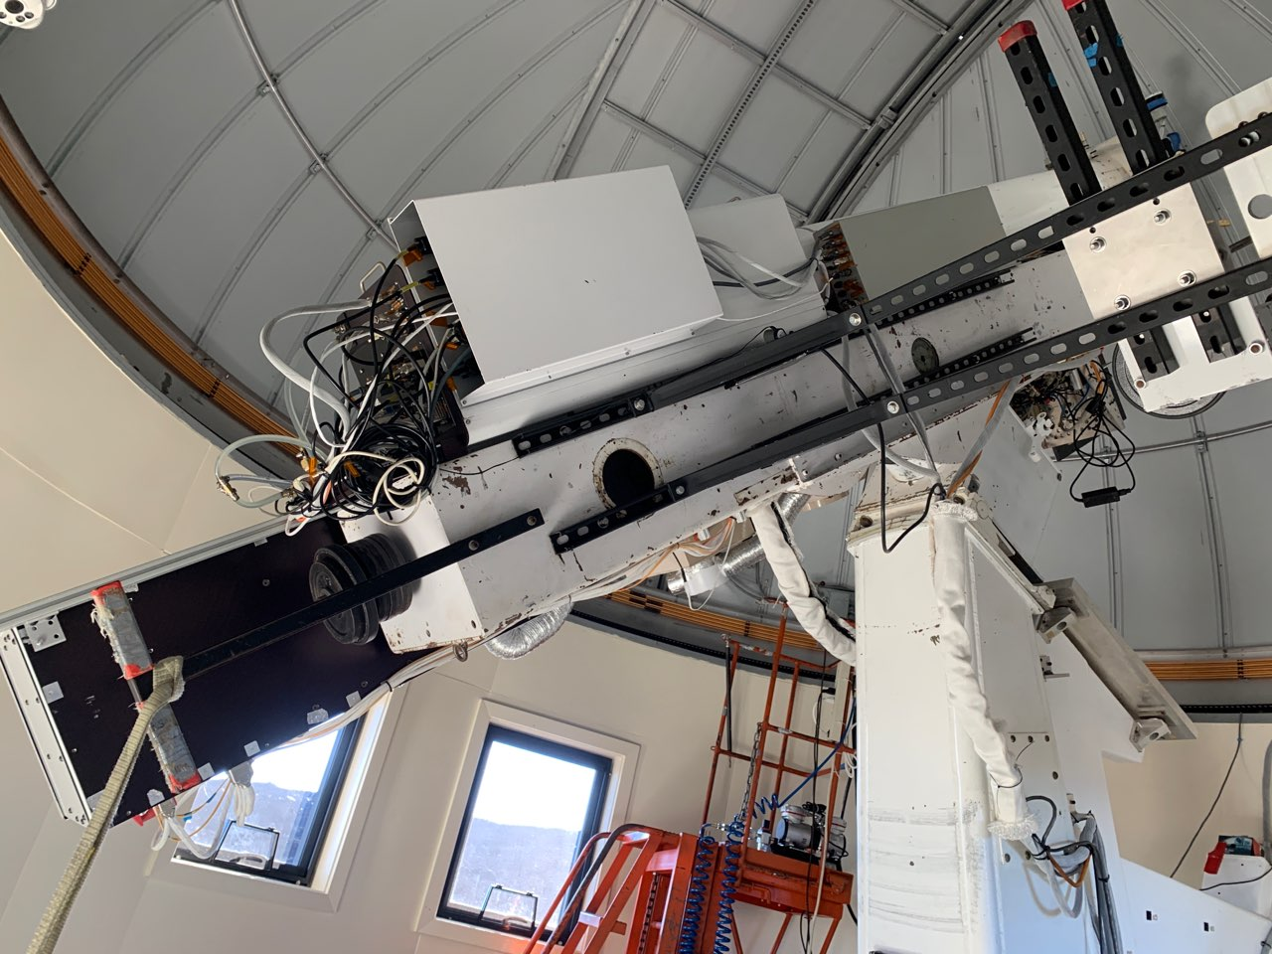
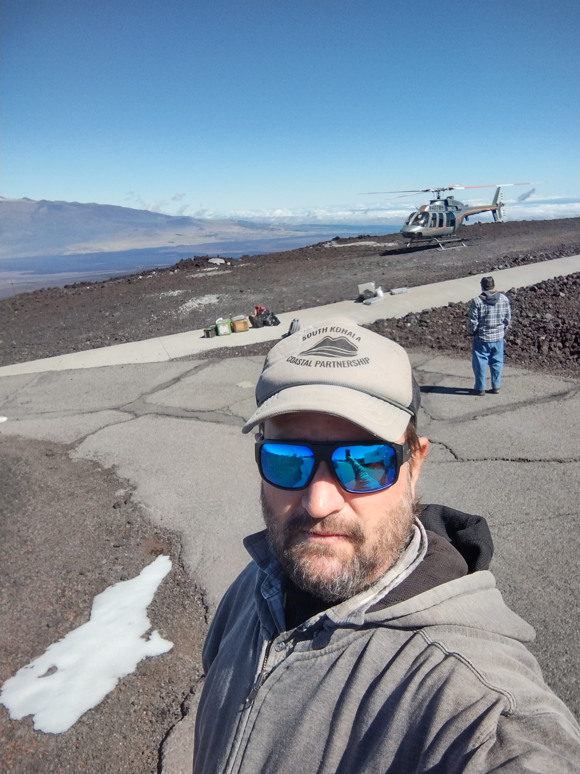
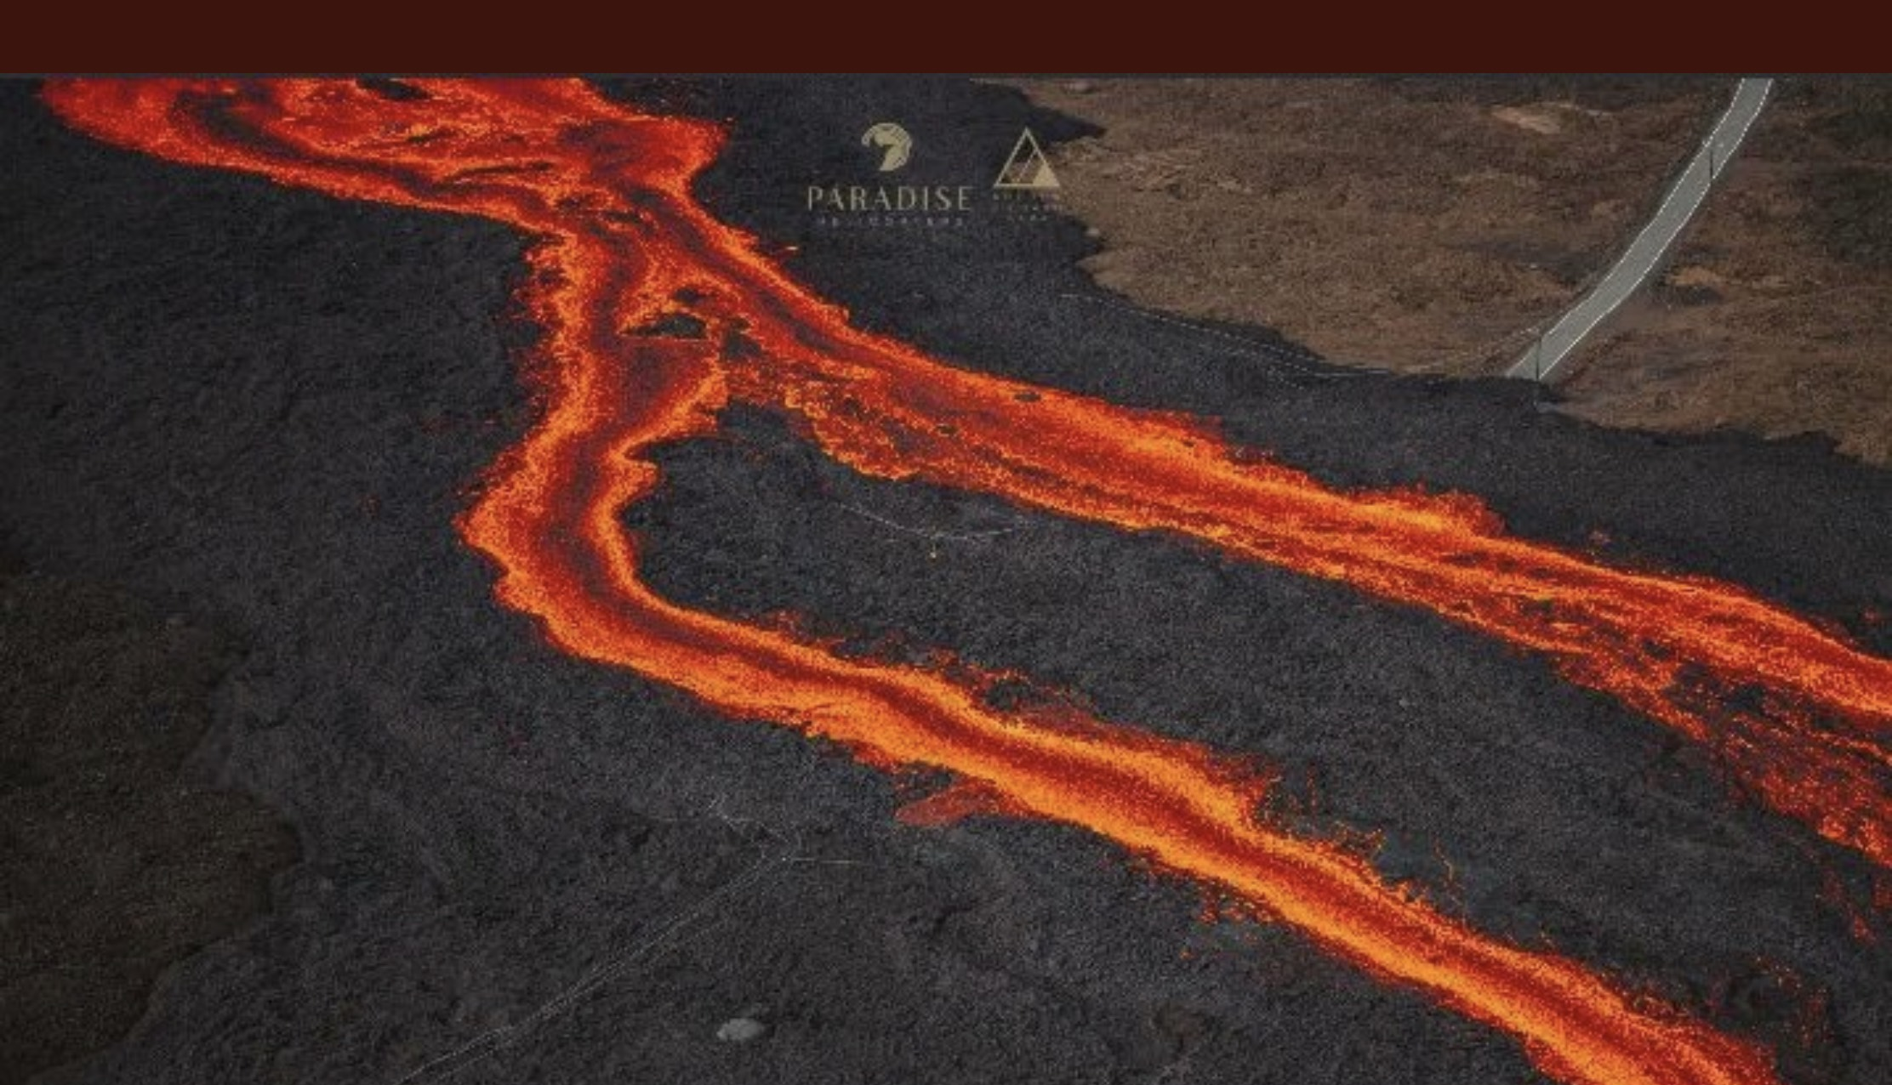
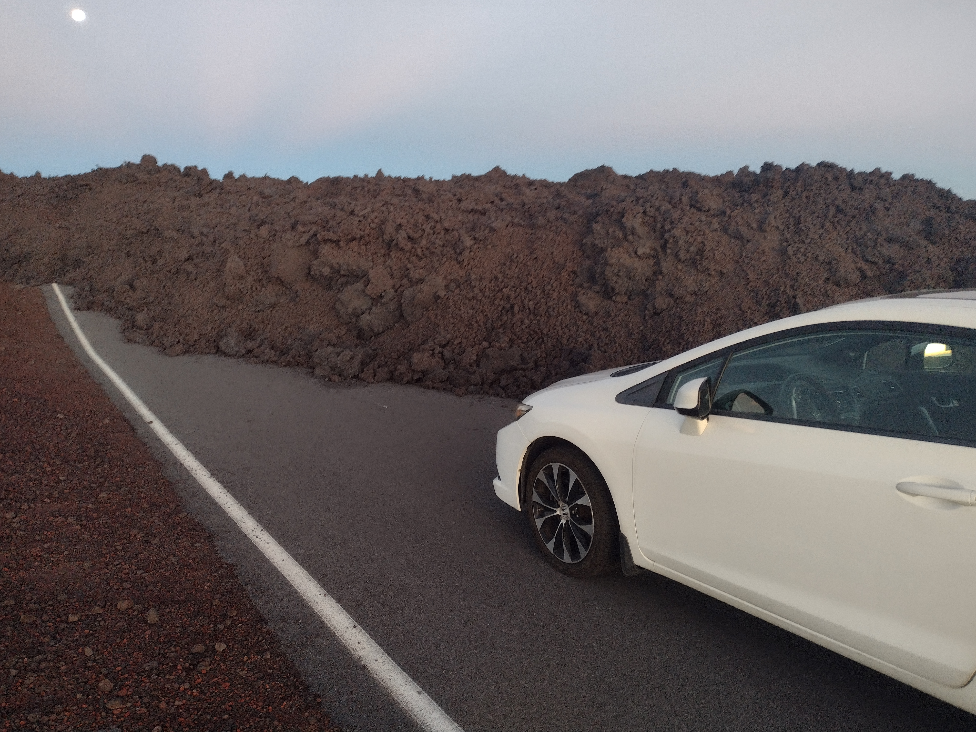
Mauna Loa Current Challenge:
Volcanic Eruption Closed the Site
Mauna Loa erupted early on Nov 28, 2022
Site Manager Ben Berkey visited site in early January (helicopter) to verify the facility and equipment were okay.
Lava flows eliminated ~1.2 miles of the Mauna Loa access road and the power lines along the road at ~9,000 feet.
Lava is up to 30 feet high in some locations.
Lava cools very slowly at depth. Still too hot to grade lava for new road and install new powerlines
Working with NOAA: update later today from NOAA
UCAR facilities / HAO working with NOAA on installation of solar panels
Hoping to have access in summer but it could be as late as the end of 2023. Missing Solar Maximum Activity
Missing Coordinated Campaigns
Access Road

Slide 16
