Slide 1
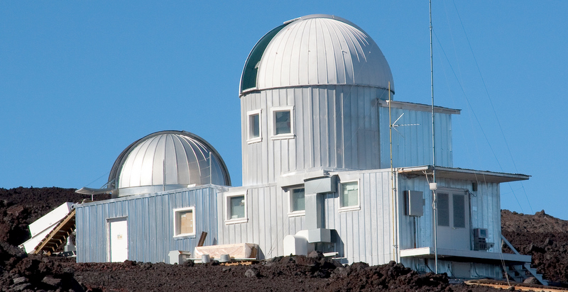
The Mauna Loa Solar Observatory
MLSO User Committee Meeting April 22, 2014

Slide 2
Science Goals
Understand how changes in the Sun’s magnetic field drive solar activity and create space weather at Earth
Establish how the coronal magnetic field responds to emerging magnetic flux, plasma flows and large scale motions
Determine solar cycle variations of magnetic field and solar outputs
At Left: CoMP observations of coronal plasma and magnetic field properties provided on MLSO web page

Slide 3
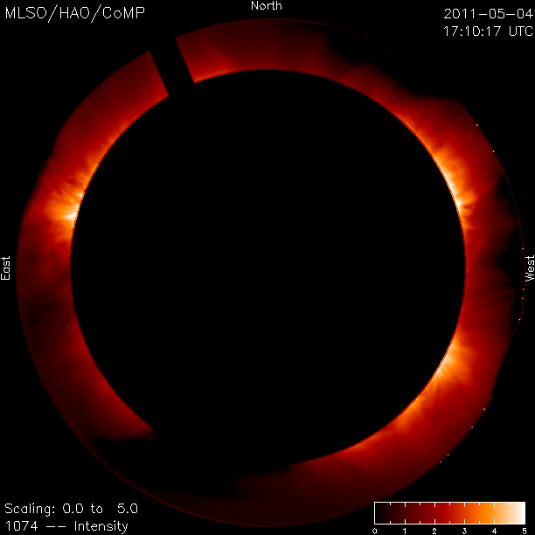
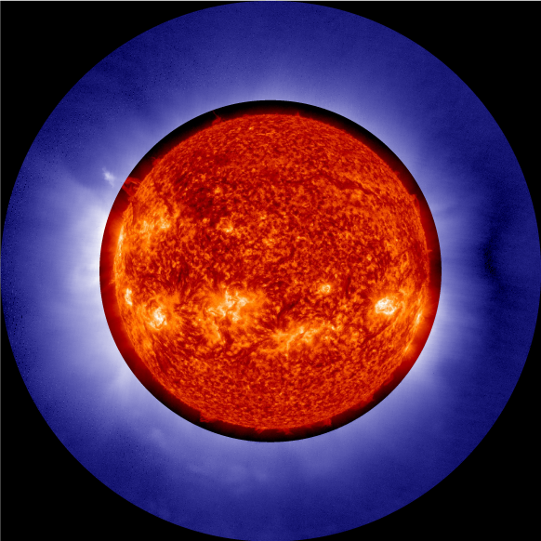
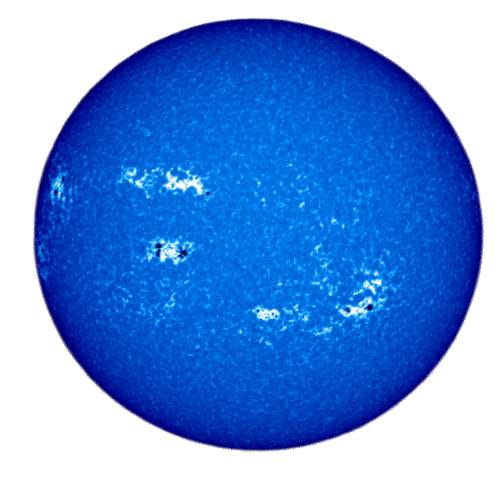
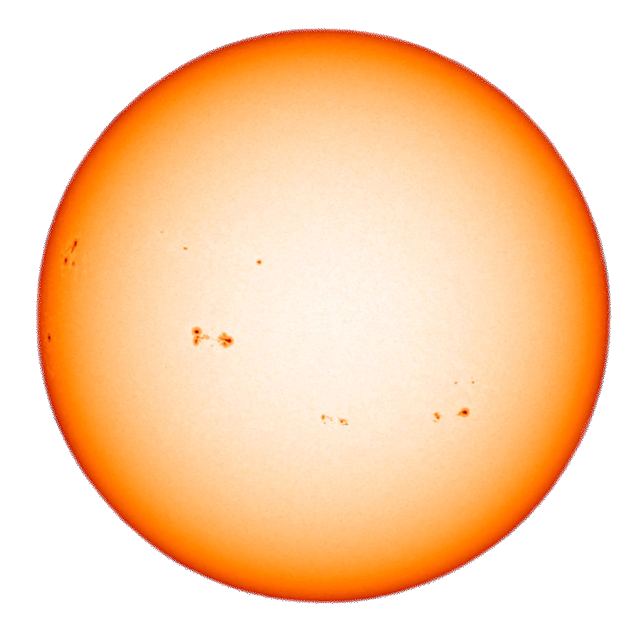
Instruments at Mauna Loa
HAO operates 4 instruments at MLSO: CoMP, K-Cor, PSPT and GONG. HAO is responsible for the data processing and data products for CoMP and K-Cor; Mark Rast at University of Colorado processes and manages all PSPT data and the GONG group processes and manages all GONG data processing and products.
CoMP: Fe-XIII 1074.7 and 1079.8 nm and He-I 1083.0 nm full Stokes I,Q,U,V polarization
COSMO K-Coronagraph: Linear polarization in white light. Dec 9, 2013 composite image of K-Cor with SDO AIA Helium-I 30.4 nm image.
Precision Solar Photometric Telescope (PSPT): Left: CaIIK line center; Right: Blue continuum at 409.4 nm
GONG H-alpha: Neutral hydrogen emission at 656.3 nm. Owned by NSO; maintained by HAO.

Slide 4
Status of Coronal Multi-Channel Polarimeter
Instrument is fully operational
Data Products: FeXIII: 1074.7 and 1079.8 nm
~1 Minute Time Resolution:
‘Dynamics’ Products:’
Intensity
Enhanced Intensity
Corrected LOS velocity
Line Width
‘Polarization’ Products:
Intensity
Enhanced Intensity
Stokes ‘U’
Stokes ‘Q’
Total Linear Polarization
PLUS: ‘Dashboard’ images (shown below), consisting of eight quantities made from best avg. images of the day
Coming later in 2014: HAO purchasing new camera that will eliminate need for Liquid nitrogen cooling. HAO has a proposal out to NSF for funds for a second camera. If approved, the second camera would improve spatial resolution and increase the field-of-view.

Slide 5
Status of PSPT: Jerry Harder has provided slides

Slide 6
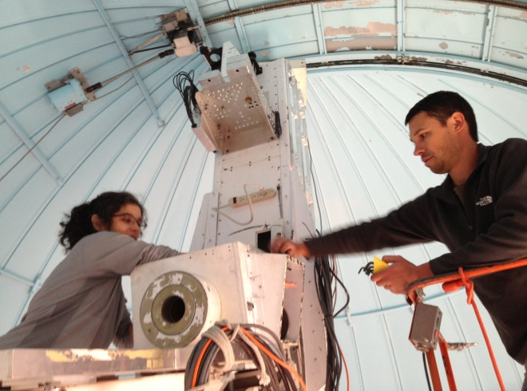
What’s New at MLSO
COSMO K- Coronagraph
Community Observing Campaigns (mostly CoMP)
At Left: Lisa Waters and Brandon Larson installing K-Cor at MLSO
Community Forward Modeling Tools utilizing MLSO, SDO, and other data
2 New Casual Observers: Lisa Waters, Greg Rose
New web page launched February 2014
COSMO Chro-Mag coming to MLSO ~Dec 2014

Slide 7
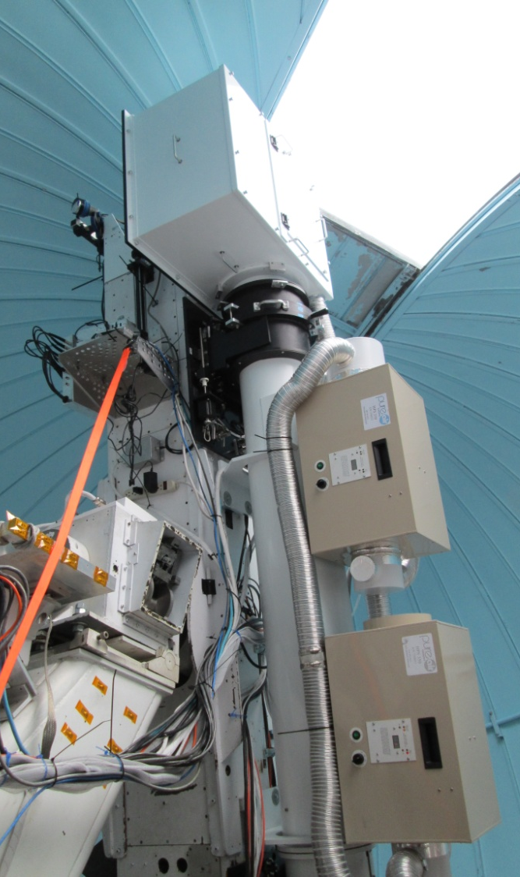
Status: COSMO K-coronagraph (K-Cor)
K-Cor performance meets design requirements of recording the white light (WL) corona down to 1.05 R_{Θ}; lowest WL FOV outside of eclipse
Installed at MLSO September 2013
Have begun providing qualitative data on web page
Calibrated data coming later this year: Need to complete analysis of demodulation results and sky polarization removal.
Diffraction pattern artifacts (image at left) may be in or near area of objective lens; will install spare lens in June. Lyot stop may be misaligned. Full realignment of optics in June.
Above: K-Cor at MLSO
Above: K-cor movie of Feb 11, 2014 CME
‘diffraction’ pattern artifacts

Slide 8
New MLSO Web Page
K-Cor data now becoming available
Updated Instrument pages
Updated News Items
More information about MLSO

Slide 9
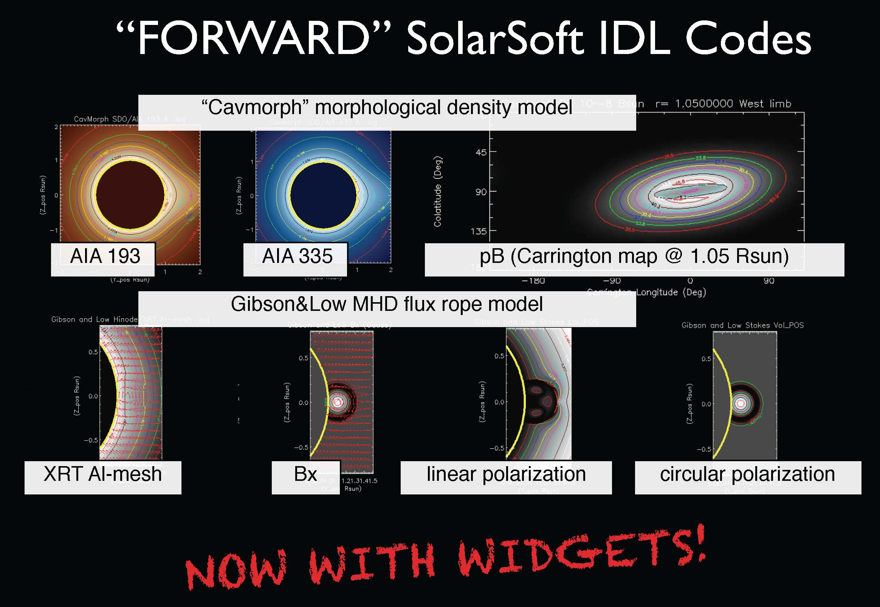
New Forward Modeling / Data tools
HAO-led development effort of a community tool to compare PFSS and MHD models of solar corona to MLSO CoMP, SDO AIA and other data. Contributors: Sarah Gibson, Blake Forland, Jim Dove, Terry Kucera, Phil Judge, Enrico Landi
http://www2.hao.ucar.edu/mlso/news/forward
Tool can also be downloaded from MLSO web page under
Data and Movies: Emission Corona FeXIII
OR
Data and Movies: More Products
OR
MLSO News

Slide 10
Community Observing Campaign Highlights with CoMP Instrument
2014: Increased acquisition of FeXIII at 1079.8 nm to study CME shock compression ratios
Requested by: Hui Tian, Harvard Smithsonian Ctr for Astrophysics and Yao Chen, Shandong University Center for Space Weather Studies
2013: Increased doppler observations to study evolution of coronal cavities and eruption of prominences and CMEs.
Requested by: Alphonse Sterling, NASA Marshall Space Flight Center and Tim Bastian, University of Virginia and NRAO
2013: Varied observations of circular polarization and FeXIII 1079.8 to study properties of coronal magnetic field
Requested by: Enrico Landi, University of Michigan, Bernhard Kleim, University of Potsdam, Terry Kucera, NASA Goddard Space Flight Center, Kathy Reeves, Harvard Smithsonian Ctr for Astrophysics.

Slide 11
Community Requests for K-Cor
2014: Acquire 8-second time cadence to identify flares with steepening hard-Xray production associated with CME-shock generated solar energetic proton events (SEPs)
Requested by: Alan Kiplinger, University of Colorado Boulder
2014: Provided successful K-Cor bandpass rejection design and specifications to SCORE coronagraph team.
2016: Joint campaign with SCORE coronagraph on NRL sounding rocket flight
Requested by: Silvano Fineschi, National Institute for Astrophysics, Torino

Slide 12
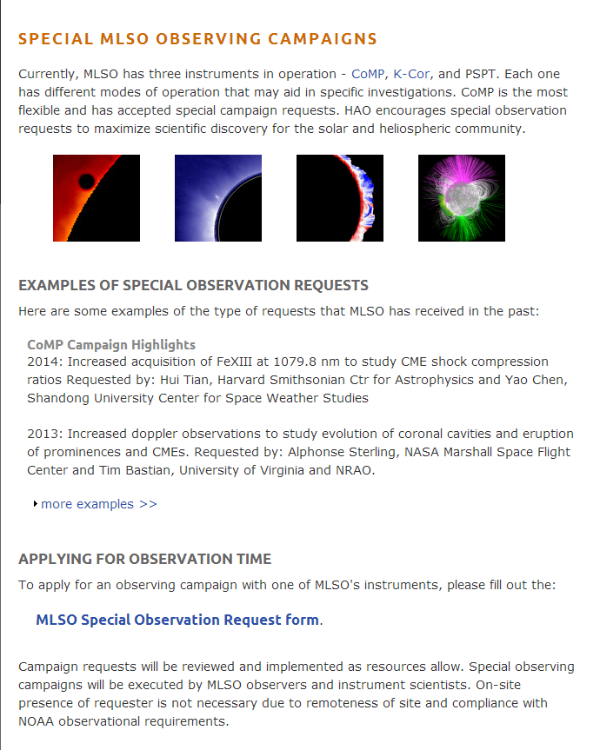
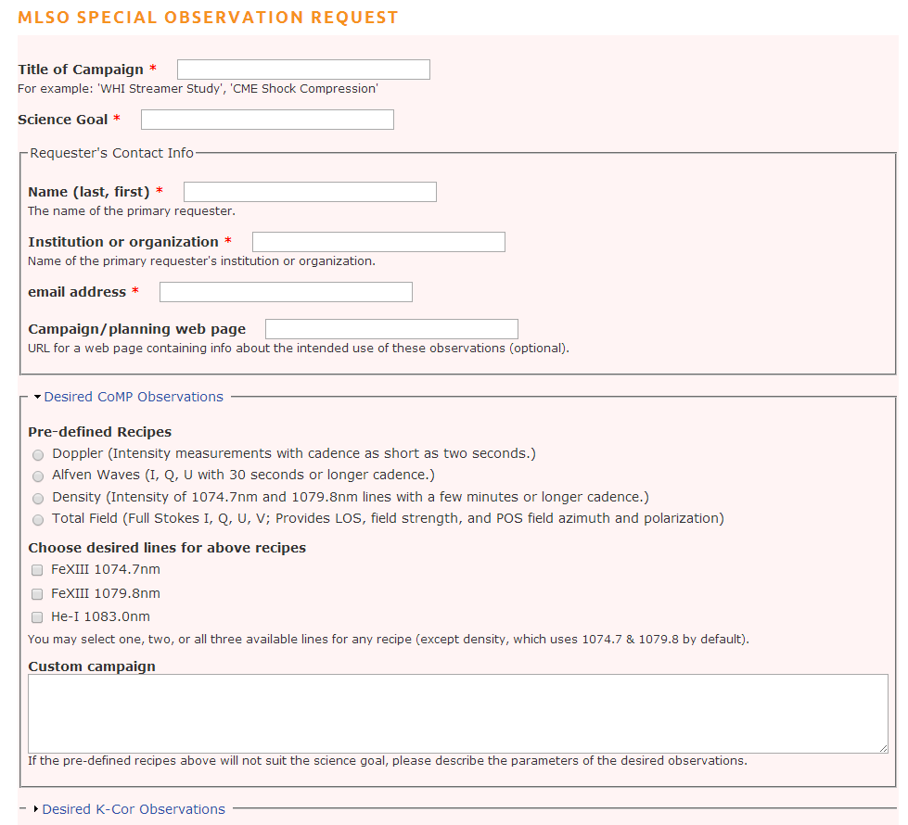
New Community Observing Campaign Web Page

Slide 13
COSMO Chro-Mag (prototype)
Science Goal: Understand how the chromospheric magnetic field and plasma interactions drive the dynamics of prominences and filaments and other chromospheric structures.
Provides synoptic full-disk imaging spectro-polarimetry:
• He I 587.6 & 1083.0 nm: chromospheric magnetograms
• Hα 656.3 nm: chromospheric structure and dynamics
• Ca II 854.2 nm: chromospheric magnetograms
• Fe I 617.3 nm: photospheric magnetograms
• High cadence: < 1 minute for all lines
• Moderate spatial resolution: 2.2 arcsec (1.1 arcsec pixels)
• Moderate but sufficient spectral resolution: > 30000
• Field of view: 2.4 Rsun square
• High polarimetric sensitivity: SNR > 103
Chro-Mag at Mesa Lab

Slide 14
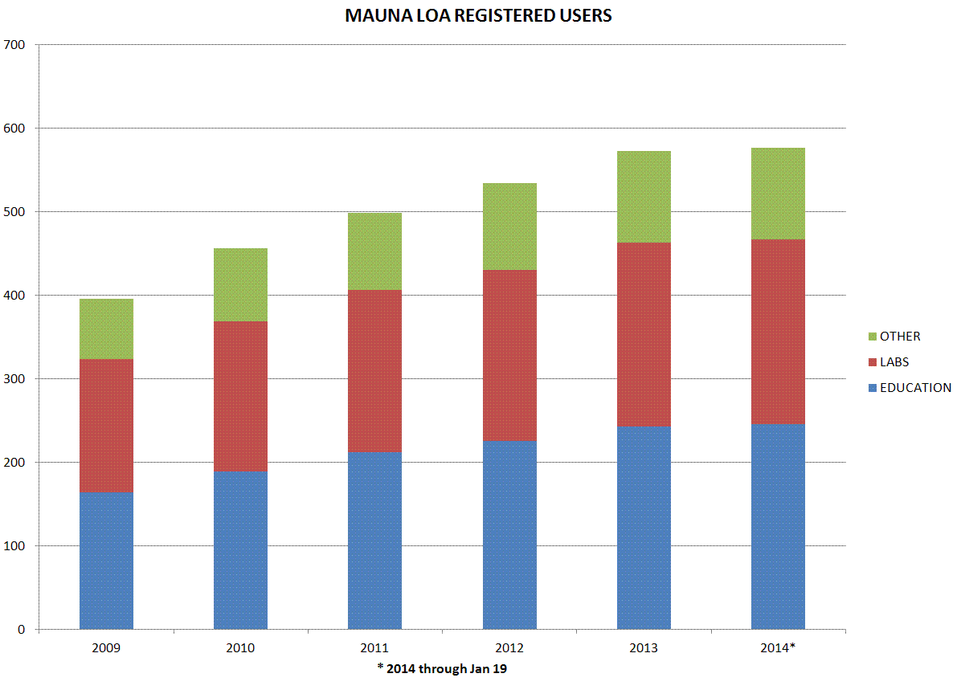
MLSO Metrics: Registered Users
through Jan 19, 2014

Slide 15
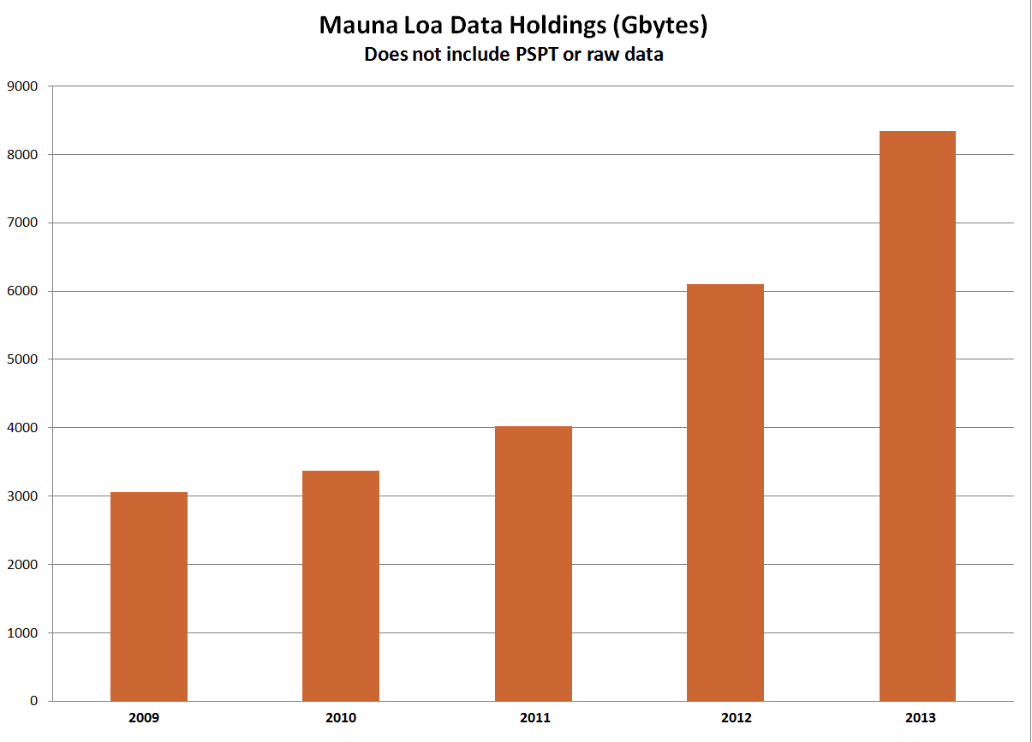
MLSO Metrics: Data Holdings

Slide 16
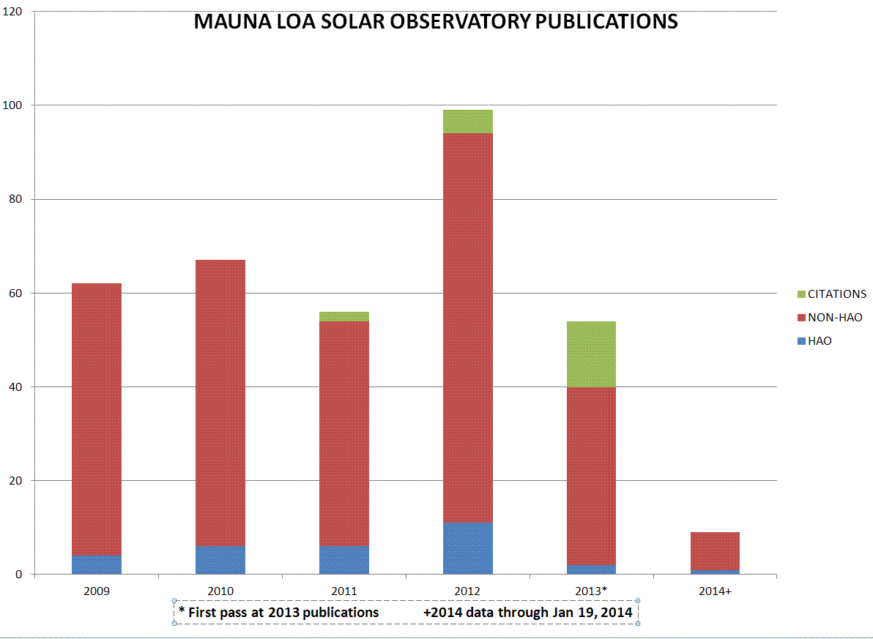
MLSO Metrics: Publications
through Jan 19, 2014
NOTE: 2013*: First draft of publication list; usually results in ~1/2 of total.

Slide 17
MLSO Metrics: Publications
through Jan 19, 2014
2014
9 papers to date: 5 CoMP, 2 Mk4, 2 PICS H-alpha, 1 PSPT [ 1 paper used Mk4 and Halpha)
2013
38 papers to date: 16 CoMP, 16 Mk4/Mk3; 5 PICS Halpha; 1 PSPT, 1 CHIP, 1 K-Cor [ 2 papers used more than one data set]
Usually takes a few years to find most publications in a given year

Slide 18
MLSO Staff and Facility
2 new casual observers (each work less than ½ time)
Lisa Waters (Casual)
Greg Rose (Casual)
Ben Berkey
Allen Stueben

Slide 19
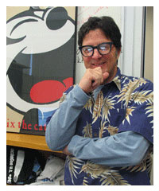
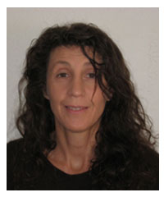
Boulder-side Staff
MLSO Data Pipeline Programmer Leonard Sitongia retired end of 2013. Giuliana deToma and I are doing Leonard’s job. We have completed interviews for new hire and should have someone in the position soon. Giuliana will continue working on event listings and take on Data Scientist quality control responsibilities.
Leonard Sitongia
Giuliana deToma
Leonard’s replacement

Slide 20
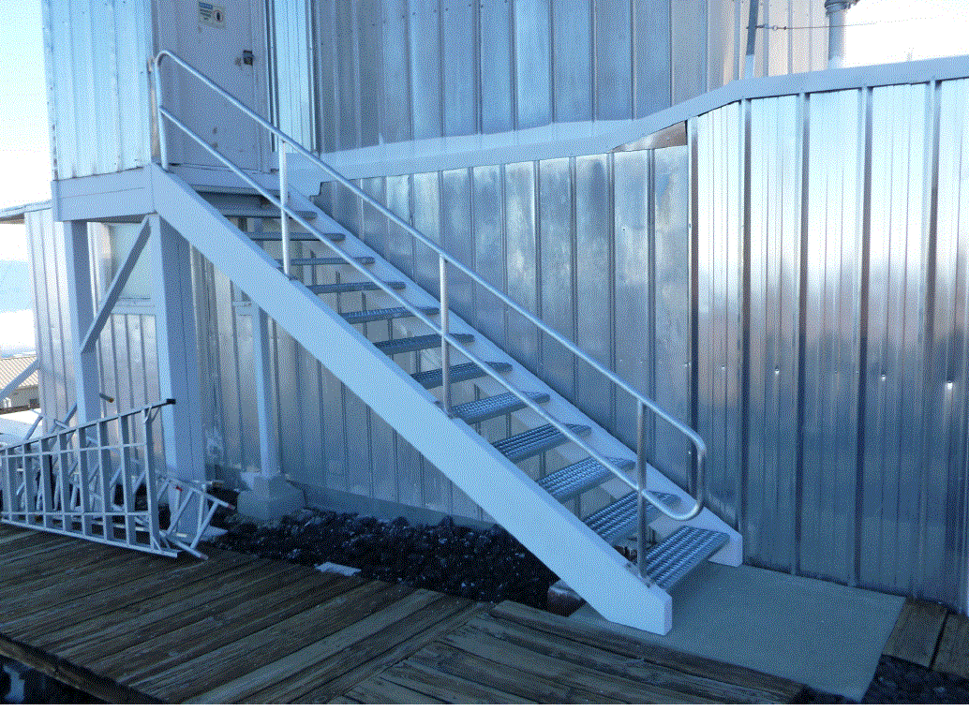
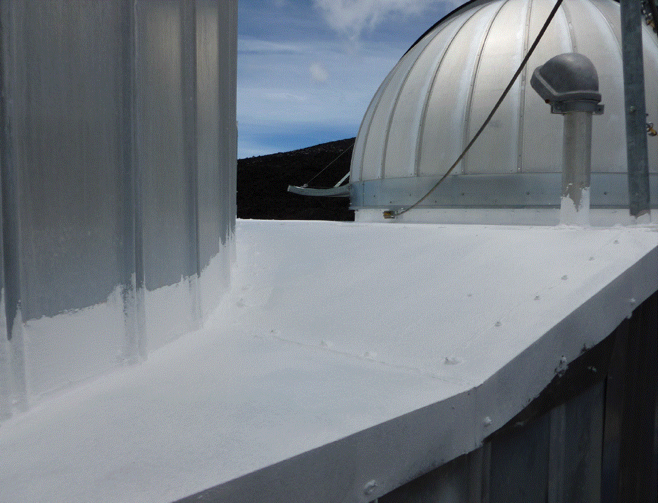
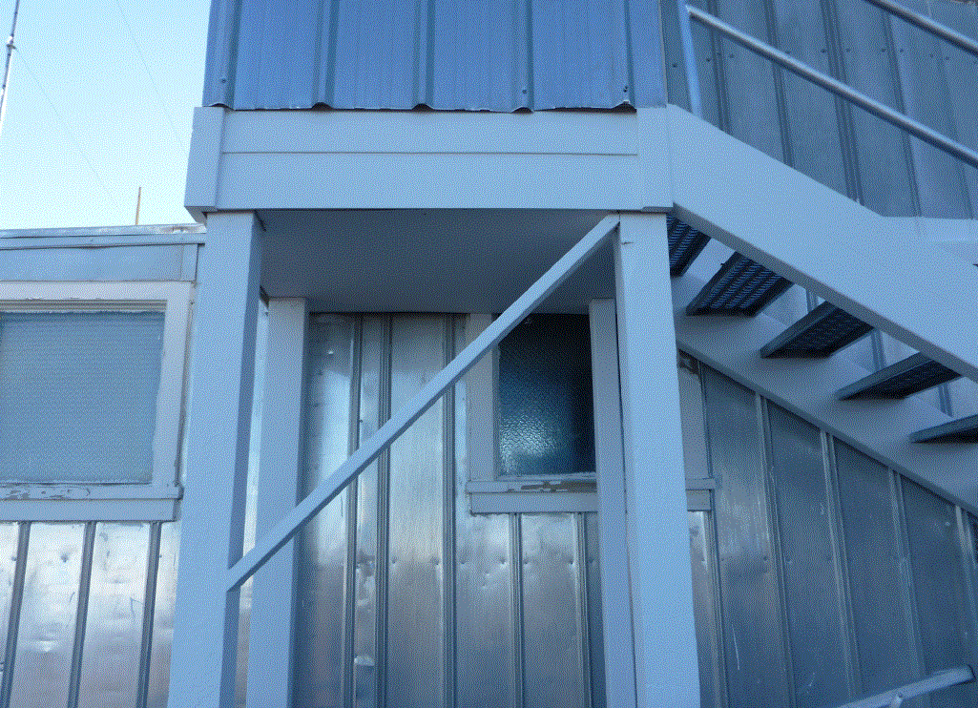
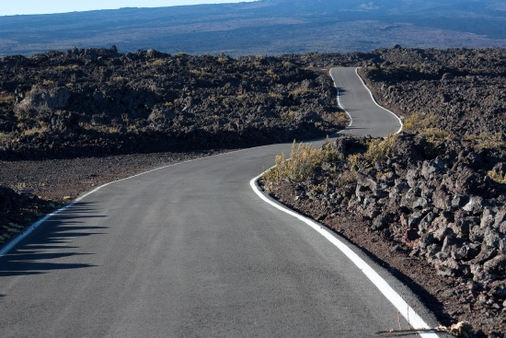
MLSO Staff and Facility
MLSO infrastructure improvements include:
UCAR has stepped up and is providing major repair funds to the building. Additional work to be completed in 2014 includes:
Assembly and installation of new dome purchased by HAO
Removal of asbestos floor tiles
New floor in control room
New windows in dome
Repair wooden boardwalk
Repair wooden porch
Replace electrical conduit
Repair water damage
UCAR to begin paying for internet with increased speed to 100 Mbps (from 25)
UCAR put in new stairs
UCAR repaired roof (it no longer leaks onto PSPT equipment!)
UCAR replaced structure holding up ‘doghouse
NOAA paved the road

Slide 21
Recent Post-Docs who have worked with CoMP observations
Joseph Plowman
Hui Tian (now at CfA)
Christian Bethge (now at Kiepenheuer Institute)
Laurel Rachmeler (now at Royal Observatory of Belgium)
Young Instrument Scientists
Alfred DeWijn (Dkist VISP, K-Cor, Chro-Mag)
Junfeng Hou (K-Cor modulator) from National Astronomical Observatories of Chinese Academy

Slide 22
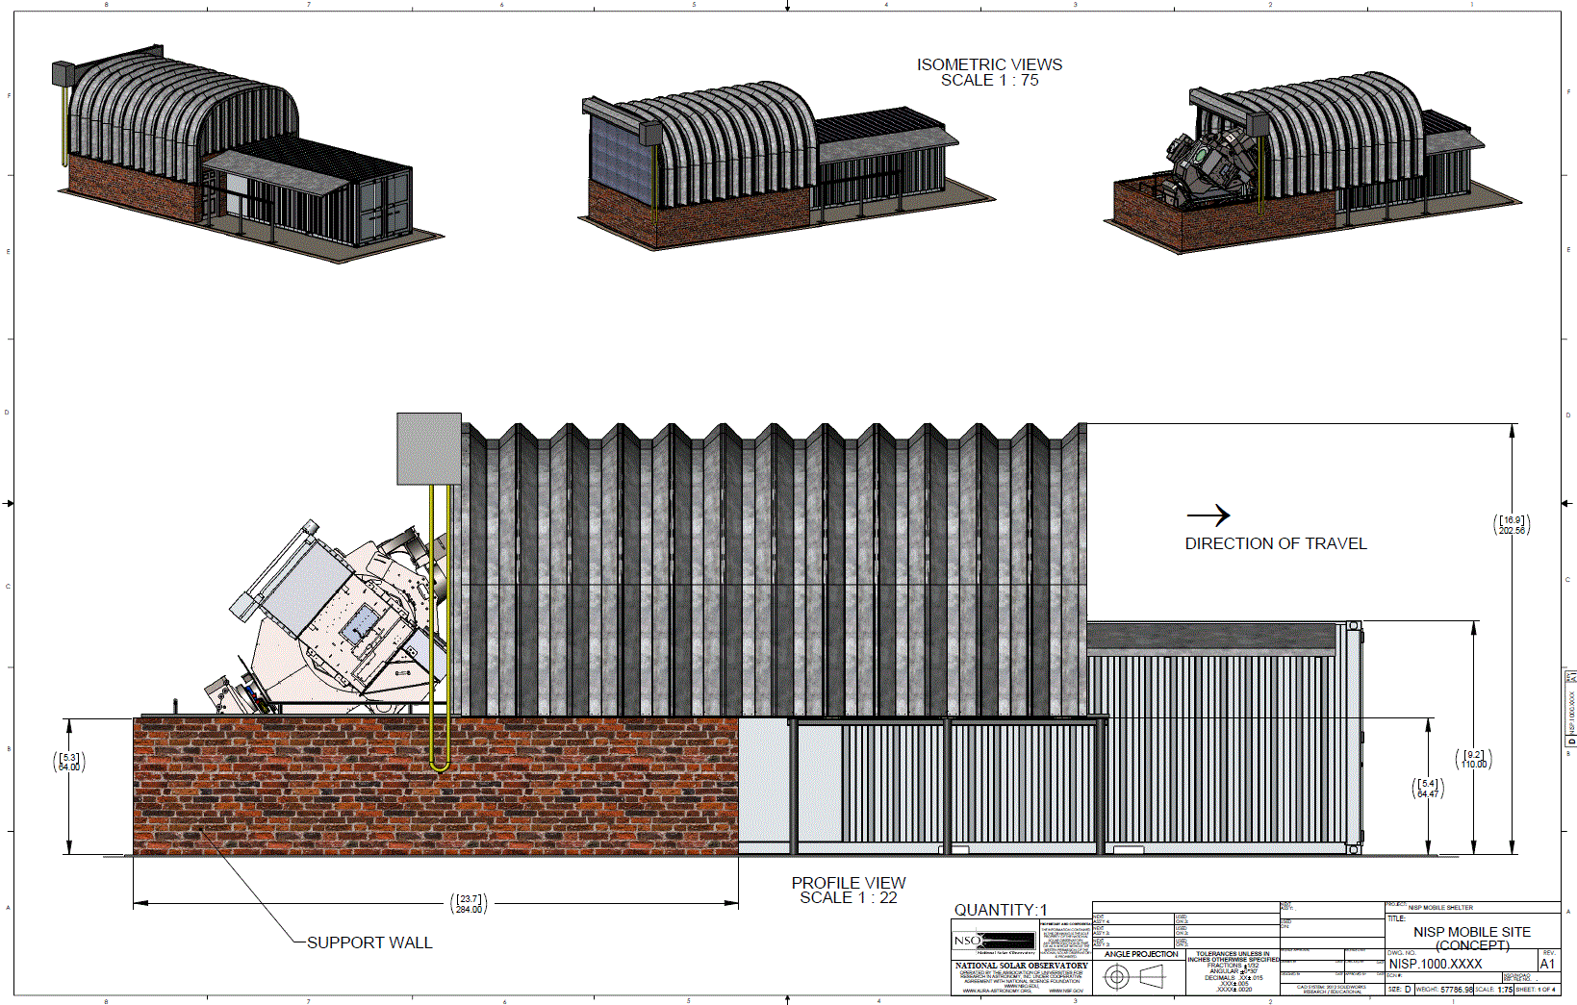
SOLIS
NSO will move the SOLIS instrument suite from its current location on top of a ~100 tower at Kitt Peak to Tucson, AZ. The system is being automated and configured to consolidate instrumentation, control electronics, and on site computing. Attached image is a conceptual drawing of the proposed upgrade to take place summer 2014. Telescope building has already been ordered and the laboratory space for the ISS instrument, computers, and control electronics is in the process of final modifications.
SOLIS will move in ~2015. Request for information will be solicited later this year. Most likely sites are:
Haleakala, Mauna Loa and Big Bear

Slide 23
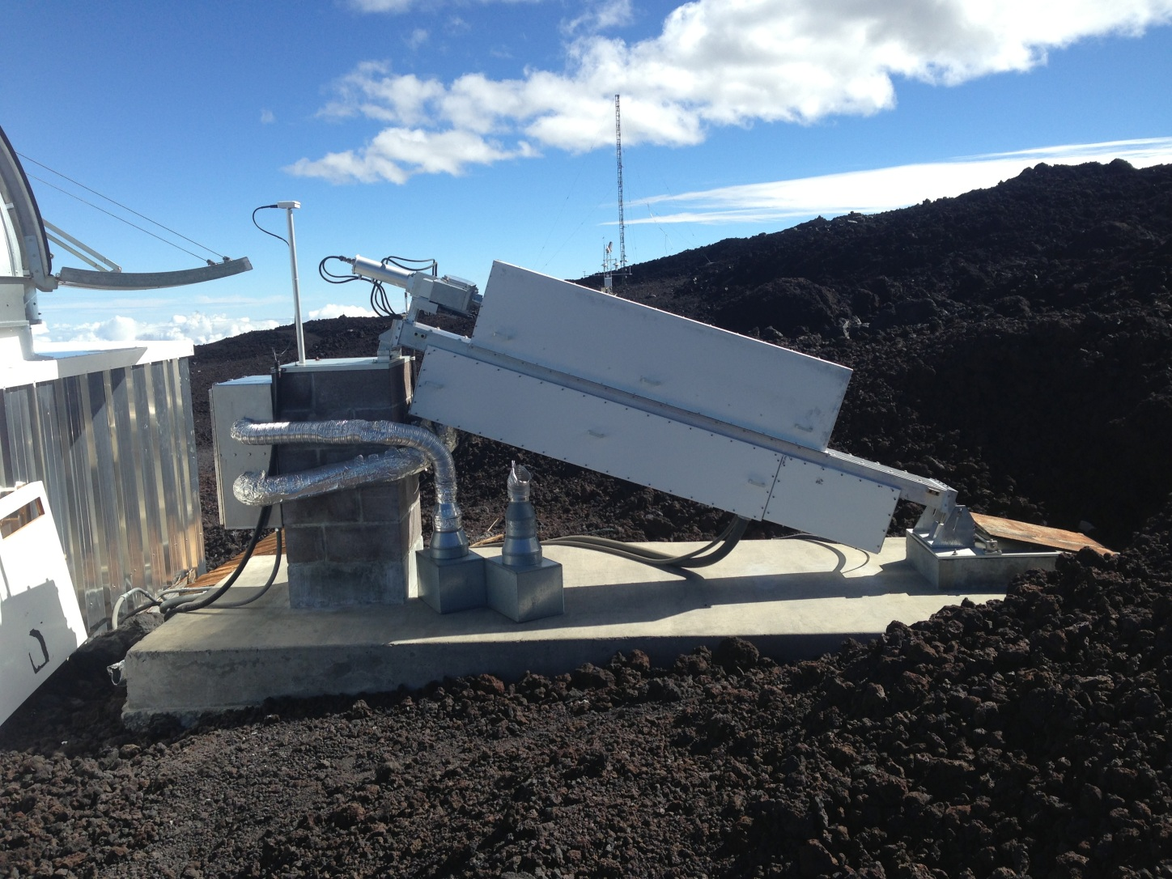
Low-L Pointing Platform at MLSO
Low-L was decommissioned many years ago. Infrastructure includes a solar-pointing system atop a concrete pad behind MLSO. Is anyone in community interested in using the platform? Proposed instruments need to comparable size to Low-L to avoid conflicts with MLSO instruments. No refridgerants are allowed at the site (NOAA rule).

