Slide 1
KSO 2nd Order Analysis and Thermal Verification
Andrew Carlile 2/24/2023

Slide 2
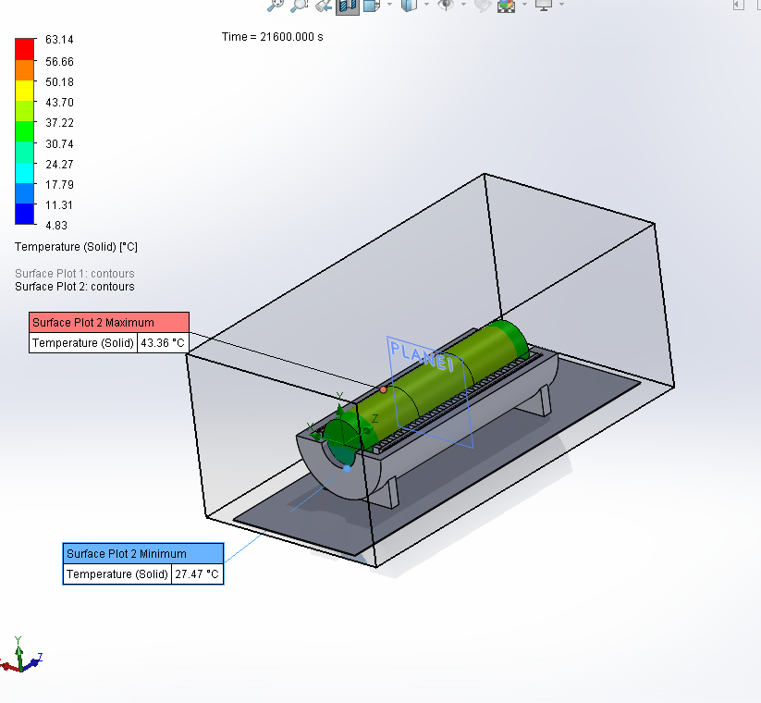
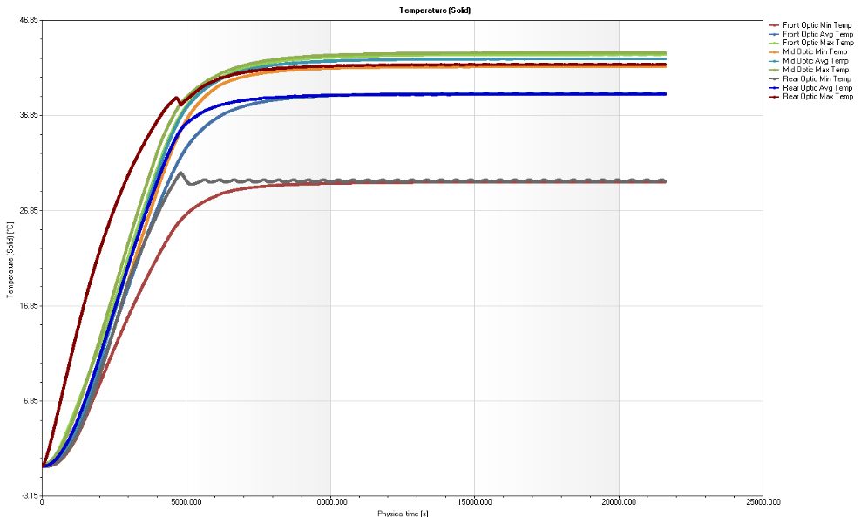
CFD Estimate 3 26 Watt Heaters
From 25 C to 35 C was tested in the lab without final air tight assembly.
2400 seconds (40 minutes) for a 10 C increase in temperature and stabilization at approximately 35 C.

Slide 3
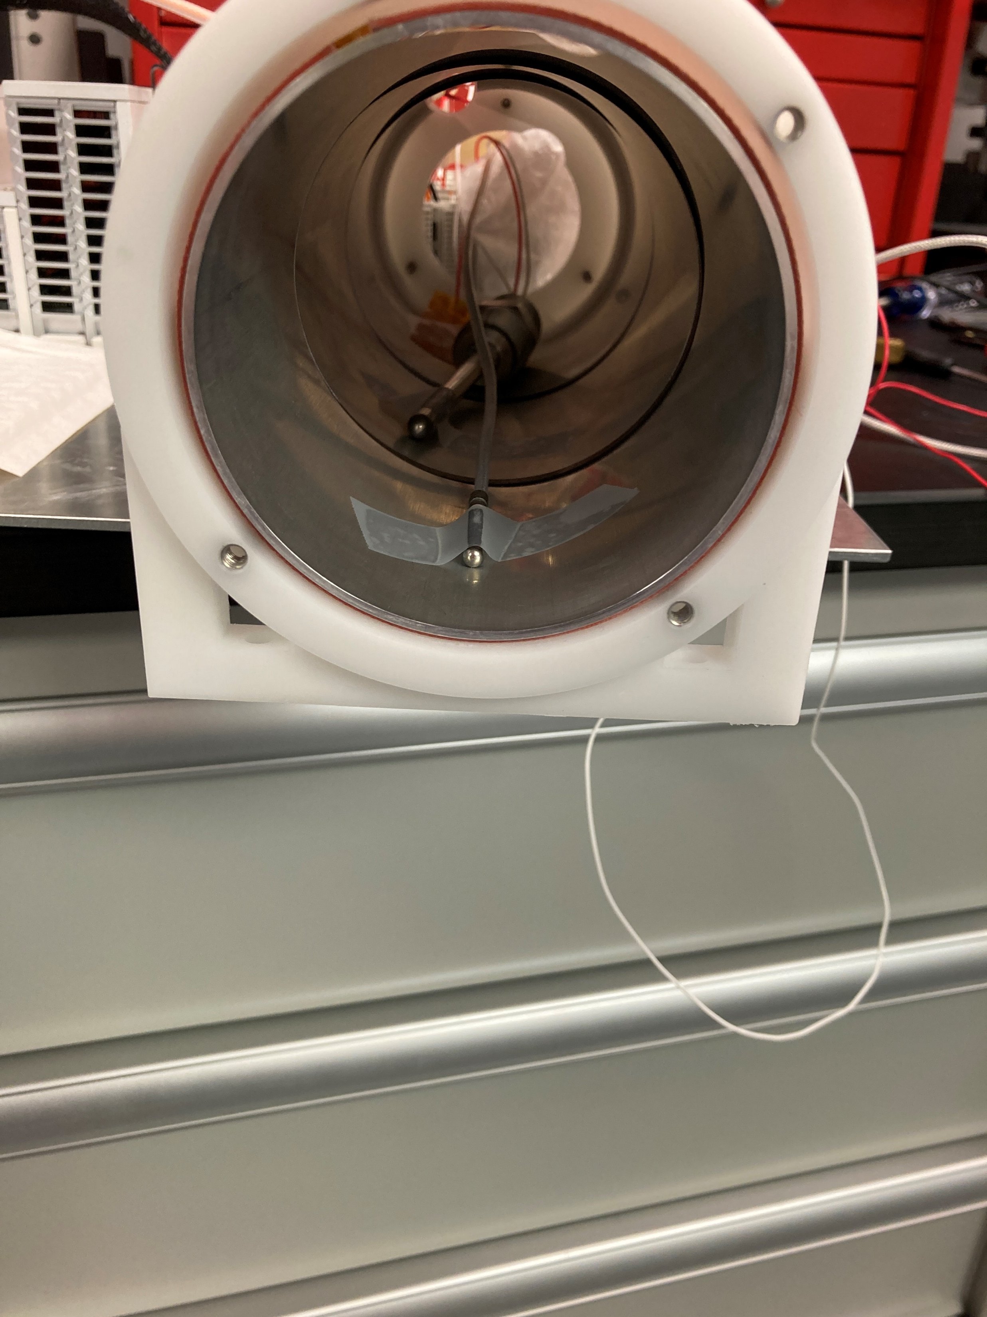
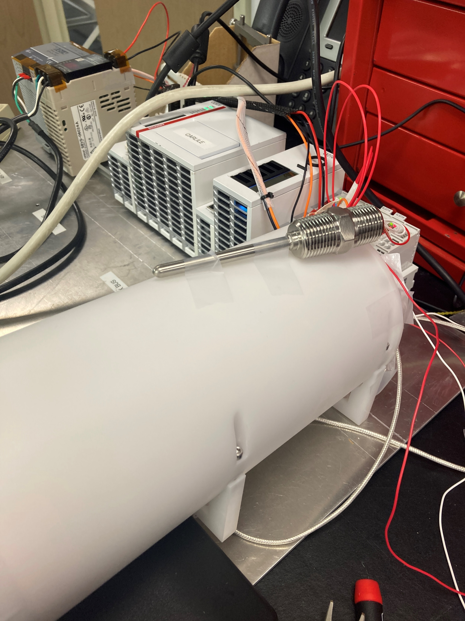
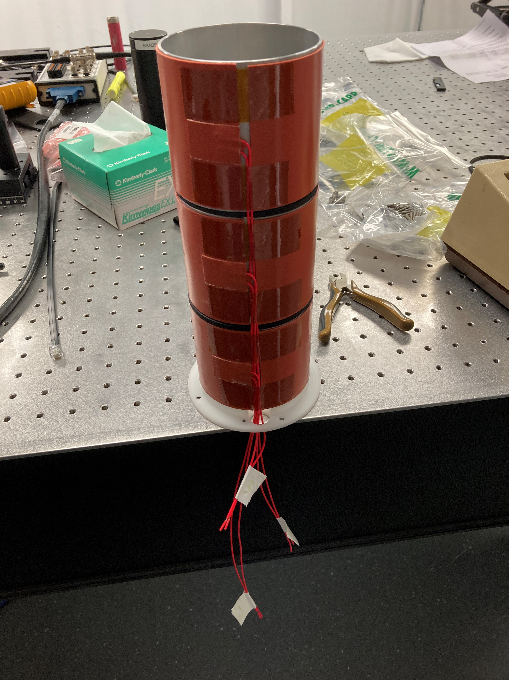
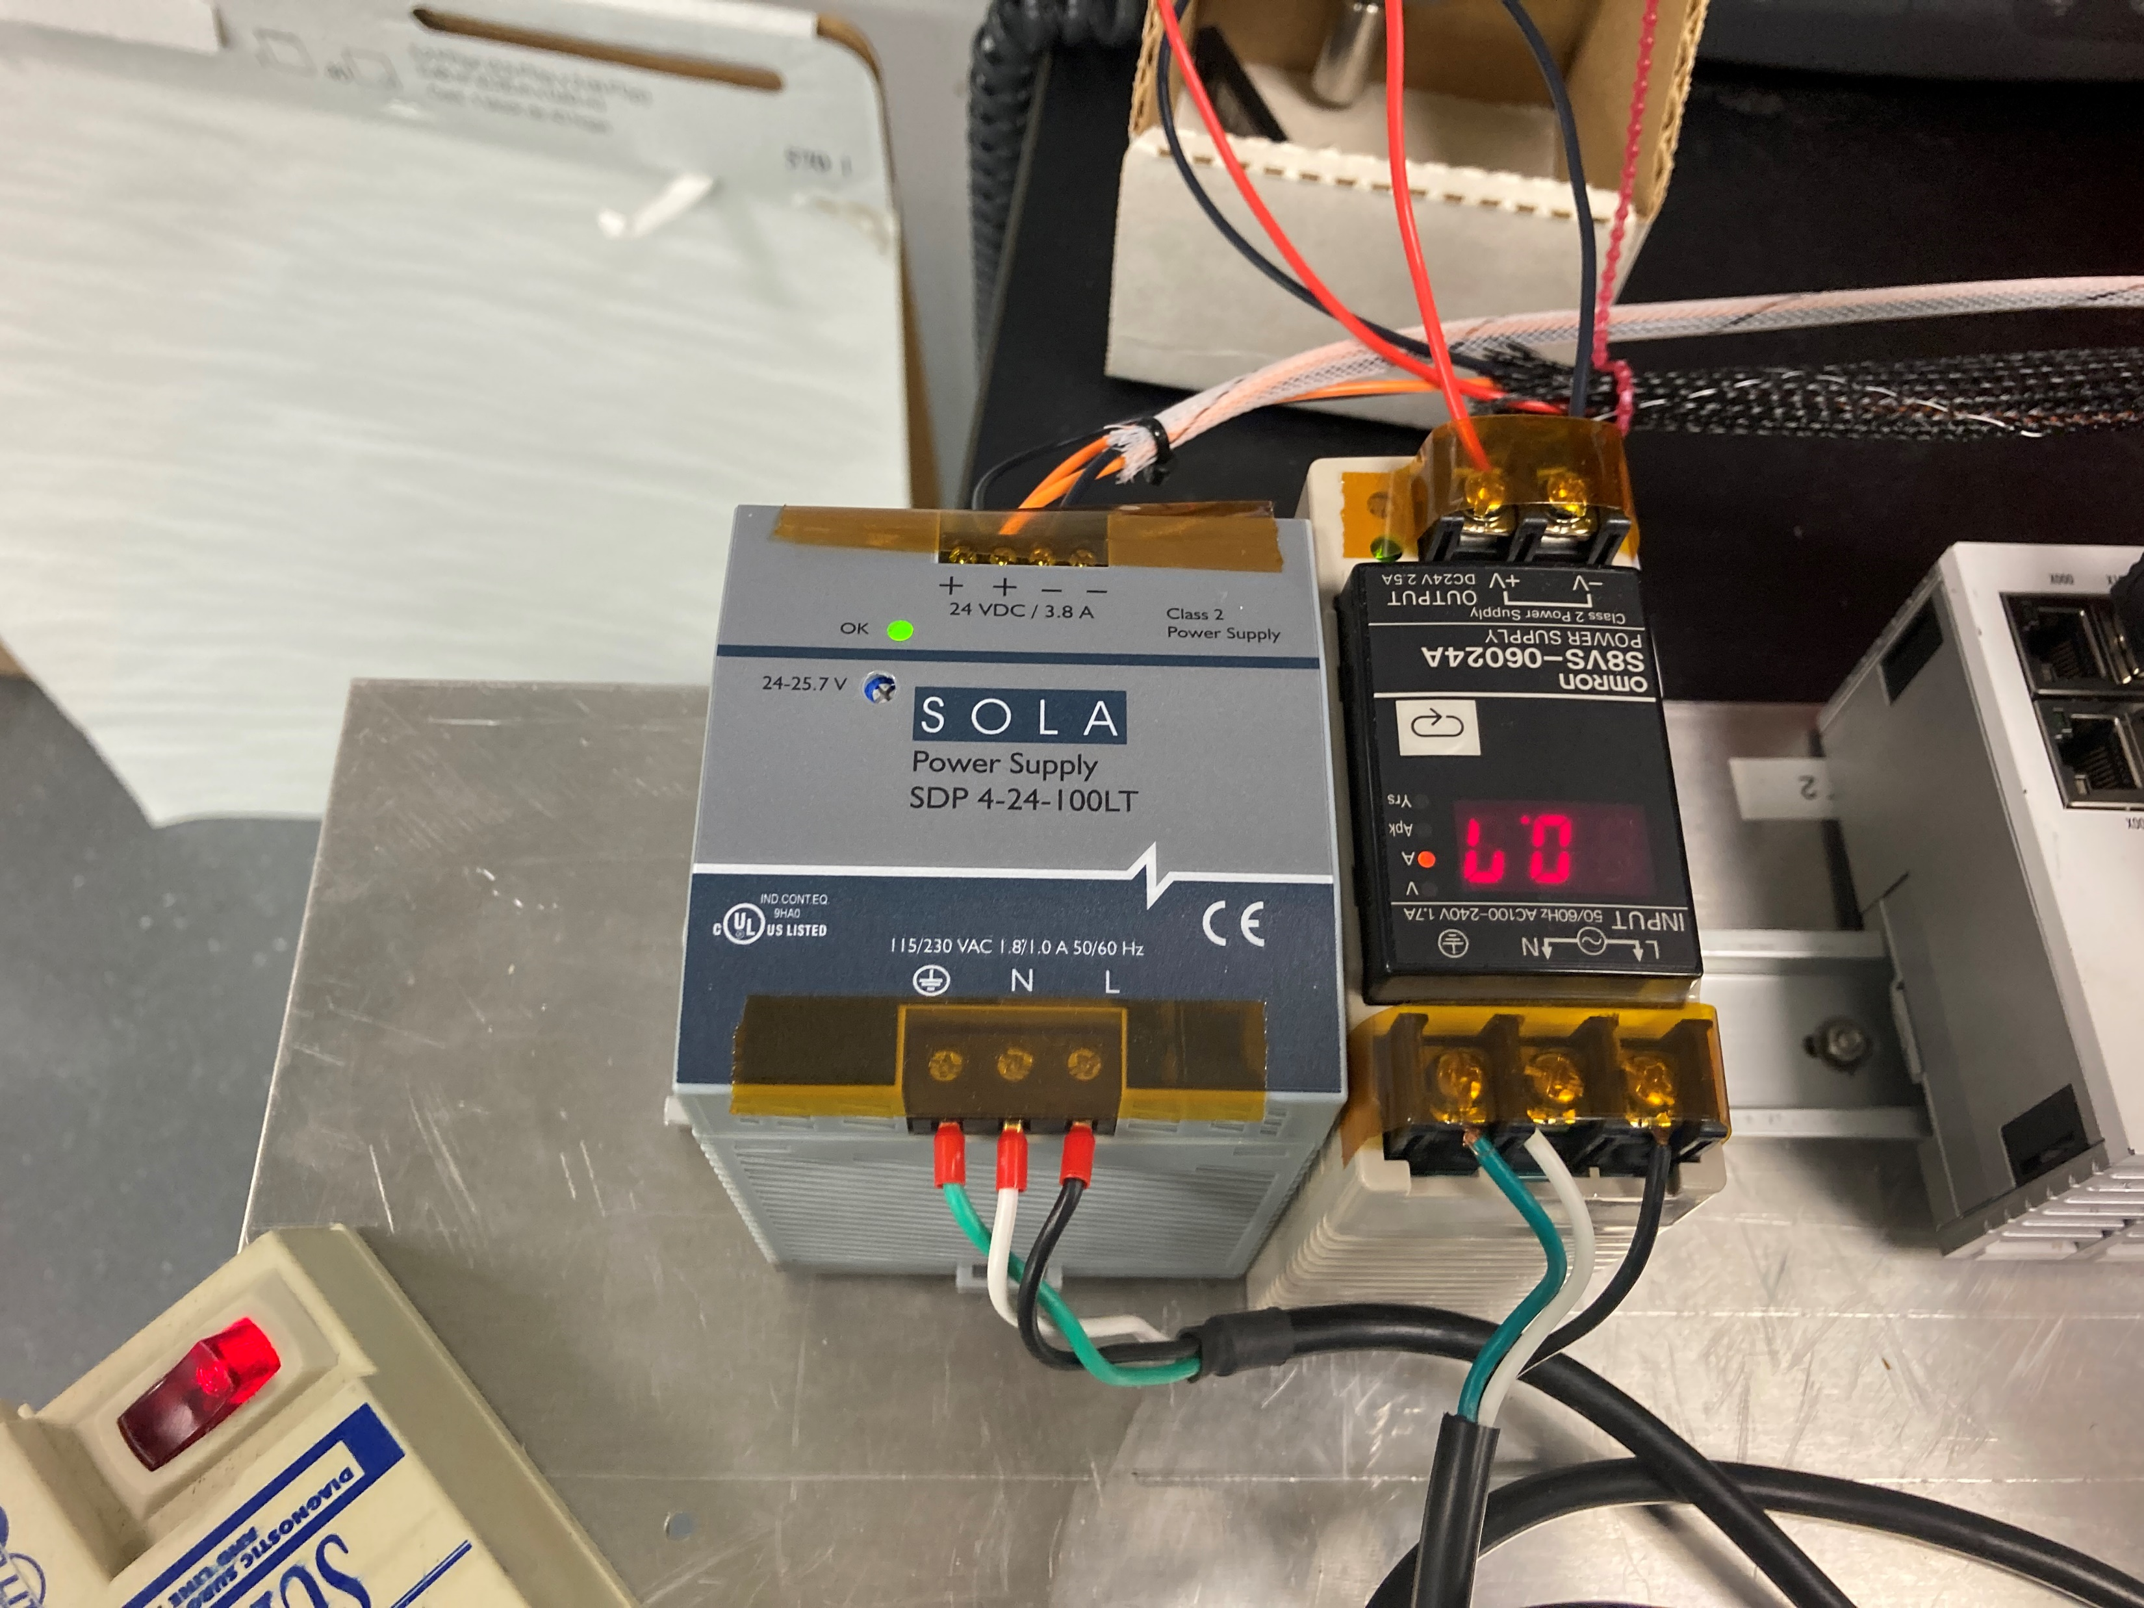
Setup: Untuned Beckhoff PID, Control System Spare parts, similar to ChroMag
Total power 75 Watts (but not just on heaters)
PID untuned, took guess at values
Ambient temperature sensor is on the exterior to find the difference between the internal and external temperature
Log files generated by Beckhoff system
(90% of the code was copied from previous projects)
Not airtight, and only the heater parts shown with reflectix to cover the holes
Zone 2 is just on/off, I didn’t have another PWM module so it will be worse and stay too hot (full 20 Watts when it turns on)

Slide 4
Anticipated Results
Only setting a goal of 35 C, don’t want to stress the system or wear out the heaters especially because room temperature air can easily get into the sleave at this time
Will show the heaters work, and that the Delrin and sleave are very good insulators
Easily hold withing a few degrees with an untuned system running copied code with open holes in the heater sleave, and essentially no mass to help hold a temperature
Confidence builder for the final system

Slide 5
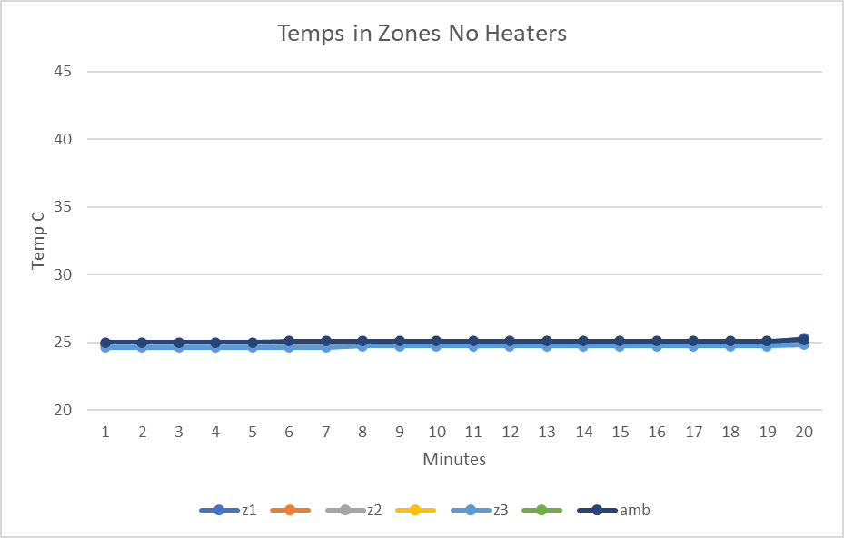
No Heaters Enabled Test, Initial Temps in Each Zone
Z1 is the rear, closest to control system, Z2 is the middle zone, Z3 is the front, and the reflectix filled that hole better

Slide 6
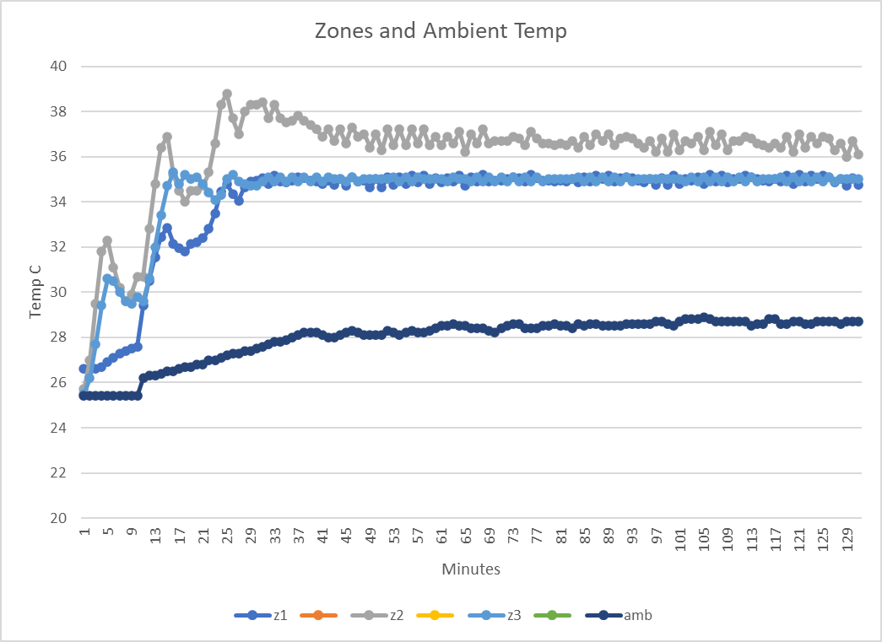
Heaters Enabled Test, Untuned, Barely Covered Holes, Small Mass
Notes:
Z1 is the rear, closest to control system, Z2 is the middle zone, Z3 is the front, and the reflectix filled that hole better
I originally set the goal temp of 30 C because I didn’t know how the system would react. Then I got confidence and moved to 35 C.
The system could be much better if I tuned it, but I don’t want to spend the time.

Slide 7
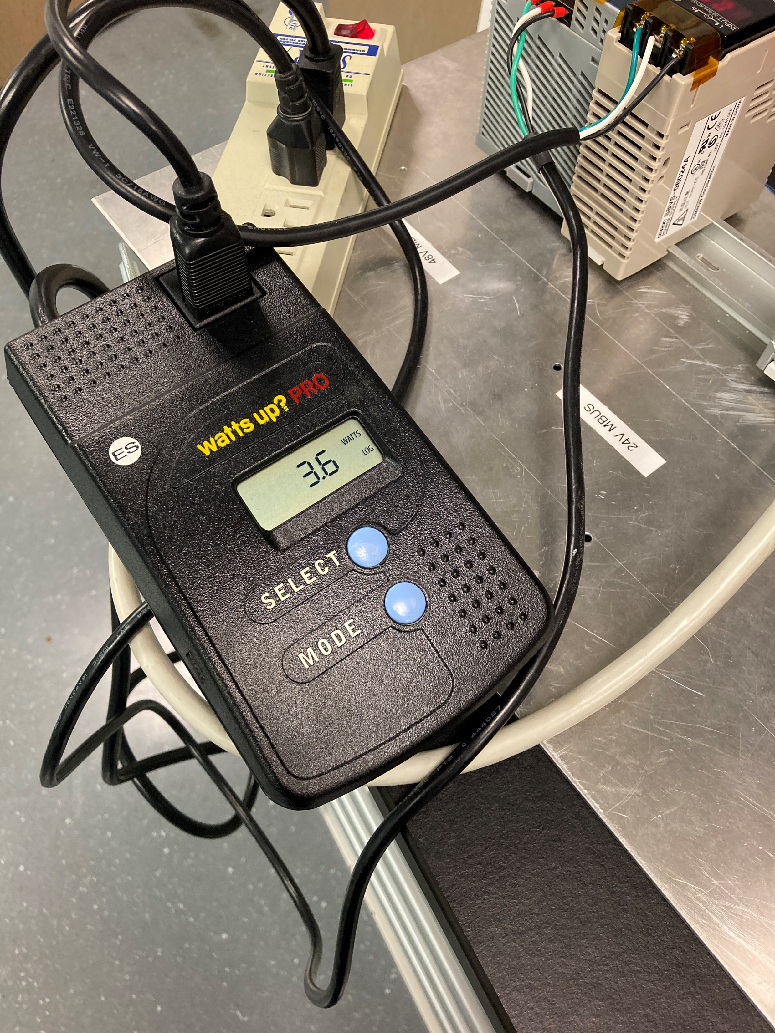
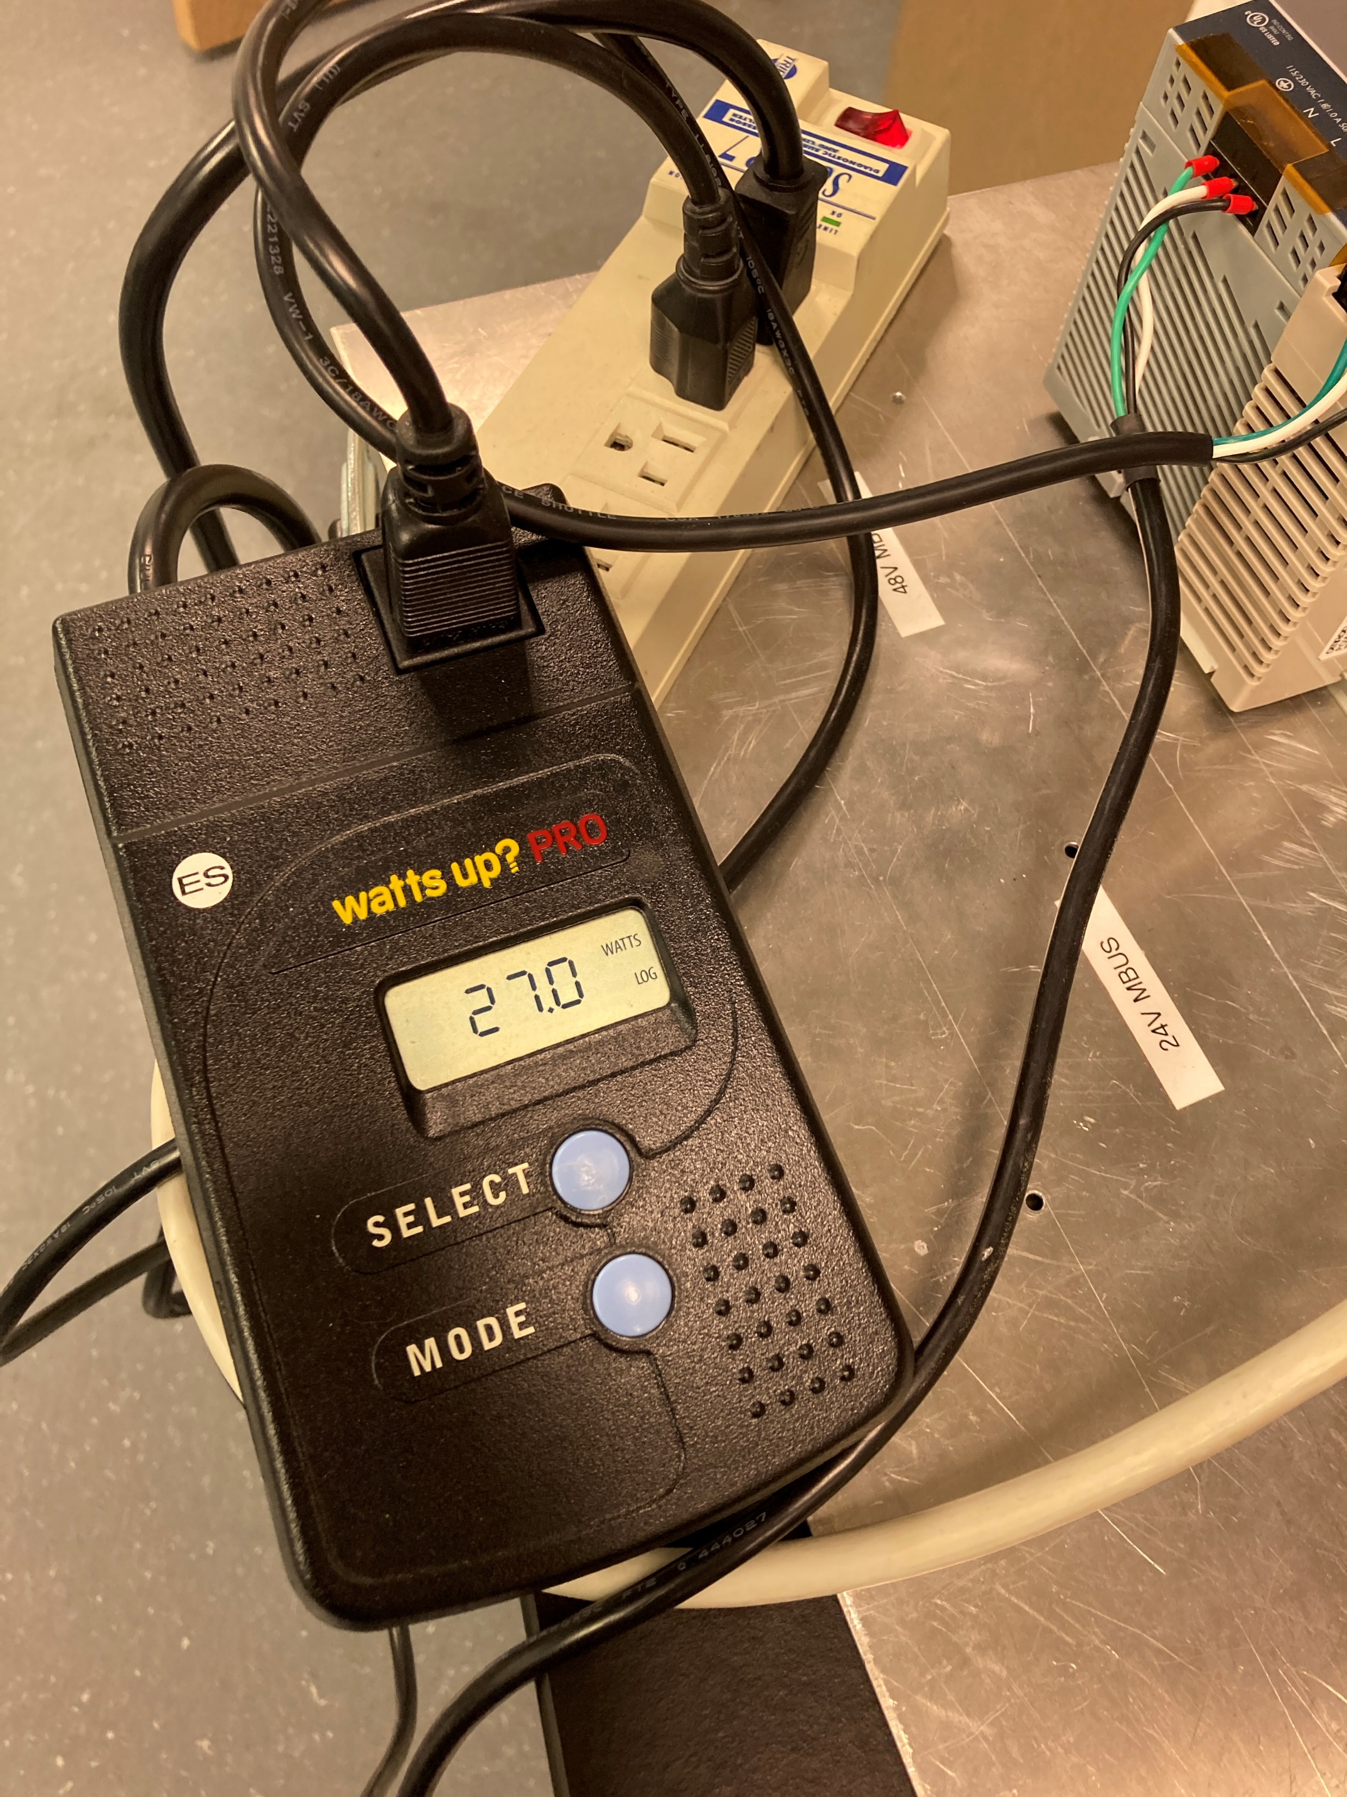
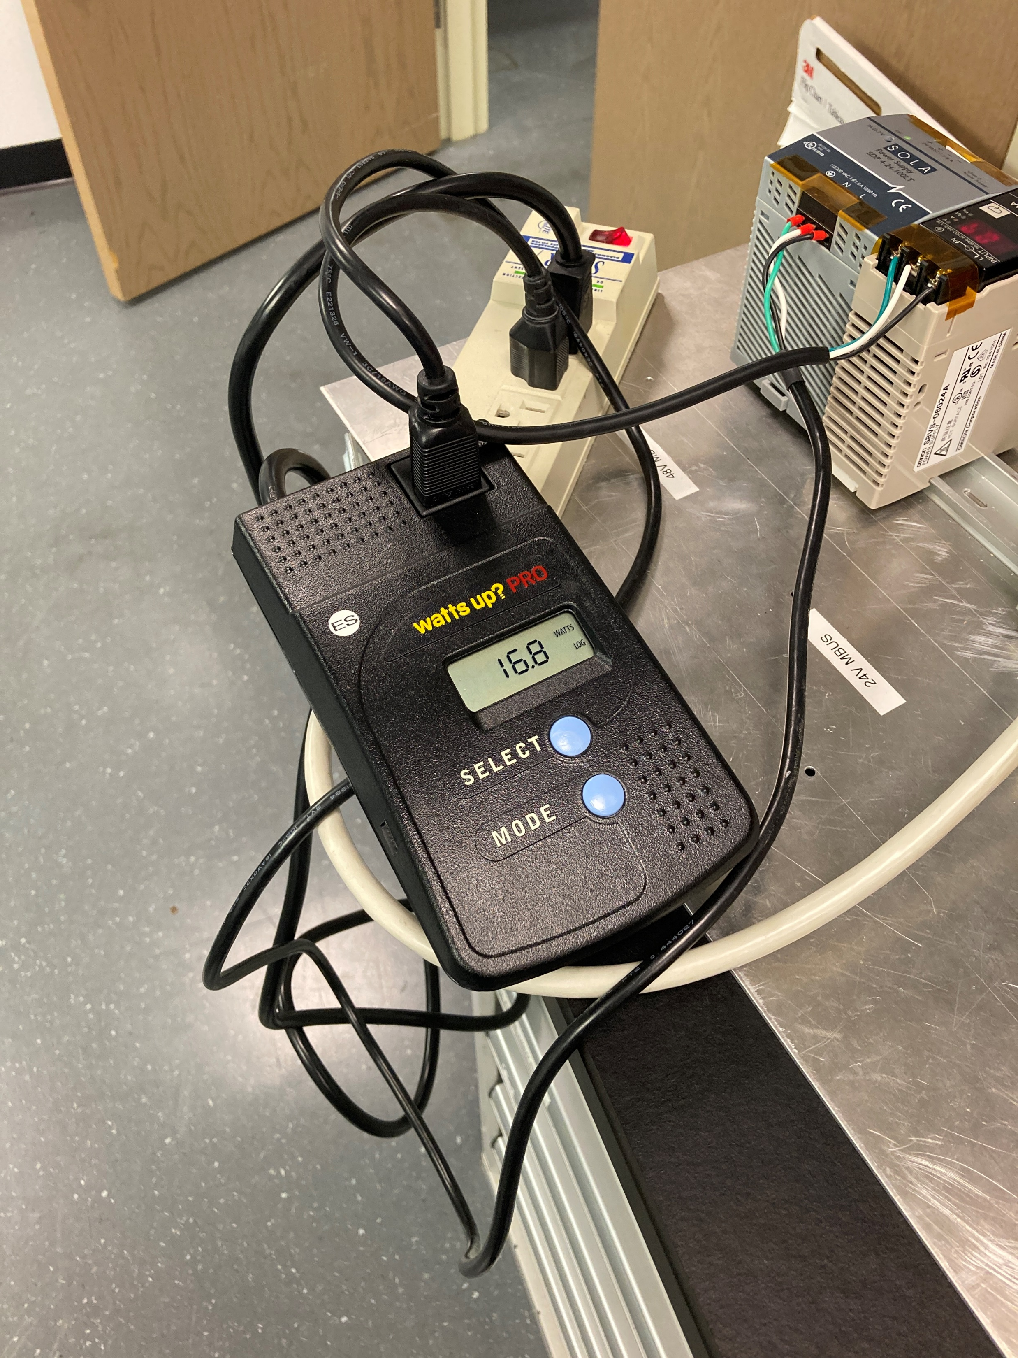
Wattages for IO Power Supply
No heaters = 3.6 Watts
Full heat = 27 Watts – 3.6 = 23.4 Watts
Stabilized = 16.8 – 3.6 = 13.2 Watts
No Heaters
Close to Max during Test
Close to stabile, zone 1 still very much on

Slide 8


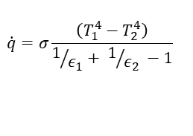
1st Order Analysis
$$\dot{q}=σ\frac{\left(T_{1}^{4}−T_{2}^{4}\right)}{1/{ε_{1}}+ 1/{ε_{2}} −1}$$
q rate 4.80E+00 Radiation Watts
q rate 7.08E+01 Conduction Watts
Filters will have some Wattage
Conduction is the primary way heat moves through the Lyot filter, attempts to isolate the flow from the baseplate are worth it
Convection and radiation are small but matter
Total Power from Convection, Conduction and Radiation 10.5 Watts for stable situation
q 3.15 Convection Watts

Slide 9
Conclusions vs Anticipated Results
Only setting a goal of 35 C – stayed close to the goal value after settling
Will show the heaters work, and that the Delrin and sleave are very good insulators - confirmed
Confidence builder for the final system – confident in the heaters and insulation strategy
Wattage for temperature increase maxed at 27 Watts, pointing to the system being able to settle faster than the analysis, but close
Stabilized Wattage approximately 13.2 Watts, with PS efficiency approximately 11.8 Watts
Anticipated 10.5 Watts in the sleave
  Anticipated was calculated with a larger temperature difference, but much better insulation to convection as the test setup for this experiment was effectively open
Settled in 35 minutes, from CFD and hand calculations we anticipated 40 minutes, but the room is warm and the chart measurement is an approximation.
Highly confident in thermal analysis, mechanical design, and heaters.

