Slide 1
Main Poker Chip Optimization, Top Level Thermal Analysis
Andrew Carlile 11-9-21

Slide 2
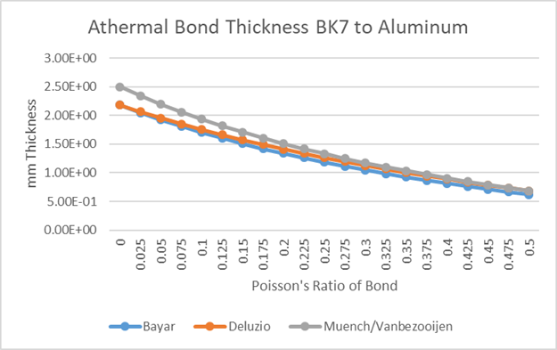
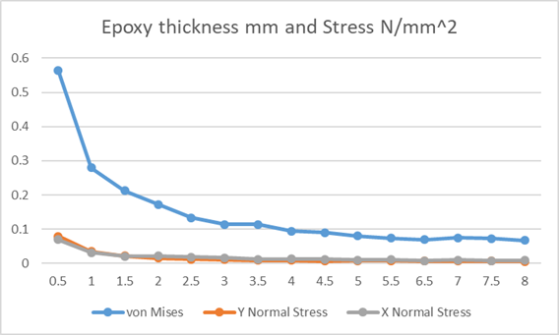
¼ and ½ Waveplates and Linear Polarizer Poker Chip
Optics are all 2” by 13 mm, main material is BK7
KSO results very similar to result from spring report on not quite right dimensions, as well as athermal adhesive thickness
Report had 0-50 C change, thinner optic, different outer poker chip dimension

Slide 3
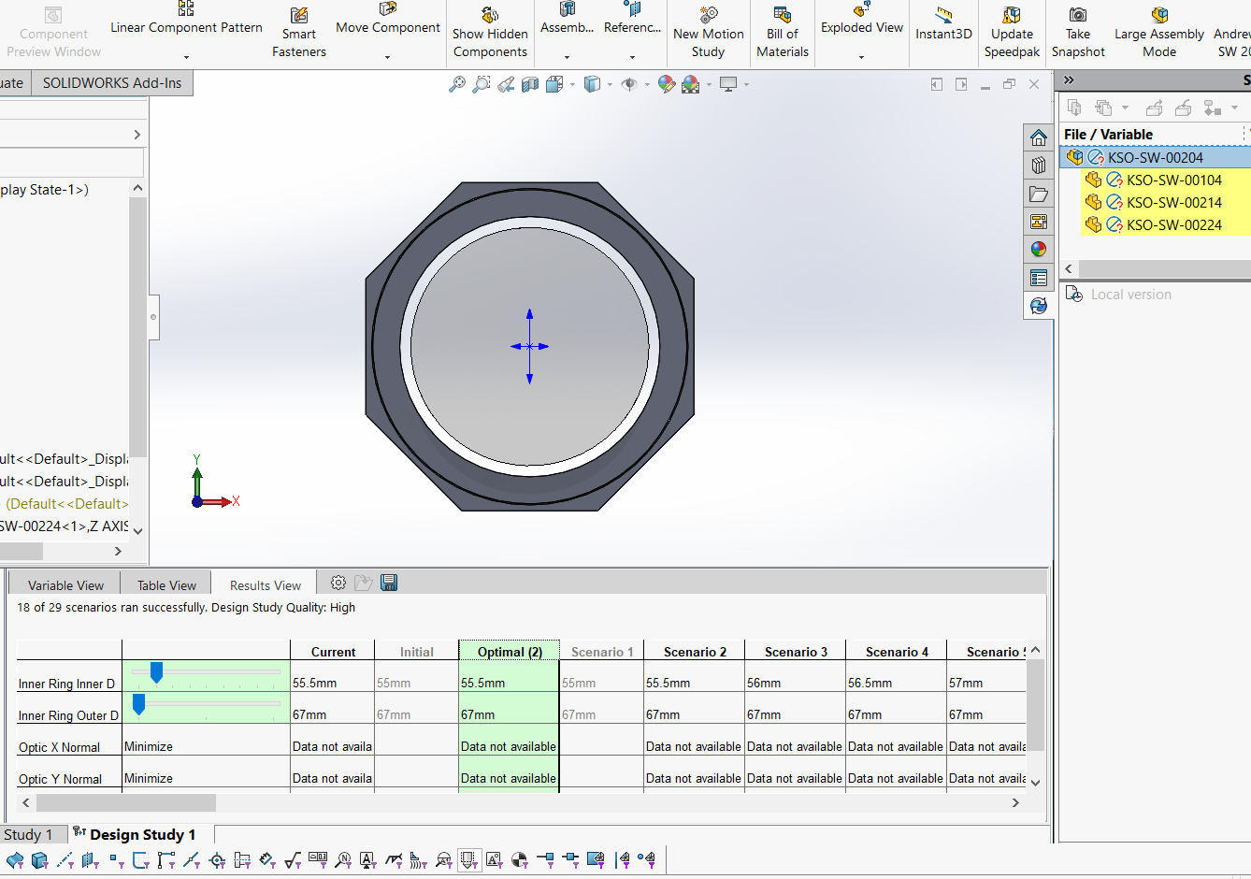
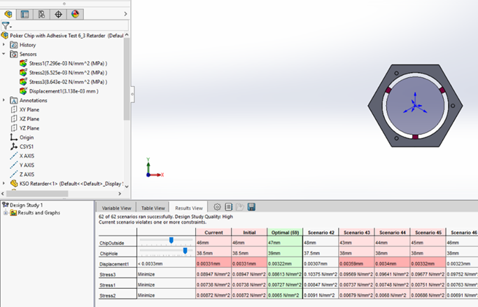
KSO 3 optic type mount
2.5 mm adhesive thickness, original diameters were different

Slide 4
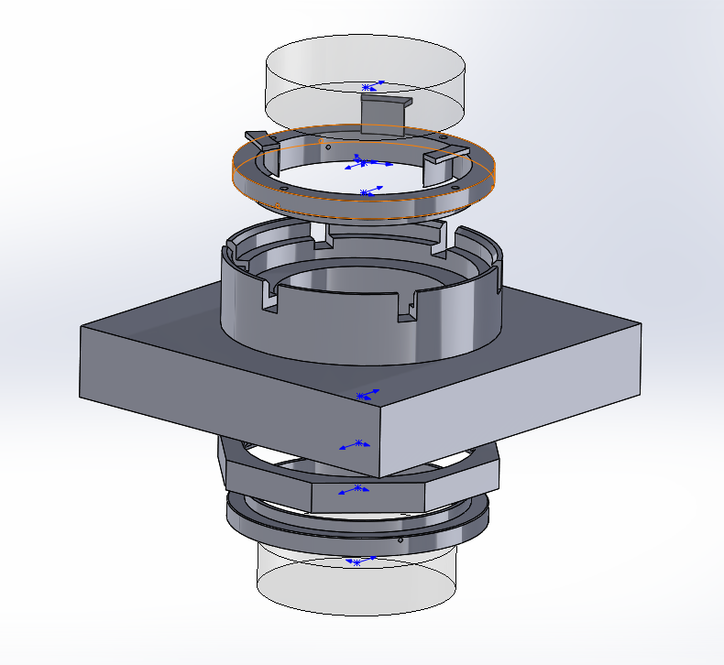
Assembly test of very close to 3 optic type, but test glass
Spaces to hold optic in inner ring
1 jig, 1 side does optic z displacement and adhesive thickness other side does octagonal chip onto inner ring

Slide 5
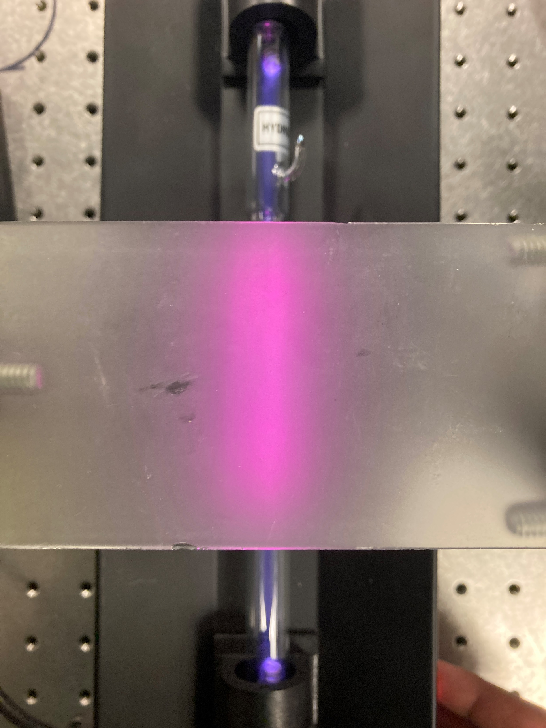
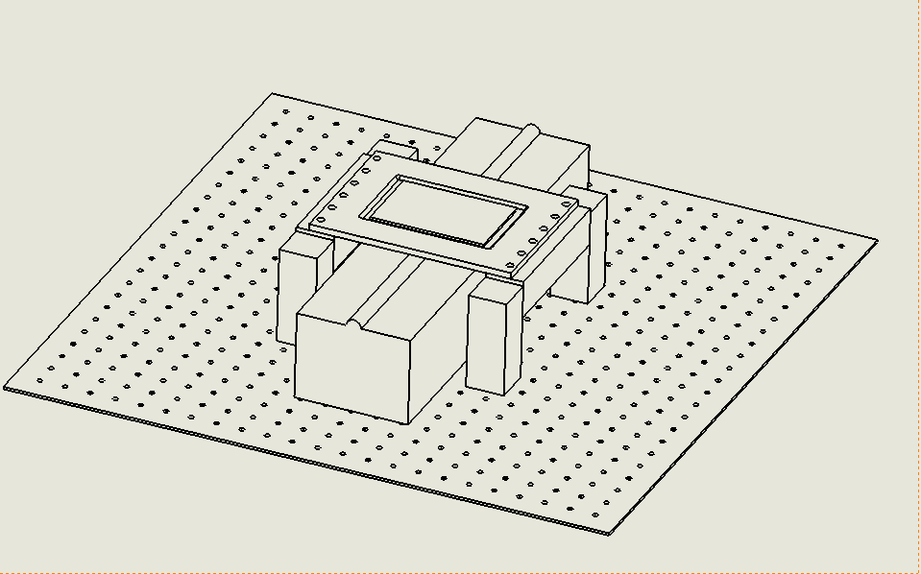
Diffuser Mount
Test with Pat went well, current system doesn’t work as it’s too cumbersome
Lower image is proposed plate with 80/20 extruded channel to hold it, we have lots of extra extrusion in CG1

Slide 6


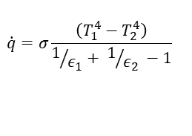
1st Order Analysis
$$\dot{q}=σ\frac{\left(T_{1}^{4}−T_{2}^{4}\right)}{1/{ε_{1}}+ 1/{ε_{2}} −1}$$
q rate 4.80E+00 Radiation Watts
q rate 7.08E+01 Conduction Watts
Filters will have some Wattage
Conduction is the primary way heat moves through the Lyot filter, attempts to isolate the flow from the baseplate are worth it
Convection and radiation are small but matter
q 3.15 Convection Watts

Slide 7
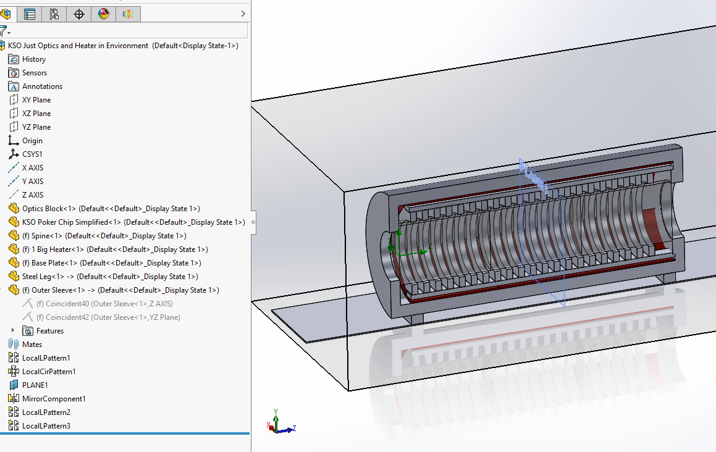
KSO Top Level Thermal Models
Simplified model, optics as 3 big chunks of glass
Adhesive is a feature as contact resistance (not modeled)
Thick Delrin no reflectix, effect will be similar
Heater logic only tied to 1 goal variable related to optic temperature
Environment at 0 C system attempting to keep the goal optic temperature at 30 C

Slide 8
Purpose of Analysis
Confirm heater sizing estimate (expected to be able to overshoot and not take forever to get to operating temp)
Ability to stabilize
SolidWorks flow does not have PWM level control, and only 1 goal per heater. (similar to ChroMag, 1 sensor 1 heater for Lyot, baseplate on a different control loop)
For KSO, we can have multiple sensors tied into a given heaters control loop, so we should be able to comfortably control to absolute temperatures easier than the model can approximate
Relative comparisons between models are valid (general FEA/CFD rule)

Slide 9
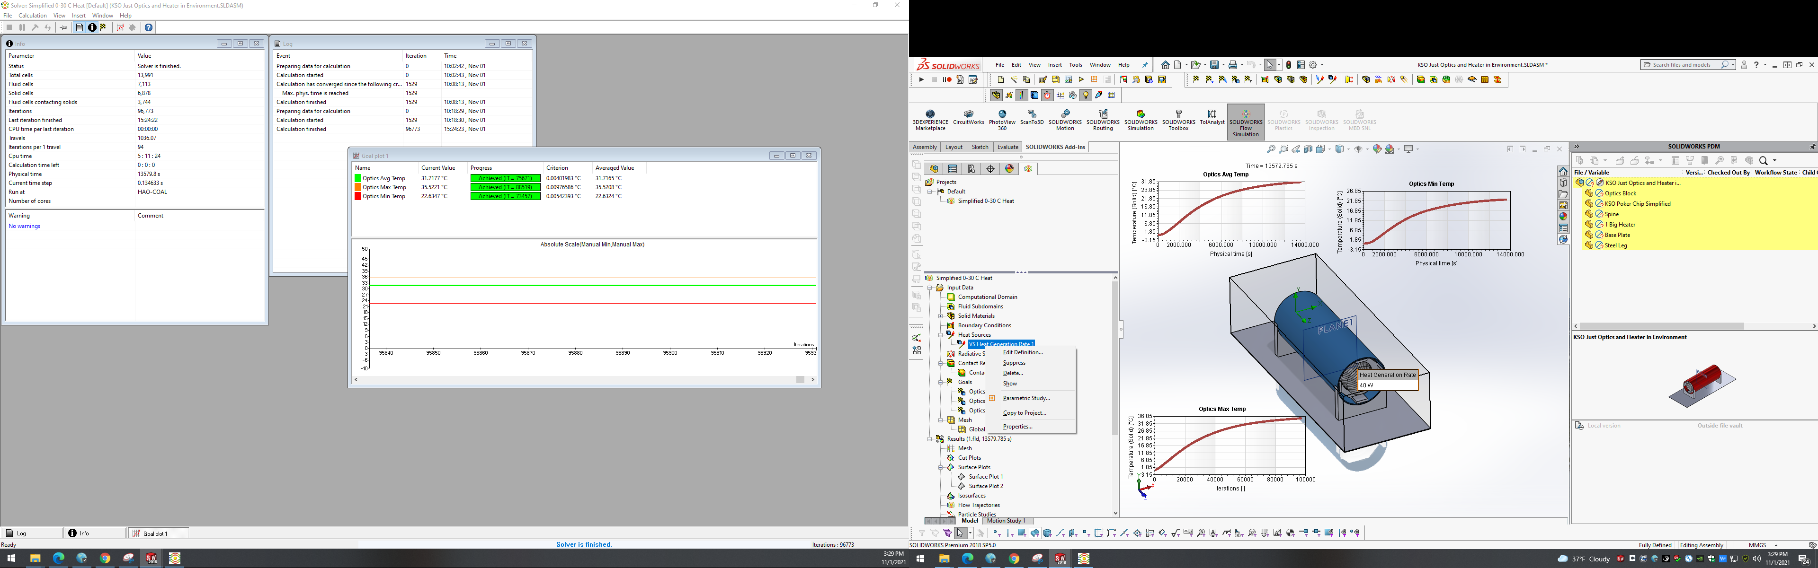
No Insulation, did not work
Never got up to temp with 60 W heater, was also a test of the system running and not crashing, not super valid. However, if the 60 W with no insulation worked, then something was wrong

Slide 10
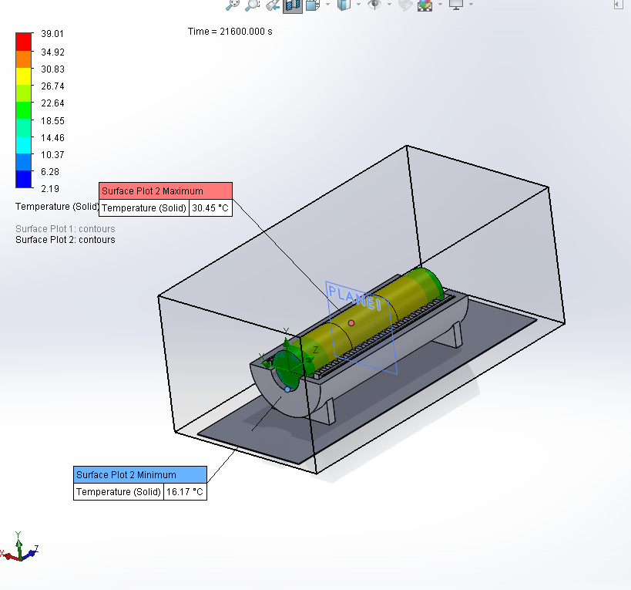
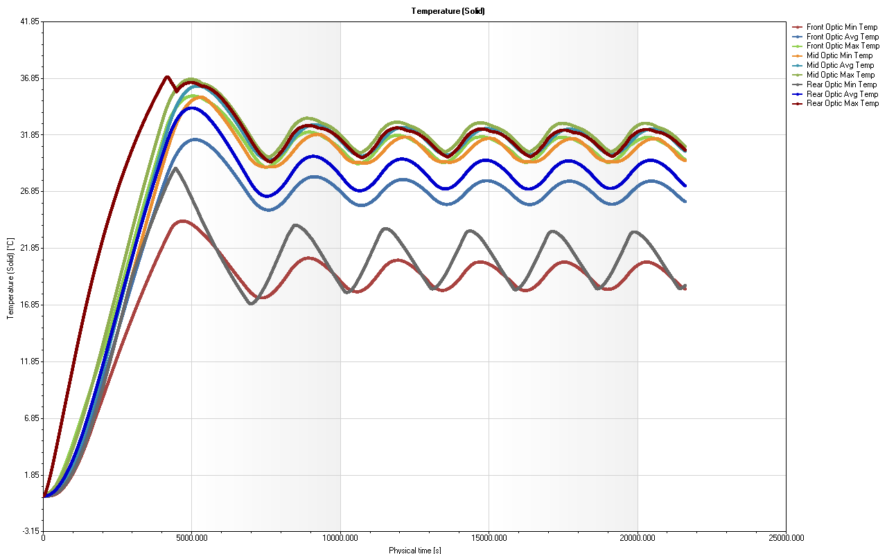
1 80 Watt heater

Slide 11
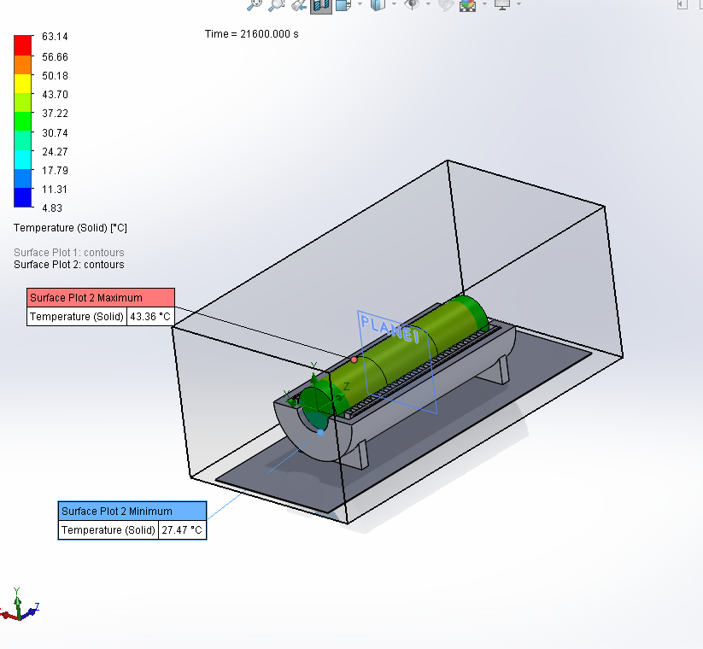
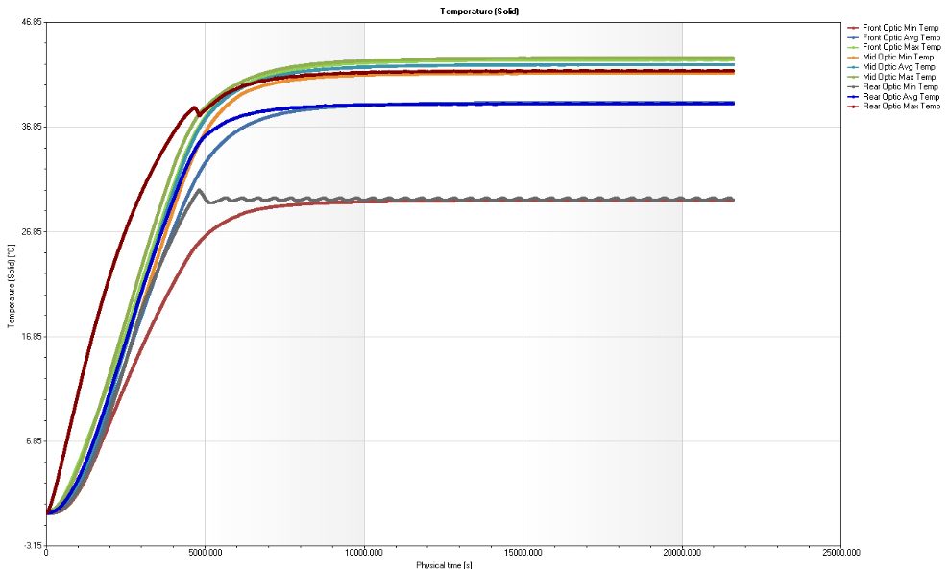
3 26 Watt Heaters

Slide 12
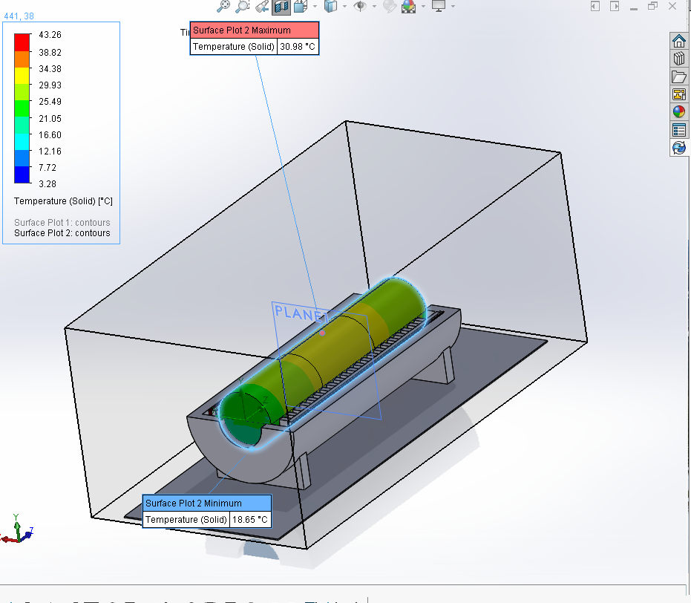
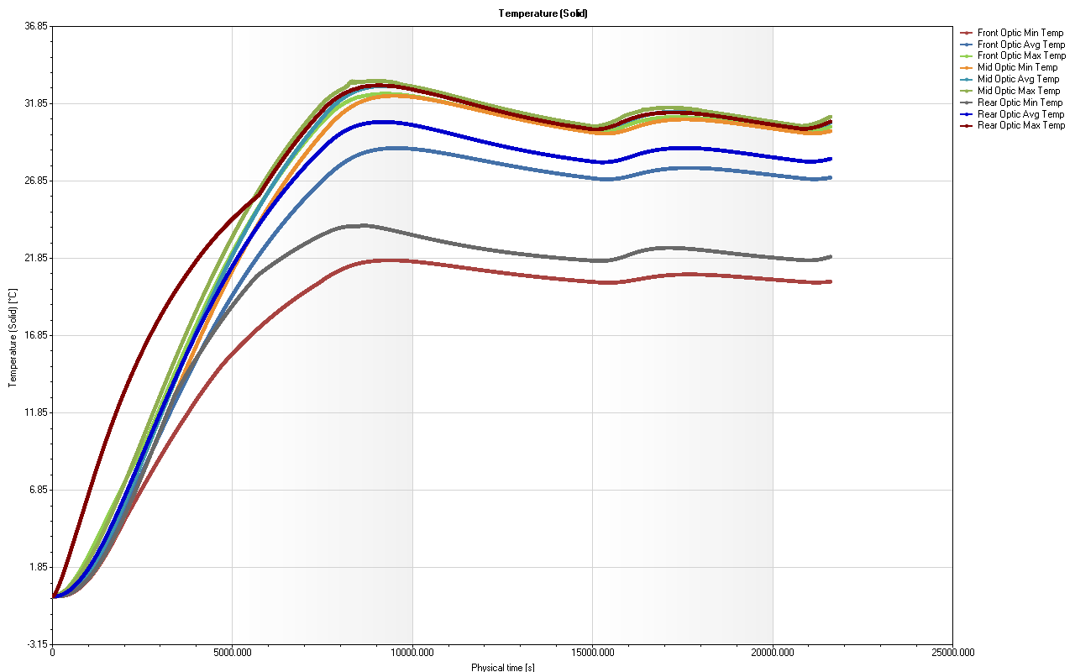
3 15 Watt Heaters

Slide 13
Conclusions
3 zone is much more stable, we need 3 sensors per heater to eliminate overshoot
Insulation seems to be sized about right, will integrate reflectix in similar manner to ChroMag
80 W total is about right for heater sizing
PWM control will help significantly
How long to get stable after a -10 C start (?)

Slide 14
Next Steps
Build test assembly
Build diffuser holder
Build 3 poker chip glass holders to test process
Finish top level design work from window to window (ignore filter holding sub-assembly for the time being)
Once those are complete, KSO design review

Slide 15
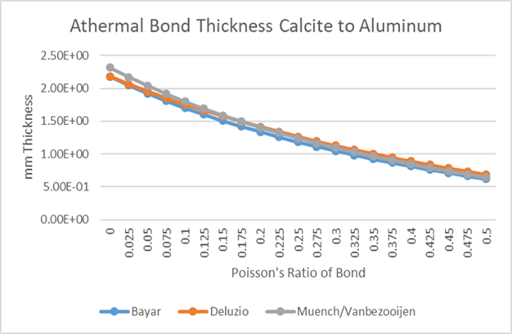
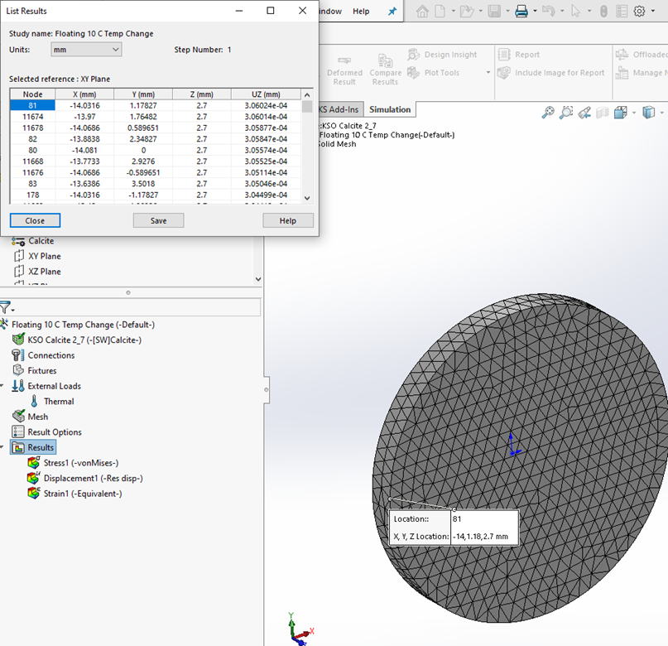
Simplified Calculations

Slide 16
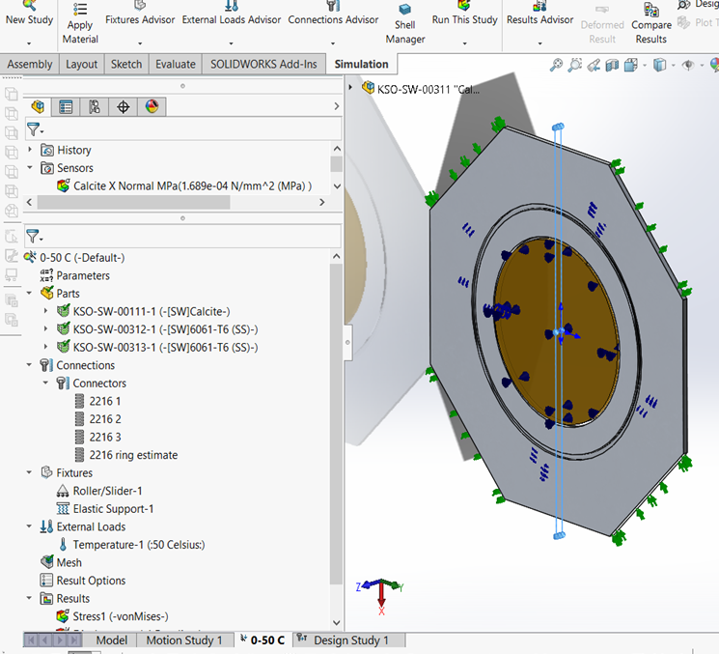
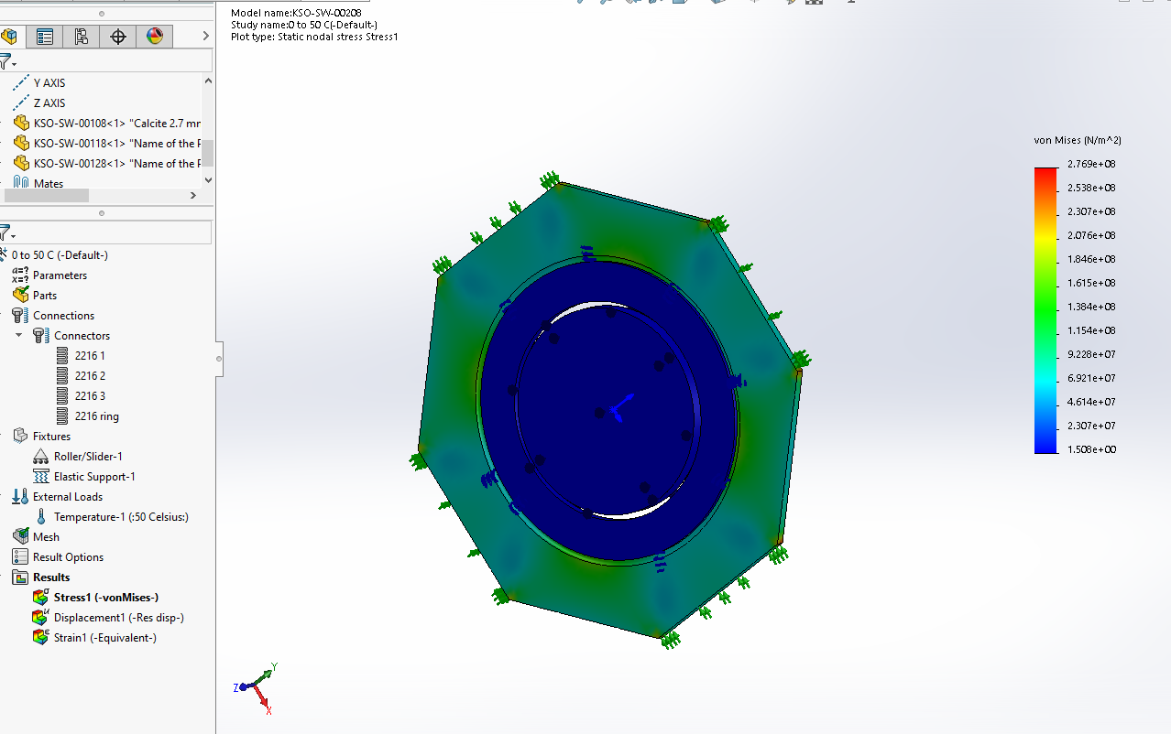
Poker Chip Optimization Setup
Setup of 1 FEA thermal/structural analysis from 0 C to 50 C with realistic loads and boundary conditions
Check against simplified calculations
Run a variety of model dimensions to minimize stresses and displacements

Slide 17
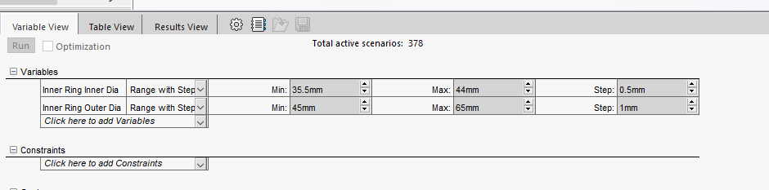
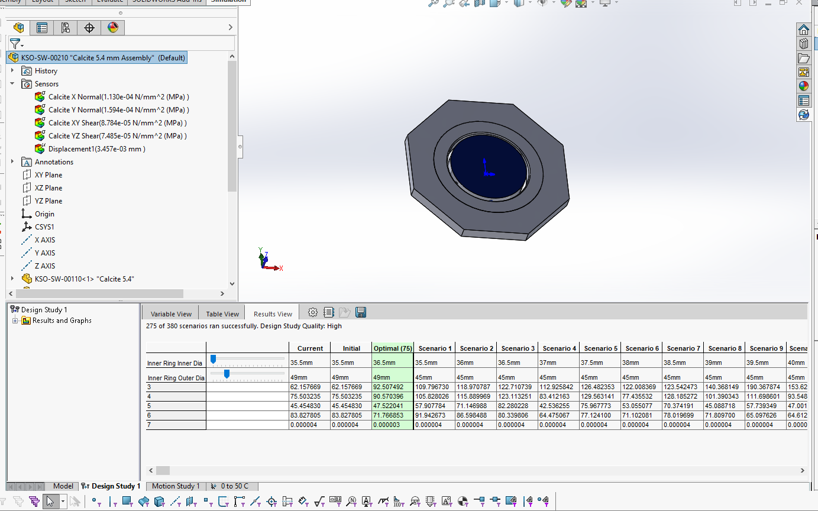
Optimization Ranges
Varying inner diameter, which sets the adhesive bondline thickness, should be close to athermal approx.
Outer diameter determines size of inner chip and octagonal part hole size

Slide 18
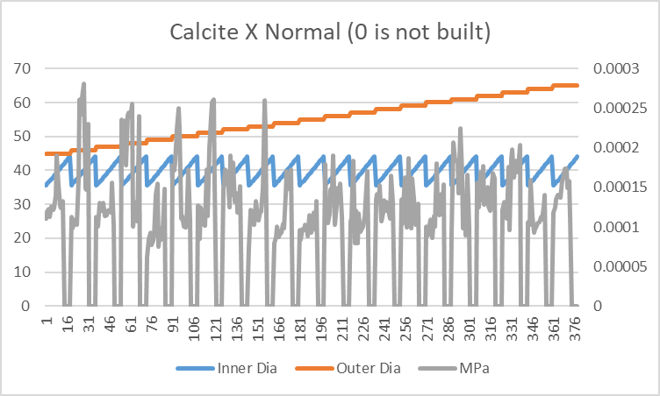
Understanding Results from Optimization Study of 5.4 mm thickness Calcite Assembly

Slide 19
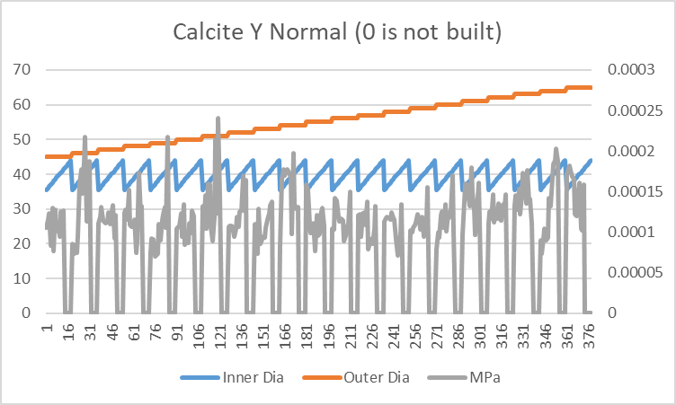
Understanding Results from Optimization Study of 5.4 mm thickness Calcite Assembly

Slide 20
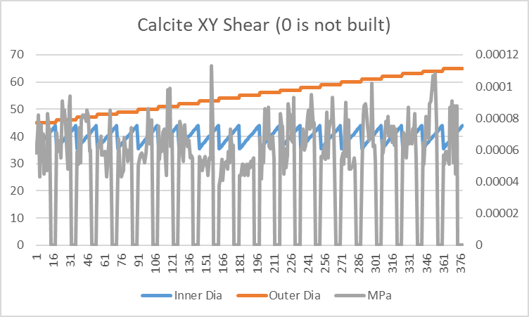
Understanding Results from Optimization Study of 5.4 mm thickness Calcite Assembly

Slide 21
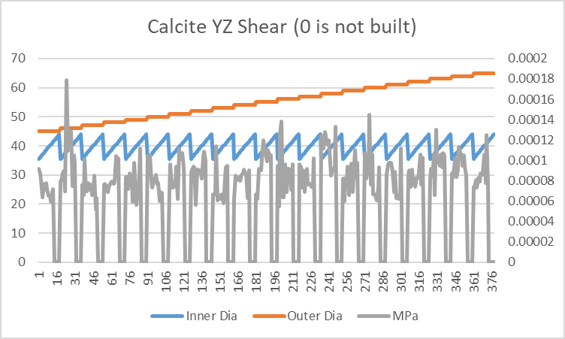
Understanding Results from Optimization Study of 5.4 mm thickness Calcite Assembly

Slide 22
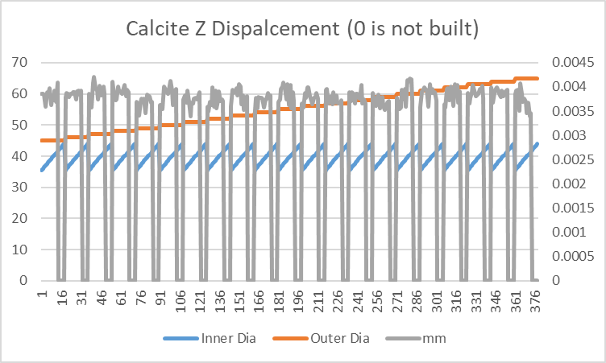
Understanding Results from Optimization Study of 5.4 mm thickness Calcite Assembly

Slide 23
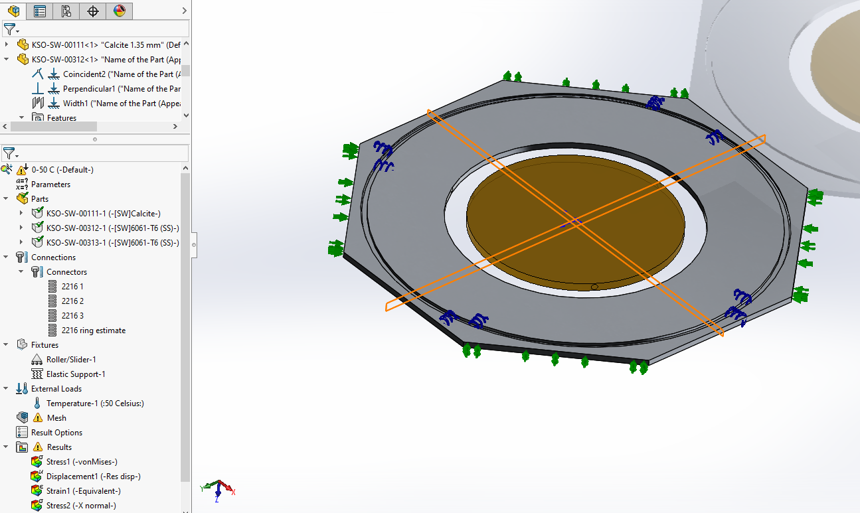
1.35 mm Calcite Optimization
Weird shape, matches athermal bondline thickness
Loaded into PDM

Slide 24
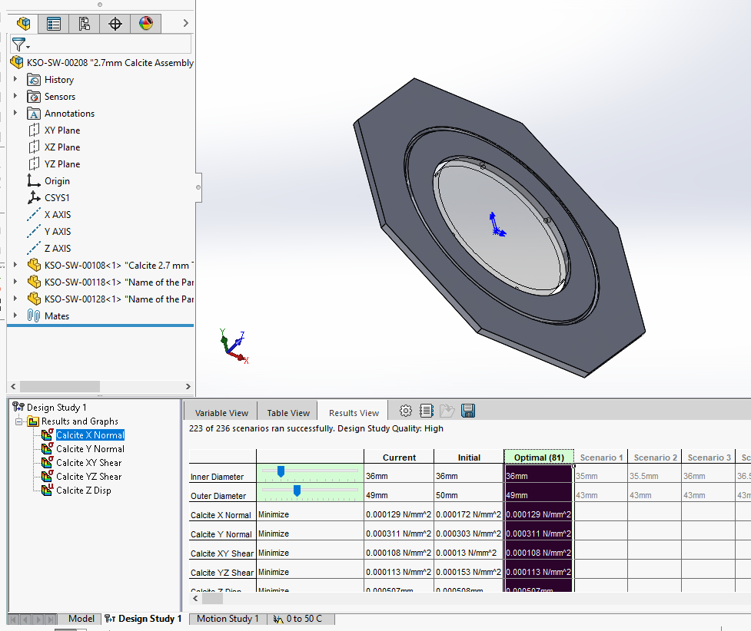
2.7 mm Calcite Optimization
Normal shape (compared to old Lyot filters)
Bondline thinner

Slide 25
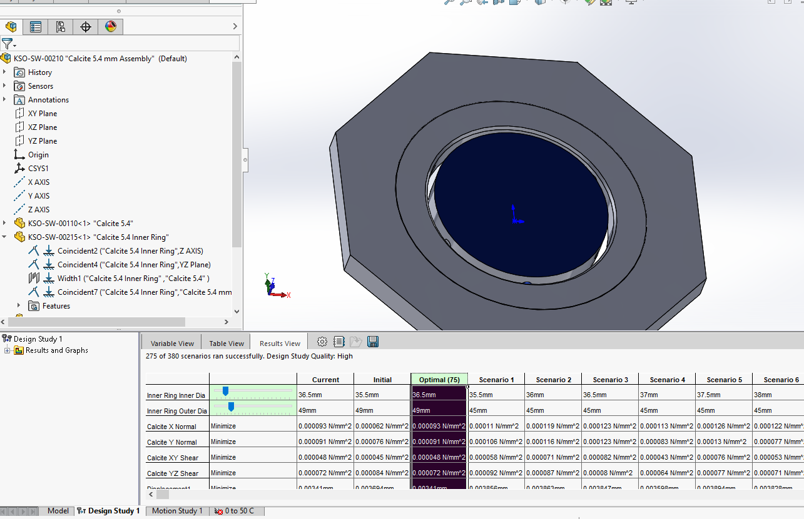
5.4 mm Calcite Optimization
Normal shape (compared to old Lyot filters)
Bondline close to theory

Slide 26
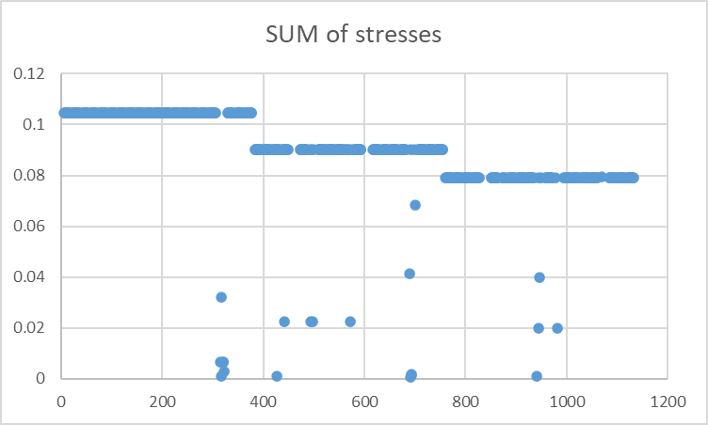
10.8 mm Calcite Optimization
Added adhesive patch size
Normal shape (compared to old Lyot filters)
Bondline close to theory
Model was less stable, excel to sort answer

Slide 27
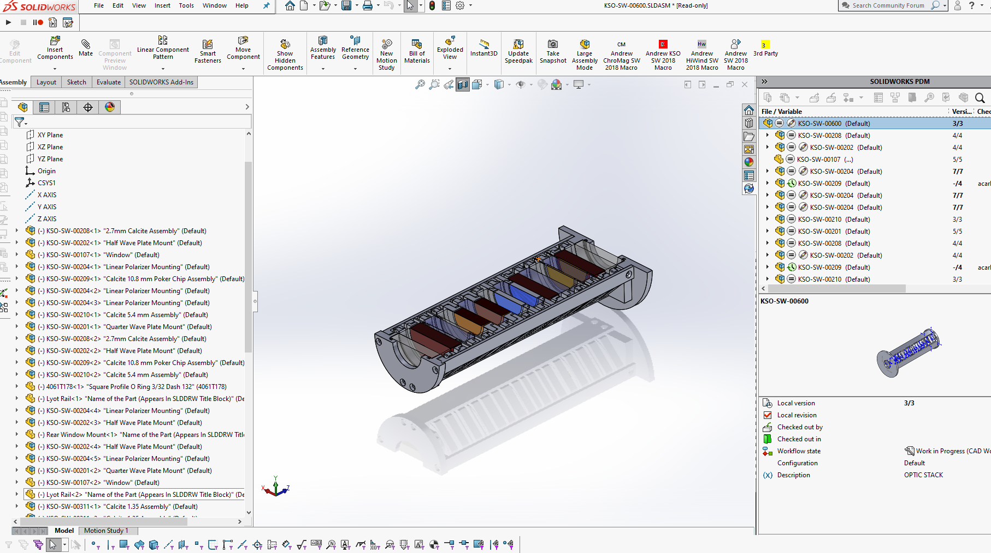
Optic Stack Updated

Slide 28
Next Steps
Finish drawings of Lyot optic stack and assembly procedure
Finish heater tube/mount controller
Drawings, procedure finalize
Meet with KSO, January 20, 2022?
Email Werner and offer package of drawings/analysis will arrive a bit early
Presenting, covering electrical, mechanical, con ops, leave question time
Ask Damon/Mitch as well
Steve’s gut says 30 C for prefilter, higher for main optic block, is good for goal temp

Slide 29
12/10/2021 Updates
Test assembly complete
Higher Goal Temp results
Simulation with front filter results

Slide 30
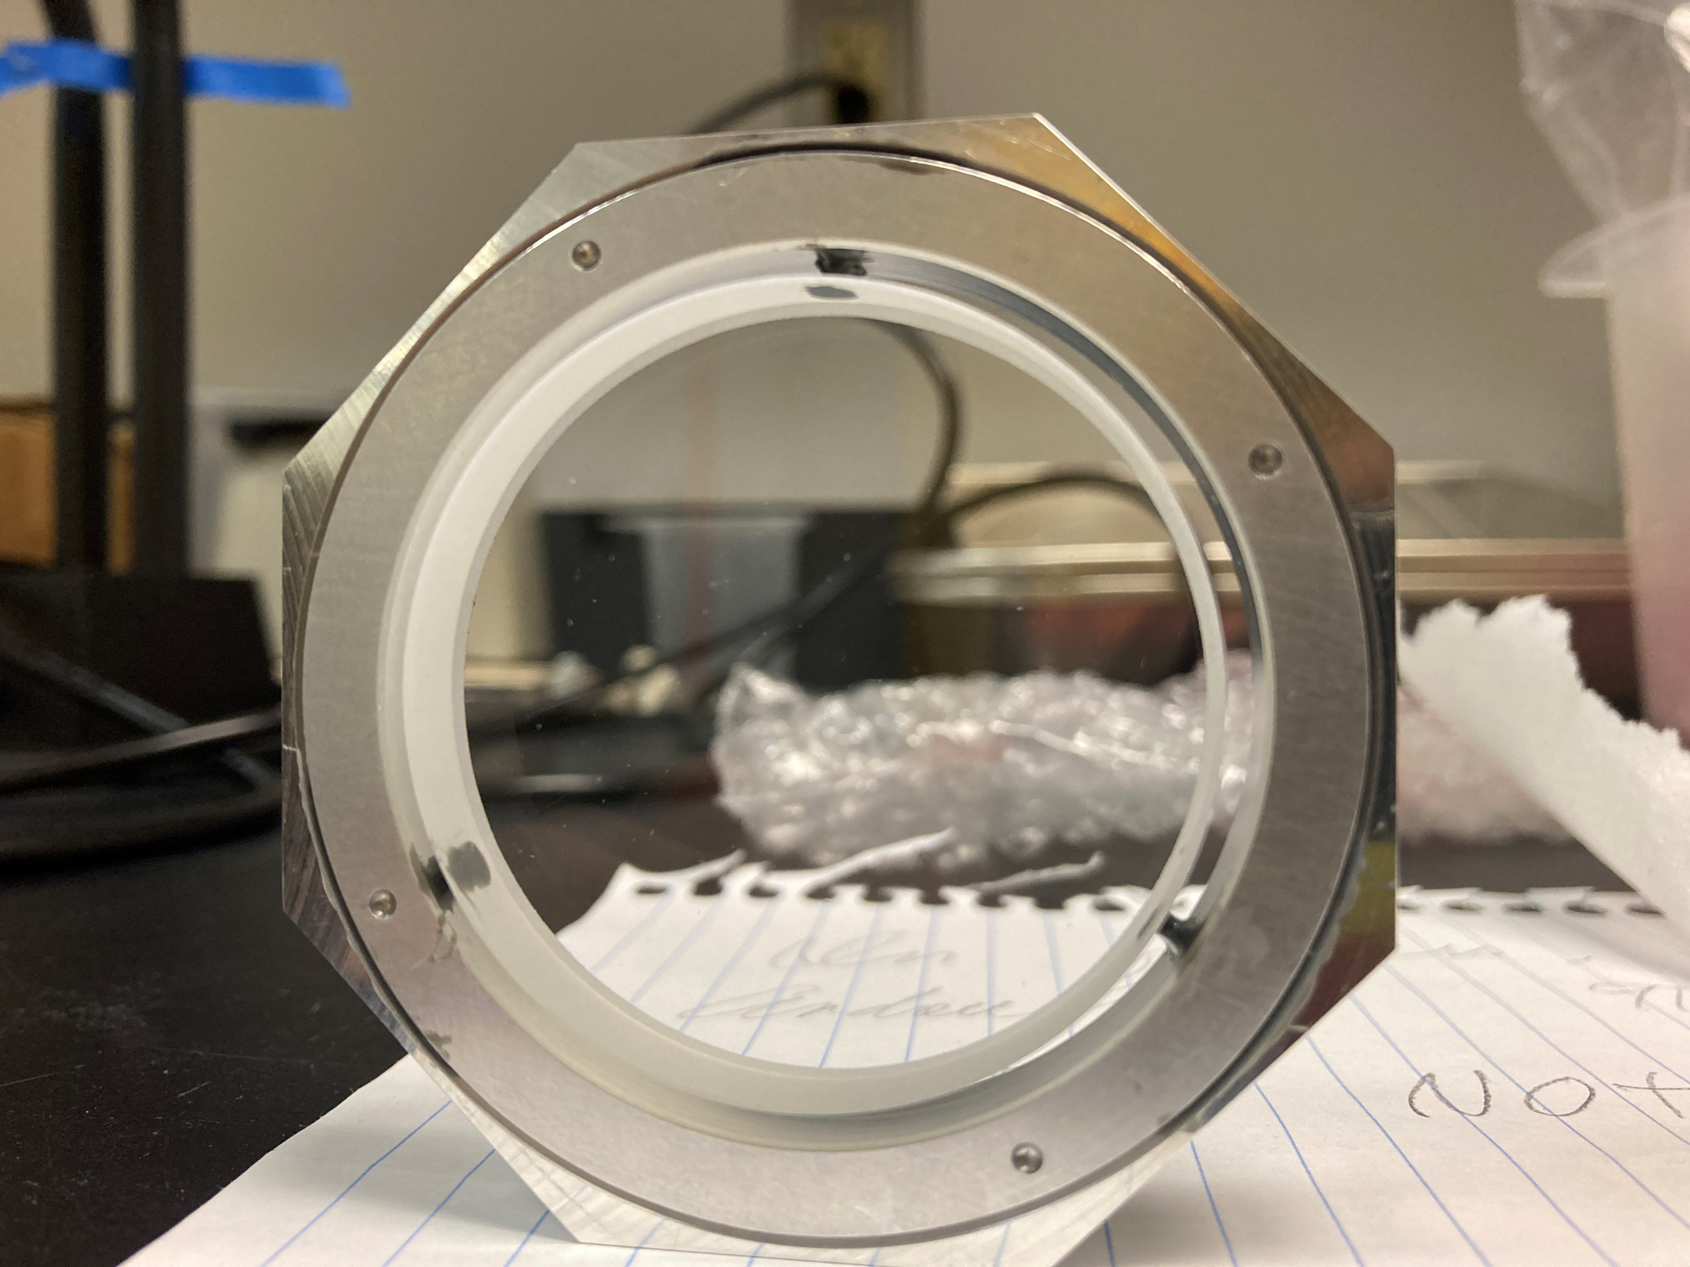
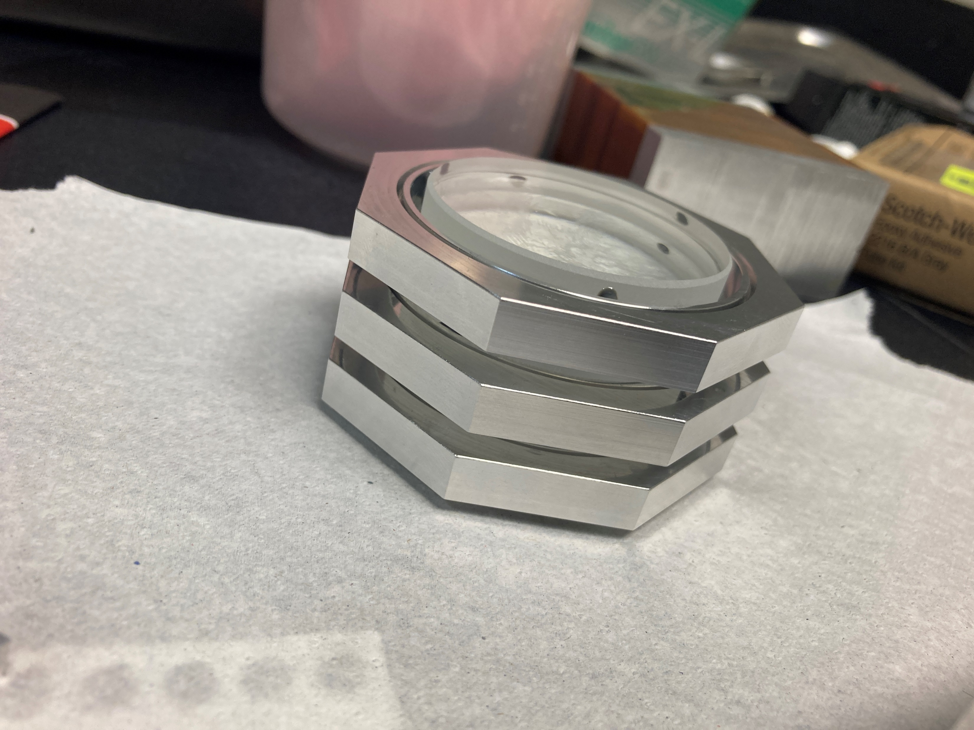
Pictures of Test assembly

Slide 31
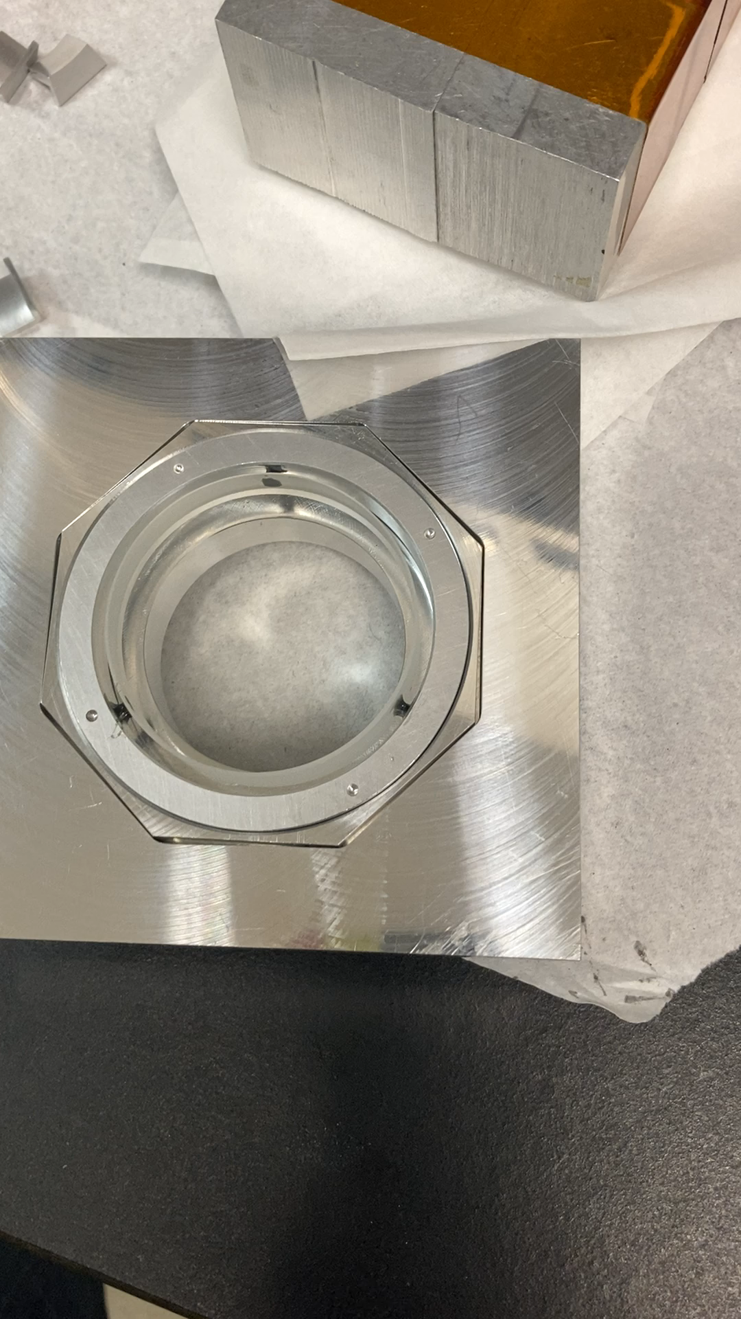
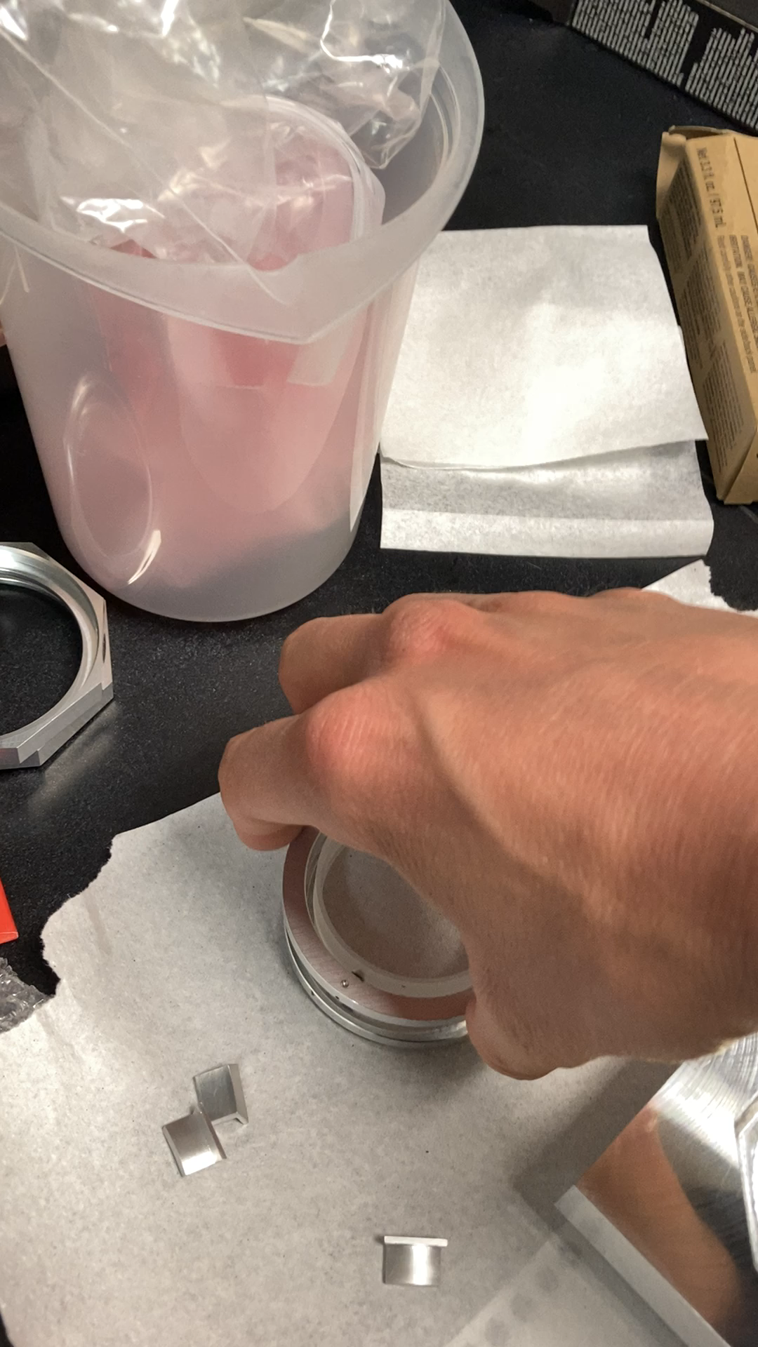
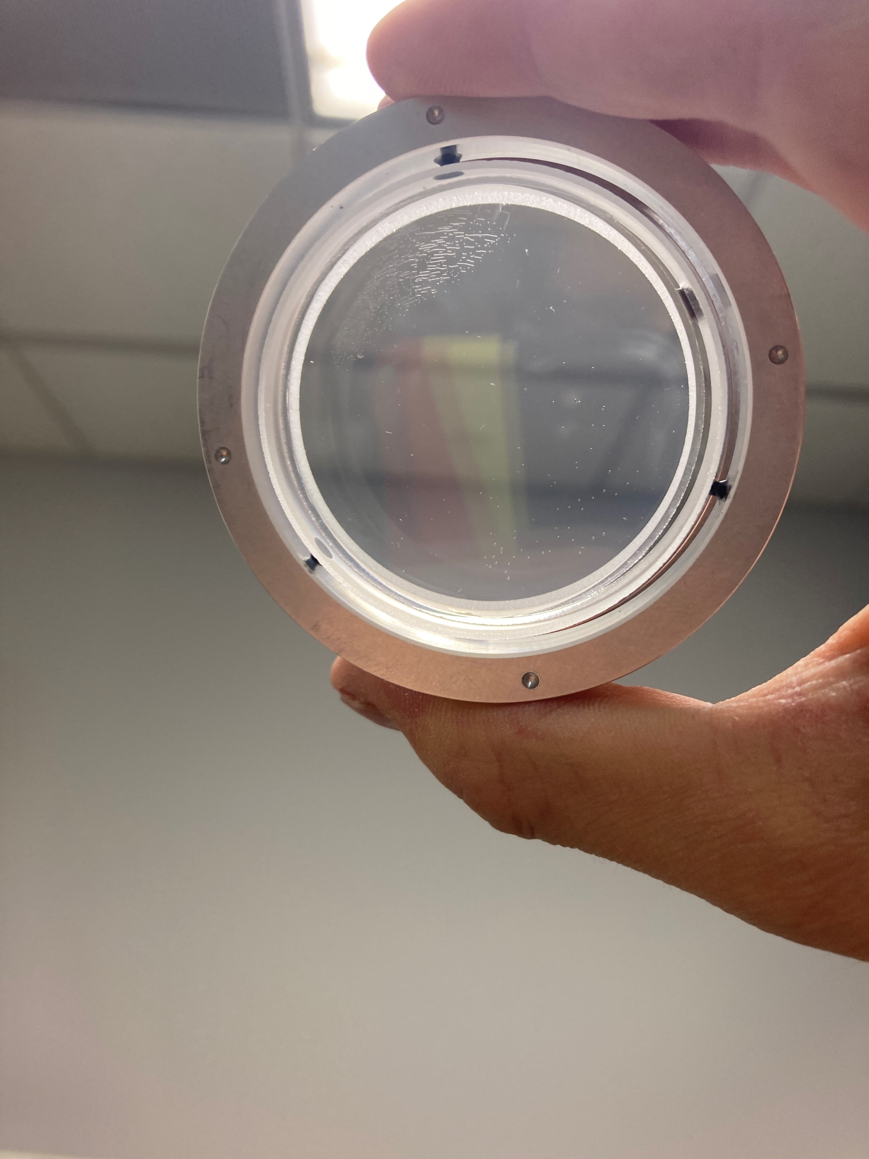
Bubbles in test assembly, hard to turn ring

Slide 32
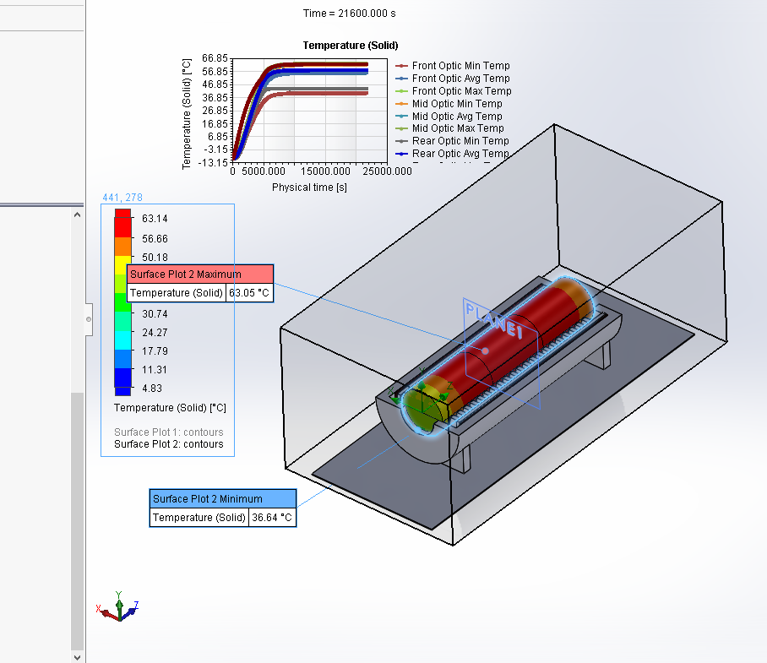
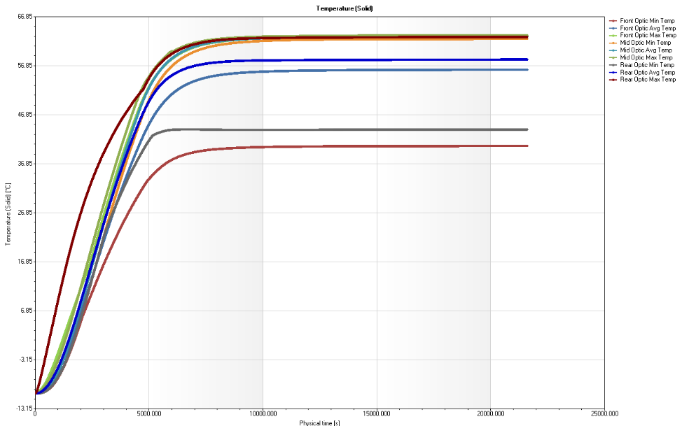
Thermal Result from -10 C to a Goal of 45 C

Slide 33
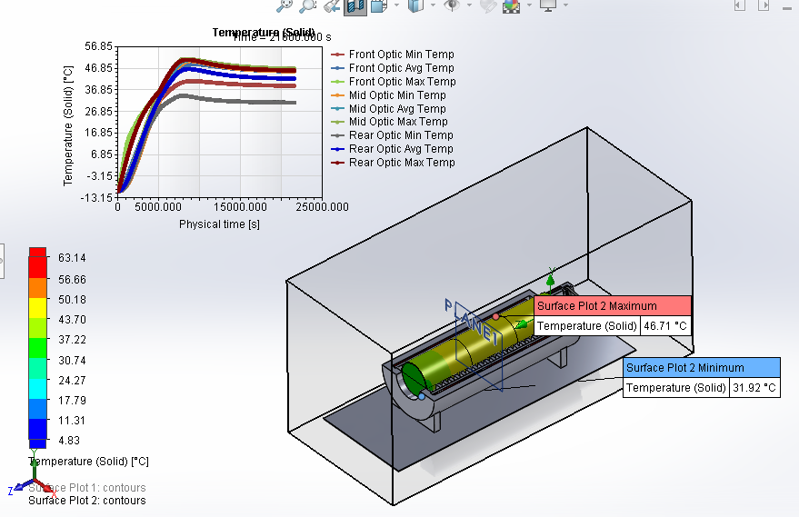
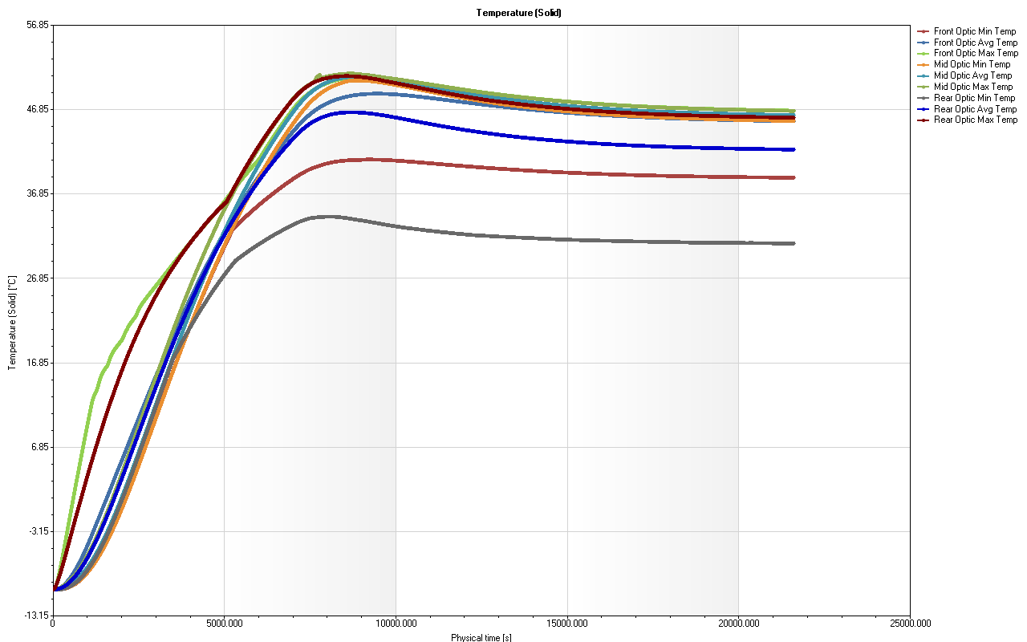
-10 C to a goal of 45 C with front filter estimate

