Slide 1
KSO window test
Andrew Carlile, Pat Zmarzly
4-28-2022

Slide 2
AT HAO, 4-28-2022
3 windows
https://escooptics.com/collections/windows/products/windows-precision-bk7-optical-glass?variant=19494800963
Bonded 2 into inner ring of KSO-SW-
1 at room temp, approximately 20 C
1 bonded at elevated temp, approximately 35 C

Slide 3
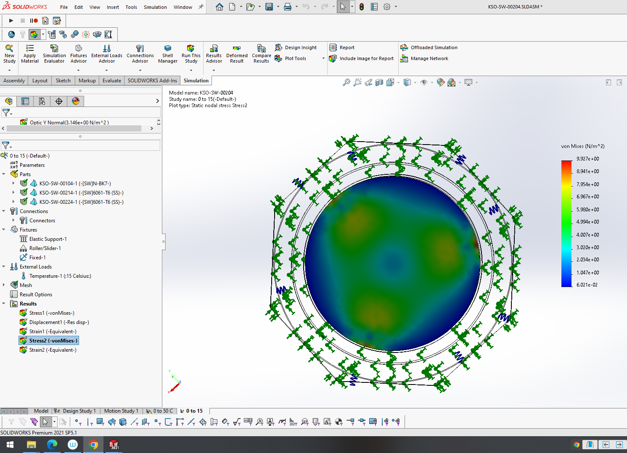
Closest FEA result
Prediction is very low if any wavefront error from temp change
Highest stress/most PV or RMS wavefront error should be at the edges close to the adhesive

Slide 4
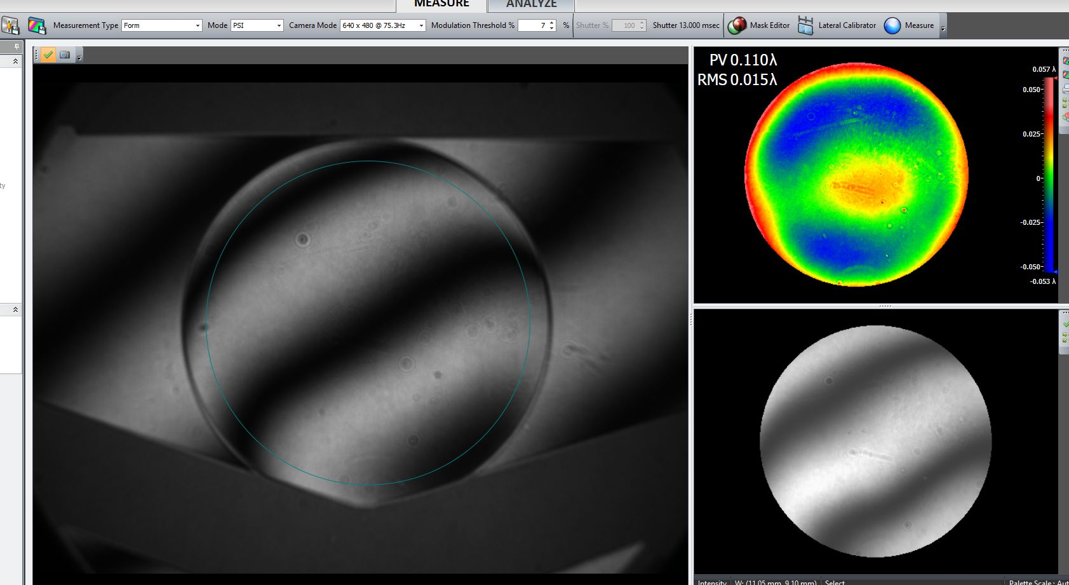
Window with no mounting

Slide 5
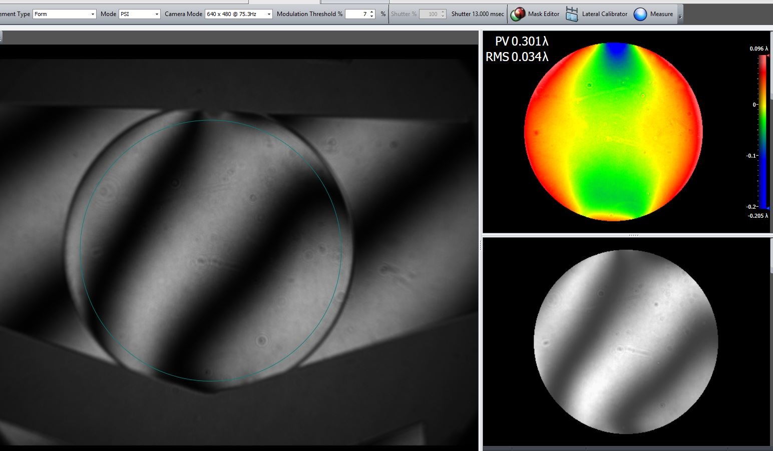
Induced Stress by clamping on Window but not very much

Slide 6
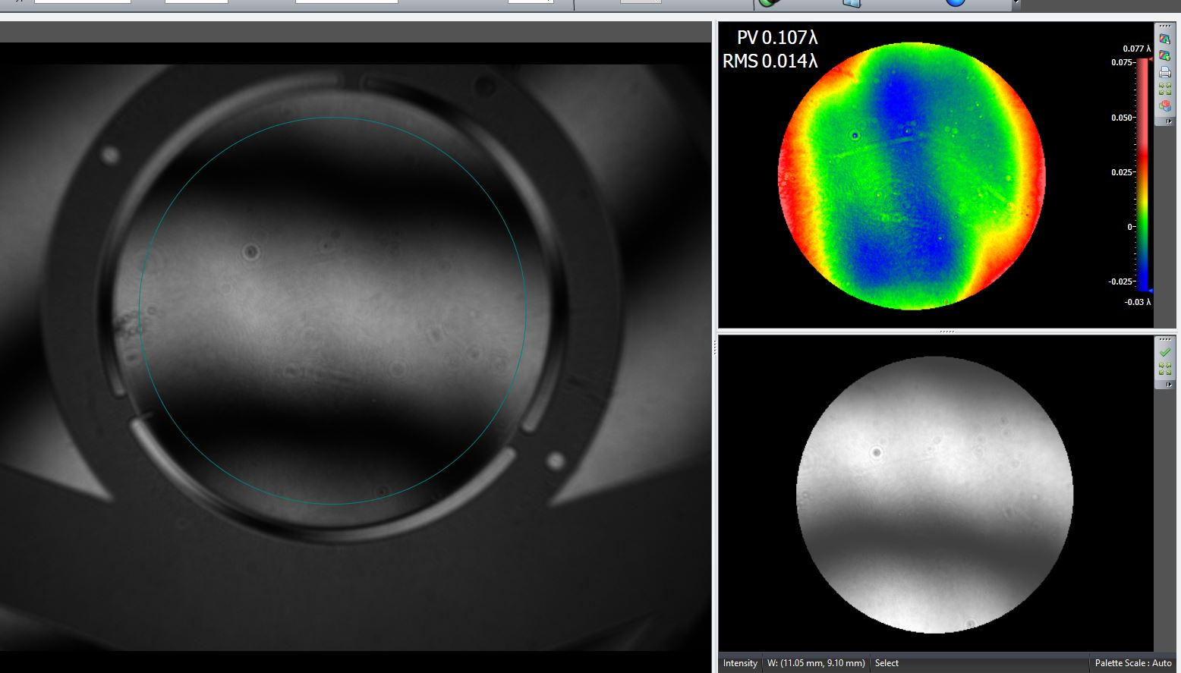
Window mounted at 20 C, test at 20 C

Slide 7
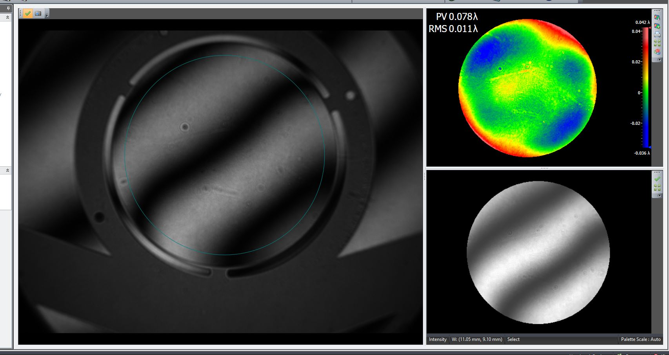
Window mounted at 35 C, test at 20 C

Slide 8
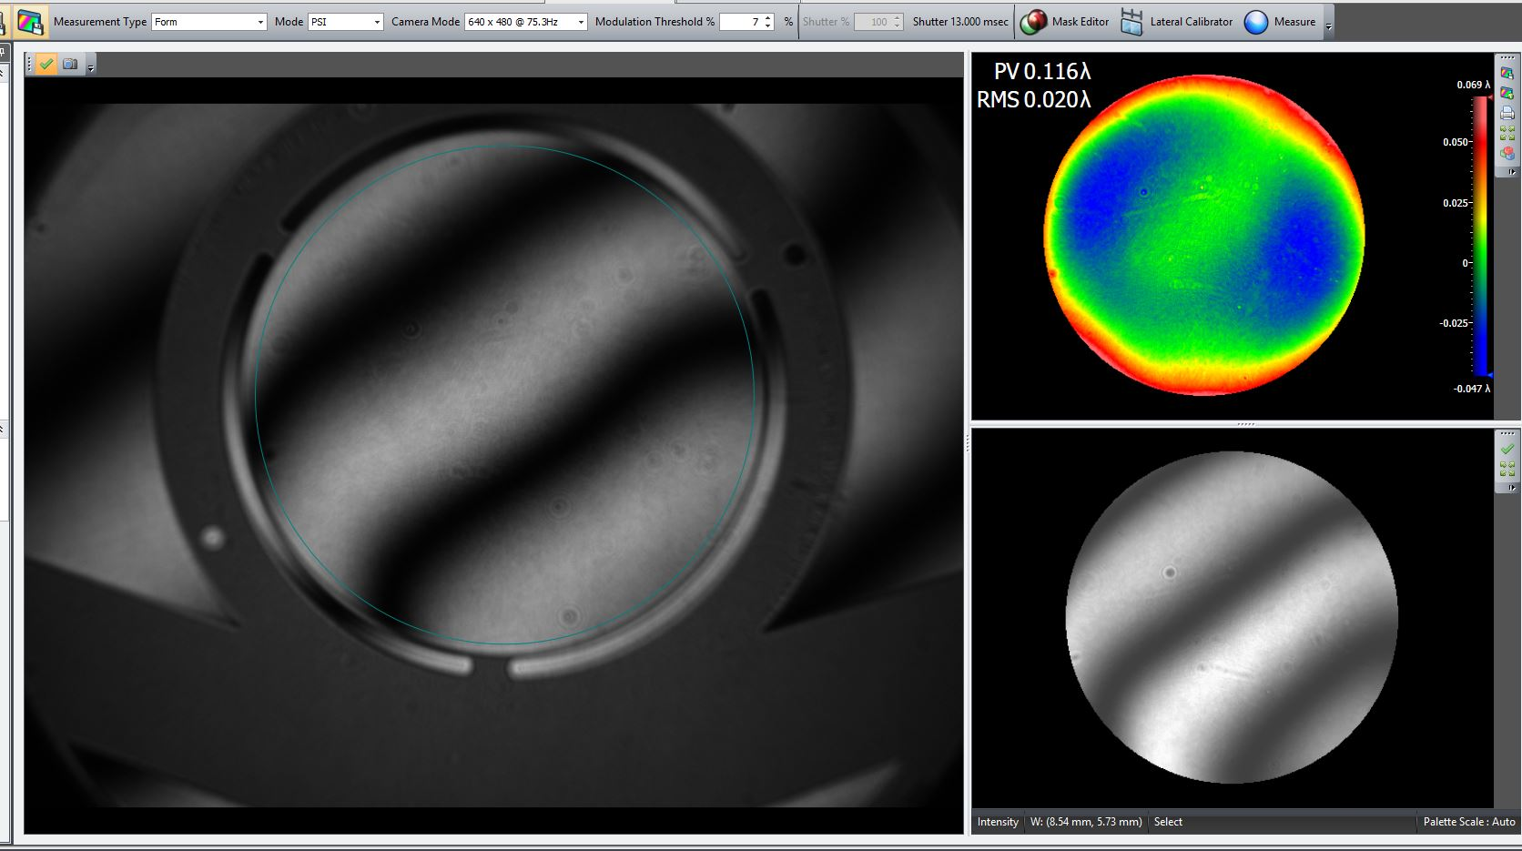
Increasing aperture on “hot” window

Slide 9
Summary, Rings are athermal
Test Piece | Wave test parameter | Result | Comments
Window Unmounted | PV | 0.11
 | RMS | 0.015
Stressed Unmounted | PV | 0.301 | Shows we can detect stress
 | RMS | 0.034
Window Bonded at 20 C | PV | 0.107 | Very low
 | RMS | 0.014
Window Bonded at 35 C | PV | 0.078 | Very low
 | RMS | 0.011

