Slide 1
Causes of Large-scale Ionospheric Disturbances and Challenges in Predicting Them
Gang Lu
National Center for Atmospheric Research
Boulder, Colorado, USA
Fall AGU meeting, Chicago, 12-16 December 2022

Slide 2
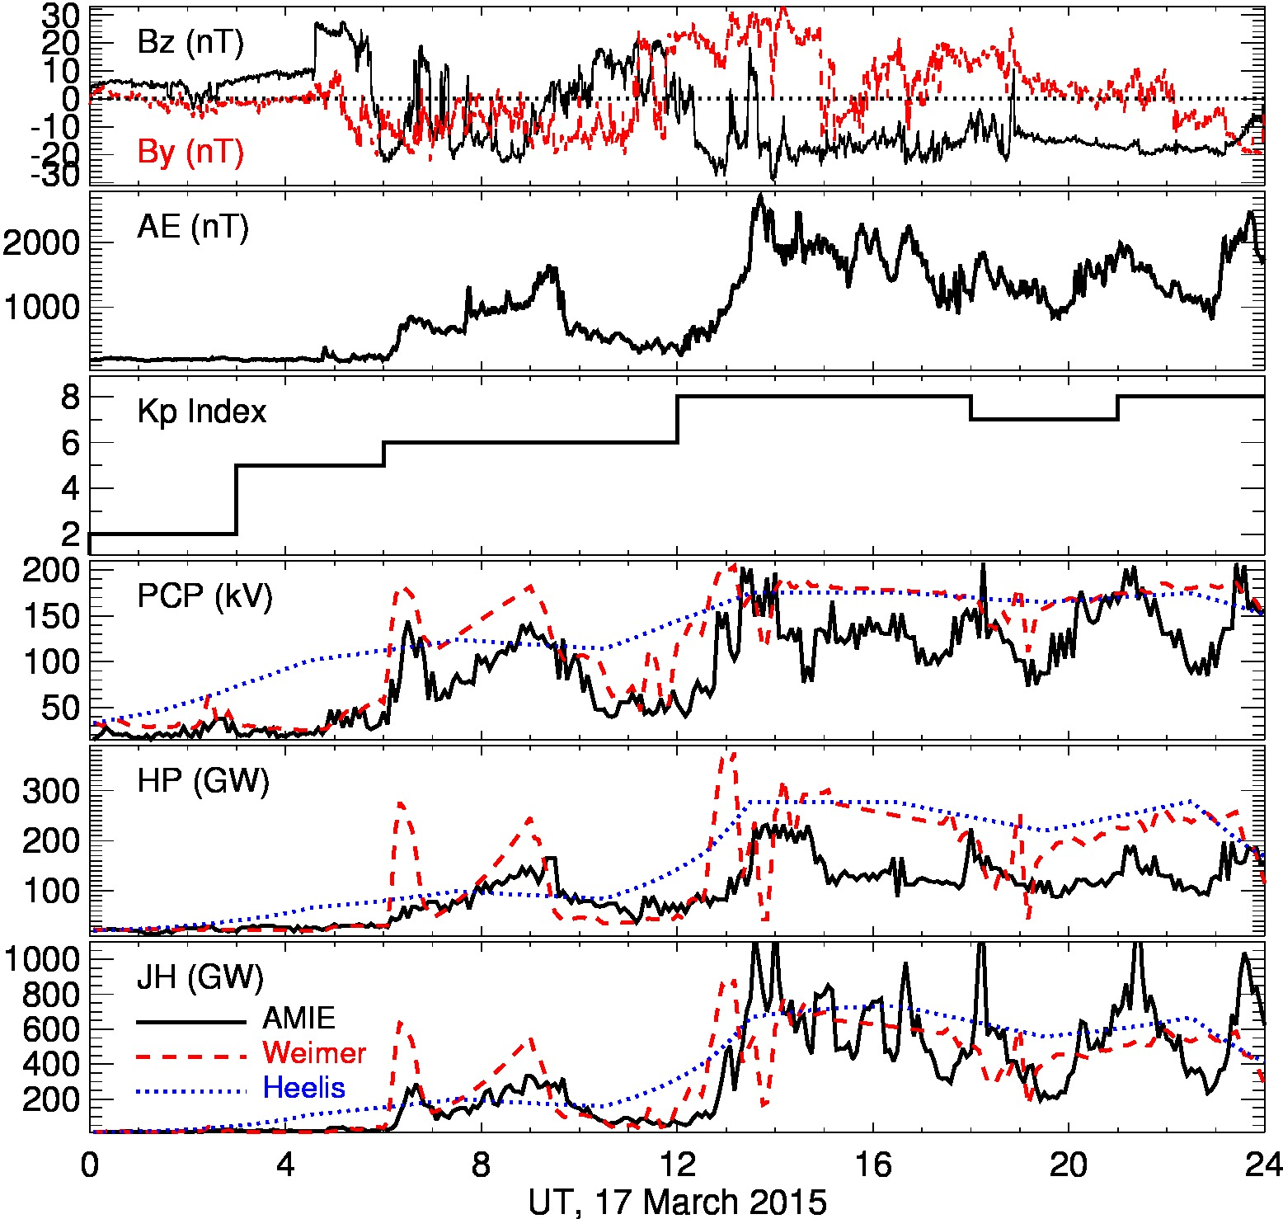
18:00UT

Slide 3
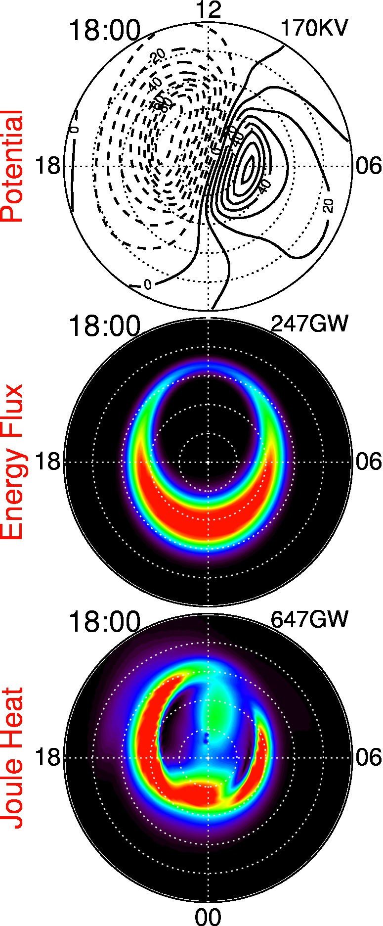
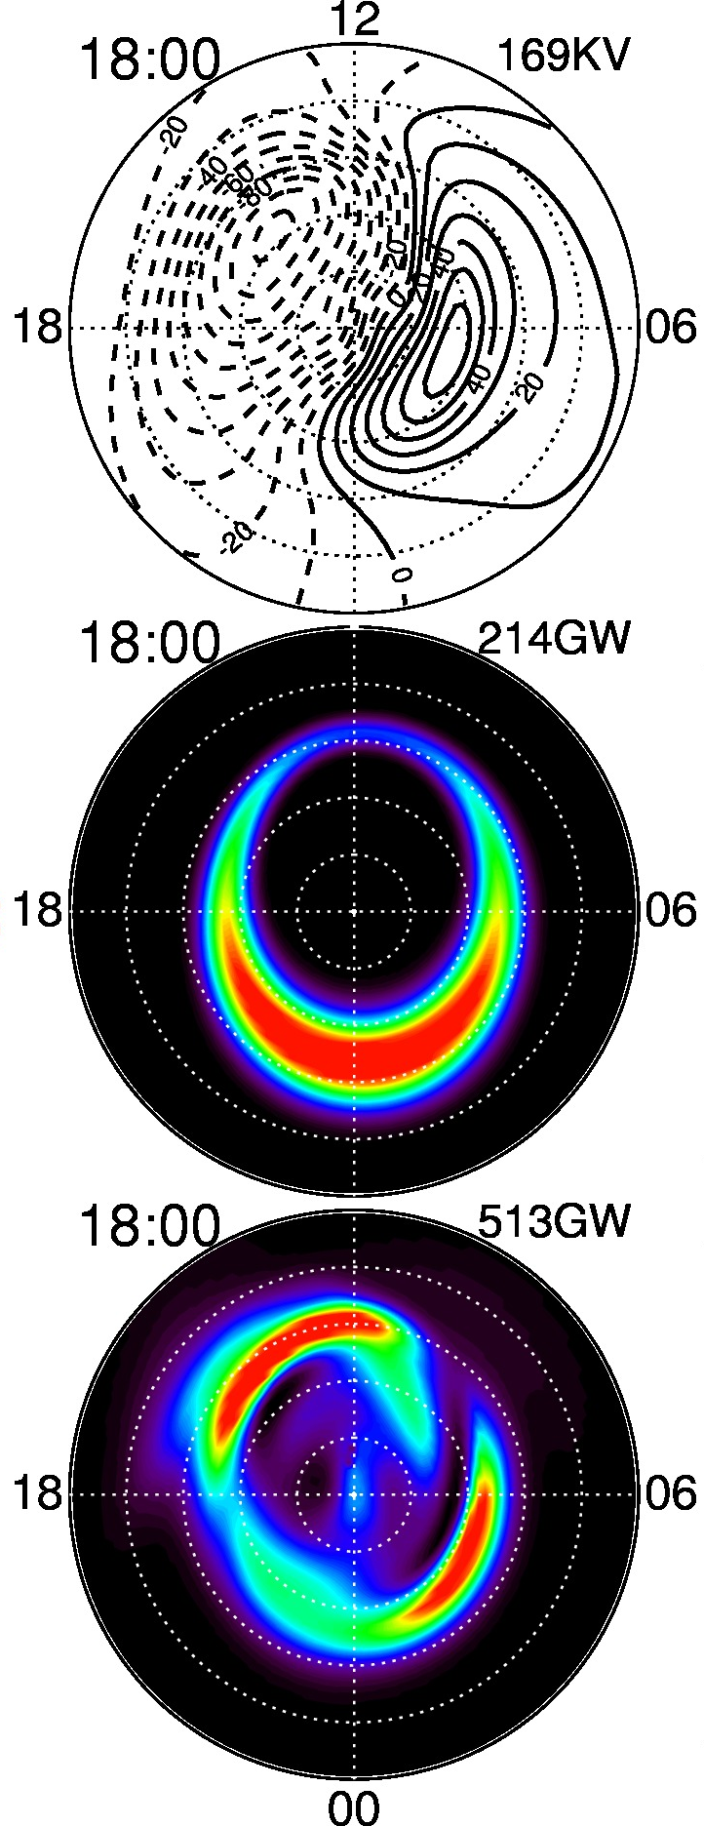
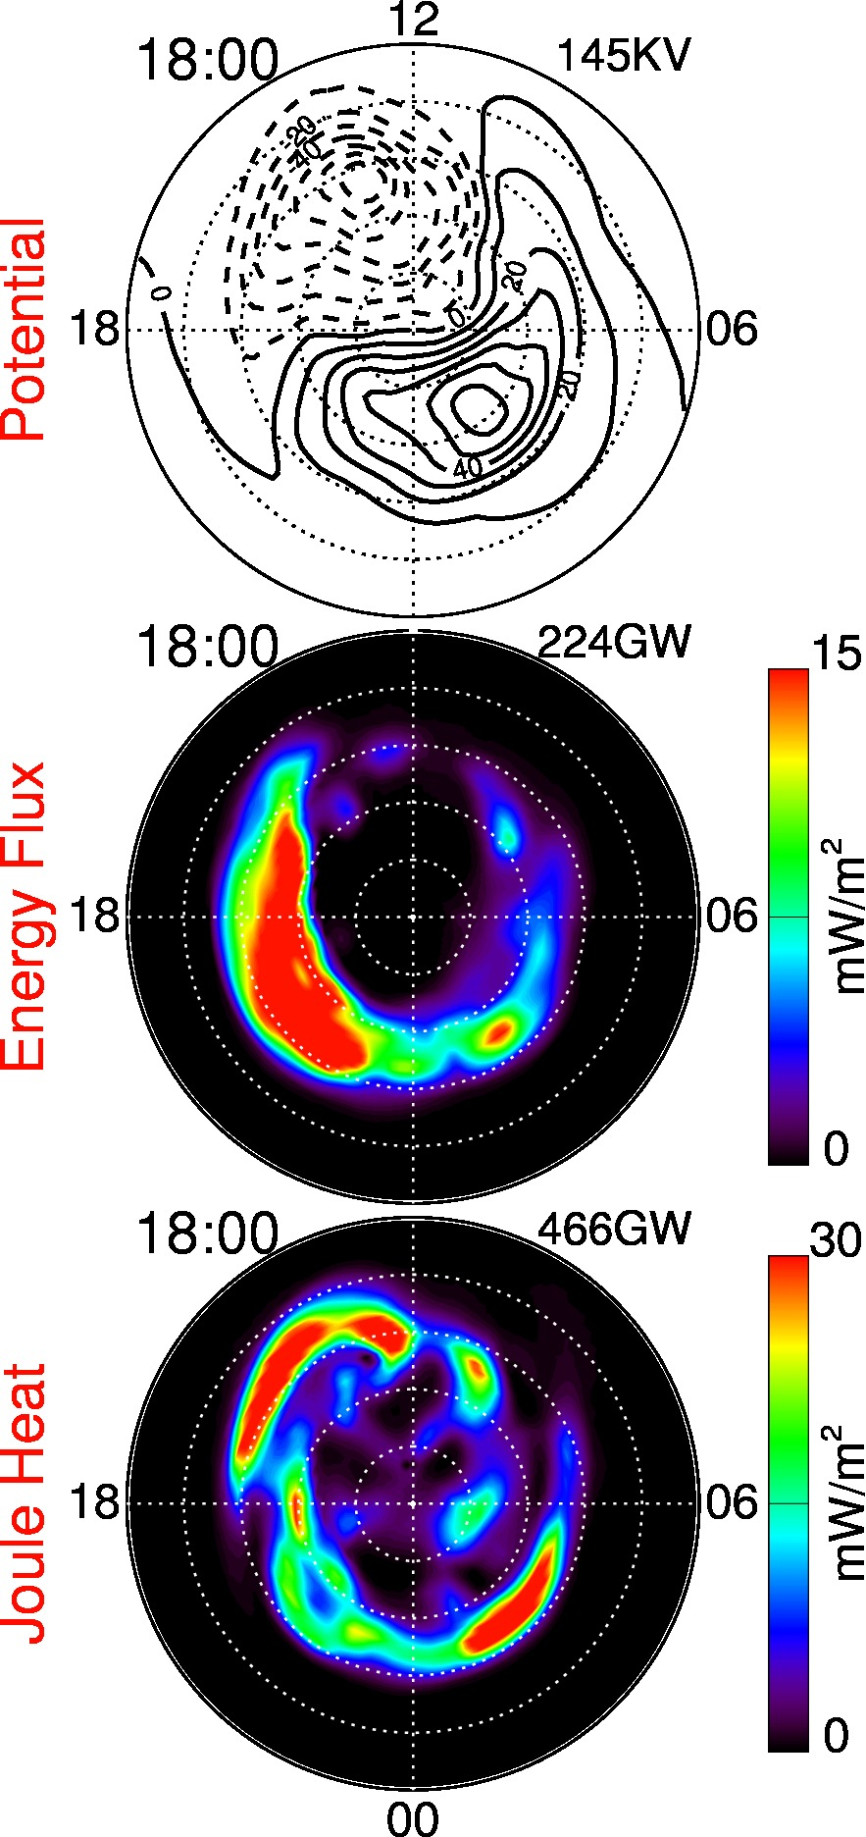
Heelis
Weimer
AMIE
18:00 UT, 17 March 2015

Slide 4
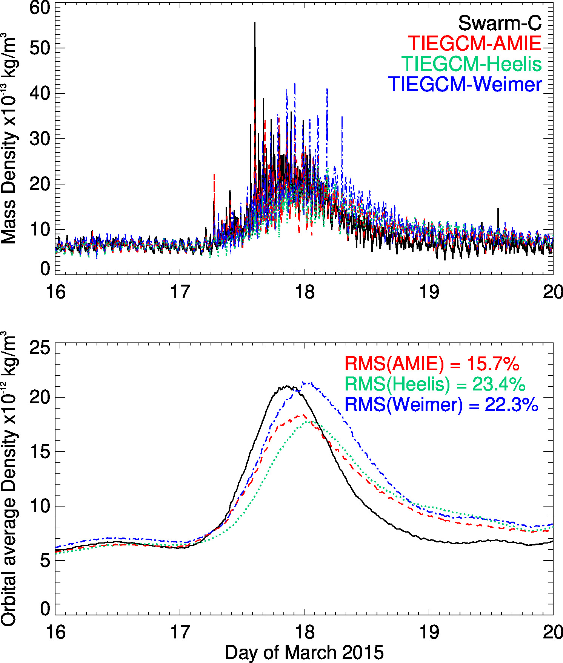
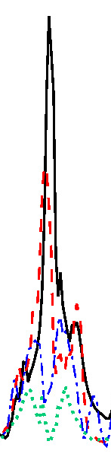
Comparison with Swarm Mass Density
14:30 UT

Slide 5
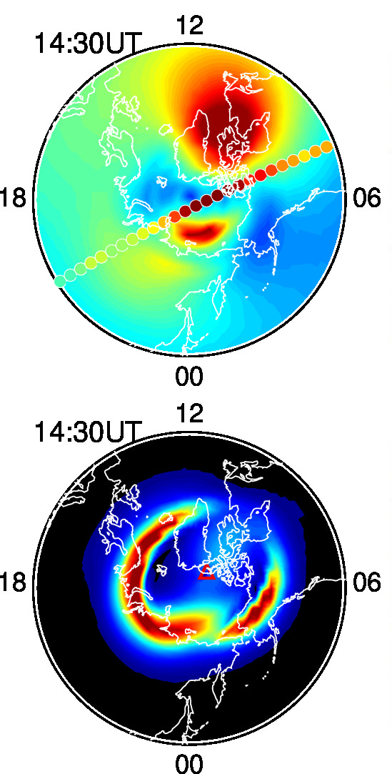
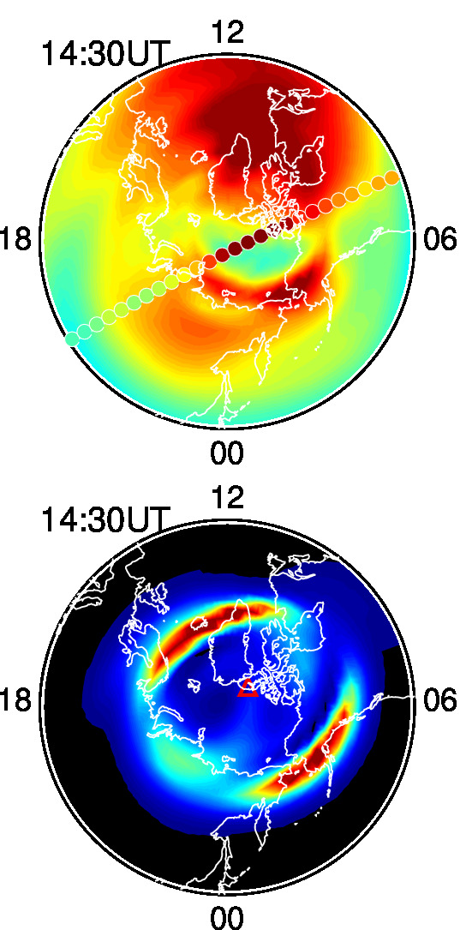
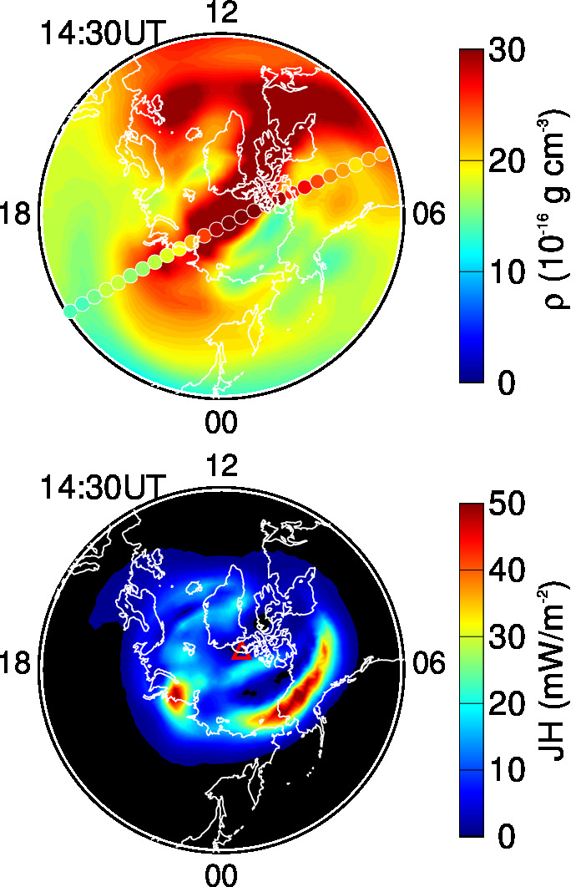
Comparison with Swarm Mass Density
TIEGCM-Heelis
TIEGCM-Weimer
TIEGCM-AMIE
Notes:
Increased mass density does not coincide with JH

Slide 6
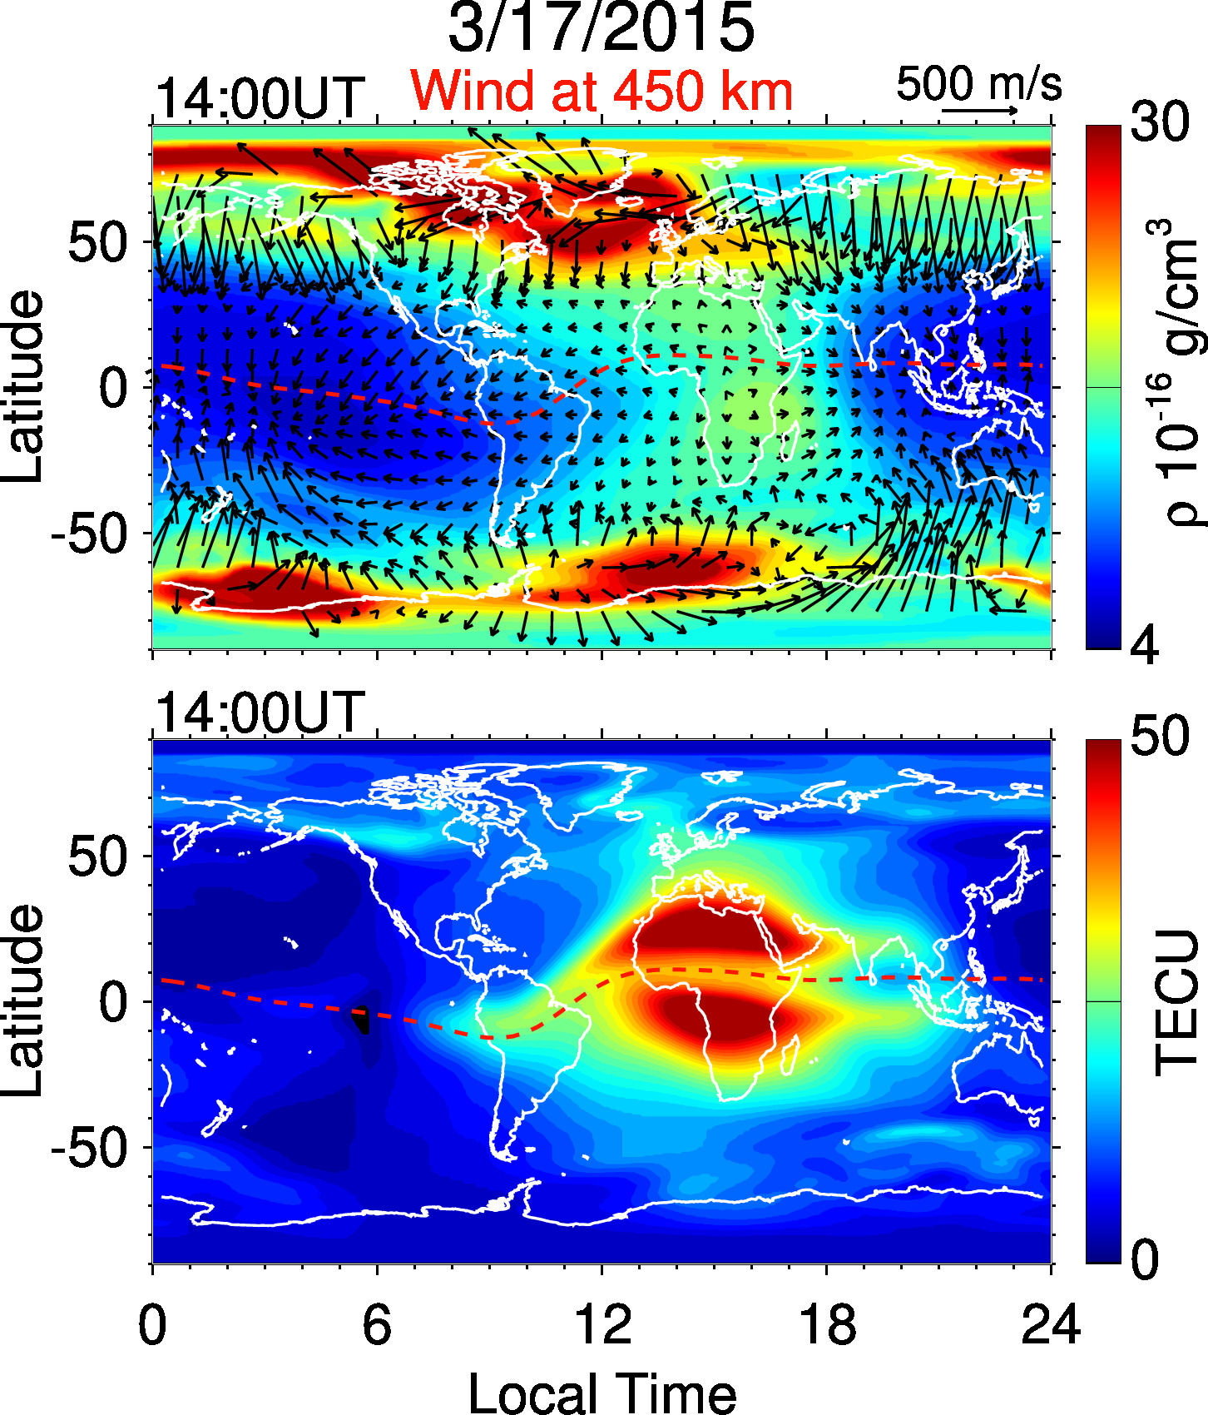
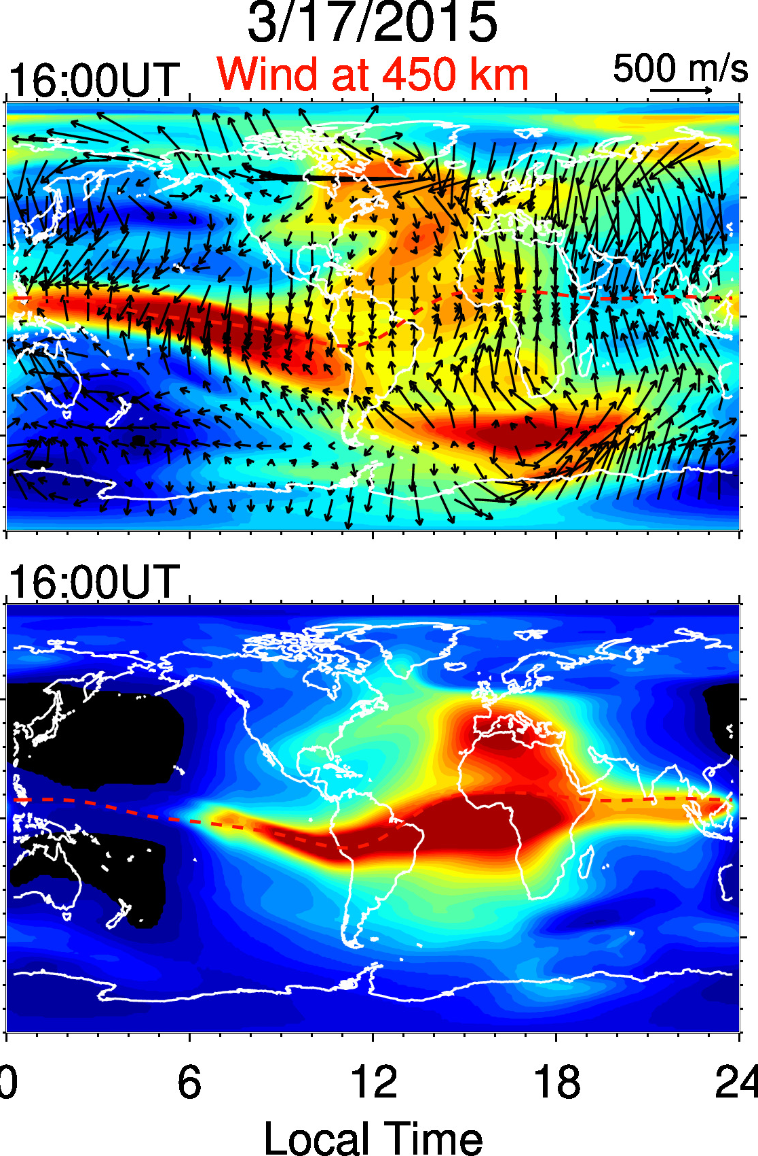
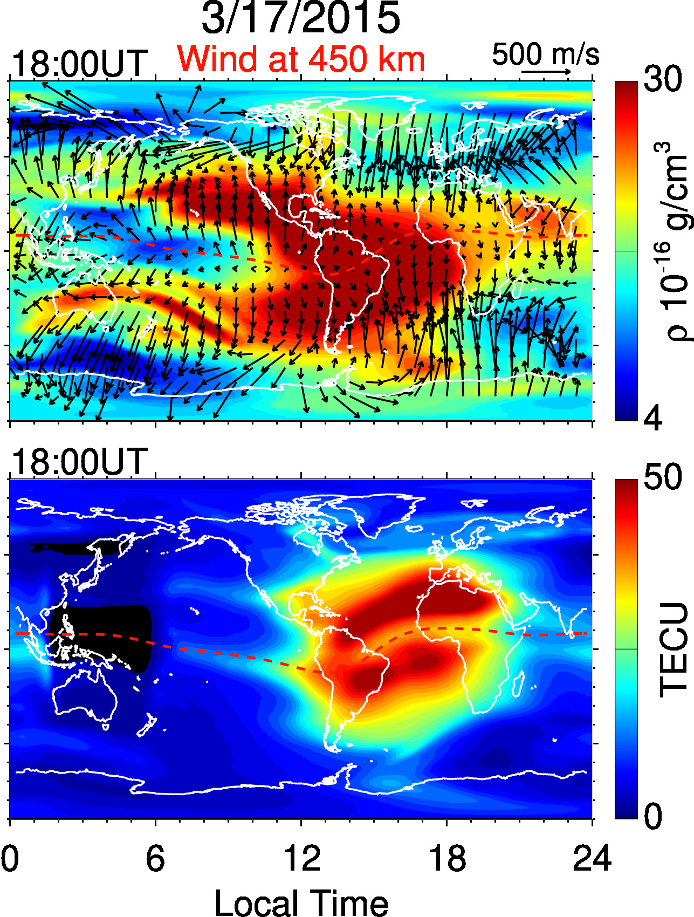
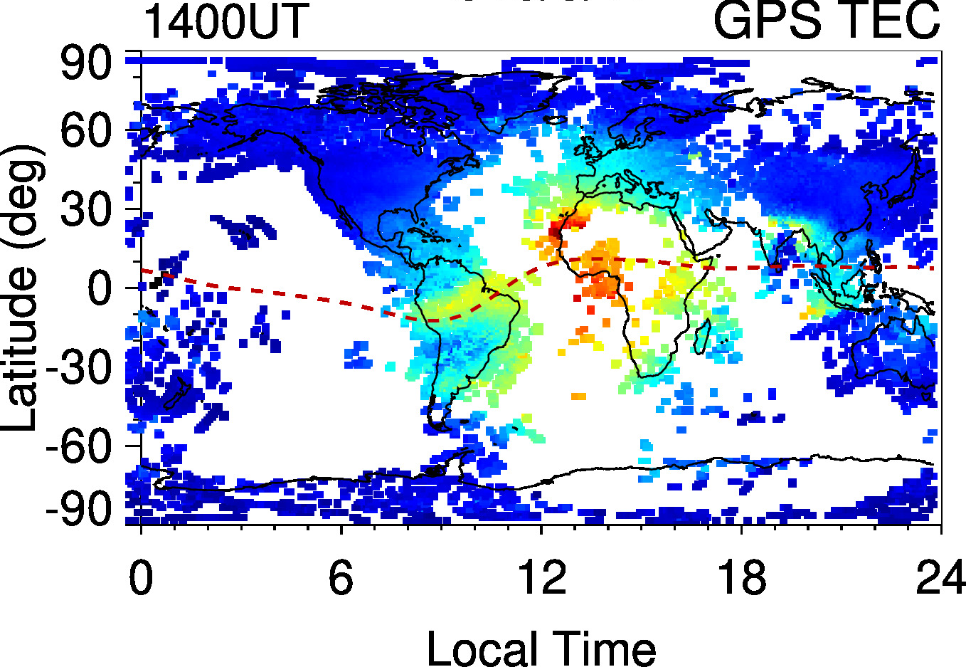
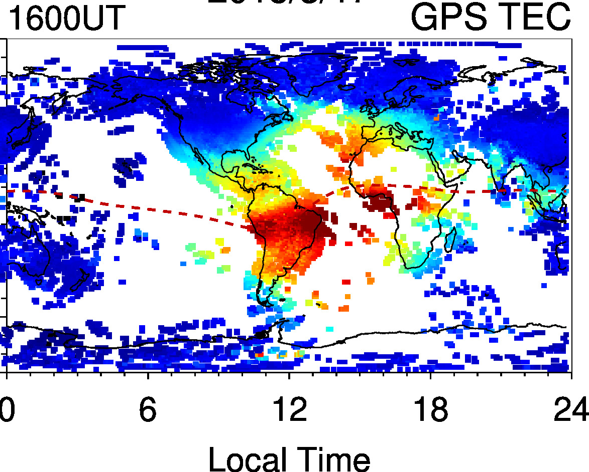
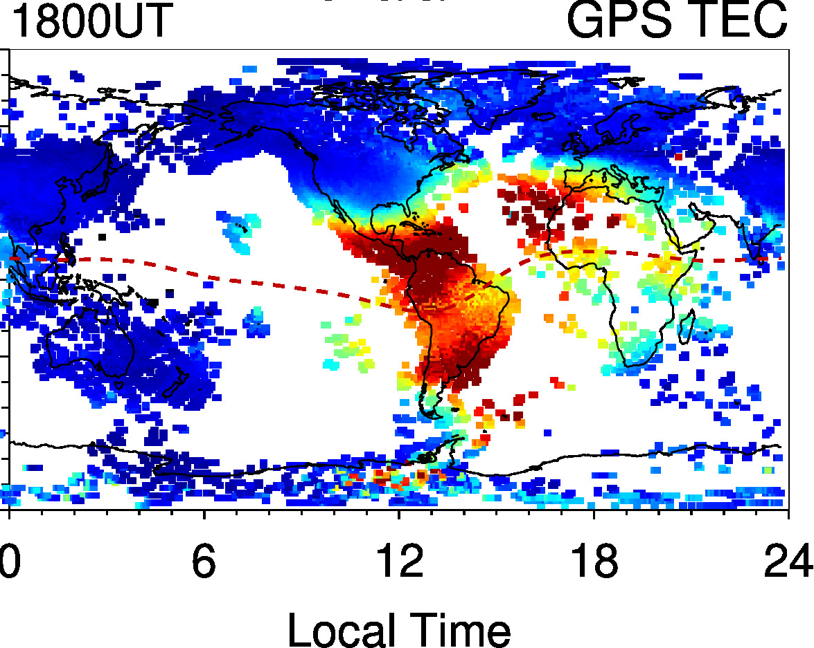
Notes:
While energy input from the magnetosphere mainly confined in the high-lat region, its impact on the ionosphere/thermosphere is global through disturbance winds that alter the global circulation

Slide 7
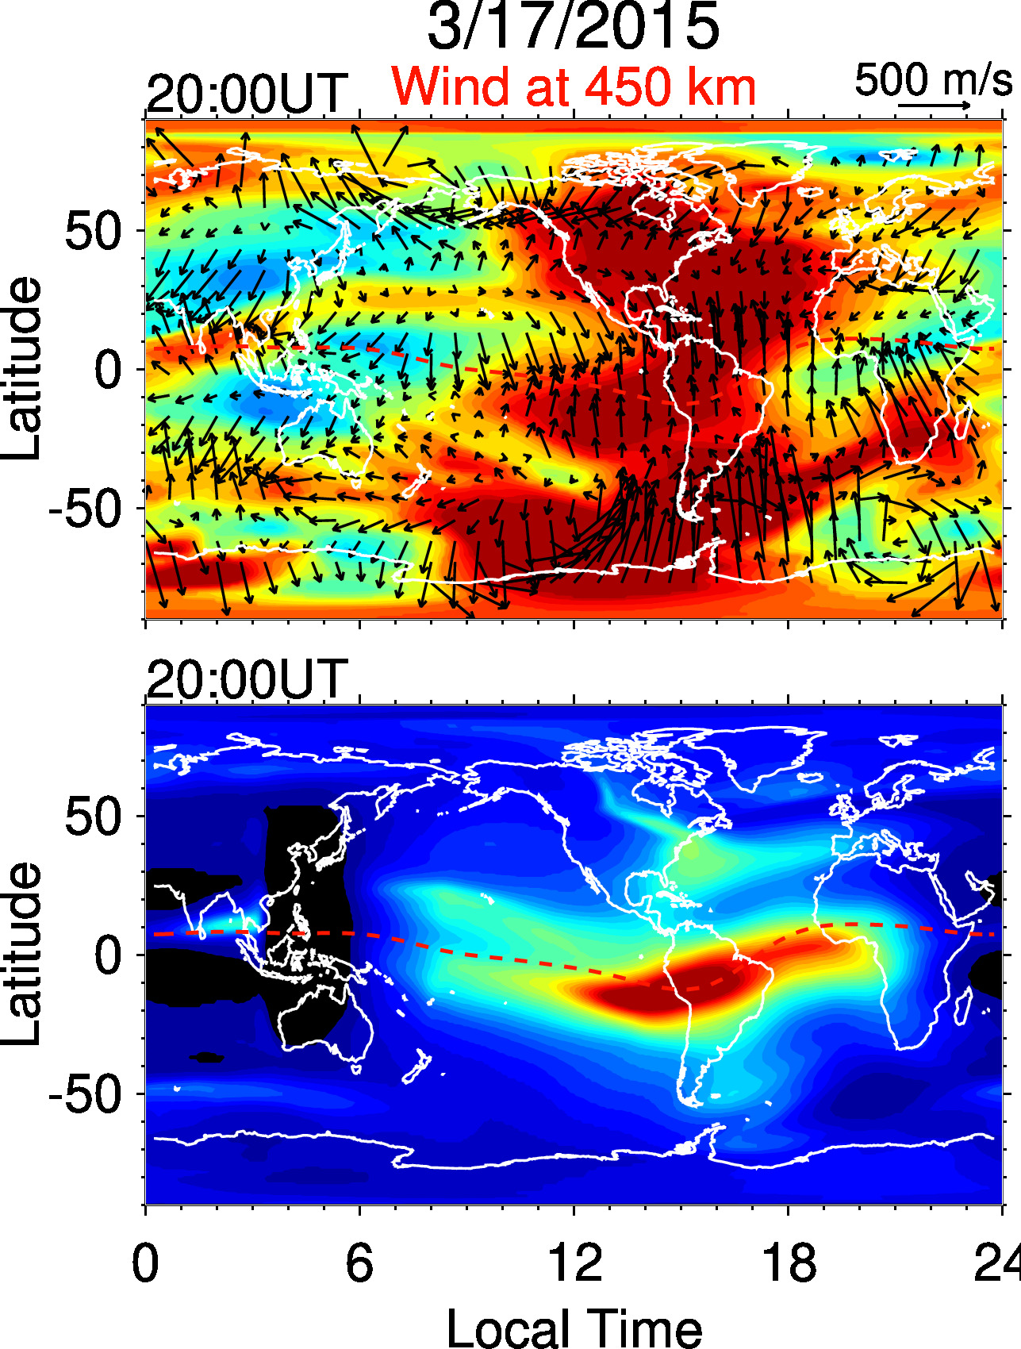
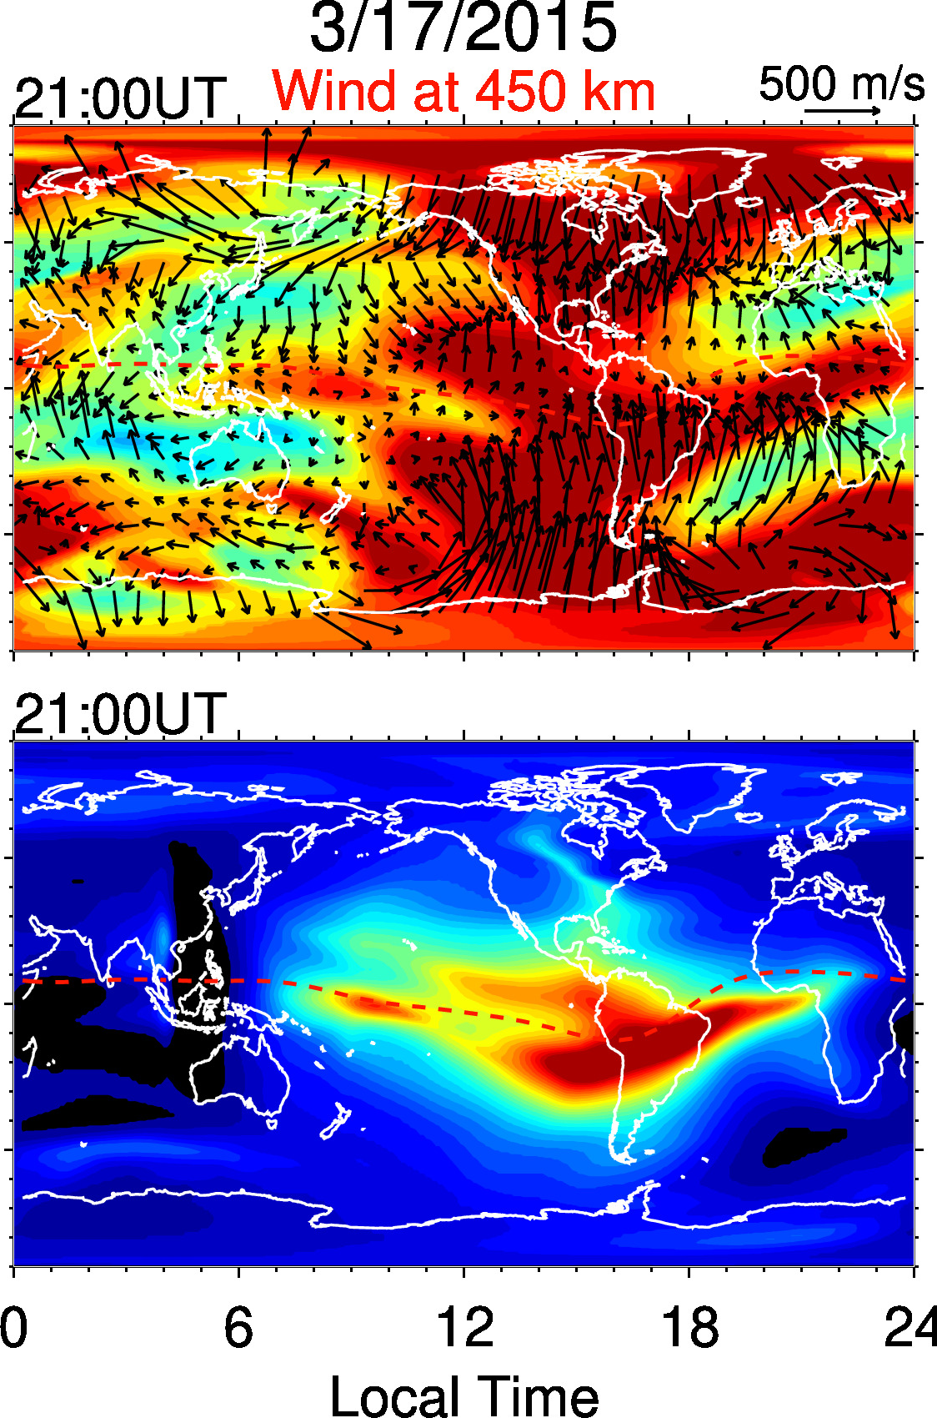
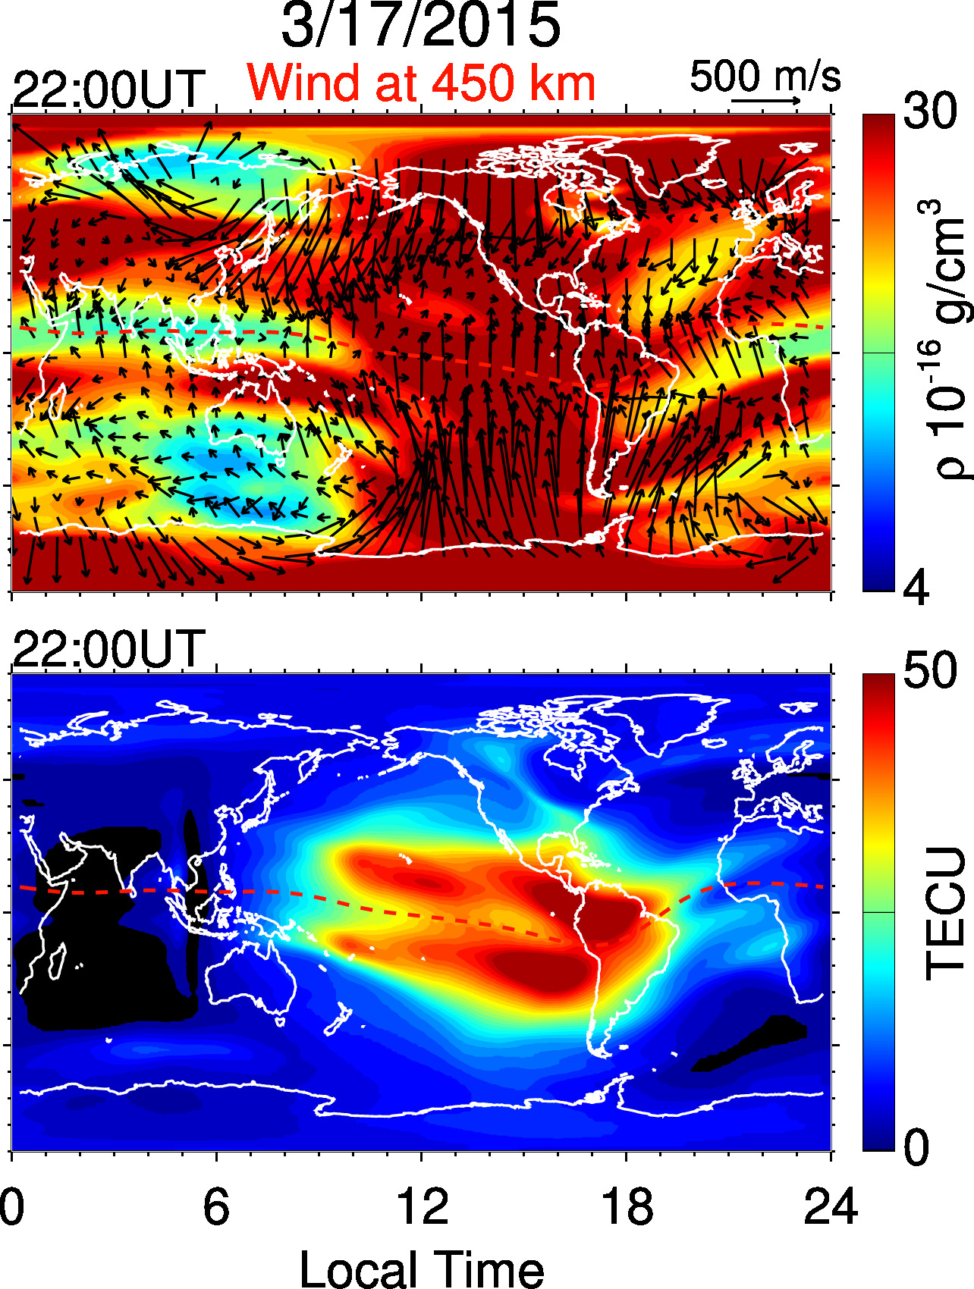
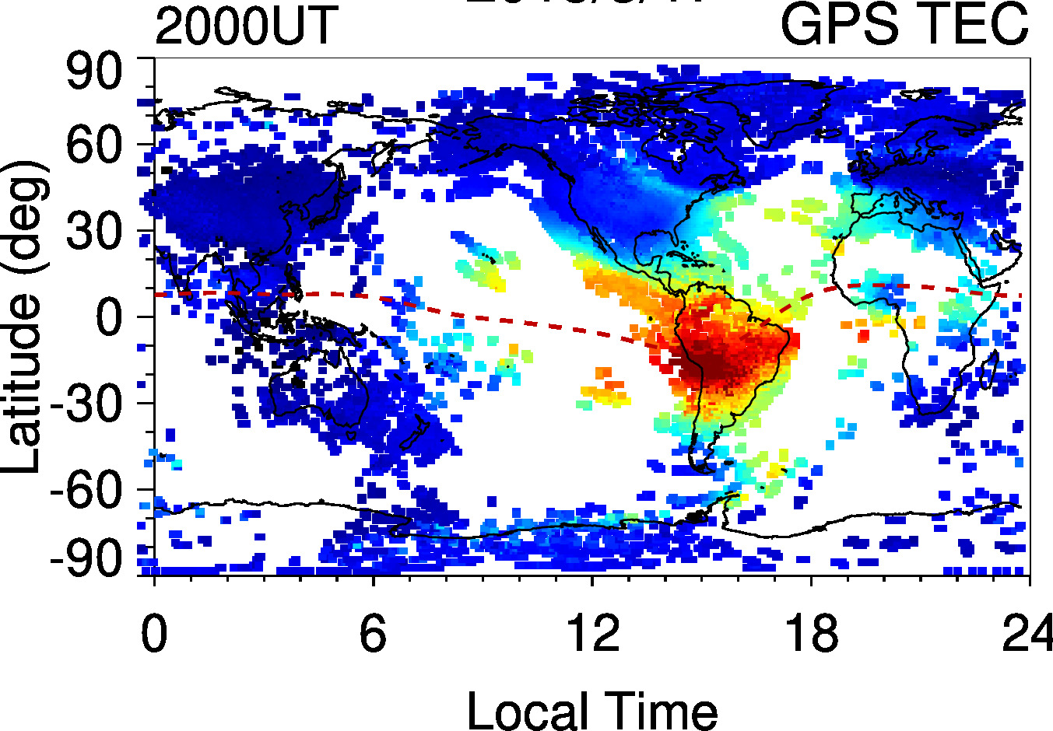
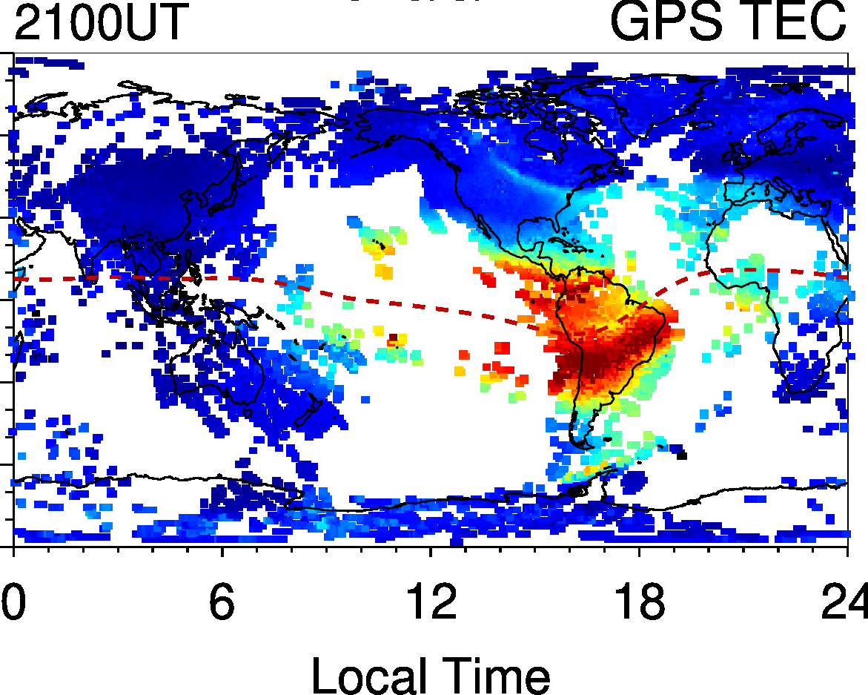
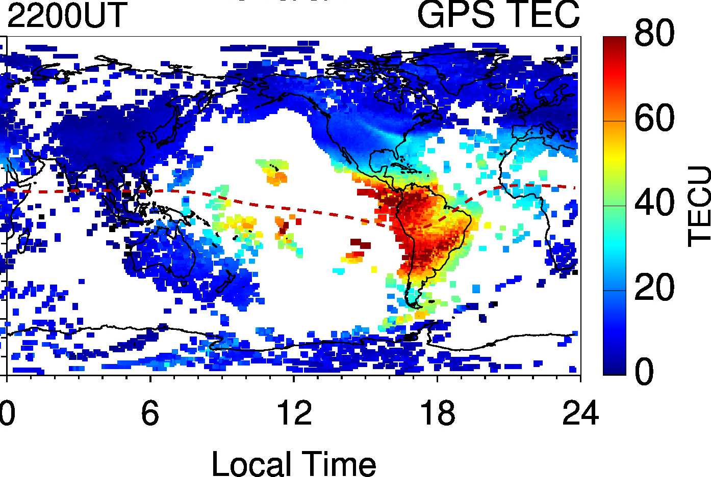

Slide 8
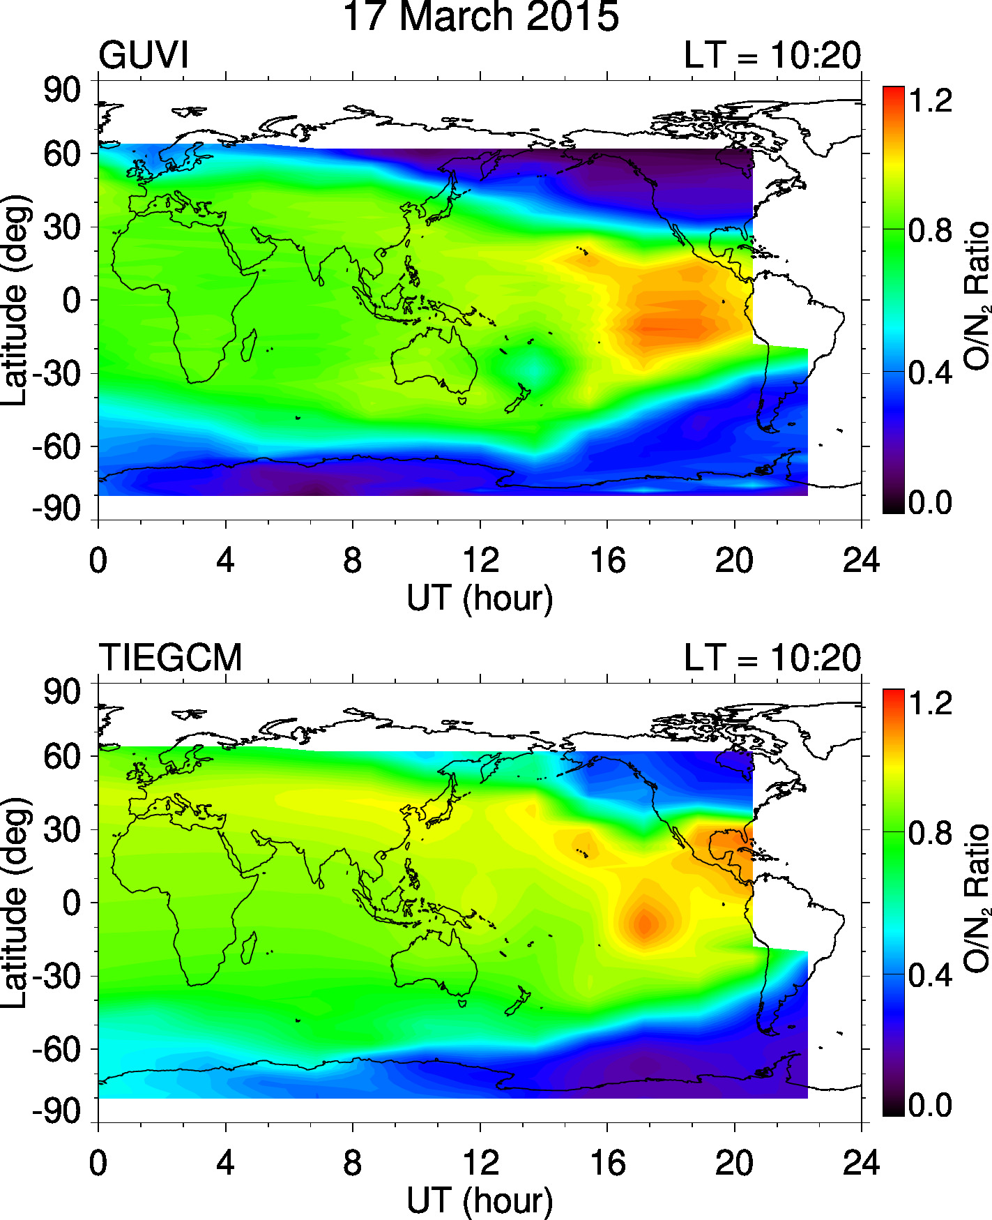
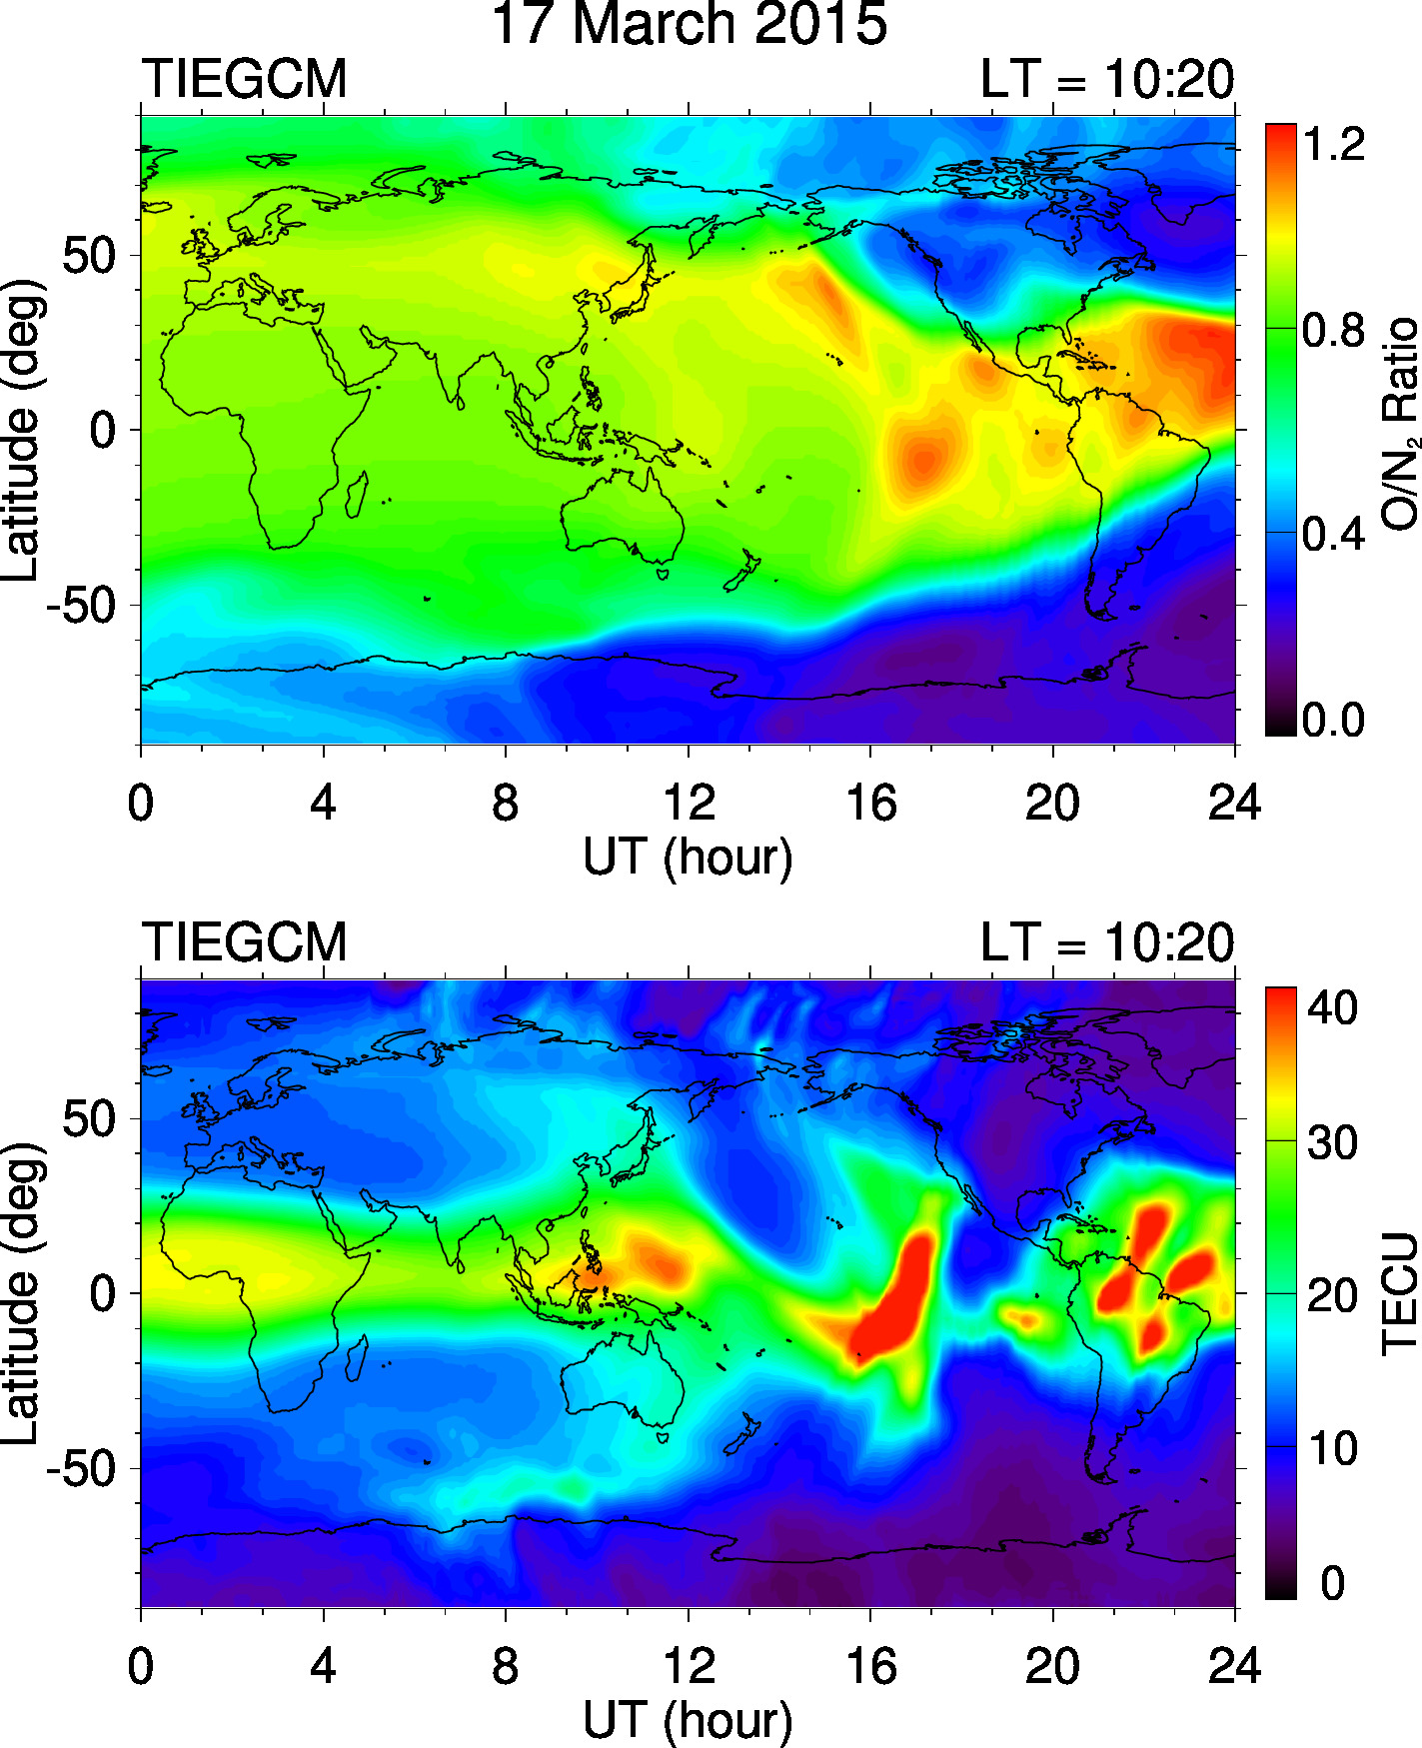

Slide 9

Plasma Continuity Equation
$$\frac{∂N_{s}}{∂t} = { P}_{s} −{ L}_{s}− ∇∙\left(N_{s}\overset{⃑}{V}\right)$$
Production:
Solar flux
EPP
Loss: Composition
Temperature
Transport:
Winds
ExB drift
Diffusion
Notes:
- The different factors are function of local time, latitude and altitude (e.g., winds are important in the E-region transport, and ExB drift important in the F-region)

Slide 10
Challenges in predicting IT disturbances
Accurate specification of high-latitude convection and auroral precipitation: not only the total energy inputs but also their spatial distributions
Accurate description of dynamic and electrodynamic processes: PPEF and disturbance winds
Accurate representation of chemical interactions: temperature and composition changes
TEC
TEC
TEC
Notes:
- Only talked about forcing from above

