Slide 1
Coordinated Investigations of the Global Ionosphere-Thermosphere System Through Data Assimilation & Numerical Modeling
Gang Lu
National Center for Atmospheric Research
Boulder, Colorado, USA
AOGS ST15, 4 August 2023

Slide 2
Science Goals of the GDC Mission
Goal 1: Understand how the high latitude ionosphere-thermosphere system responds to variable solar wind/magnetospheric forcing.
Goal 2: Understand how internal processes in the global ionosphere-thermosphere system redistribute mass, momentum, and energy.
Notes:
The upcoming GDC mission will consist of 6 satellites. However, the IT system is extremely complex due to the interaction of various dynamical, electrodynamical, and chemical processes. Therefore, even with the unpreceded 6 satellites, GDC along will not be able to completely resolve the IT system dynamics as needed for SW specification. Other observations as well as numerical modeling will be needed to complement the GDC mission.
To that end, advanced data assimilation and 1st principle, physics-based models (e.g., TIEGCM) can make a great contribution toward these goals

Slide 3
Assimilative Mapping of Ionospheric Electrodynamics (AMIE)
Statistical
Model
Φ
E
I
J||
ΔB
Φ_{i}
E_{i}
I_{i}
J_{||i}
ΔB_{i}
Statistical
Model
Satellites
Radars
Σ_{P}
Σ_{H}
F_{E}
E_{m}
IS Radars
Precipitating
Particles
= Σ a_{i}
IS Radars
Magnetic
Variations
Satellite
Magnetometers
Auroral
images
Ground
Magnetometers
Data
Fitted
Distributions
Fitted
Coefficients
Basis
Functions
Data
F_{E}: energy flux
E_{m}: mean energy
[After Richmond & Kamide, 1988]

Slide 4
AMIE Inputs & Outputs
Inputs
Outputs
Modified conductances
Energy flux & mean energy
Electric & magnetic fields
Electric potential
Horizontal currents
Field-aligned current
Joule heating
Poynting flux
Equivalent current
Data
Satellite:
Electric fields
Ion drifts
Magnetic fields
Precipit. particles
Radars:
Ion drifts (IS & HF)
Conductances (IS)
Ground magnetometers
Auroral Imagers:
Ground & space
Model
Auroral Conductance:
Fuller-Rowell & Evans (HP)
Hardy (Kp)
Electric Potential:
Mill Stone Hill (HP)
Heppner-Maynard (IMF)
Weimer (IMF)
IZMEM (IMF)

Slide 5
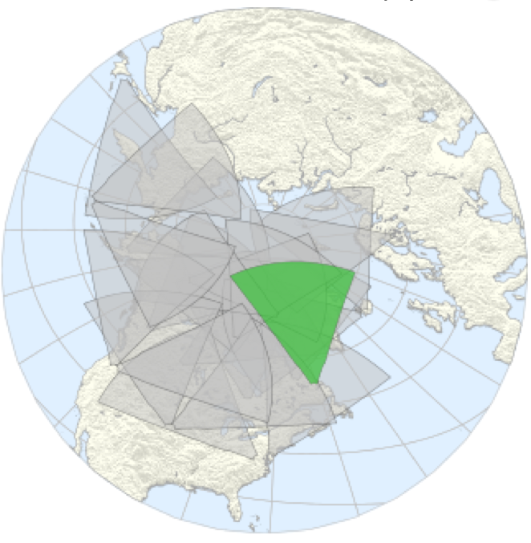
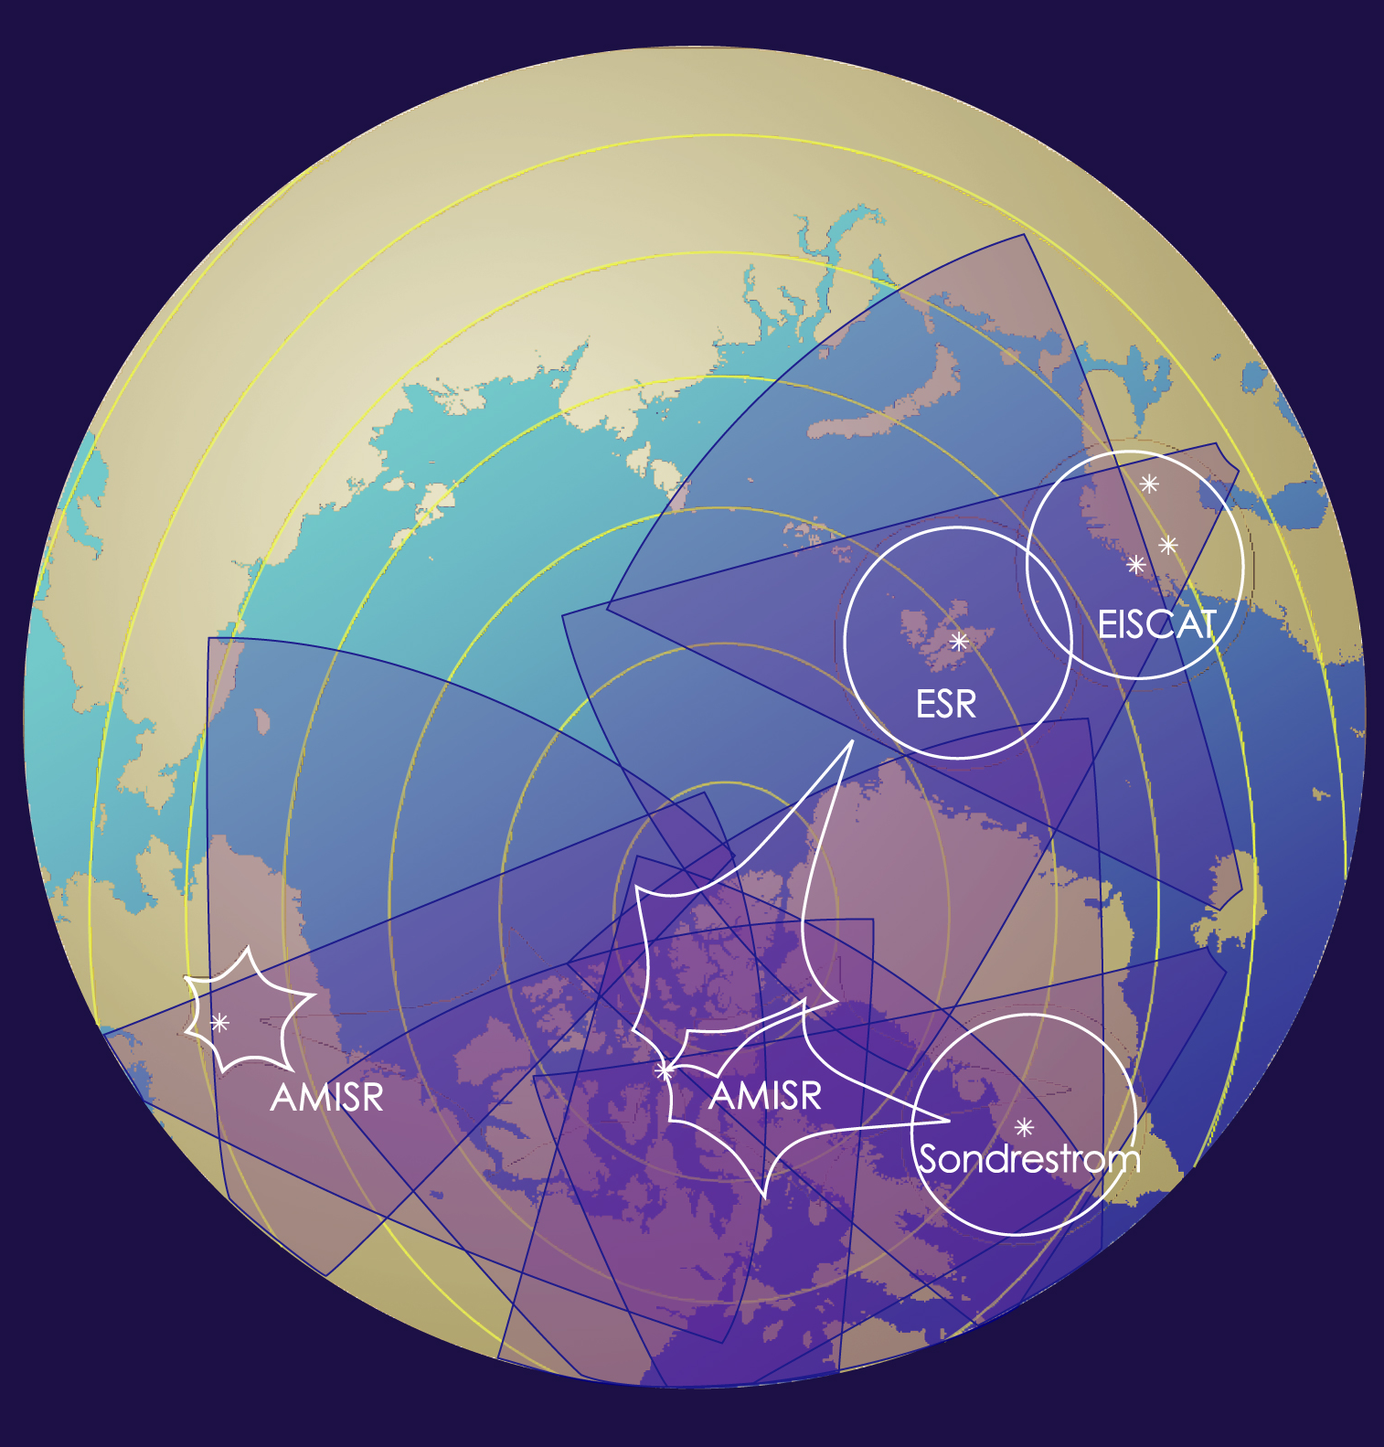
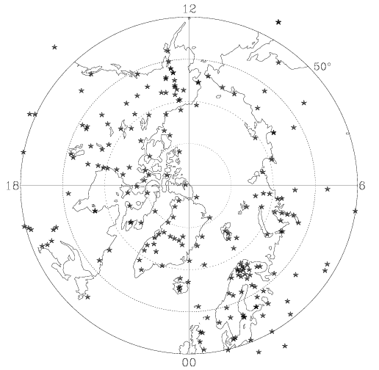
Ground Based Instruments
SuperDARN
IS Radars
magnetometers

Slide 6
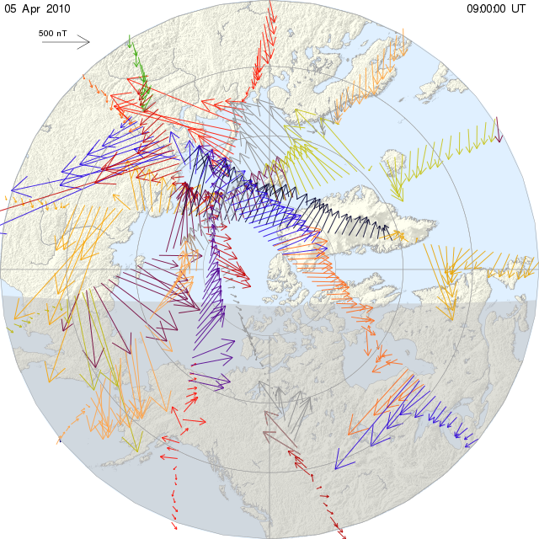
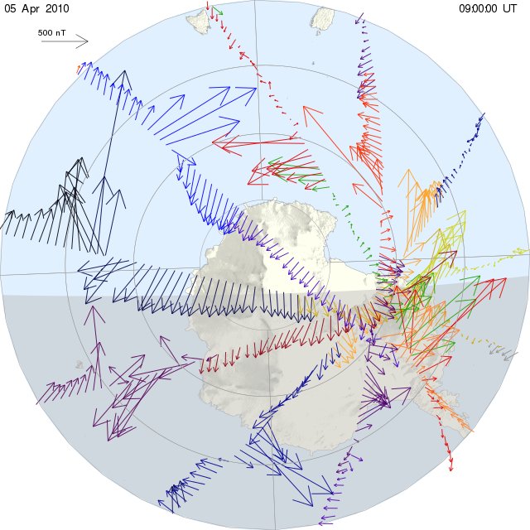
AMPERE Magnetic Field Measurements

Slide 7
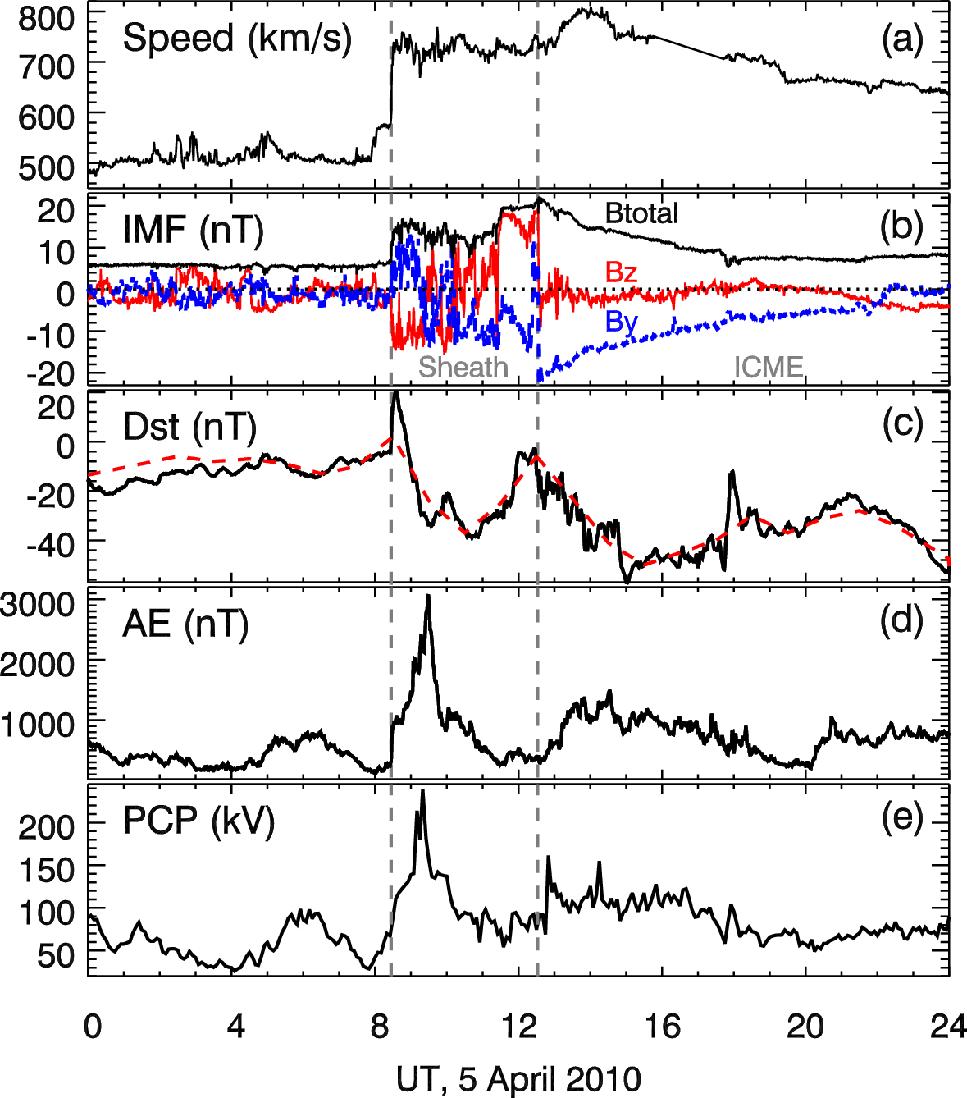
Solar Wind & Geomagnetic Conditions
Notes:
I’ll discuss a specific storm event during the April 2010 storm. This slide shows the geophysical condition on that day.
The internal between the vertical dashed lines marks the plasma sheath region proceeding the CME during solar wind dynamic pressure enhancement
After 12:30UT and during the passage of ICME, the IMF By slowly rotates from negative to zero while Bz had very smaller values and was mostly southward
- SSC, storm main phase, recovery phase
While Dst was relative small with a minimum value of ~50 nT, but AE was very large at ~3000 nT in peak value, which was similar to superstorms such as the Bastile Day storm in 2000 and the Halloween Storm in 2003.

Slide 8
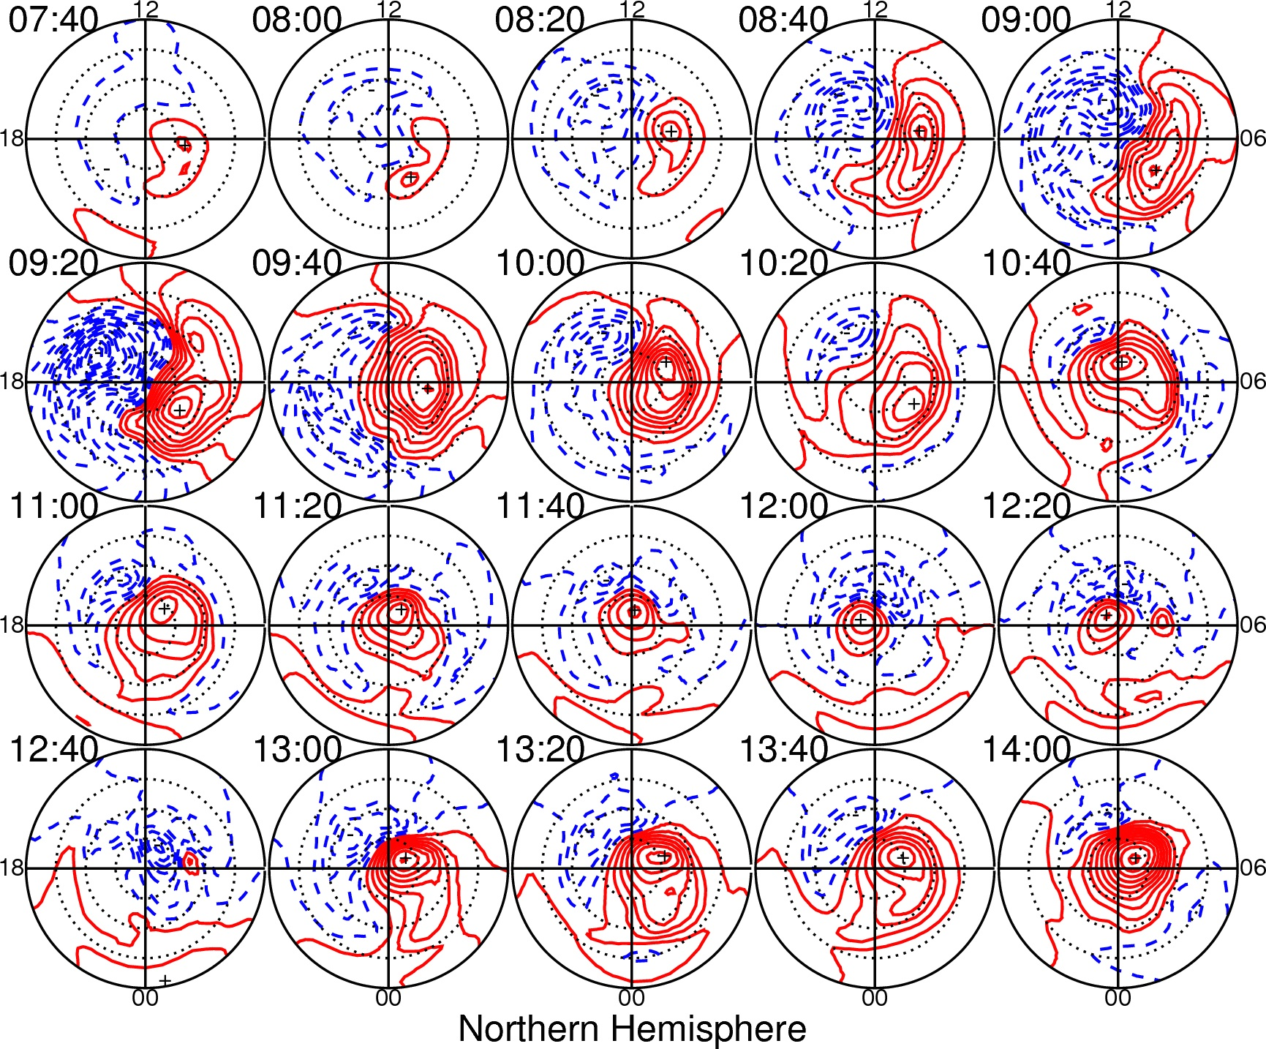
Notes:
Convection patterns in 20-min increment
- Dramatic change in large-scal plasma convection configuration

Slide 9
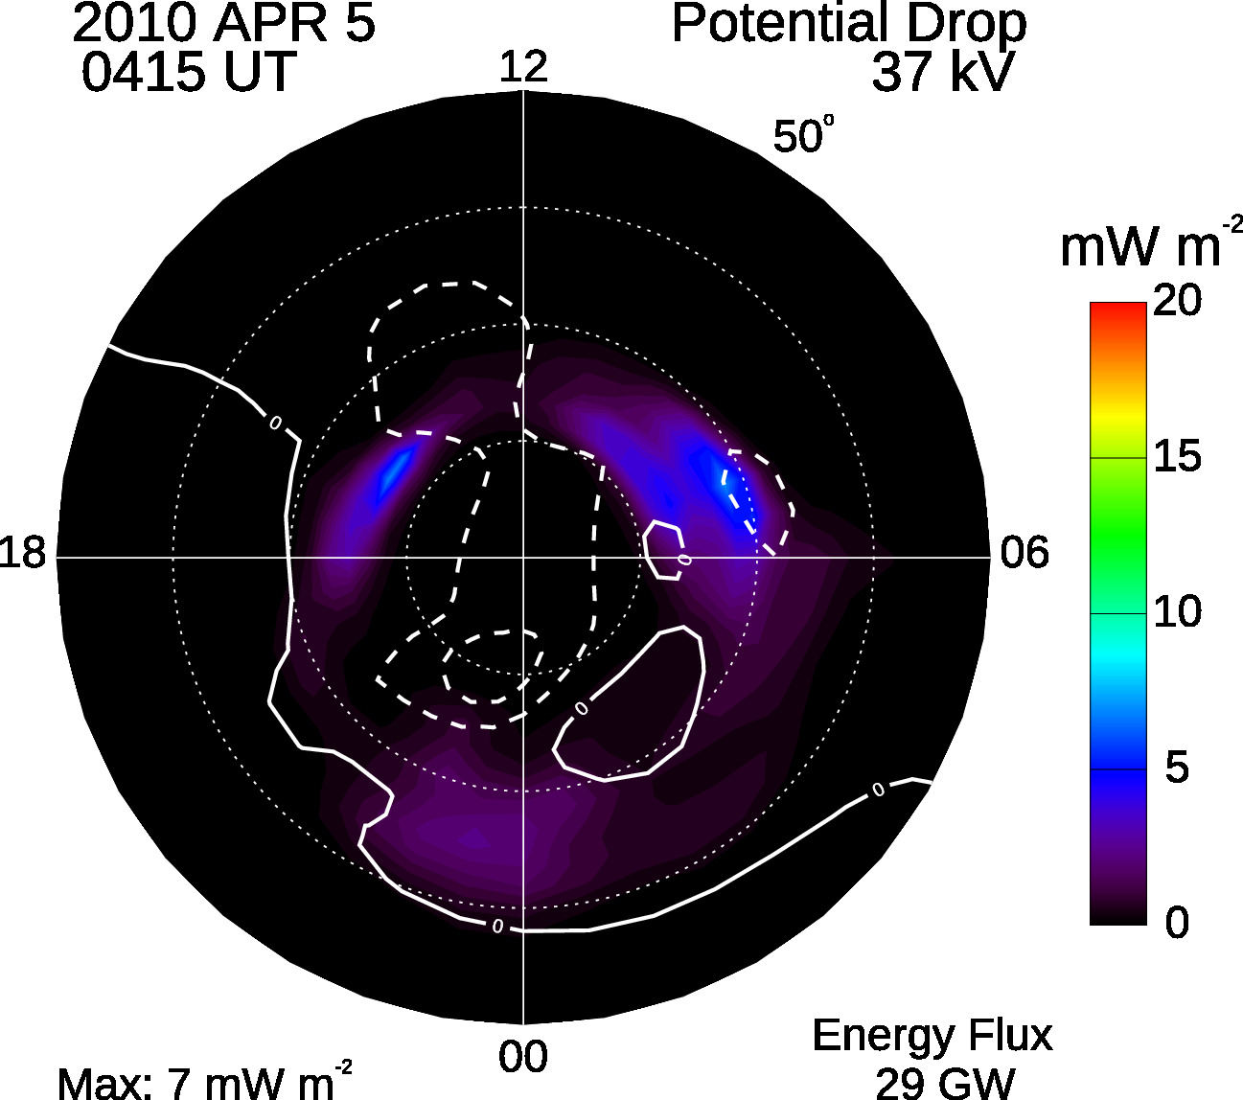
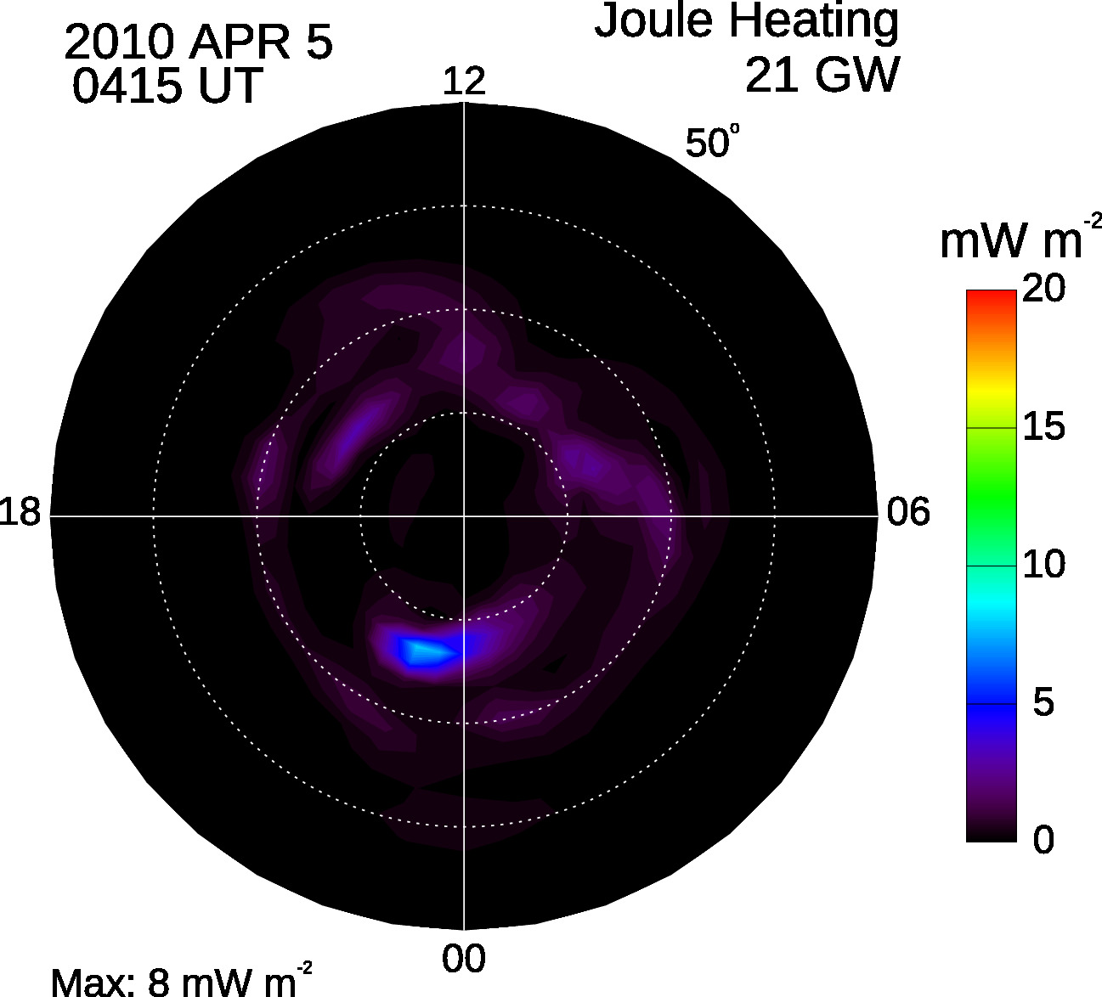
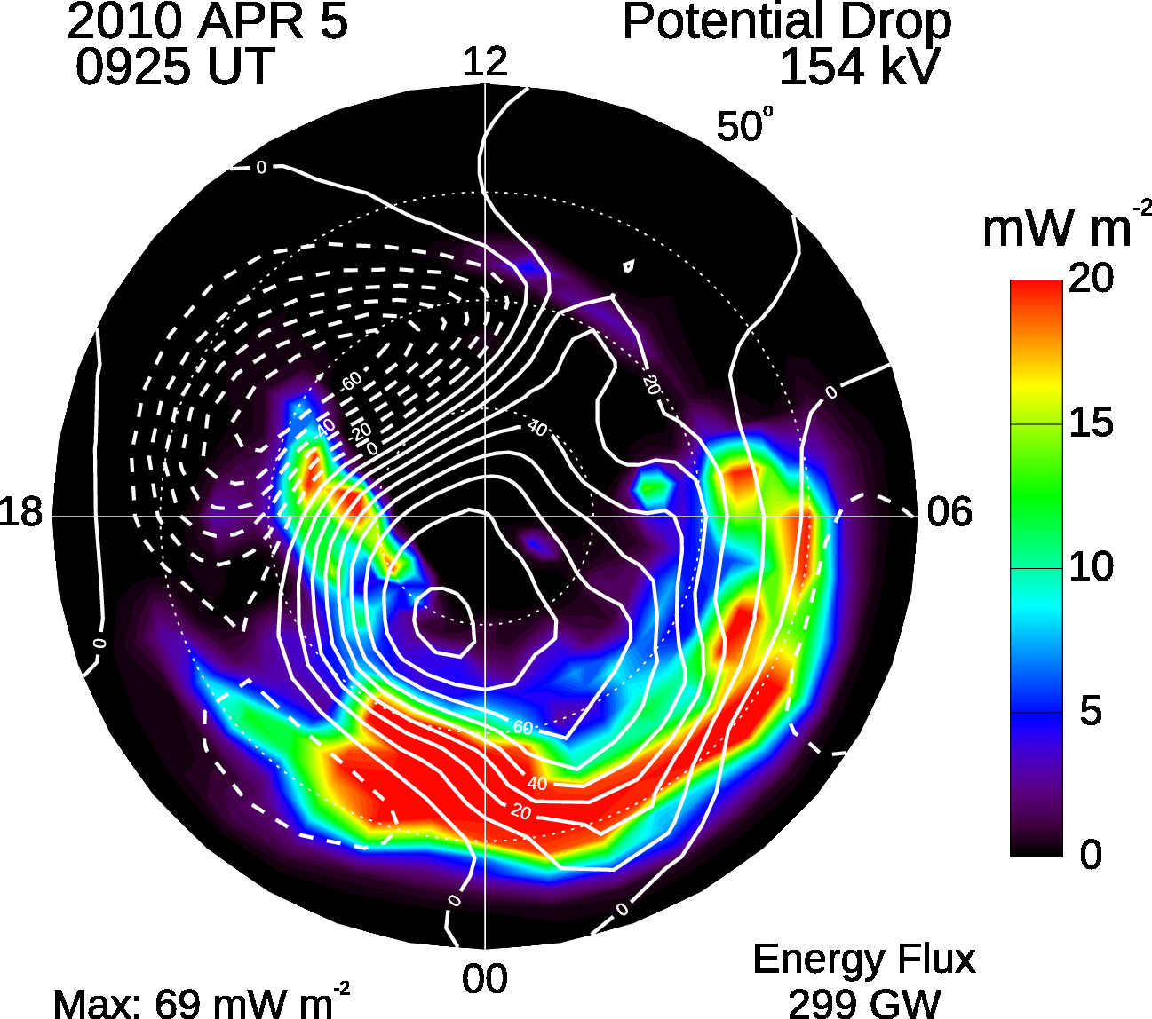
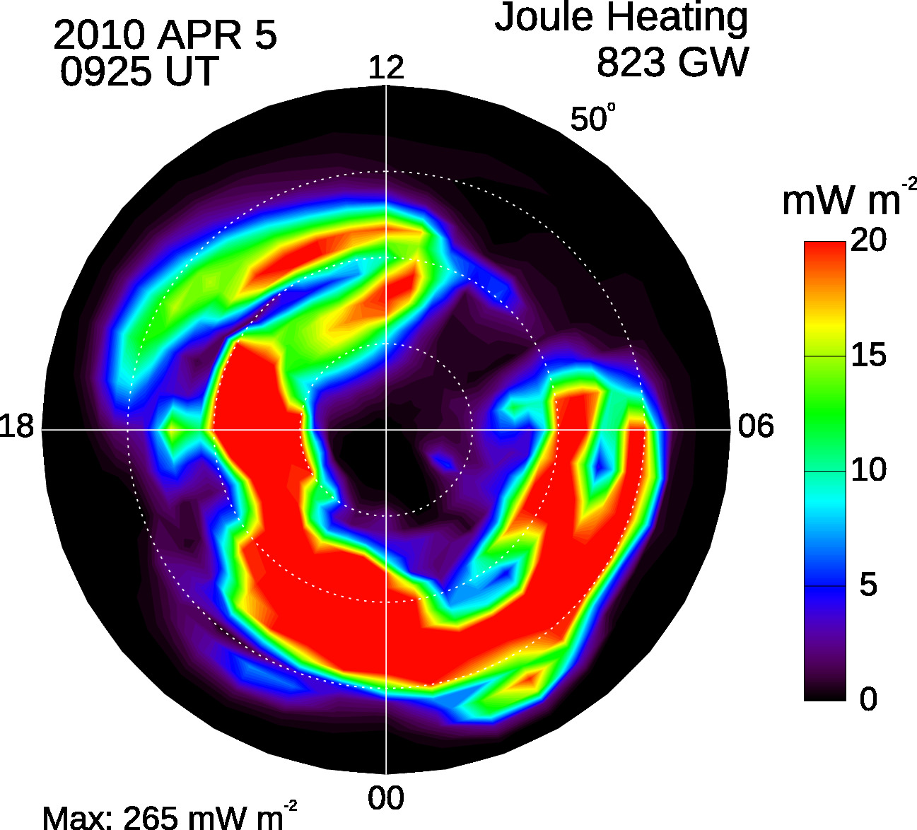
Quiet Time
Storm Time

Slide 10
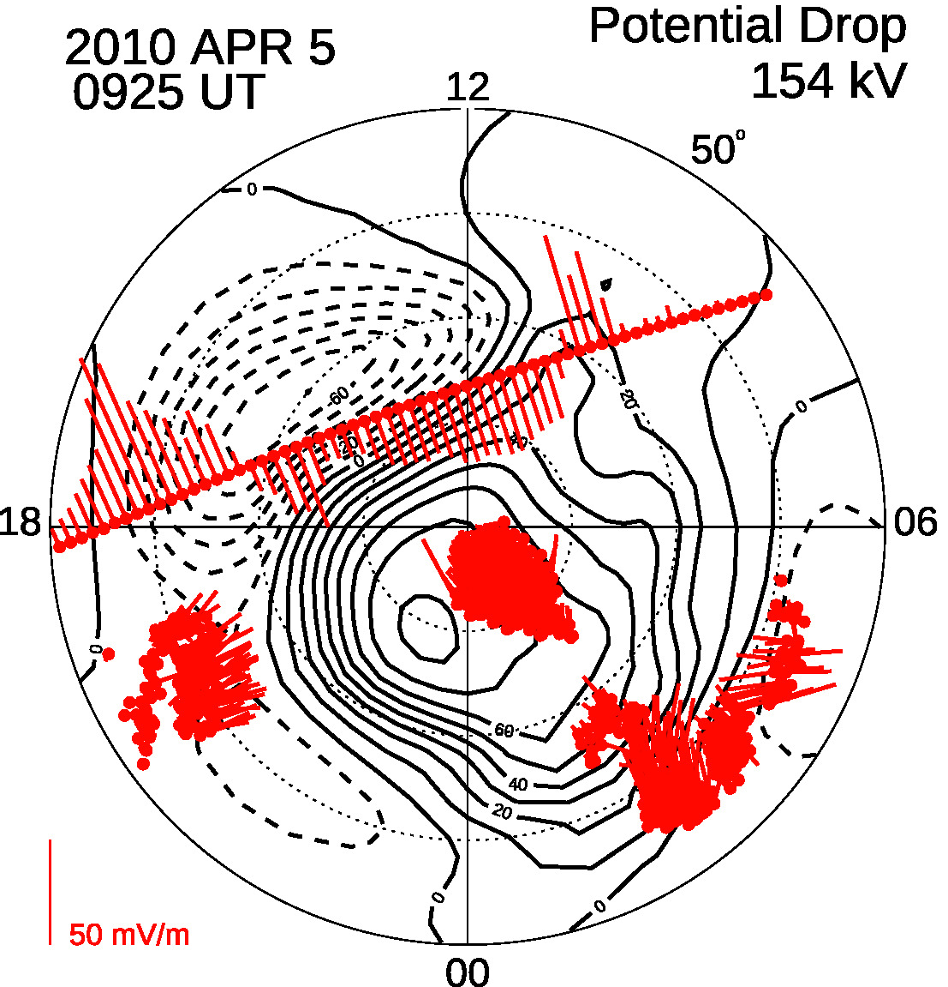
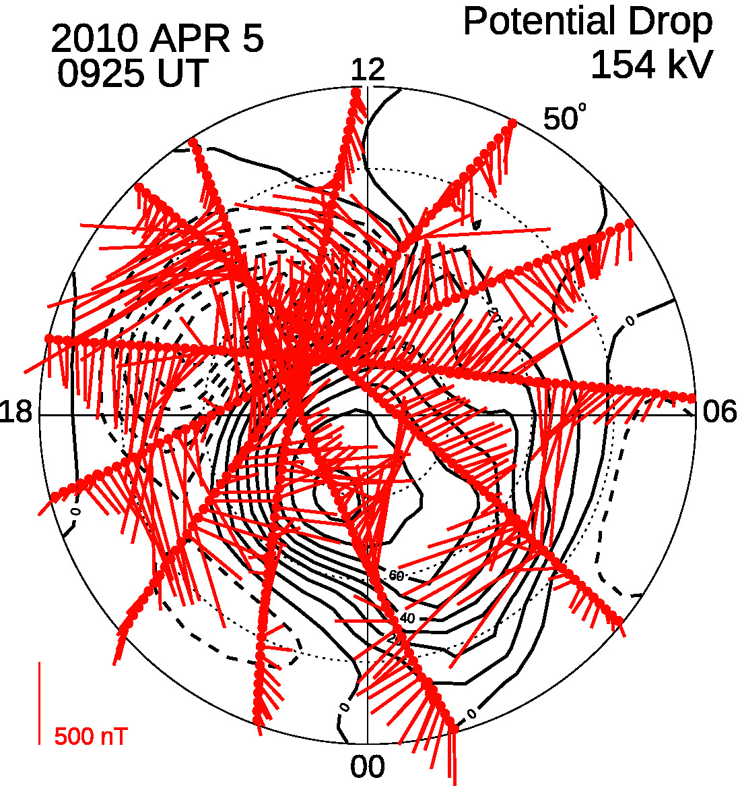
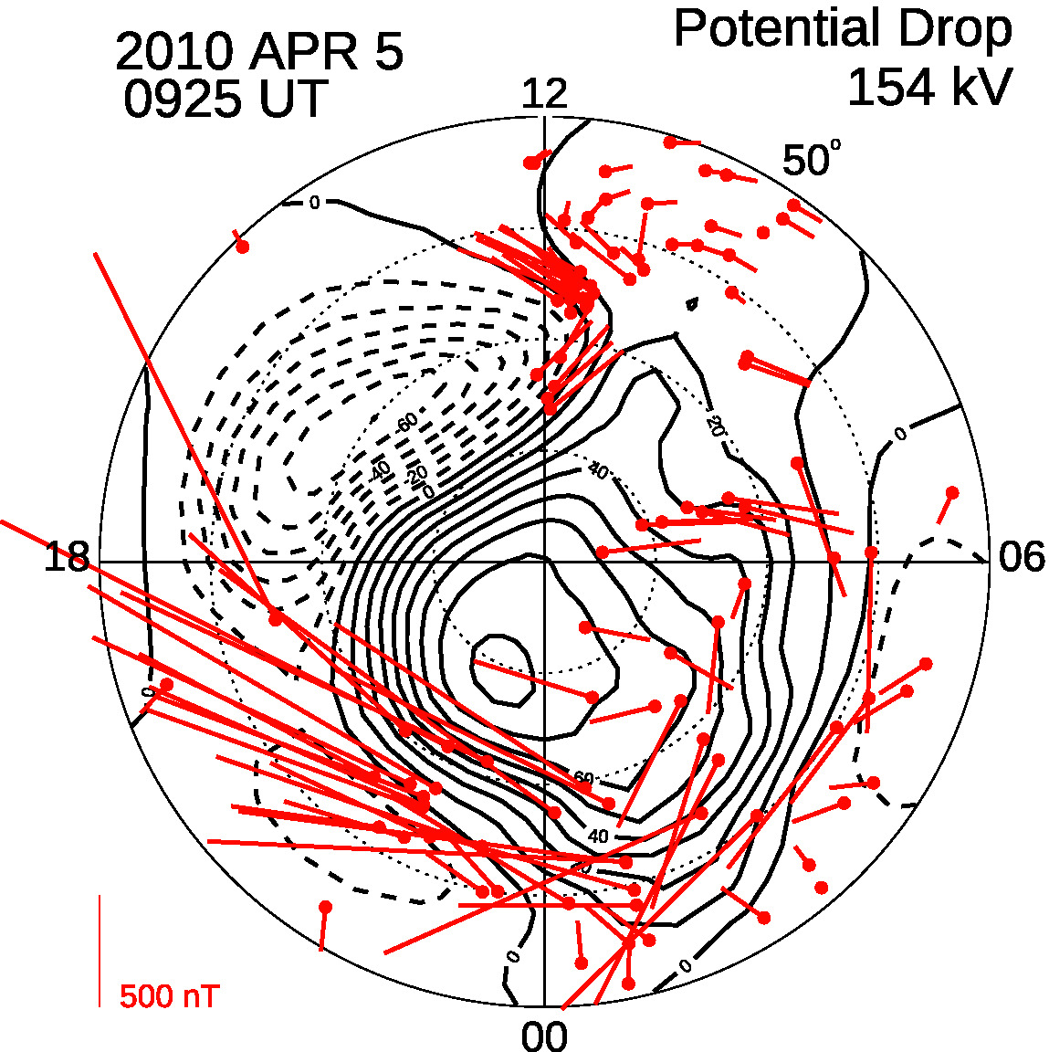
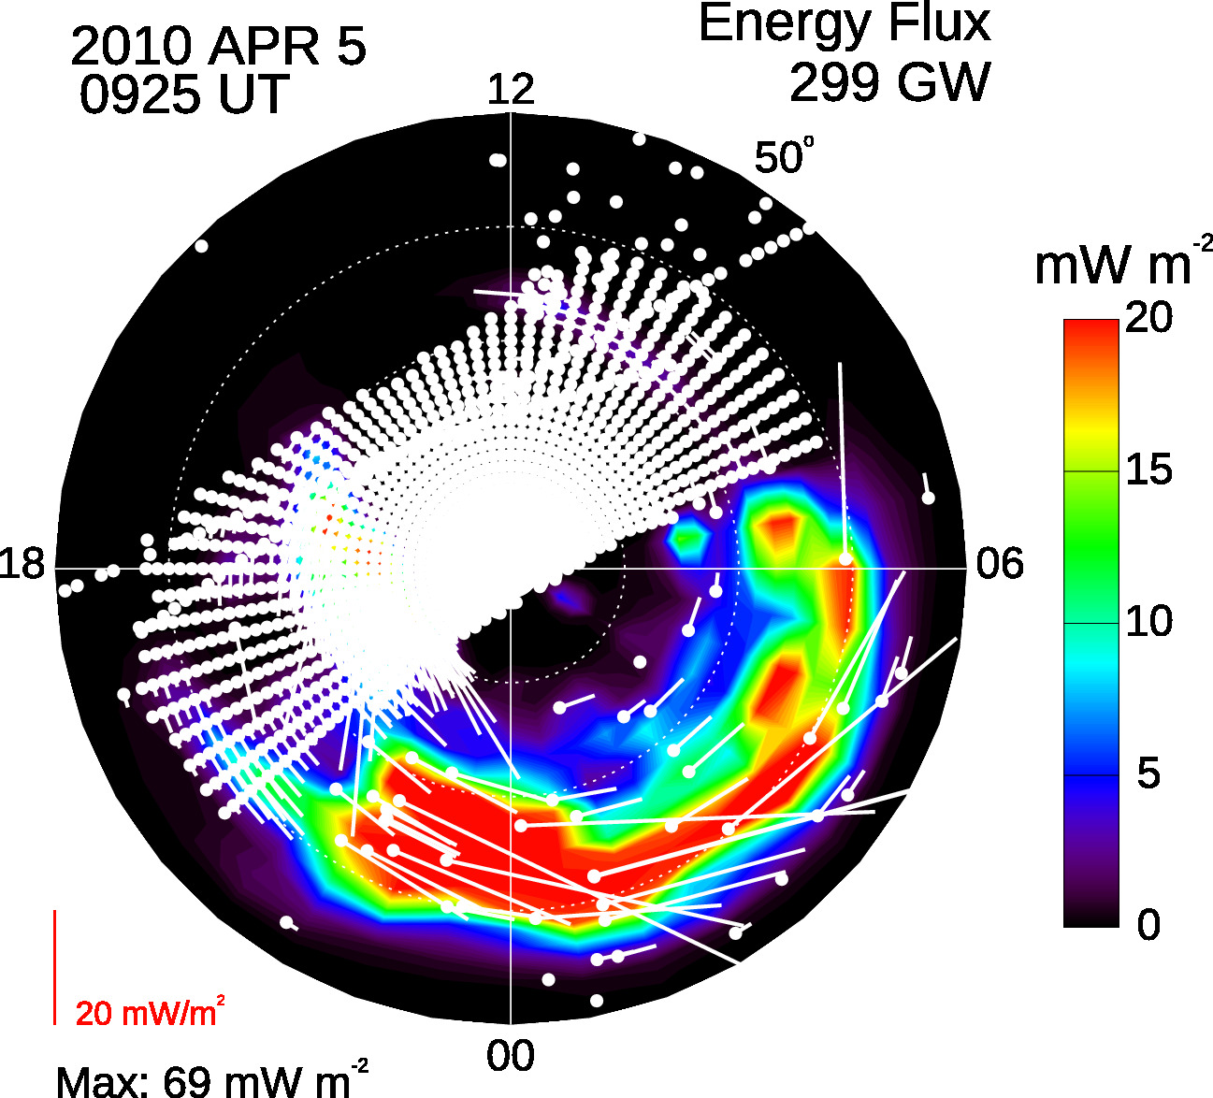
DMSP + SuperDARN
AMPERE
Ground Magnetometers
DMSP SSJ5
DMSP SSUSI
GMAG

Slide 11
High-Latitude Electrodynamic Fields are important
Drivers of the Neutral Atmosphere
Solar
Radiation
Auroral Precipitation
Plasma Convection
TIEGCM
(Thermosphere-Ionosphere- Electrodynamics General Circulation Model)
95 ~ 600 km
TIMEGCM
(Thermosphere-Ionosphere-Mesosphere- Electrodynamics General Circulation Model)
35 ~ 600 km
WACCM-X
(Whole Atmosphere Community Climate Model- eXtended)
0 ~ 600 km
Notes:
These are the NCAR upper atmospheric models

Slide 12
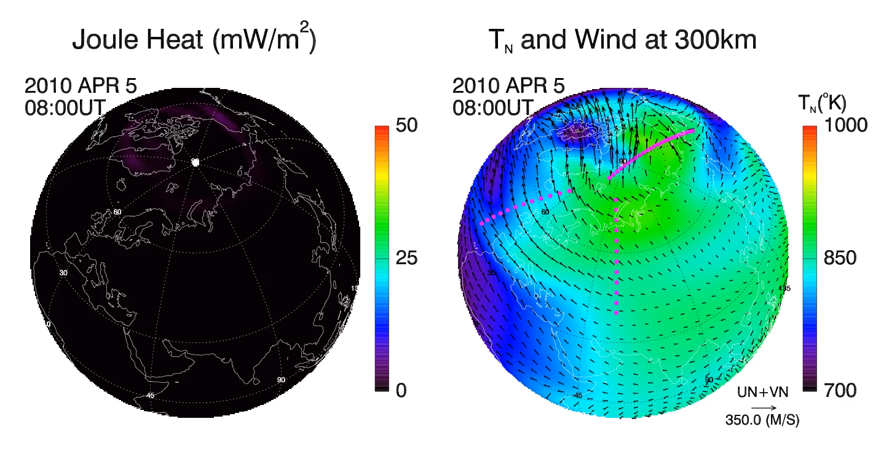
Notes:
I’d like to end my talk by showing a movie to illustrate again the global thermospheric response to magnetospheric forcing.
The left side panel shows the height-integrated JH. At 8UT period to the storm, JH dissipation is very small
The right side panel shows TN at 300 km and overlaid with winds vectors.
There were three thermospheric satellites operating during the storm, namely GOCE in the dawn-dusk plane, CHAMP in noon-midnight, and GRACE in prenoon-premidght
As the movie, you will see that even with three strategically position satellites, they are not adequate to fully capture the storm-time thermospheric disturbances
>>> I hope I have given you a flavor of the highly complex nature of thermospheric winds in response to forcing from both on meso-scale and on global scale. Under disturbed condition, forcing from the magnetosphere is far larger than forcing from below, and is the dominant factor for space weather.

Slide 13
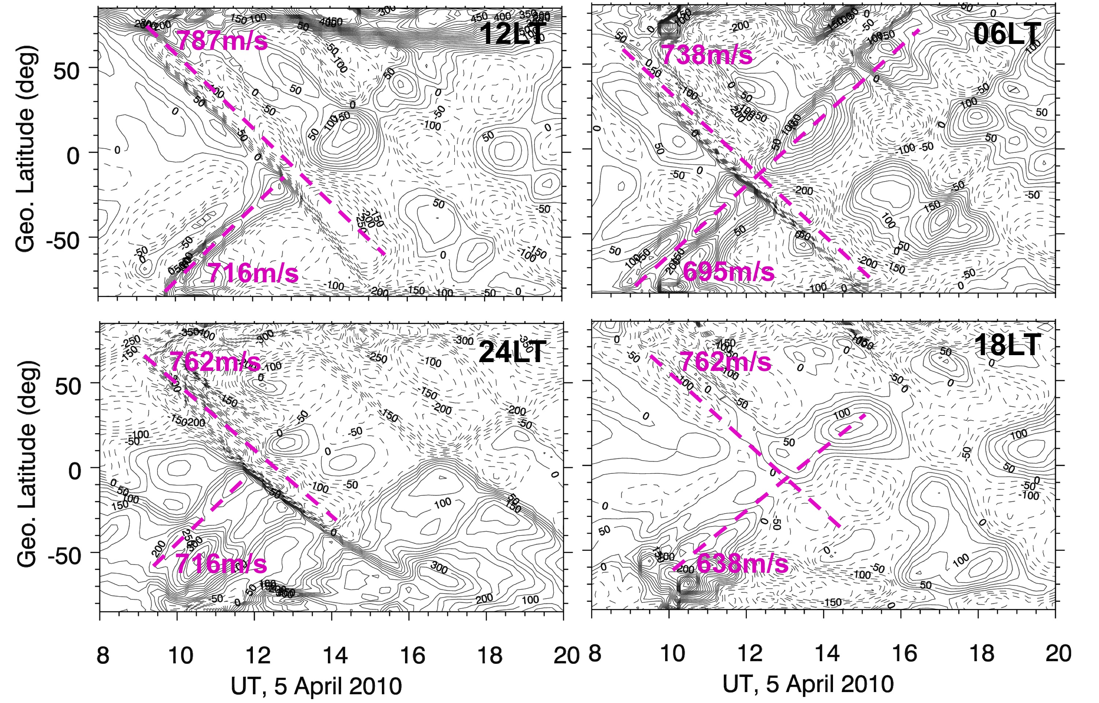
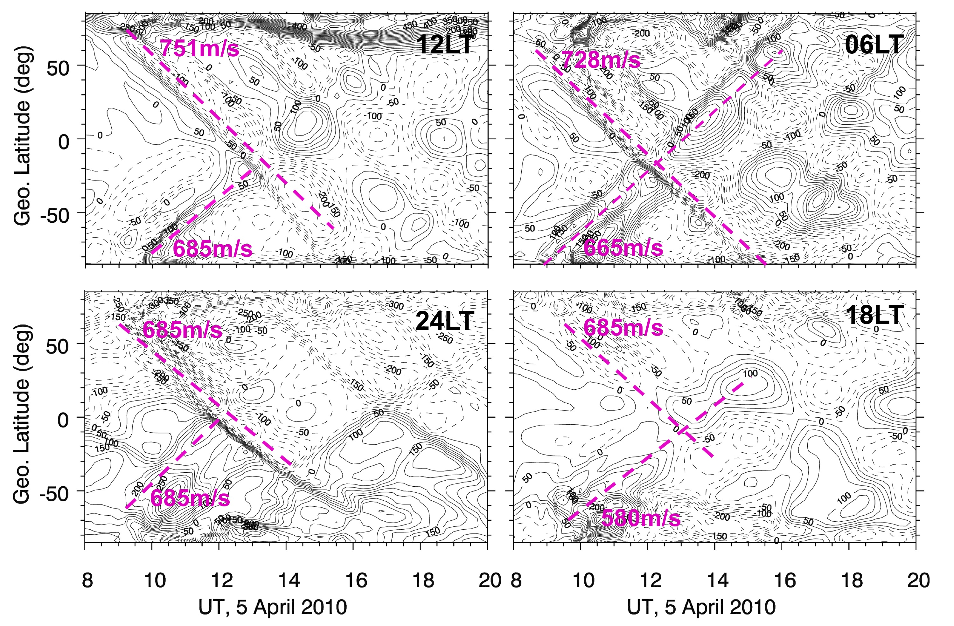
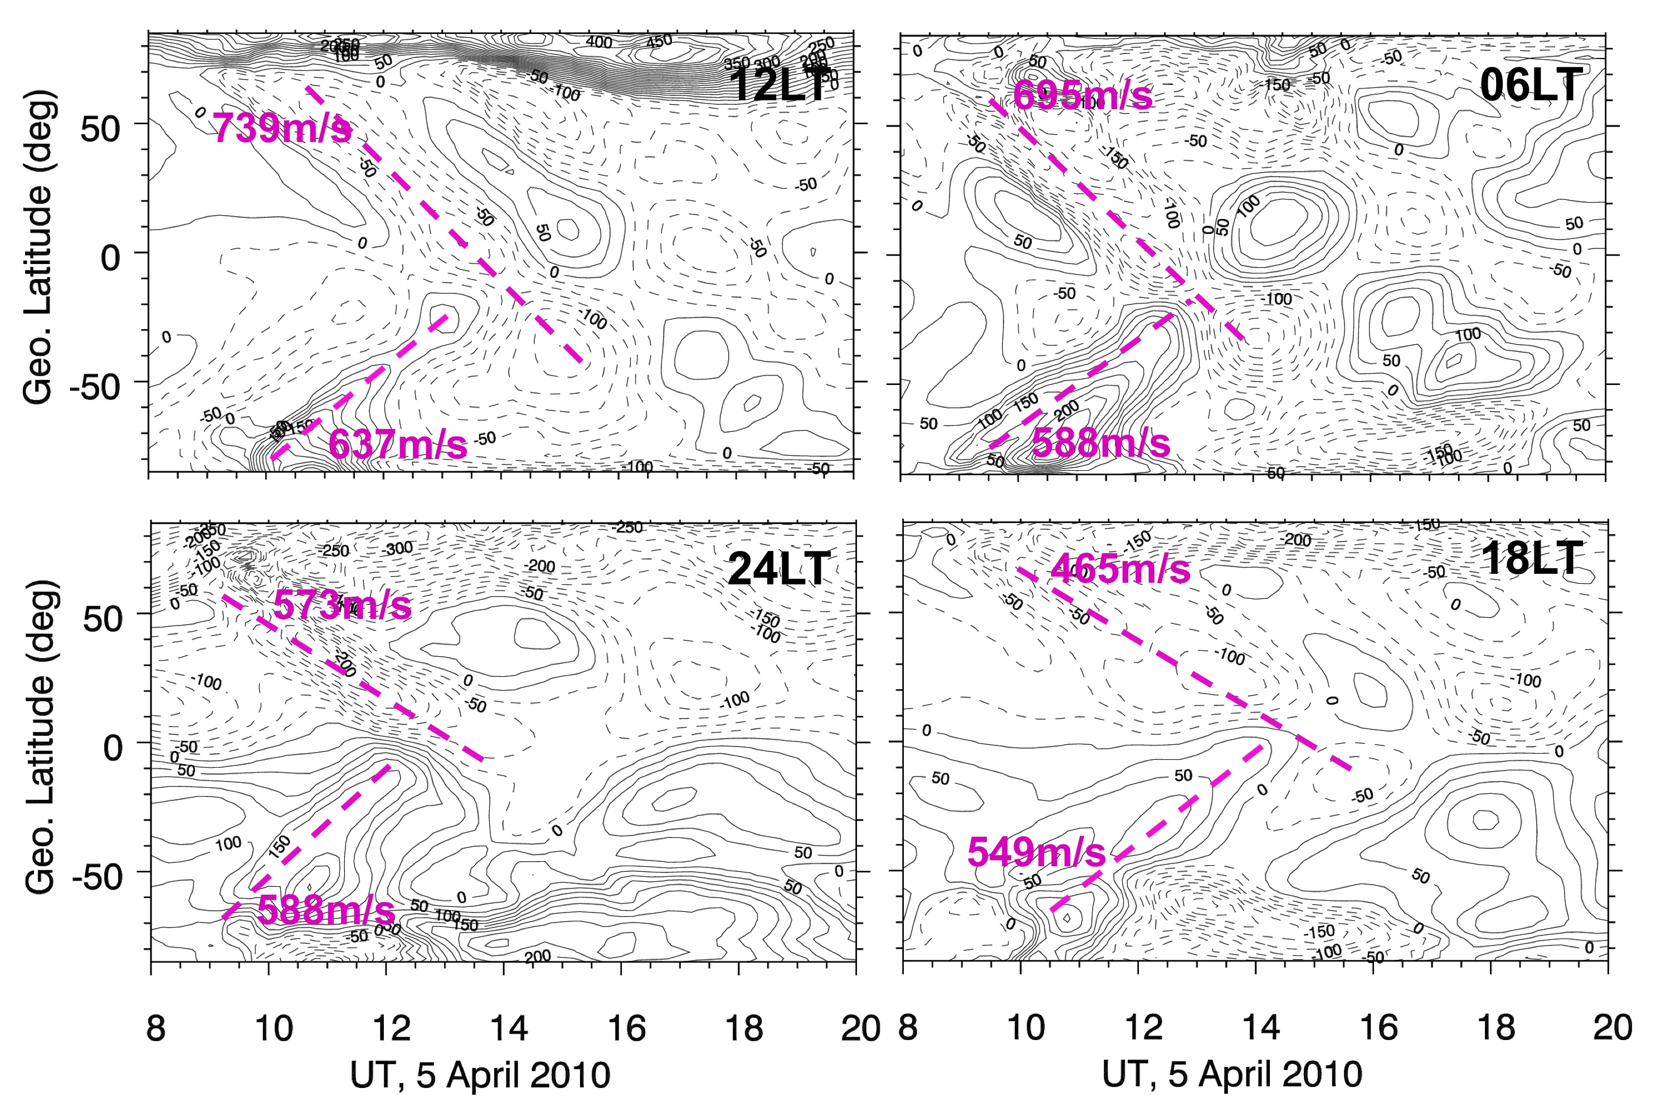
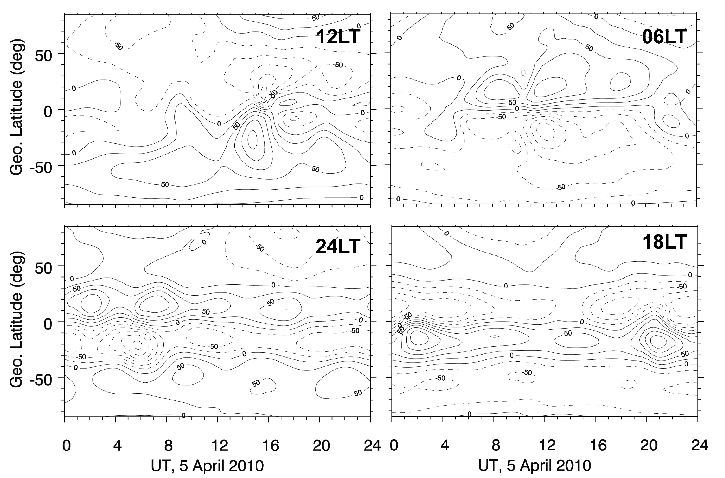
How deep can the forcing from above penetrate?
400 km
300 km
200 km
100 km

Slide 14
Storm Effects on Global Temp. & Density

Slide 15
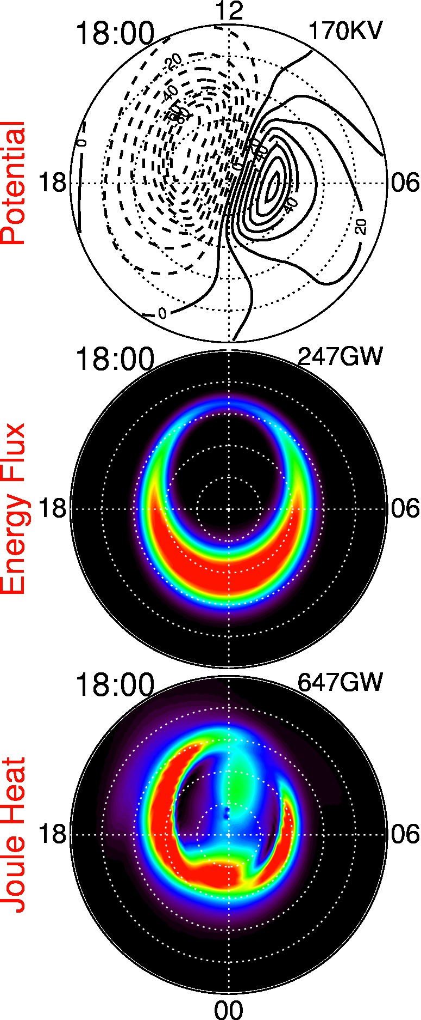
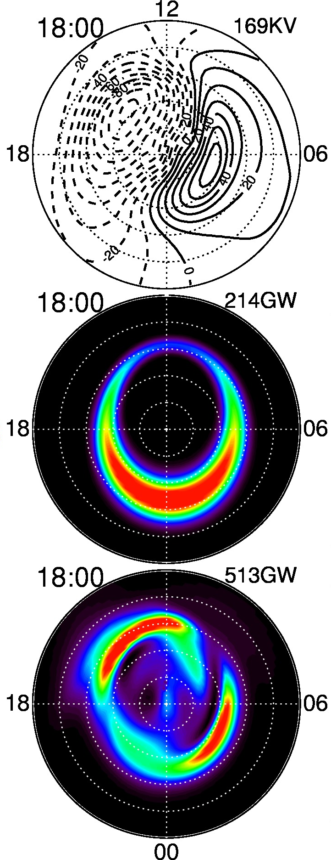
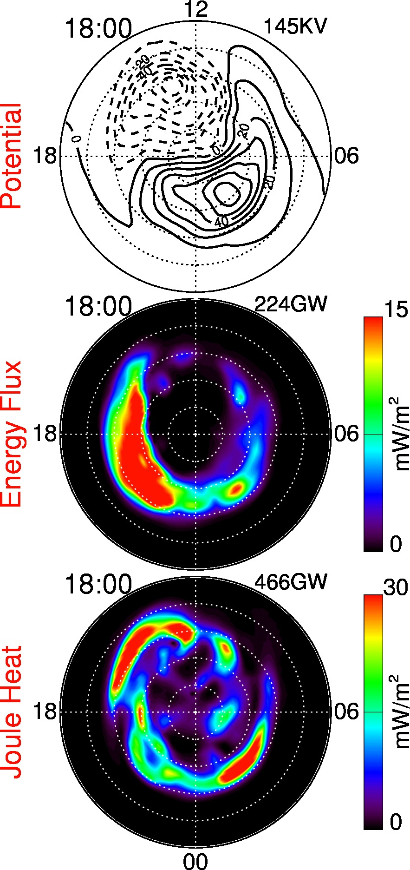
Heelis
Weimer
AMIE
18:00 UT, 17 March 2015

Slide 16
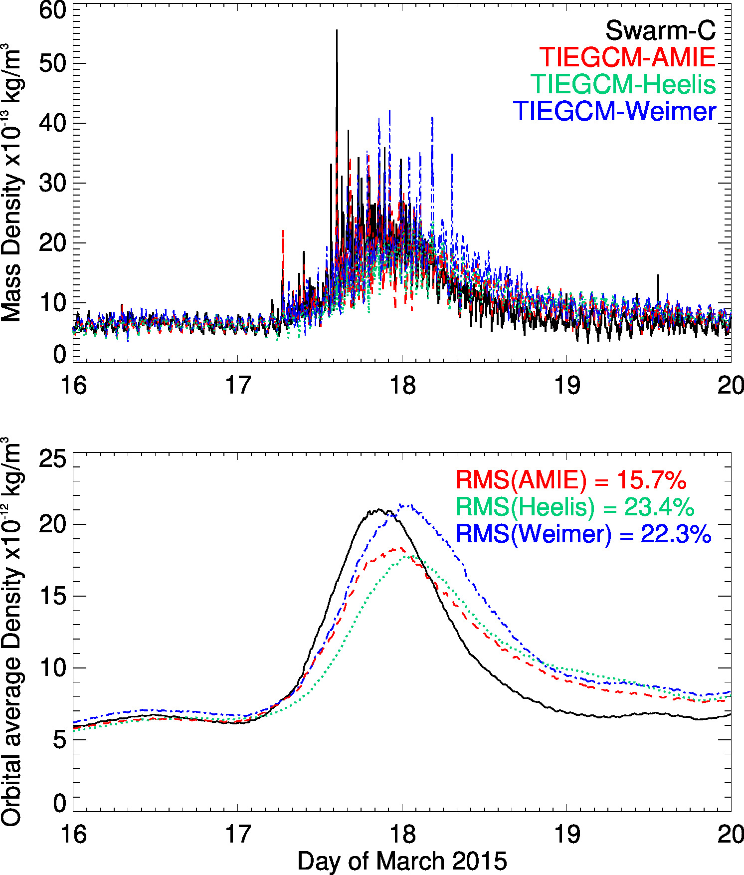
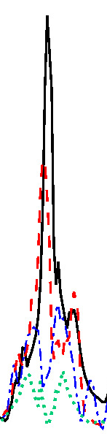
Comparison with Swarm Mass Density
14:30 UT

Slide 17
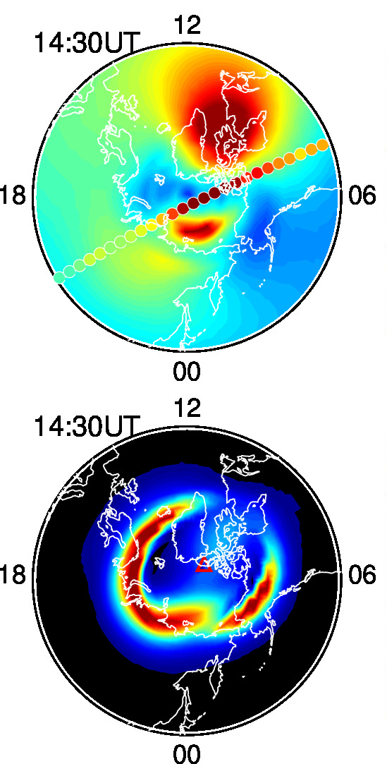
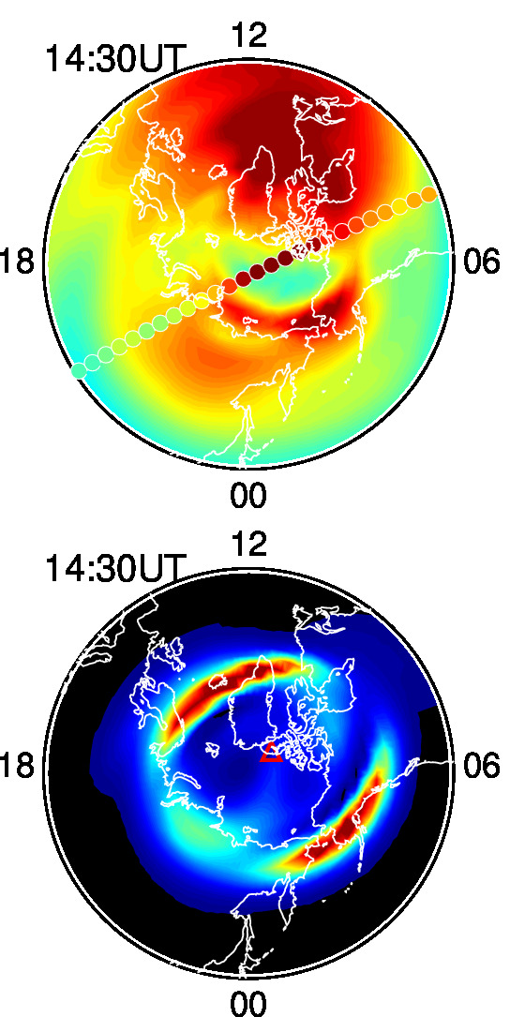
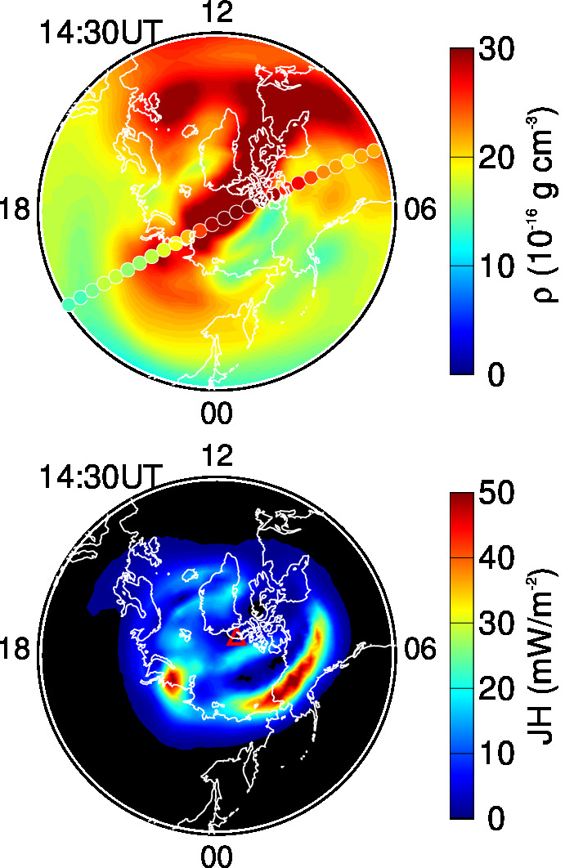
Comparison with Swarm Mass Density
TIEGCM-Heelis
TIEGCM-Weimer
TIEGCM-AMIE
Notes:
Increased mass density does not coincide with JH

Slide 18
Summary
AMIE is a useful tool to assimilation other ground and space-based observations that complement the GDC mission.
Coupled AMIE-TIEGCM is able to capture the main storm features in the IT system, but quantitative model-data differences still exist.
The GDC mission will provide unprecedent coverage of the global IT system, and advanced data assimilation tools as well as numerical modeling can greatly enhance its scientific objectives.
TEC
TEC
TEC
Notes:
- Only talked about forcing from above

Slide 19
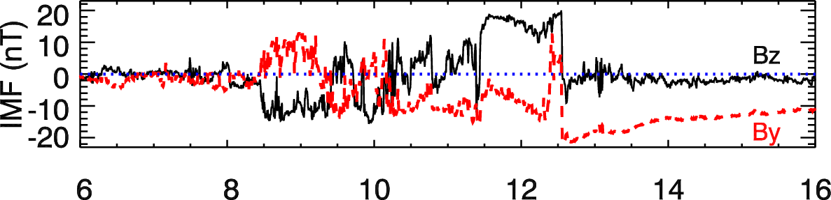
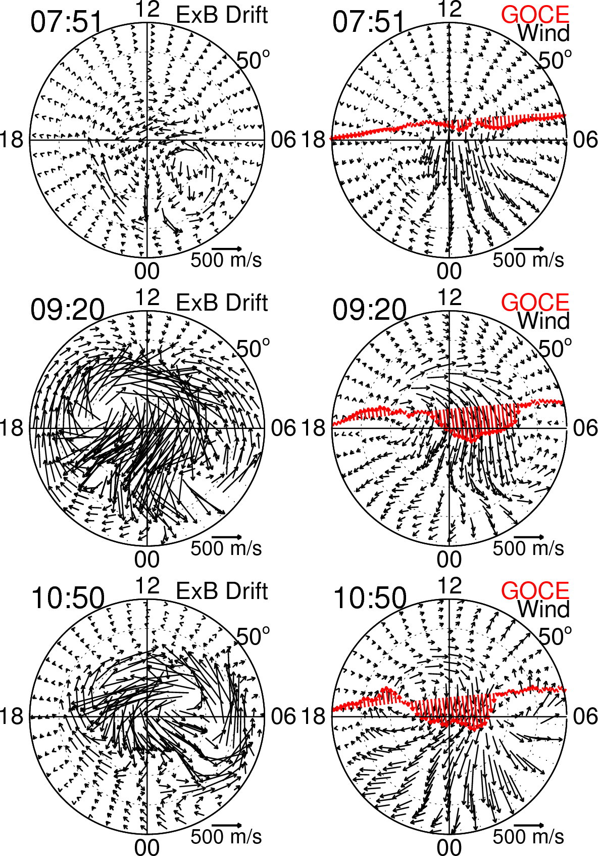
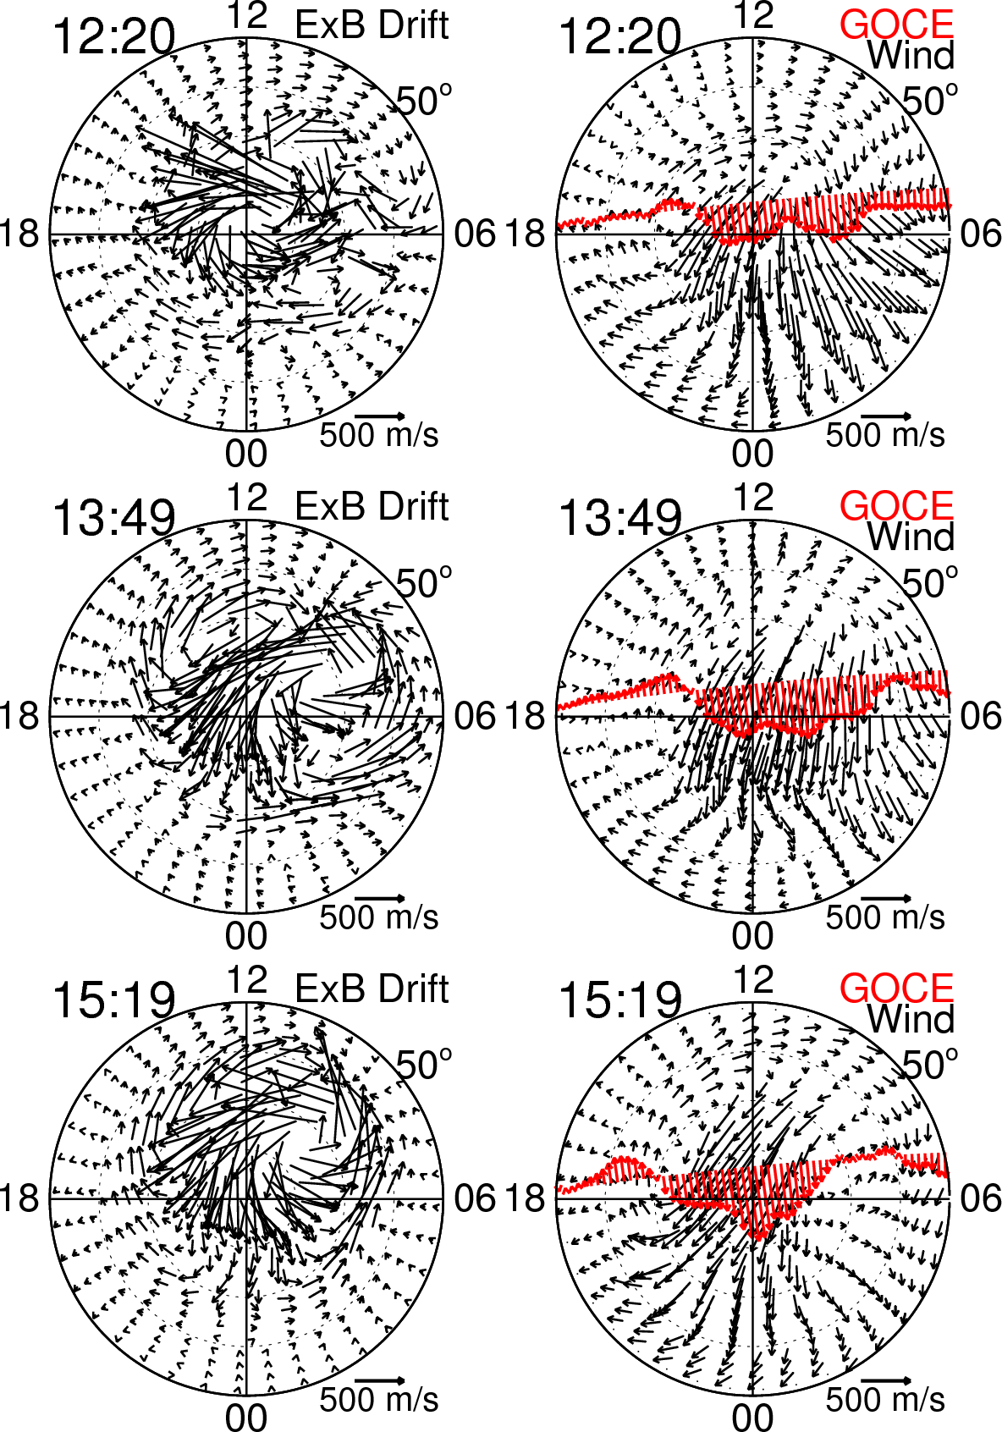
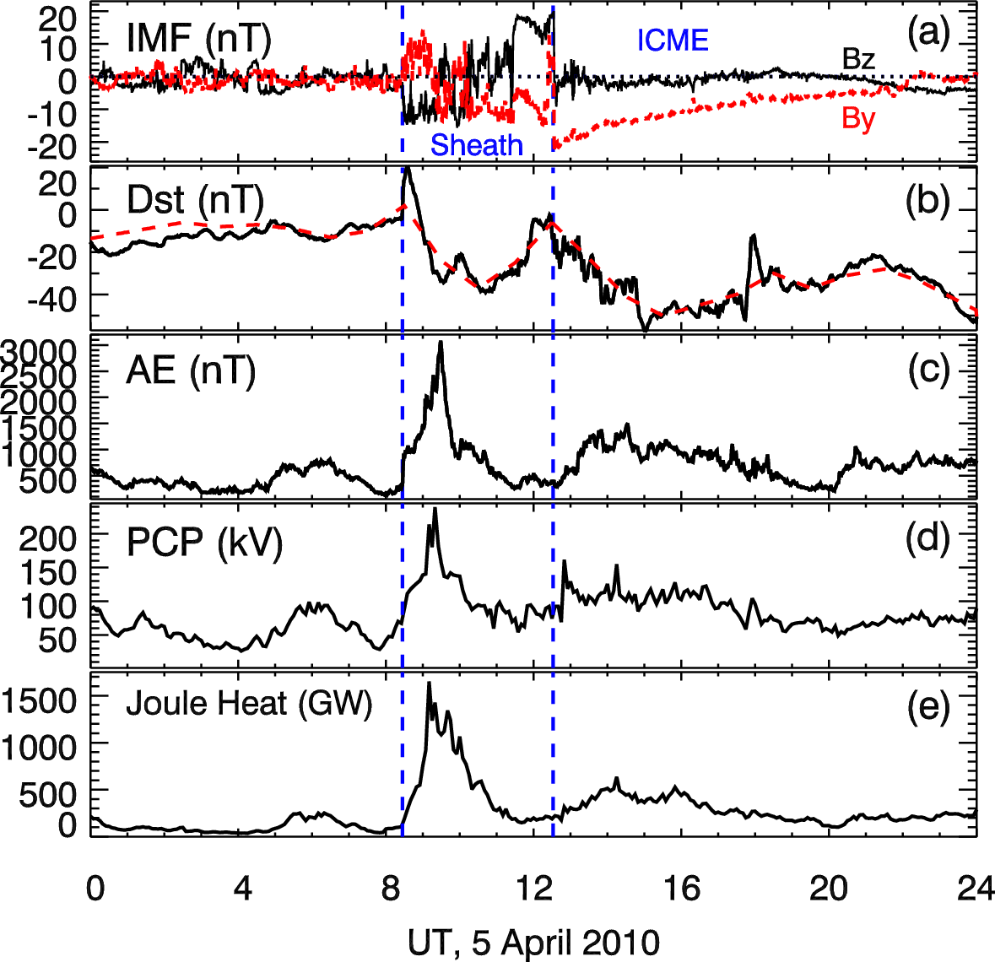
Notes:
In order to investigate how thermospheric winds response to the very dynamic magnetospheric forcing, we use the plasma convection and auroral precipitation patterns obtained using the AMIE data assimilation algorithm based ob various ground- and space-based measurements to drive the NCAR TIMEGCM model. I am going to show the neutral wind at 250 km during the different phases of the storm.
- Plots are in geographic coordinates, and the center of each plot is the geographic pole so that the convection pattern looks somewhat skewed.
Very dynamic ion drift
While the winds are also going through major changes, but they are much less drastic compared to ion drift
Good qualitative agreement with GOCE measurements, especially the wind reversals are well captured by the double-res TIMEGCM simulations

