Slide 1
GOLD Image Simulation
Stan Solomon
High Altitude Observatory
National Center for Atmospheric Research
GOLD Science Team Meeting • Boulder, Colorado • 25 August 2016

Slide 2
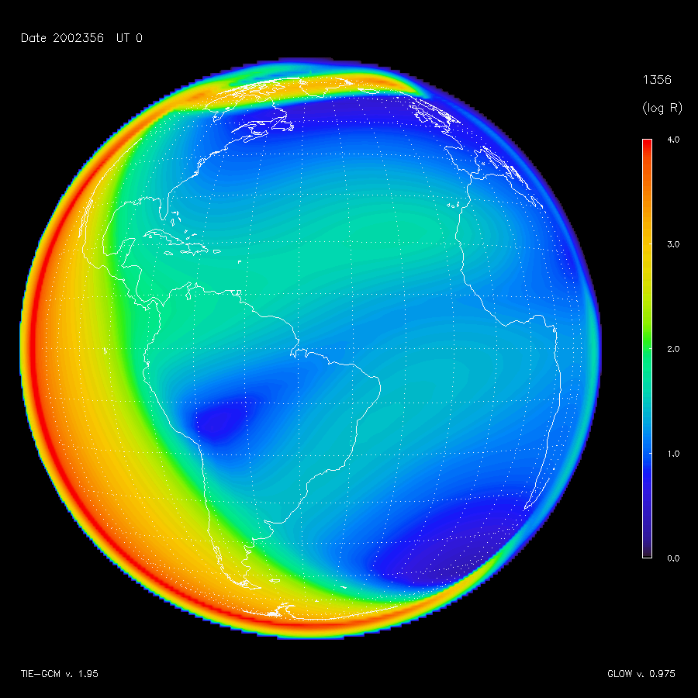
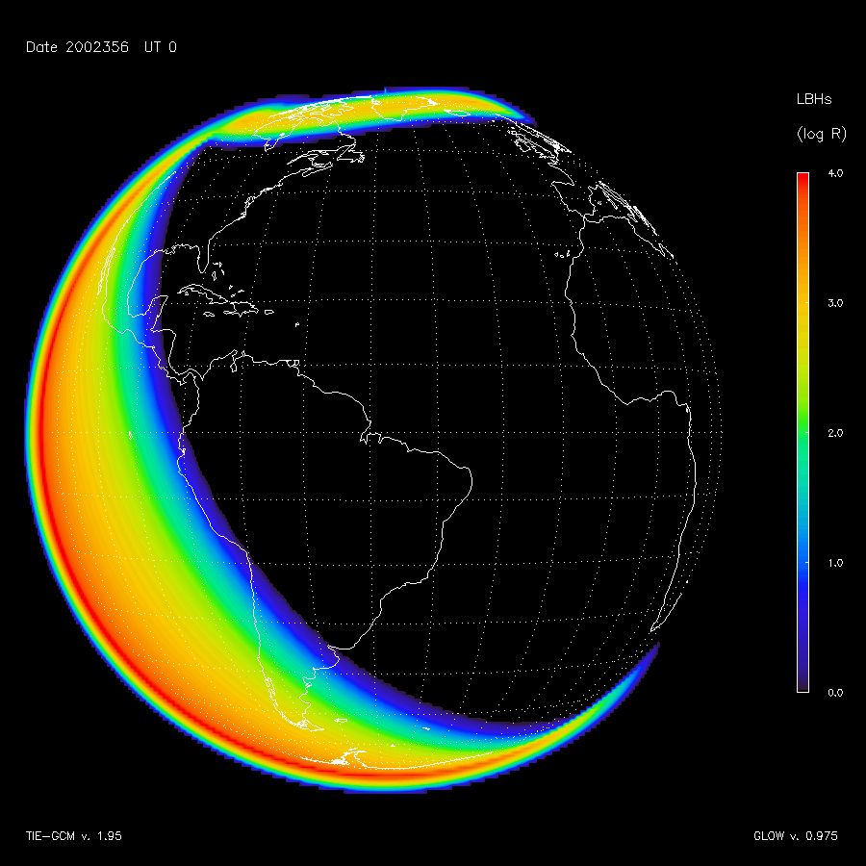
Example Simulations
O(⁵S) Doublet at 135.6 nm N₂ LBH “short” bands 141-153 nm

Slide 3
Simulation Animation
Notes:
This is based on a TIE-GCM simulation of the December 2006 “AGU Storm.”

