Slide 1
GOLD Spectral Image Simulation
Stan Solomon
High Altitude Observatory
National Center for Atmospheric Research
GOLD Science Team Meeting • Boulder, Colorado • 24 August 2016

Slide 2
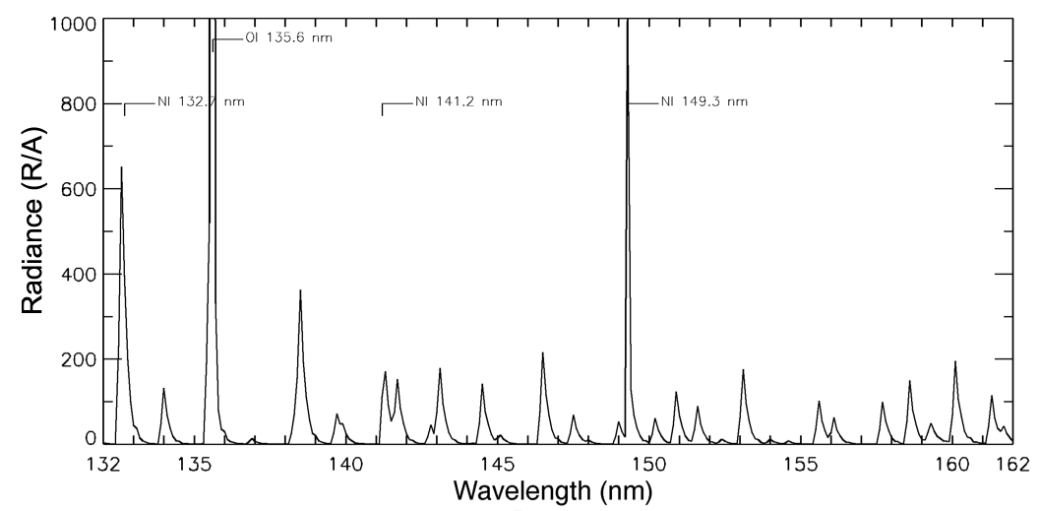
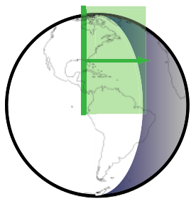
GOLD Measurement Technique
Daytime Far-Ultraviolet Spectrum
Atomic Oxygen 135.6 nm doublet
N₂ LBH bands
Horizontal scan of disk & limb; image along vertical slit
• Temperature obtained on disk from rotational shape of N₂ LBH bands
• O/N₂ composition measured using ratio of 135.6 doublet to LBH bands
• Temperature on limb determined by slope of emission altitude profile
• O₂ profile on limb from stellar occultations
• O⁺ at night observed using 135.6 recombination emission

Slide 3
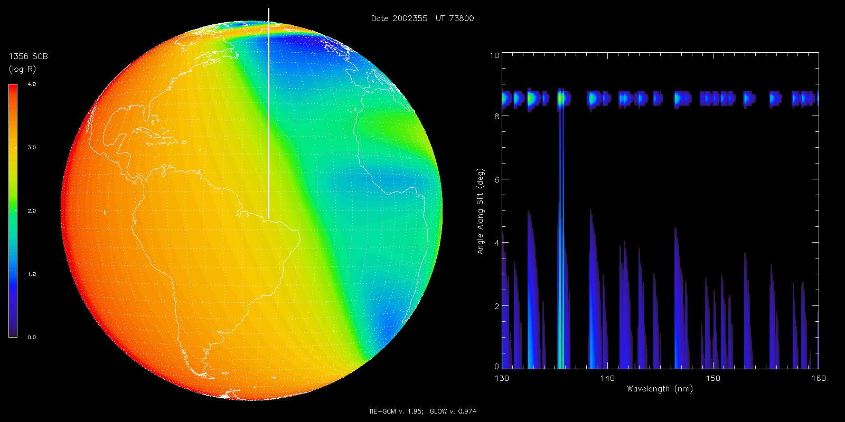
Image Cube Simulation
Disk Image Detector Image

Slide 4
Image Cube Simulation
Disk Image Detector Image

