Slide 1

Observation System Simulations for the GOLD Mission
Stan Solomon
High Altitude Observatory
National Center for Atmospheric Research
HAO/NCAR • 13 January 2016

Slide 2
Outline
• The Global-scale Observations of the Limb and Disk mission
— introduction and overview
• Observations and measurement technique
• Global Modeling and airglow simulations
• Work in progress on radiative transfer effects

Slide 3
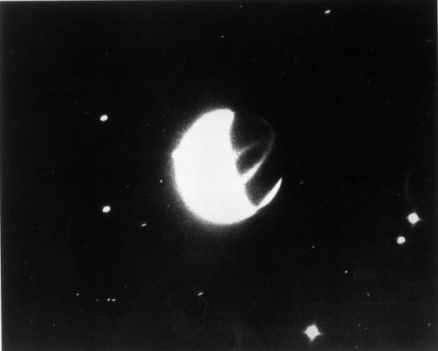
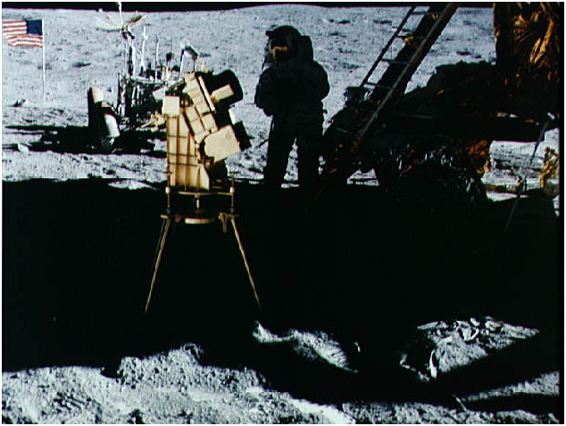
Global UV Imaging: Primeval Heritage
Dayglow
Equatorial Ionization Anomalies
Aurora
Far-Ultraviolet Image of the Earth George Carruthers, Instrument PI
John W. Young with Apollo 16 Far-Ultraviolet Camera

Slide 4
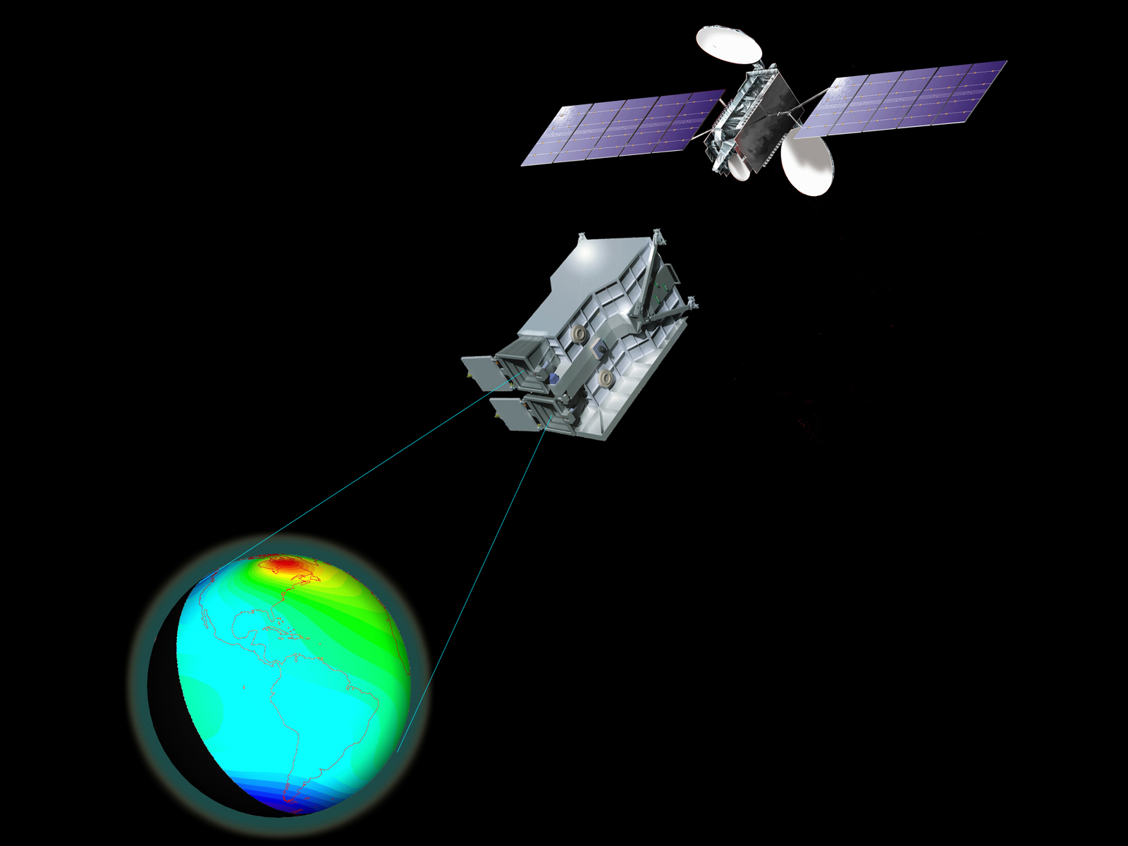

Slide 5
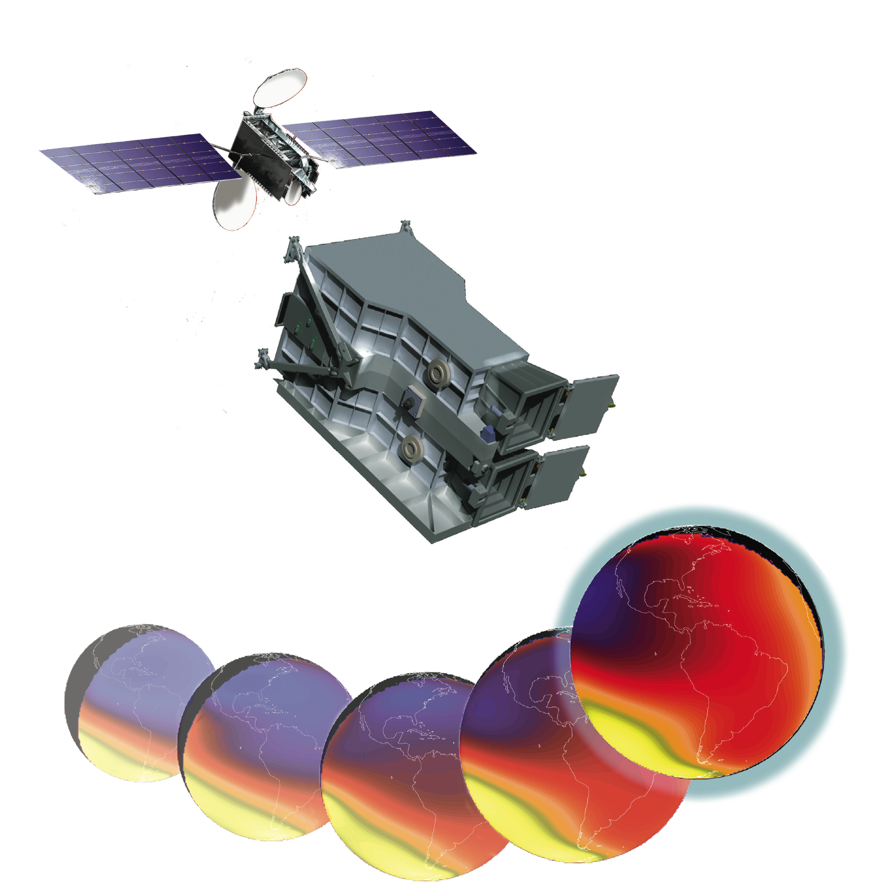

Global-scale Observations of the Limb and Disk
GOLD is an ultraviolet imaging spectrograph to measure the temperature, composition, and electron content of the terrestrial upper atmosphere from geostationary orbit.

Slide 6
Global-scale Observations of the Limb and Disk
Richard Eastes, PI
UCF
Bill McClintock, DPI
CU/LASP
Alan Burns, Project Scientist
HAO/NCAR

Slide 7
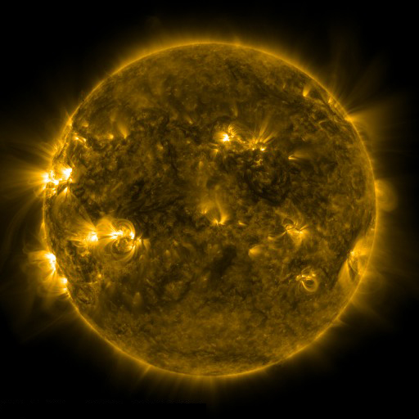
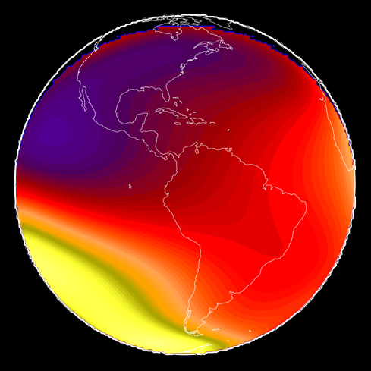

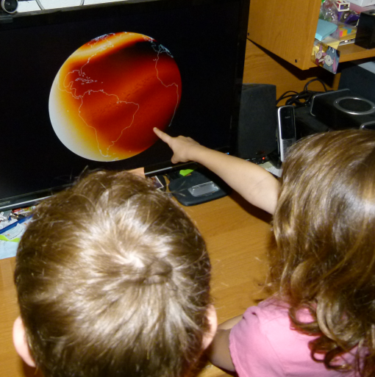
Benefits to Science and Society
  Advance Heliophysics science by linking solar observations to thermosphere-ionosphere physics
  Develop the next generation of upper-atmosphere models
  Address operational challenges in space-based communication, GPS navigation, and orbital tracking
Engage the public by providing near-real-time global images of aurora and space weather

Slide 8
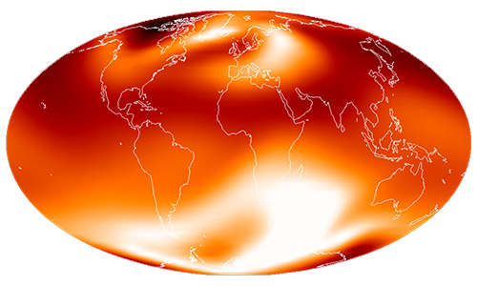
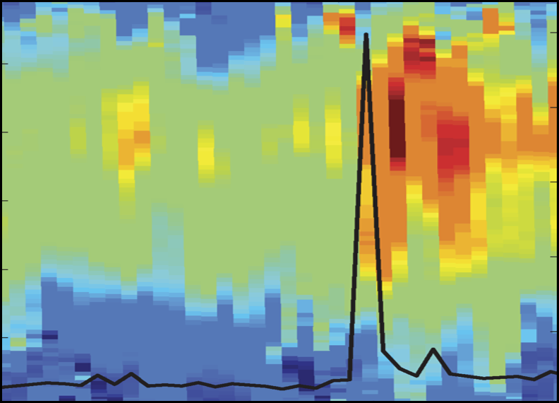
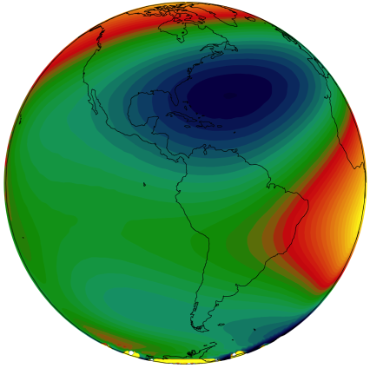
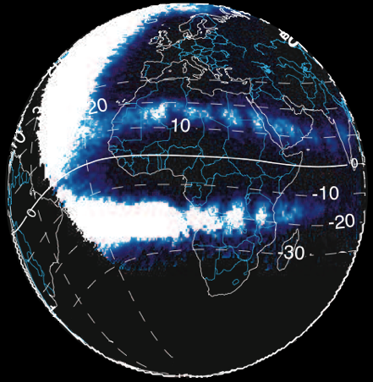
Scientific Objectives (official)
1. How do geomagnetic storms alter the temperature and composition structure of the thermosphere?
2. What is the global-scale response of the thermosphere to solar extreme-ultraviolet varability?
3. How significant are the effects of atmospheric waves and tides propagating from below on thermospheric temperature structure?
4. How does the nighttime equatorial ionosphere influence the formation and evolution of equatorial plasma density irregularities?

Slide 9
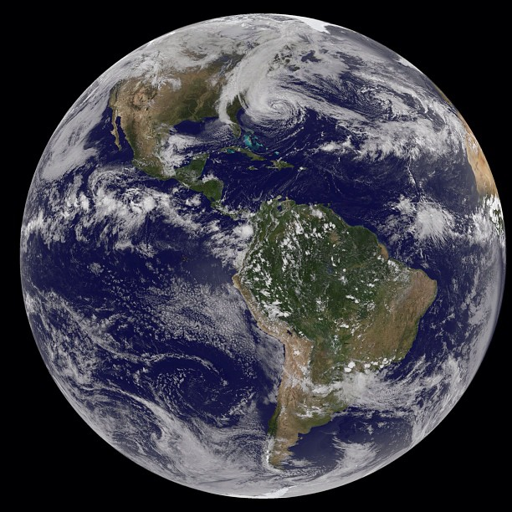
Scientific Objectives (colloquial)
It seems axiomatic that the big-picture “synoptic” view will help us understand thermosphere-ionosphere dynamics, just as it has improved analysis of tropospheric weather.
Low-Earth Orbit observations have done a lot, but give us a solar-time-centric “asynoptic” view of the upper atmosphere.
Yet, GOLD is just one instrument, it can’t see everywhere all the time.
GOES-13
2012-10-28
1302 UTC

Slide 10
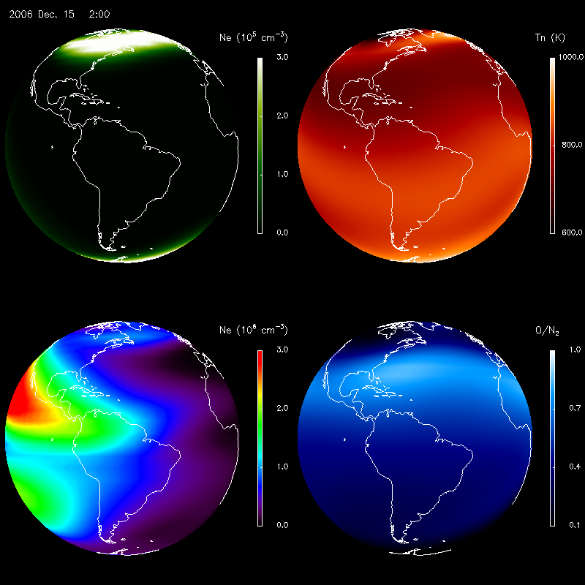
TIE-GCM Simulations
E-region Electron Density (~110 km)
Neutral Temperature (~160 km)
F-region Electron Density (~300 km)
O/N₂ Ratio (~160 km)

Slide 11
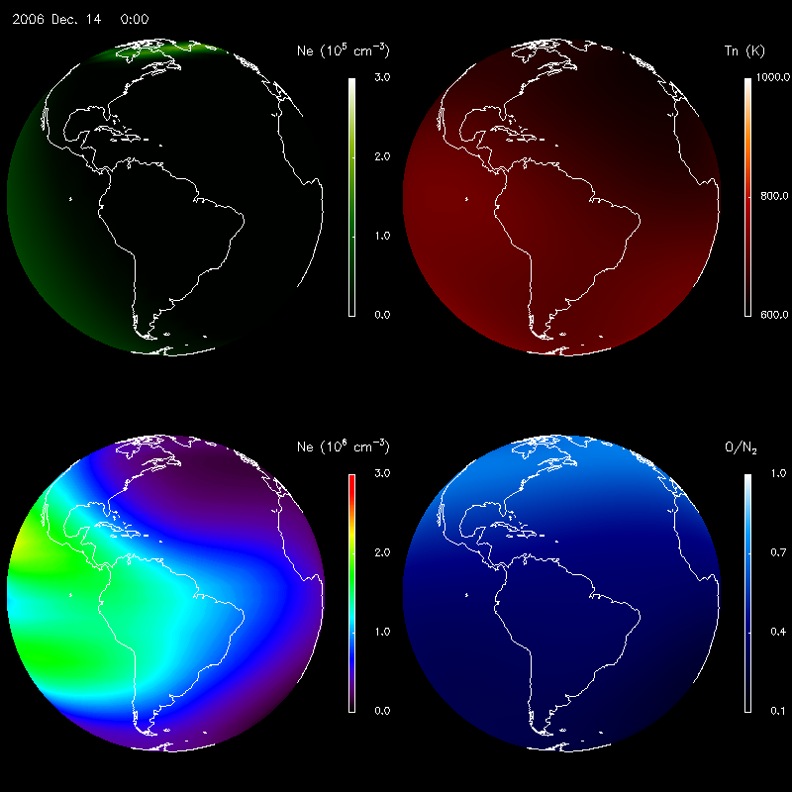
TIE-GCM Simulations
E-region Electron Density (~110 km)
Neutral Temperature (~160 km)
F-region Electron Density (~300 km)
O/N₂ Ratio (~160 km)

Slide 12
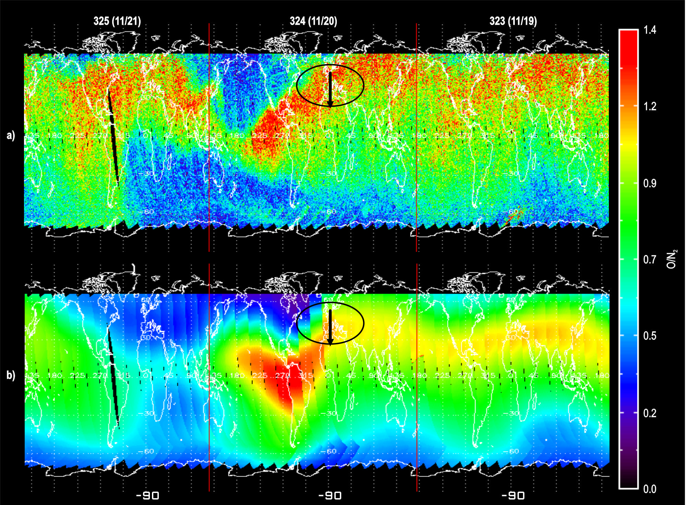
GUVI Observations of O/N₂ Composition Variations

Slide 13
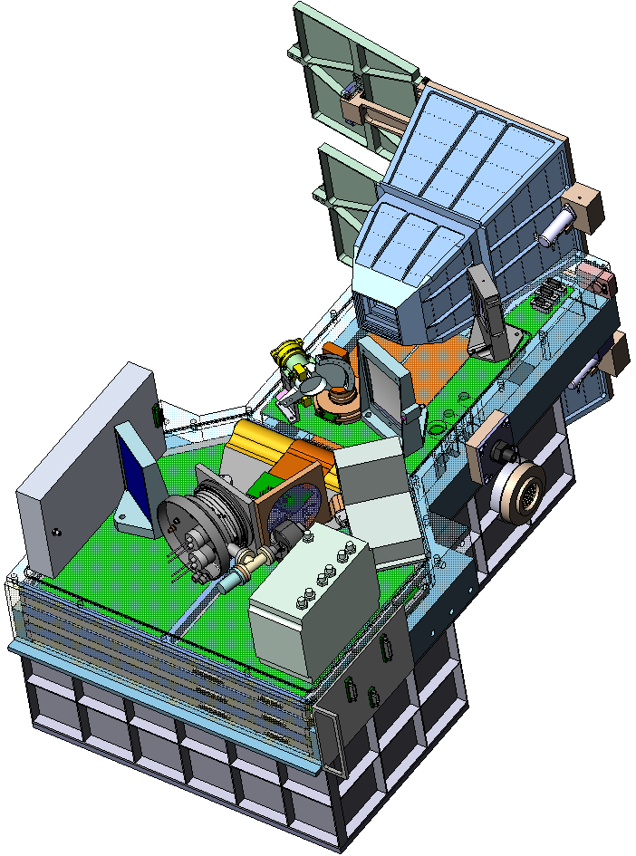
GOLD Ultraviolet Imaging Spectrograph
• Two identical channels
• Fully independent observing modes
  – Disk images and limb scans
    - Dayside: T and O/N₂
    - Nightside: O⁺ density
  – Stellar occultation
• Heritage
    – Cassini UVIS
    – MESSENGER MASCS
    – MAVEN IUVS
  • Deployed on a Geostationary Comsat
    — Provided by SES-GS
    — Airbus SES-14 at 47.5 W long.
    — Launch in late 2017
Instrument Summary
Volume | 51×55×69 cm³
Mass | 33 kg
Power | 53 W
Data Rate | 3.3 Mbit/sec

Slide 14
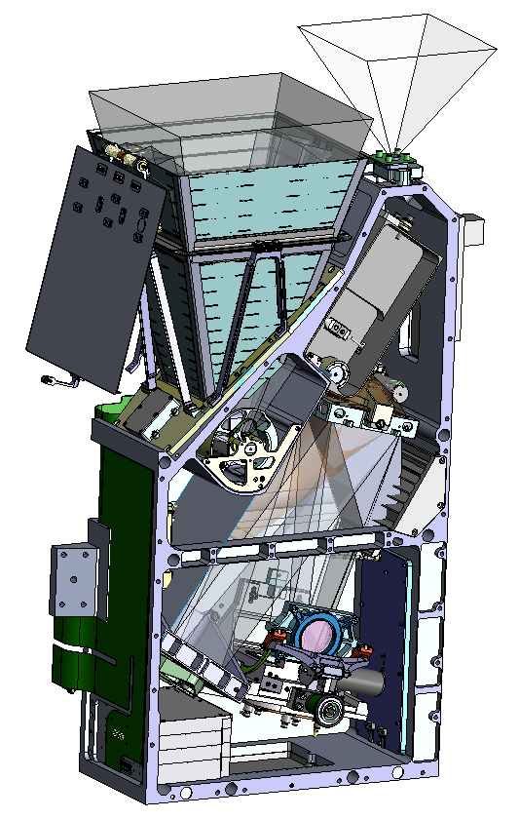
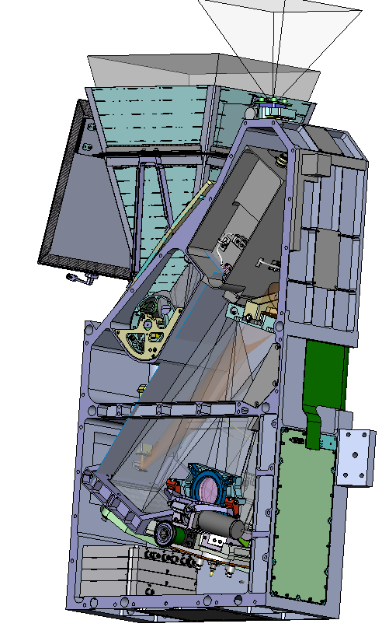
GOLD Ultraviolet Imaging Spectrograph
1-Shot Aperture Cover
Solar Safety Sensor
Light Shade
Alignment Cube
Telescope
Slit Mech
Aperture
Scan Mechanism
Scan Mirror Visor
Detector Assembly
Collimating Mirror
HVPS
Detector Electronics

Slide 15
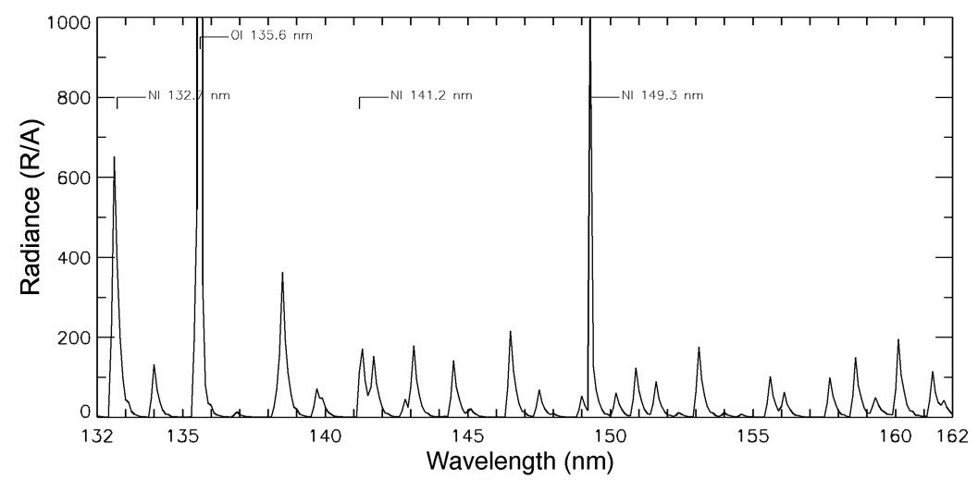
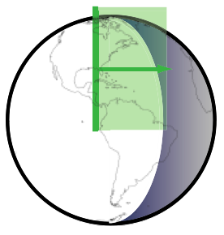
GOLD Measurement Technique
Daytime Far-Ultraviolet Spectrum
Atomic Oxygen 135.6 nm doublet
N₂ LBH bands
Horizontal scan of disk & limb; image along vertical slit
• Temperature obtained on disk from rotational shape of N₂ LBH bands
• O/N₂ composition measured using ratio of 135.6 doublet to LBH bands
• Temperature on limb determined by slope of emission altitude profile
• O₂ profile on limb from stellar occultations
• O⁺ at night observed using 135.6 recombination emission

Slide 16
Modular Observing System Simulation Concept
TIE-GCM
MSIS-IRI
Parallel
TIE-GCM
MSIS-IRI
Fast Enough
TIE-GCM
MSIS-IRI
GLOW
Fortran-90 / MPI
IDL / Bridge
Will be Parallel
LBH VRB
LOS-RT
Disk
Limb
INSTR
Analysis Algorithms
Serial OK
???

Slide 17
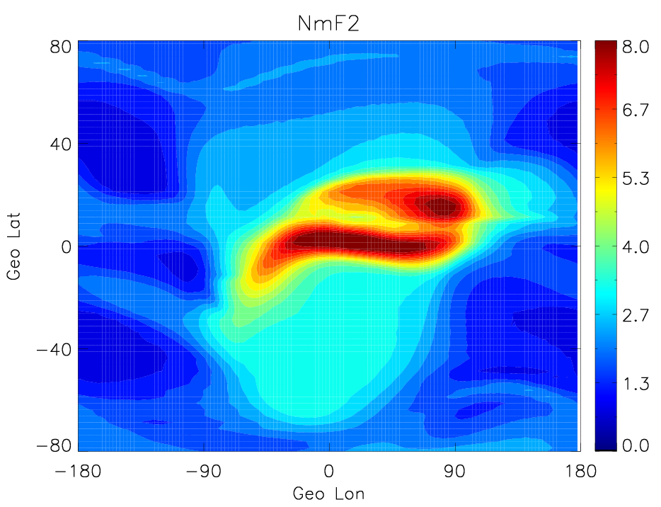
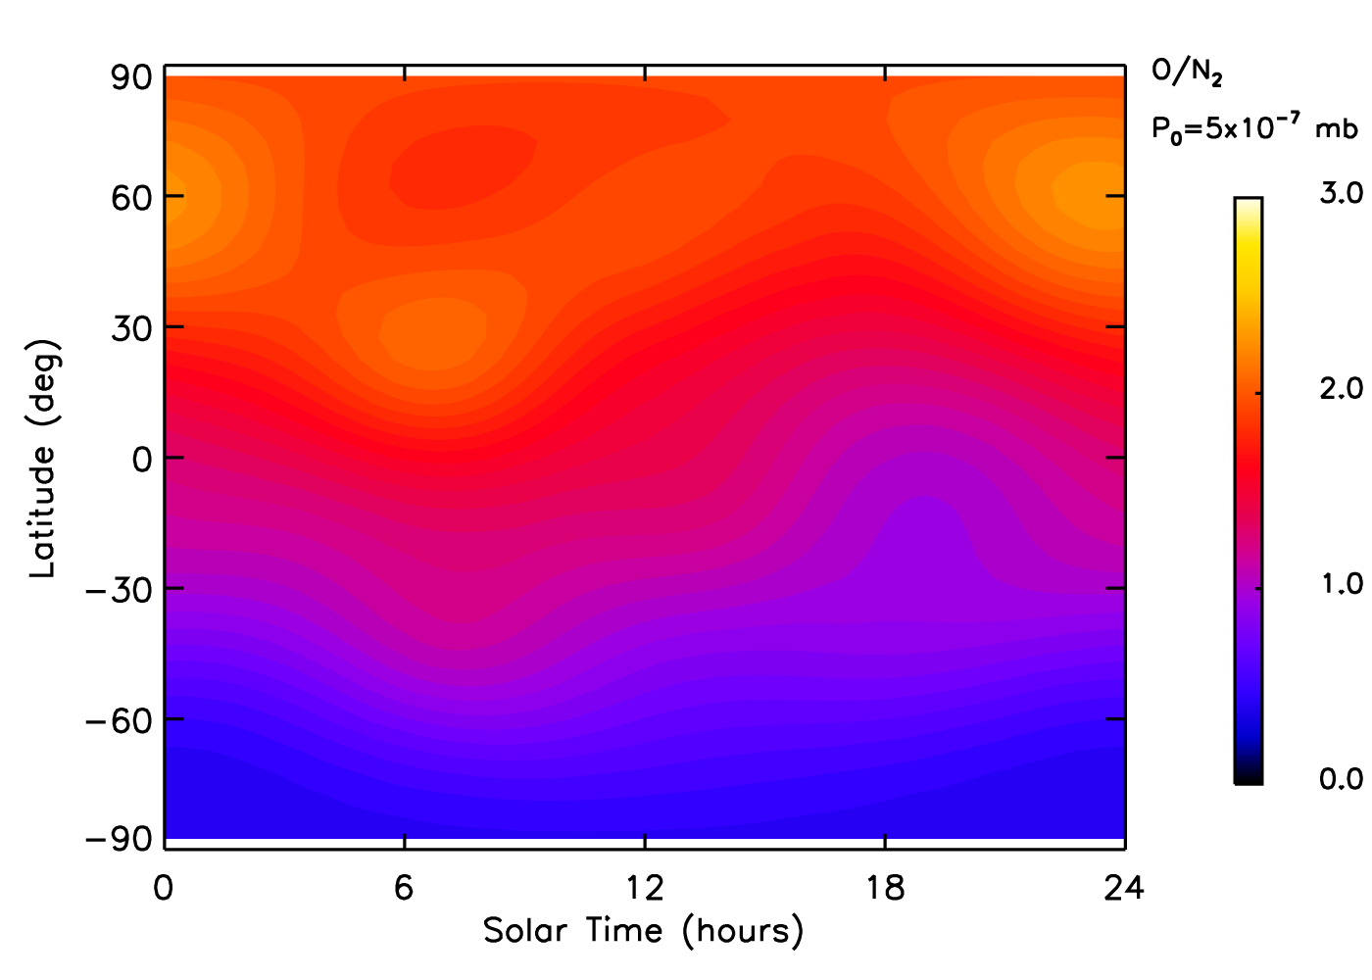
Observing System Simulation Concept — Models
TIE-GCM
MSIS-IRI
TIME-GCM
Other Empirical
WACCM-X

Slide 18
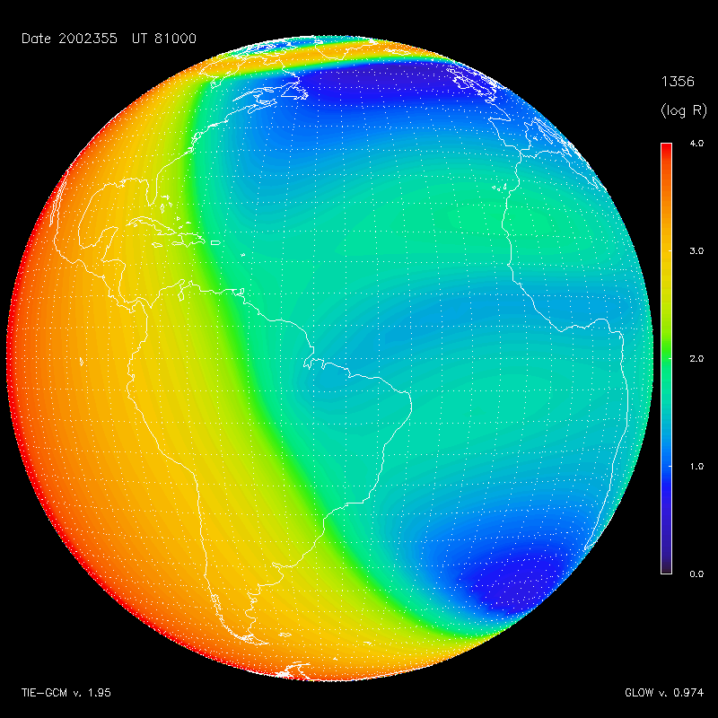
Observing System Simulation Concept — Airglow
Auroral Inputs
Solar Inputs
Neutral Atmos
Photo-electrons
GLOW
Electron Transport
Chemistry
Emissions

Slide 19
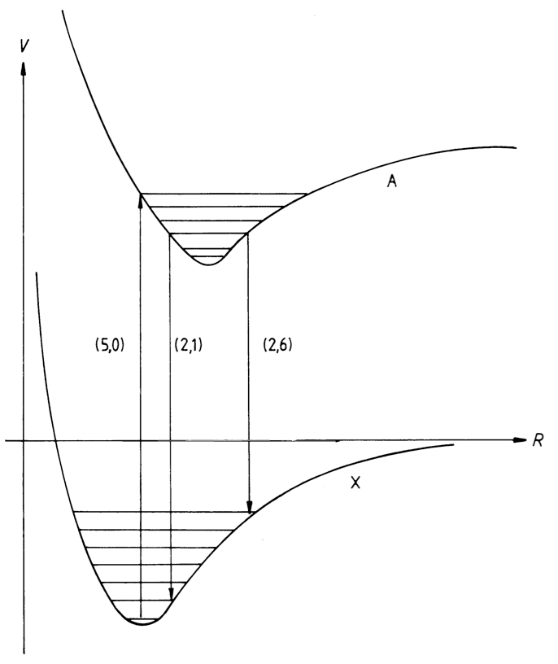
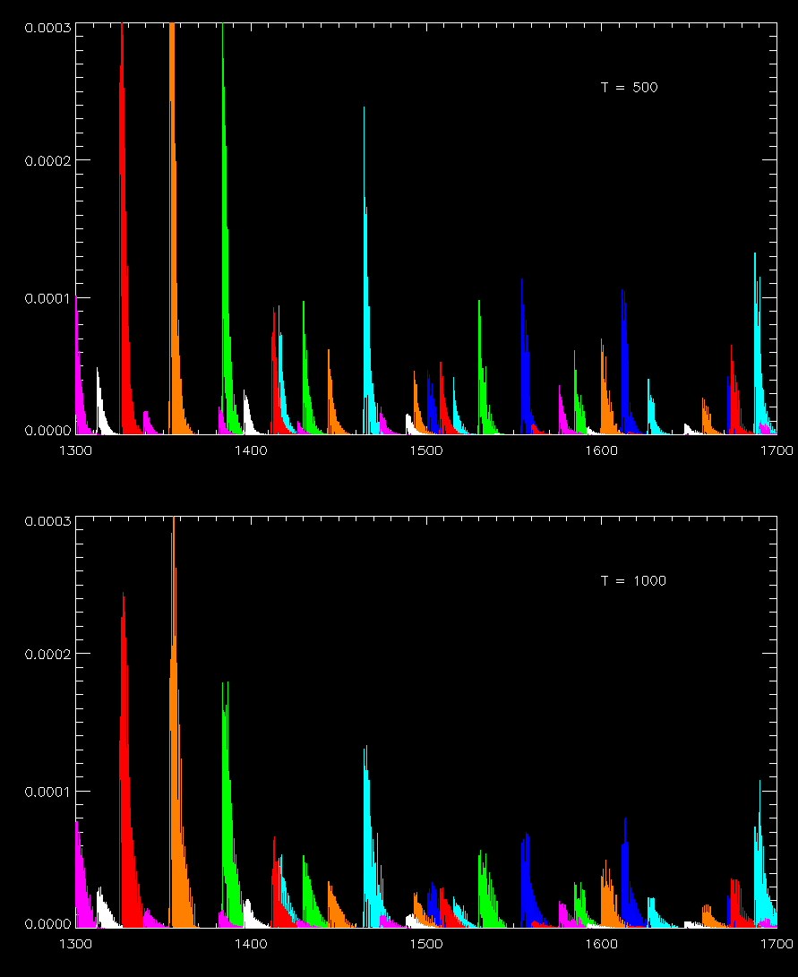
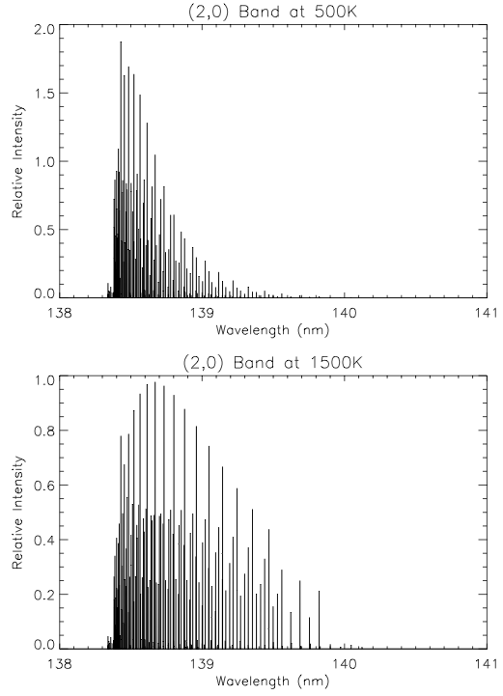
Observing System Simulation Concept — LBH Bands
LBH VRB

Slide 20
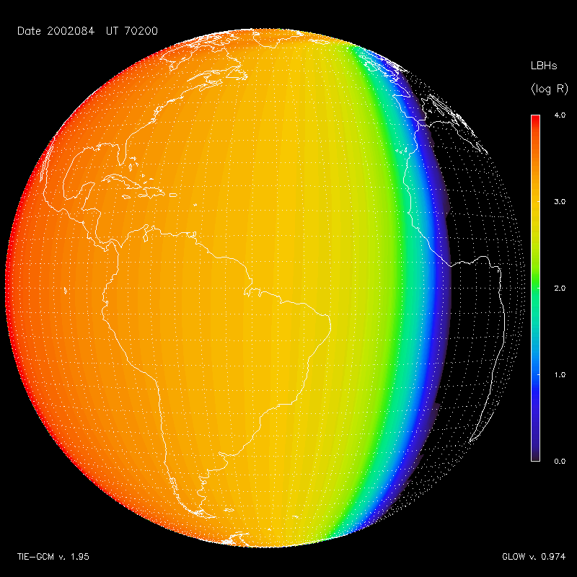
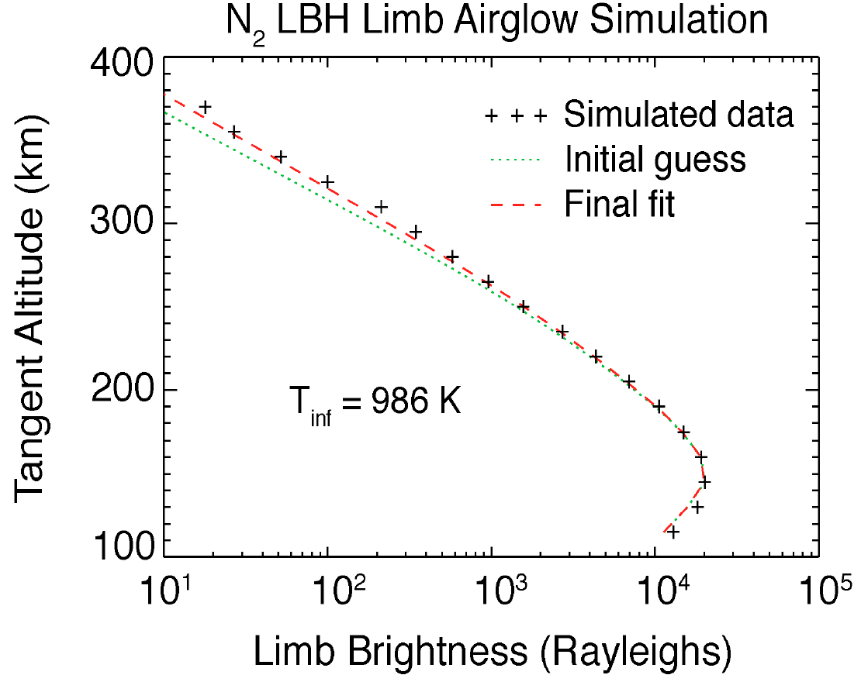
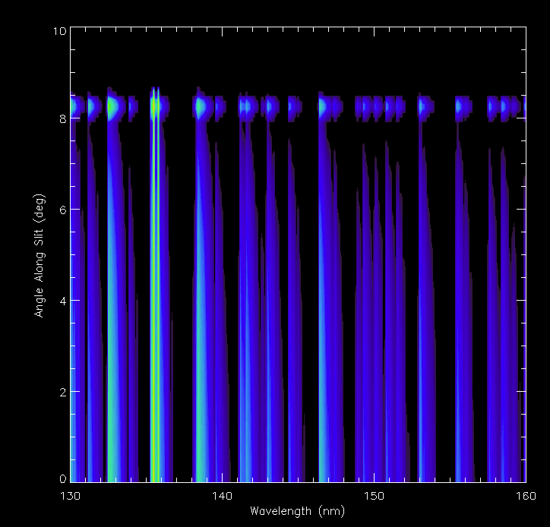
Observing System Simulation Concept—Line-of-Sight
LOS-RT
Disk
Limb

Slide 21
Observing System Simulation Concept — Instrument
Disk
Limb
INSTR

Slide 22
Line-of-Sight Integration
Satellite vector s

Slide 23
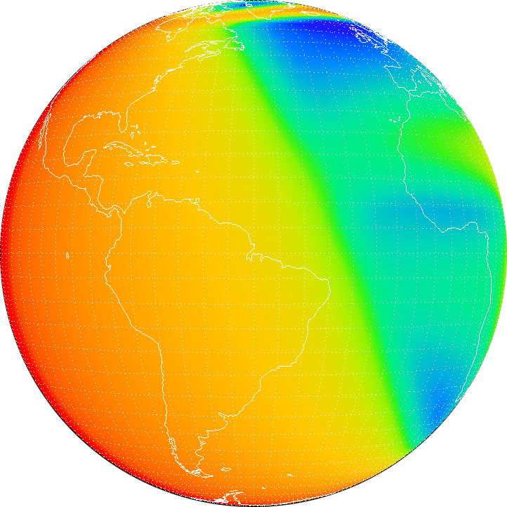
CHIPSI Coordinates — Looking back from the Satellite
  ψ
typical simulation grid ±10° at 0.1° resolution
α
  χ
χ, ψ are angles in east and north directions, relative to nadir
α is the combined angle from the nadir vector

Slide 24
Line-of-Sight Integration
v
α
Satellite vector s

Slide 25
Line-of-Sight Integration
Disk lines-of-sight intersect Earth
r₂
v
r₁
α
Satellite vector s

Slide 26
Line-of-Sight Integration
Limb lines-of-sight pass through atmosphere
r₂
r_{t}
v
r₁
Satellite vector s

Slide 27
Line-of-Sight Integration
Disk lines-of-sight intersect Earth
Limb lines-of-sight pass through atmosphere
r₂
r_{t}
v
r₂
r₁
v
r₁
α
Satellite vector s
|v| = |s| cos α ± (|r|² – |s|²sin²α)^{1/2}

Slide 28
Line-of-Sight Integration
Disk lines-of-sight intersect Earth
Limb lines-of-sight pass through atmosphere
r₂
r_{t}
v
r₂
r₁
v
r₁
α
Satellite vector s
|v| = |s| cos α ± (|r|² – |s|²sin²α)^{1/2}
subtract determinant if triangle is acute (pierce point case)
add determinant if triangle is oblique(limb exit case)
if determinant is zero, line-of-sight is tangent to r
if determinant is negative, line-of-sight misses atmosphere
Notes:
Calculate line-of-sight direction from instrument angles
Calculate length of v₁, v₂
Transform to Cartesian coordinates
Calculate path through atmosphere and divide into segments
Integrate through airglow model, considering absorption along path
Build up observation cube at every angle and wavelength

Slide 29
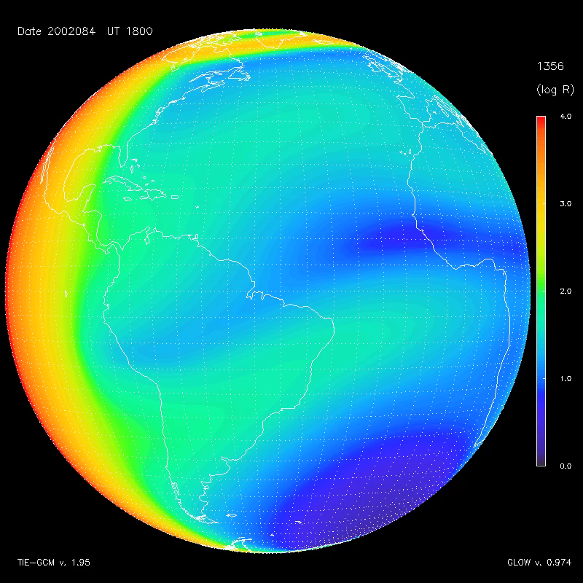
Airglow Simulations

Slide 30
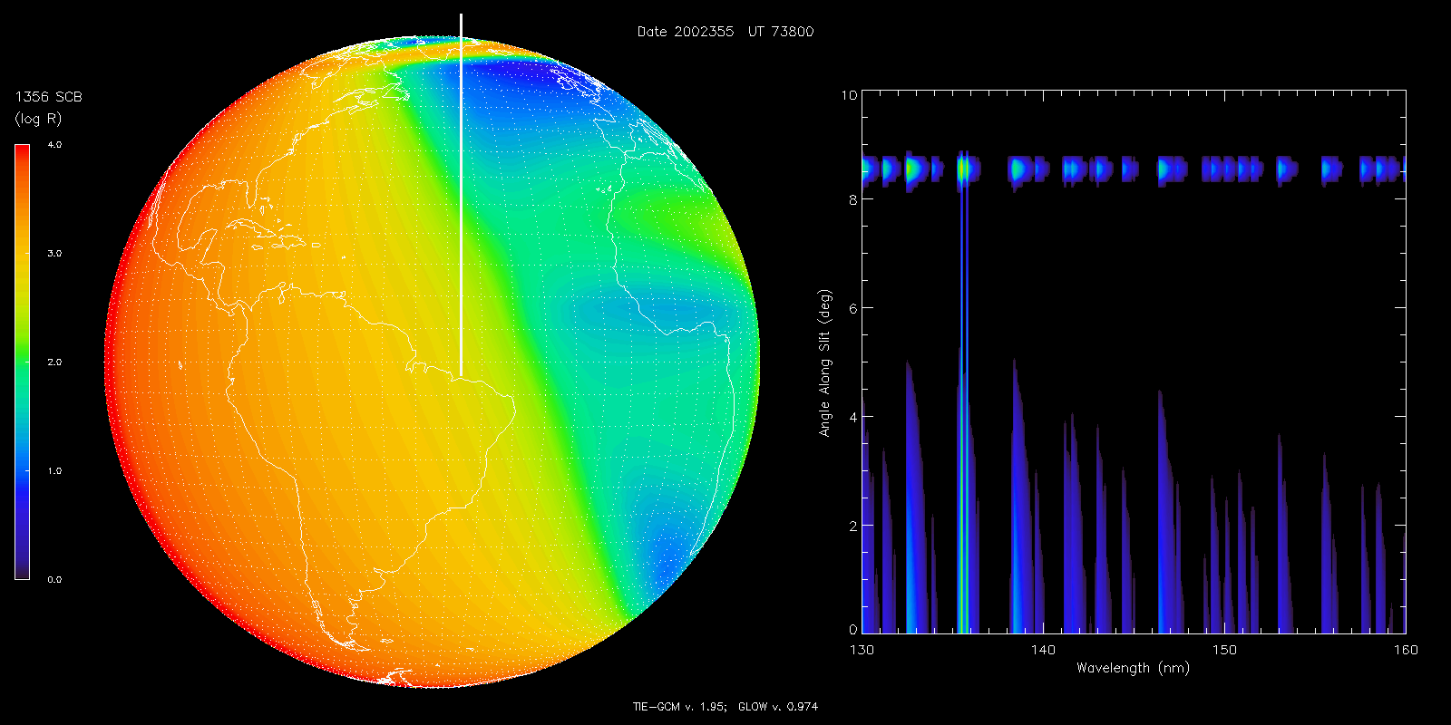
Image Cube Simulation
Disk Image Detector Image

Slide 31
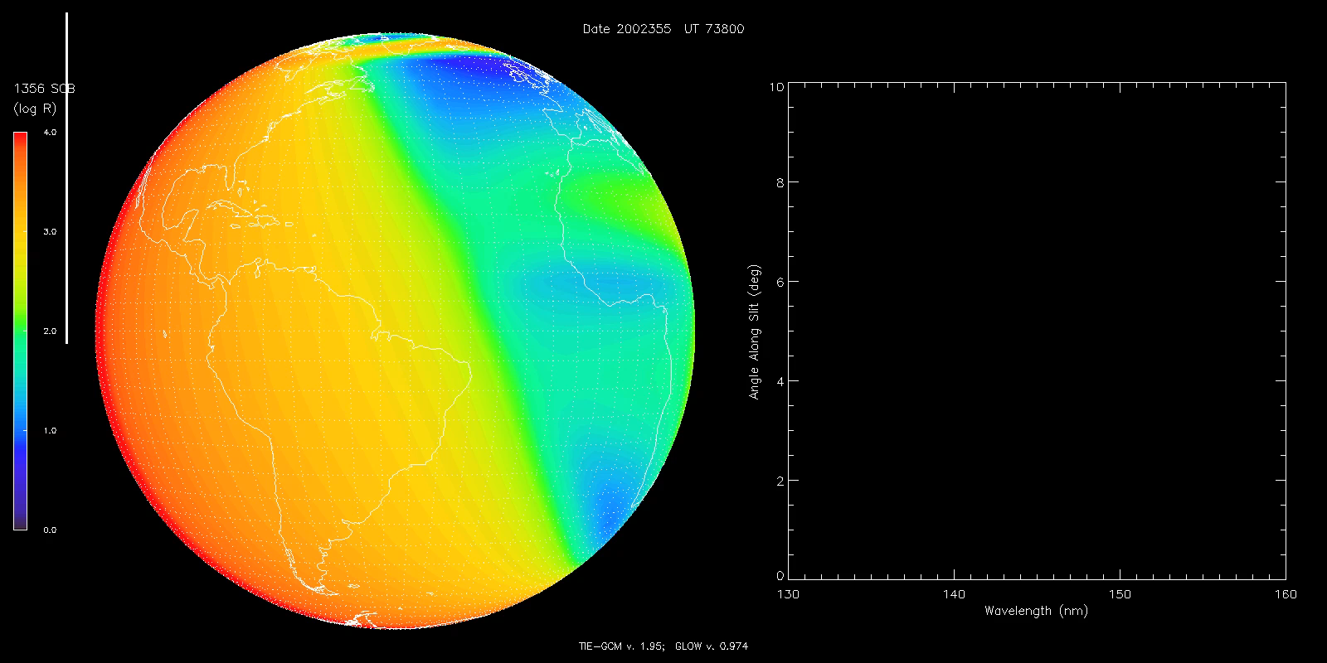
Image Cube Simulation
Disk Image Detector Image

Slide 32
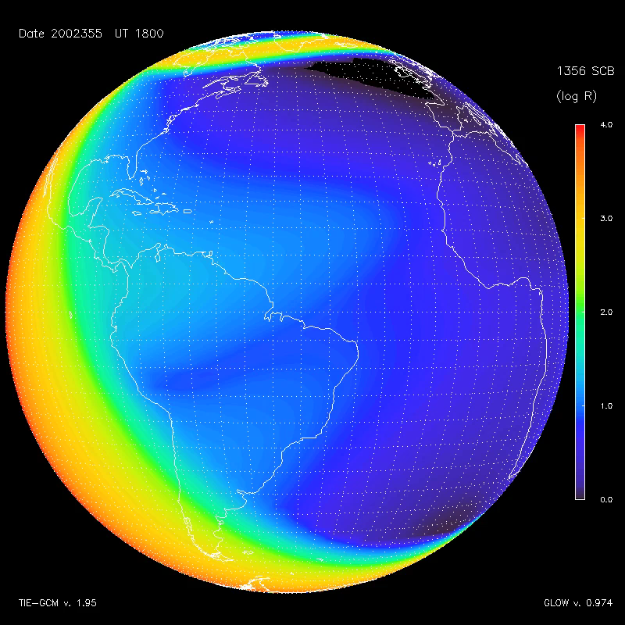
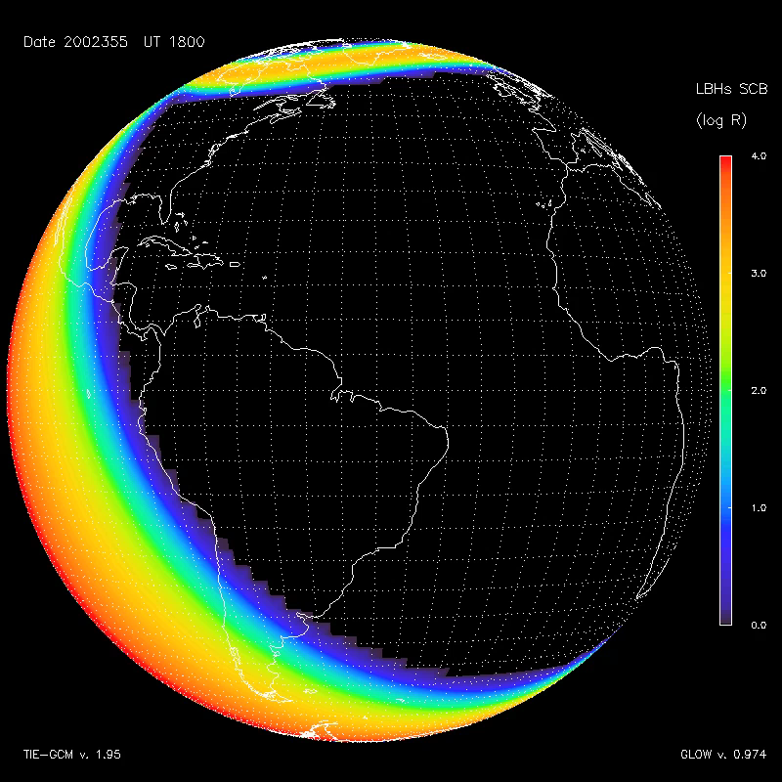
December Solstice Case
O (⁵S) 135.6 nm doublet N₂ LBH “short” (138–148 nm)

Slide 33
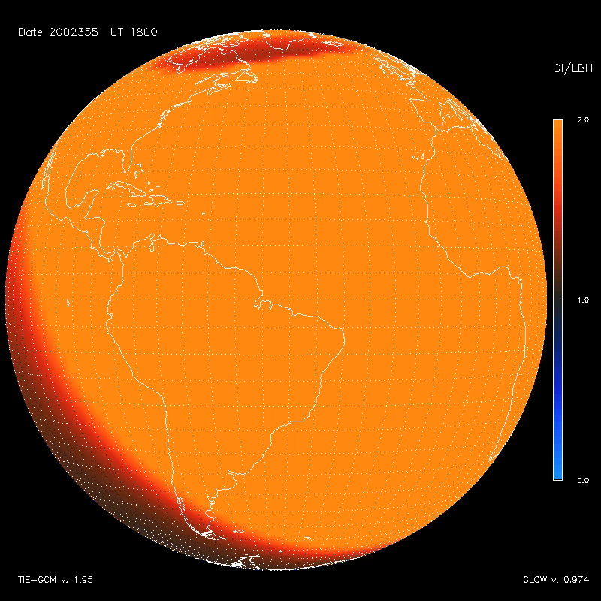
December Solstice Case
O(⁵S) / N₂ LBH ratio

Slide 34
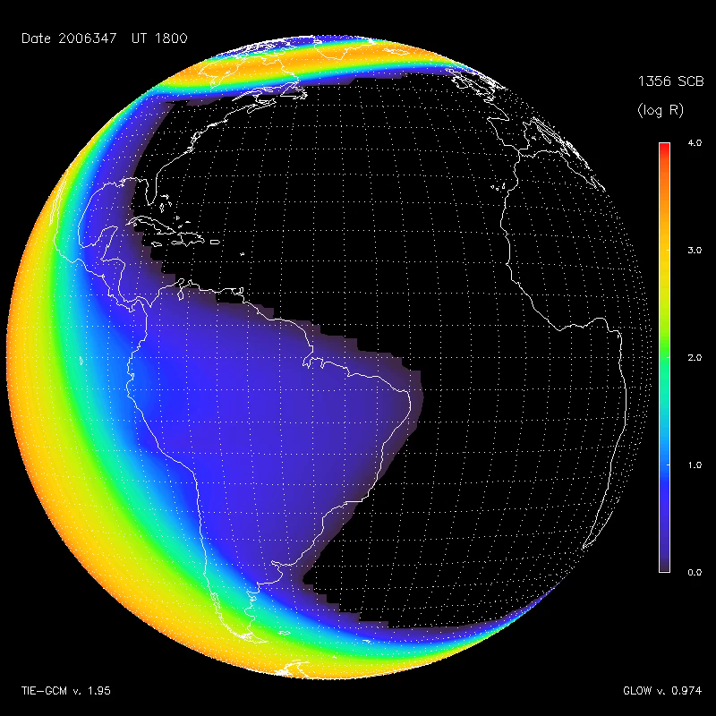
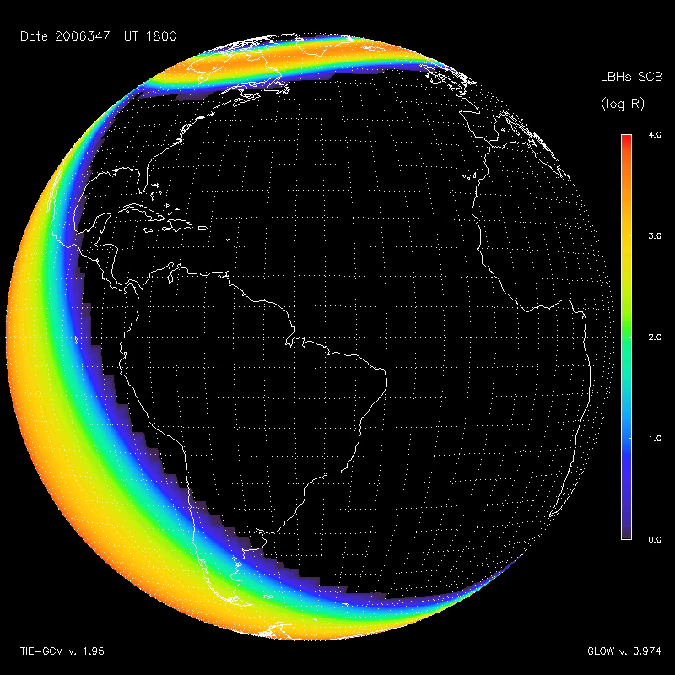
The December 2006 “AGU Storm”
O (⁵S) 135.6 nm doublet N₂ LBH “short” (138–148 nm)

Slide 35
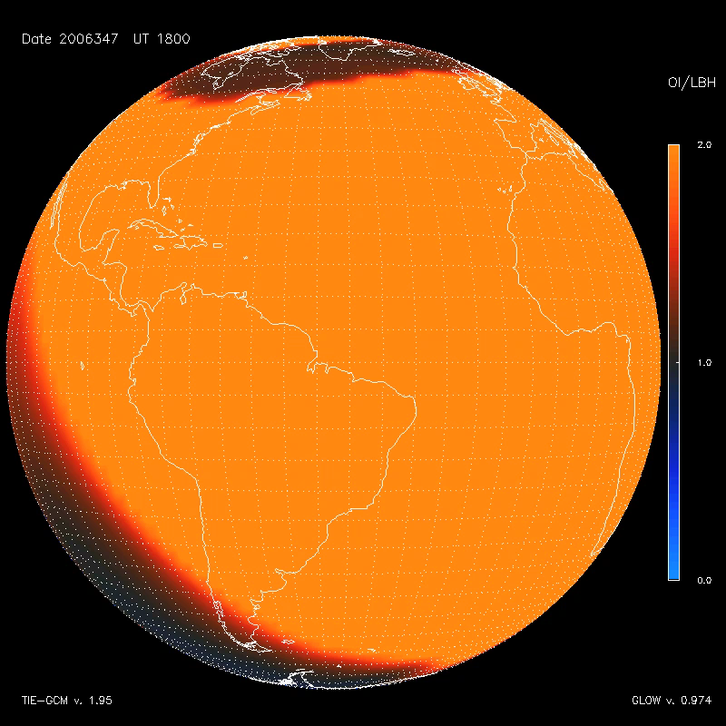
The December 2006 “AGU Storm”
O(⁵S) / N₂ LBH ratio

Slide 36
Radiative Transfer Effects
Calculating the column brightness that emerges from the atmosphere is generally not as simple as just integrating along the line-of-sight.
If the emission is optically thin, then it is just the integral along the line-of-sight (except of course it’s really a cone, not a line, i.e., there is always some discrete field of view).
If the emission is partially absorbed, then absorption along path must be considered. That is easily done by calculating the column density and applying Beer’s Law.
If the emission is subject to scattering, particularly by resonant scattering, then things get interesting, because photons are added to the line-of-sight as well as removed.
N₂ LBH bands are generally considered to only be absorbed by O₂ (except perhaps for bands terminating in the v’’=0 ground state, which could be partially self-absorbed).
The O(⁵S) doublet at 135.6-135.9 nm is subject to absorption by O₂ and weak resonant scattering. These effects are small but significant.
The O(³S) triplet at 130.2-130.4-130.6 nm is and allowed transition that is subject to very strong resonant scattering, including sunlight, and is extremely optically thick. This is of interest here primarily because it contributes to the instrumental background. That is also the case for the H Ly-a emission.

Slide 37
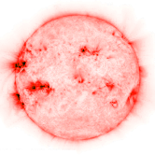
Illustration of Multiple Scattering
hν (EUV)
hν (FUV)
O
e*
O
hν (FUV)
etc.
N₂
O
O
O₂

Slide 38
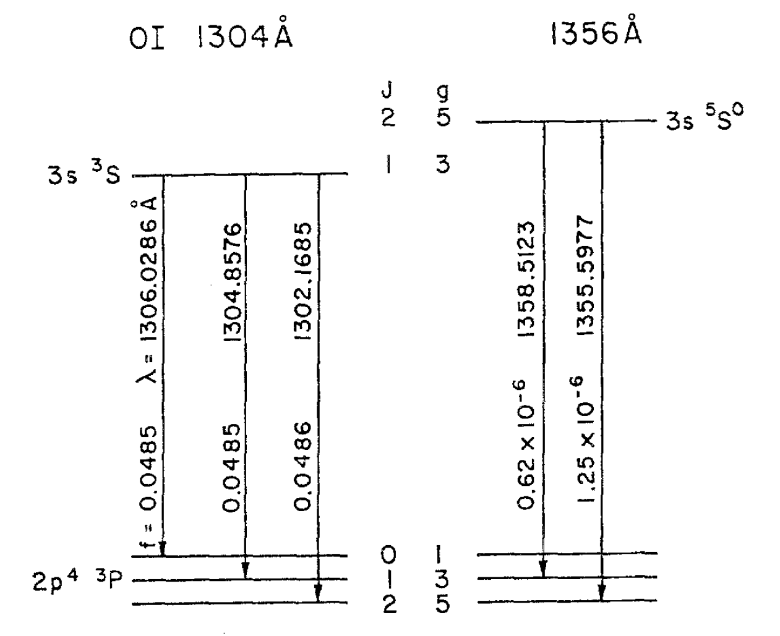
Atomic Oxygen Transitions in the Far-Ultraviolet
Note that the “1356” oscillator strengths are orders of magnitude less than the “1304” oscillator strengths. Also note that the “1359” line is weaker than “1356,” and it doesn’t connect to the O(³P₂) ground state.
Multiple scattering in the “1356” line is actually quite low, and virtually negligible in the 1359 line.
This suggests that we may approximate resonant scattering in the 1356 doublet using a simplified “monochromatic” approach, without having to consider frequency redistribution within the individual lines. That’s a good thing, because radiative transfer with frequency redistribution can be computationally intensive.

Slide 39
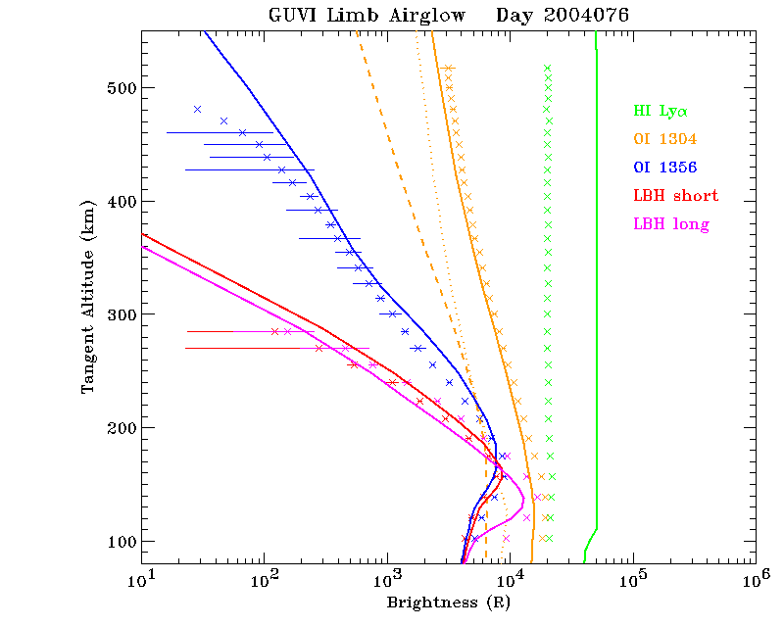
Comparisons with GUVI Data using Gladstone Feautrier Code

Slide 40
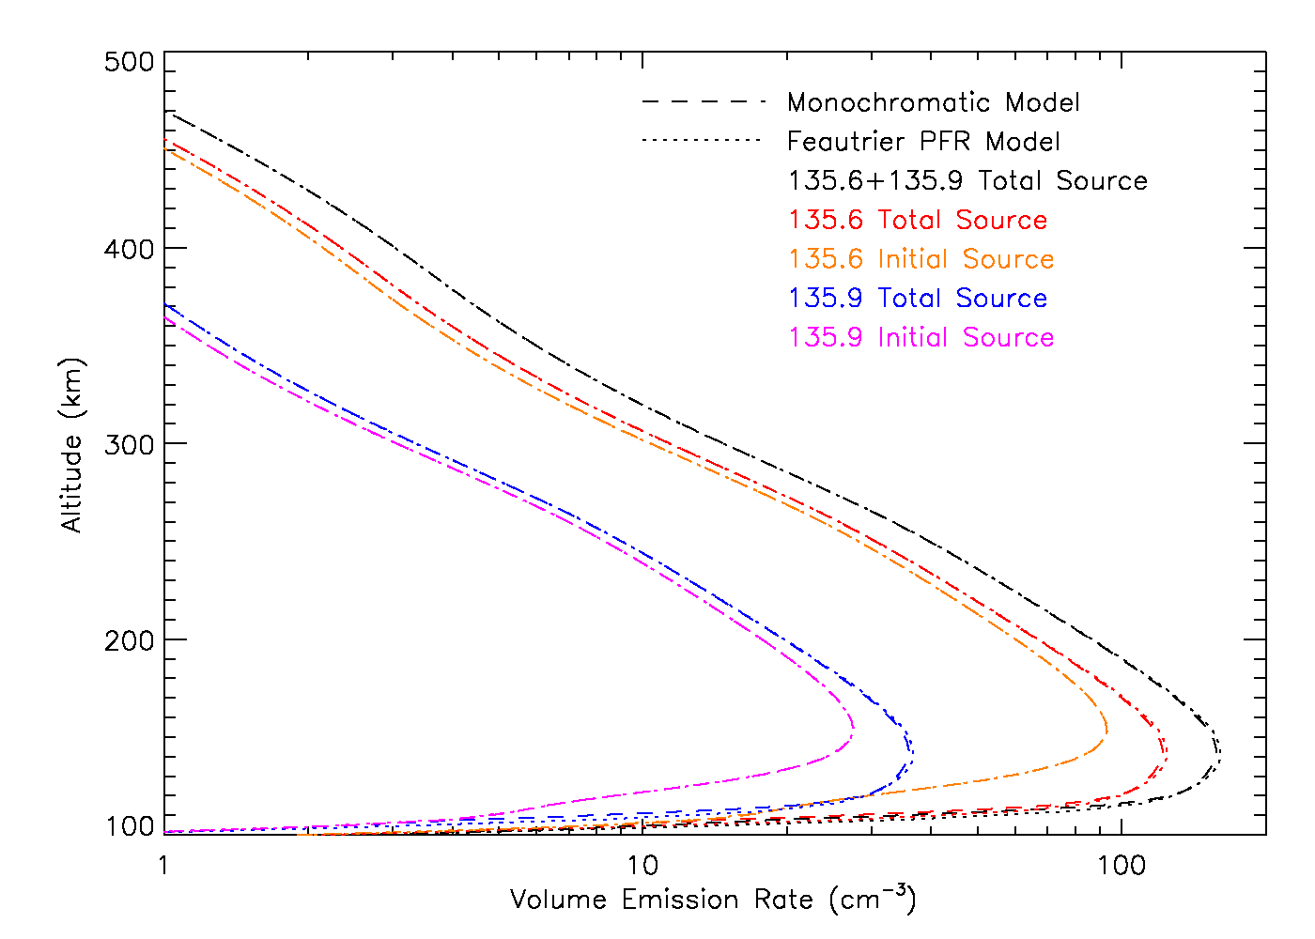
Comparison of Simplified Model to Gladstone Feautrier Code
Initial and final source functions, i.e., the amount of light produced per unit volume

Slide 41
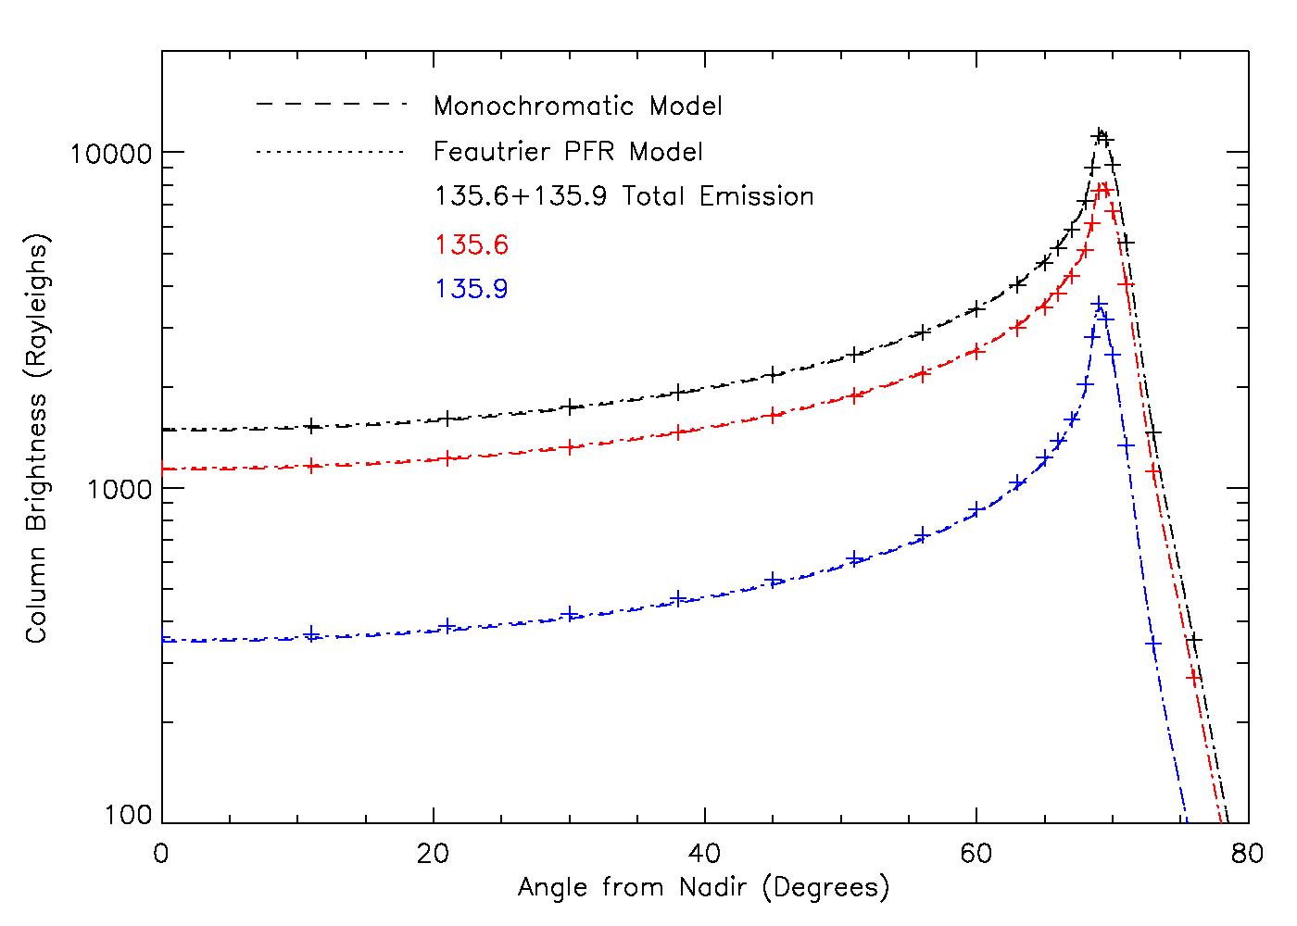
Comparison of Simplified Model to Gladstone Feautrier Code

Slide 42
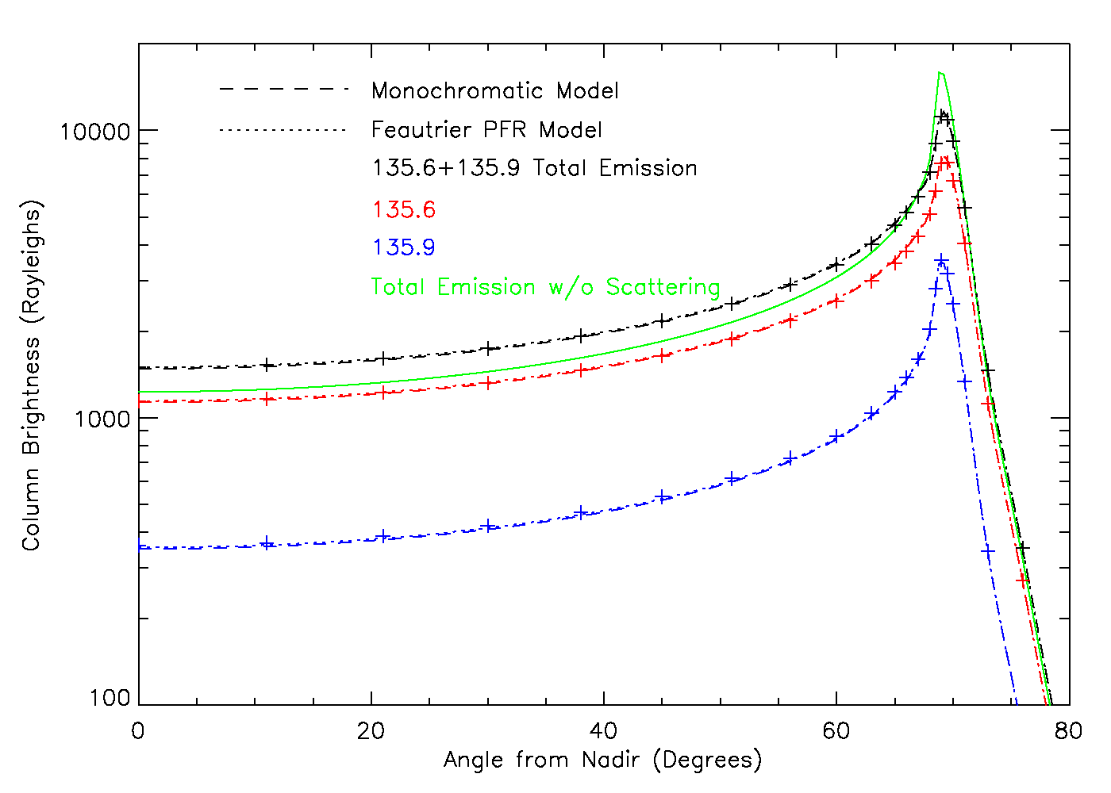
Comparison of Simplified Model to Gladstone Feautrier Code

Slide 43
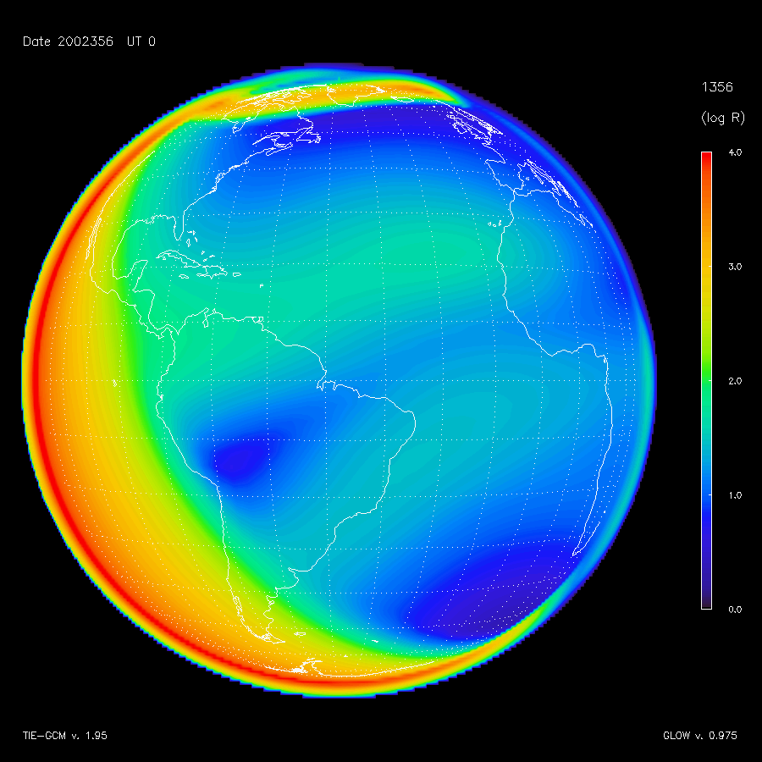
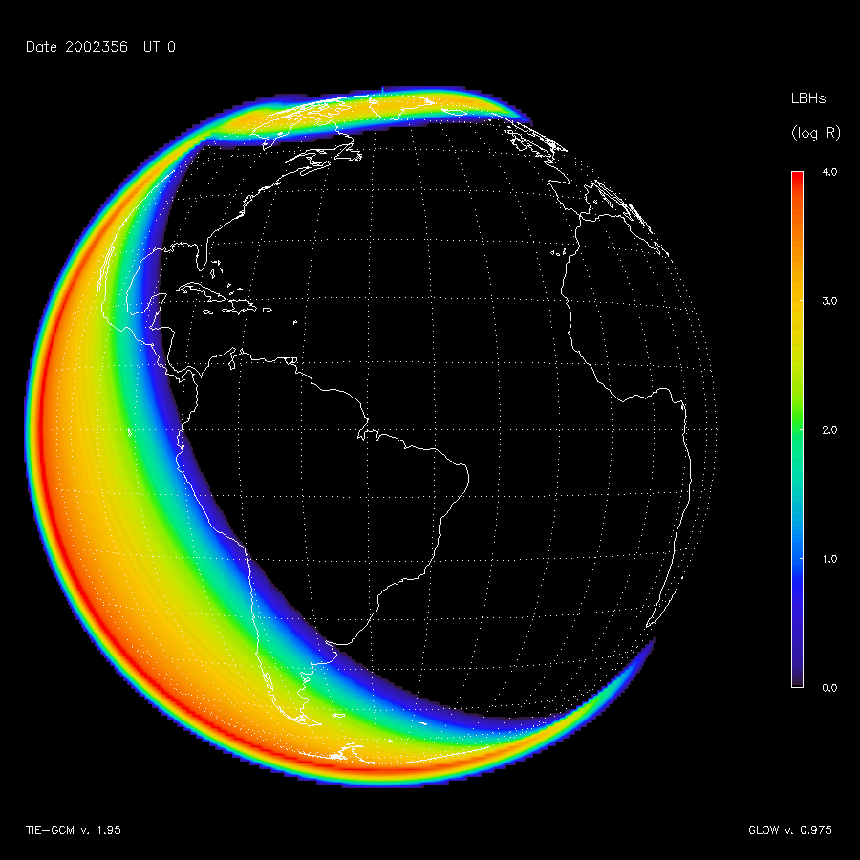
Latest & Greatest Simulations Applying all of the Above
O(⁵S) Doublet at 135.6 nm N₂ LBH “short” bands 138-148 nm

Slide 44
Conclusions
• We have a comprehensive observational simulation system for the GOLD mission.
• The methodology can be adapted to the ICON mission.
• The methodology can be adapted to other remote sensing observations as well.
• Based on community models; open-source code.
• Can use this system for algorithm development and data analysis.
• Still work to do:
  — Oi 130.4 nm triplet; instrument simulator; WACCM-X and WAM interfaces; data assimilation...

Slide 45
Backup on Viewing Geometry and Coordinate Systems

Slide 46
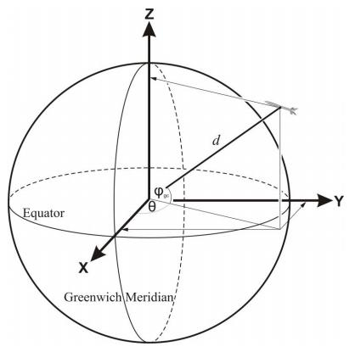
Coordinate Systems
• Earth Centered Inertial (ECI):
  z-axis is north pole of Earth
  x-axis is toward vernal equinox
  y-axis = z X x
• Earth Centered Rotational (ECR or ECEF):
  z-axis is north pole of Earth
  x-axis is intersect of prime meridian and equator
  y-axis = z X x
• Geographic (GEO):
  altitude relative to oblate ellipsoid surface
  longitude ±180° from prime meridian
  geodetic latitude:
    angle between local vertical and equator
• Instrument Coordinates (CHIPSI)
  χ is angle from S/C nadir to east
  ψ is angle from S/C nadir to north
Earth Centered Rotational (ECR) coordinate system (a.k.a. Earth Centered Earth Fixed (ECEF), but this name is somewhat confusing, so ECR is preferred).

Slide 47
Notes on Coordinate Systems
• ECI is largely unnecessary for geostationary observations.
  —Approximations due to motion of vernal equinox and pole wobble
    — Typically surmounted by use of J2000 reference frame
• ECR is the most straightforward coordinate system for line-of-sight calculations.
• ECR can be defined in either cartesian or spherical coordinates, but...
  — Note that polar angle θ ≠ geodetic latitude
    — Angle from pole, not equator (similar to polar angle v. declination problem)
    — Defined in spherical coordinates, not on ellipsoid
• Models are in GEO coordinates, but ignore change in Earth radius.
  — However, we consider Earth radius when transforming from GEO to ECR
    — In essence, this warps the model onto the ellipsoid
    — Note that I am using the WGS-84 Ellipsoid, but not the EGM-96 harmonics
      — This results in an error of ~ ±0.1 km
• CHIPSI coordinates assume that the center of the detector is pointed at nadir.
  — May need to consider alignment and pointing offsets
  — S/C coordinate system for GOLD is x≈v; z toward nadir

