Slide 1
Observation Simulation System for the GOLD (and ICON?) Missions
Stan Solomon
High Altitude Observatory
National Center for Atmospheric Research
ICON Science Team Meeting • HAO/NCAR • 28 October 2015

Slide 2
Outline
• We are developing a comprehensive observation simulation system for the GOLD mission.
• The modeling component and some aspects of the observation geometry are equally applicable to the ICON mission.
• The hope is that we can build an appropriate interface so that both missions can exploit this effort in a collaborative manner.
• The software will be available to anyone who would like to use it.

Slide 3
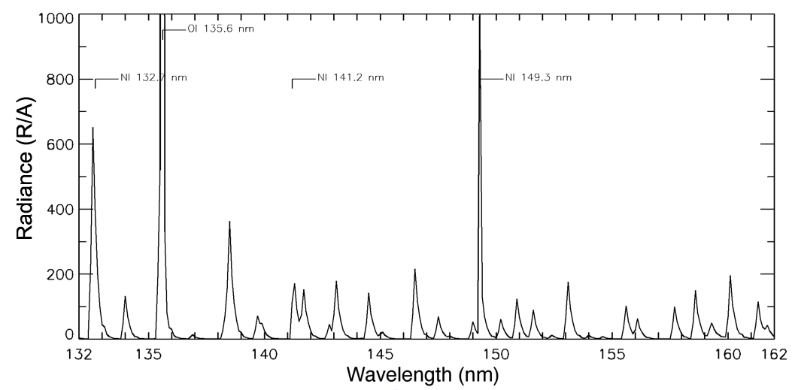
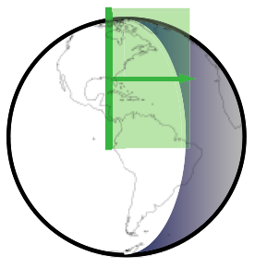
GOLD Measurement Technique
Daytime Far-Ultraviolet Spectrum
Atomic Oxygen 135.6 nm doublet
N₂ LBH bands
Horizontal scan of disk & limb; image along vertical slit
• Temperature obtained on disk from rotational shape of N₂ LBH bands
• O/N₂ composition measured using ratio of 135.6 doublet to LBH bands
• Temperature on limb determined by slope of emission altitude profile
• O₂ profile on limb from stellar occultations
• O⁺ at night observed using 135.6 recombination emission

Slide 4
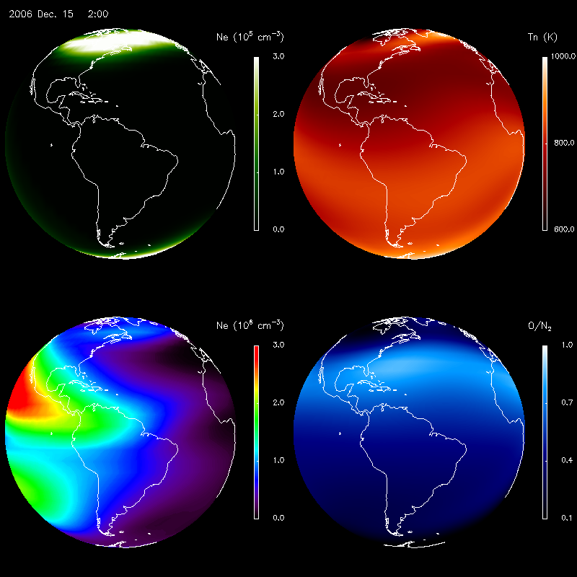
TIE-GCM Simulations
E-region Electron Density (~110 km)
Neutral Temperature (~160 km)
F-region Electron Density (~300 km)
O/N₂ Ratio (~160 km)

Slide 5
Modular Observing System Simulation Concept
TIE-GCM
MSIS-IRI
Parallel
Fast Enough
GLOW
Fortran-90 / MPI
IDL / Bridge
Will be Parallel
LBH VRB
LOS-RT
Disk
Limb
INSTR
Analysis Algorithms
Serial OK
???

Slide 6
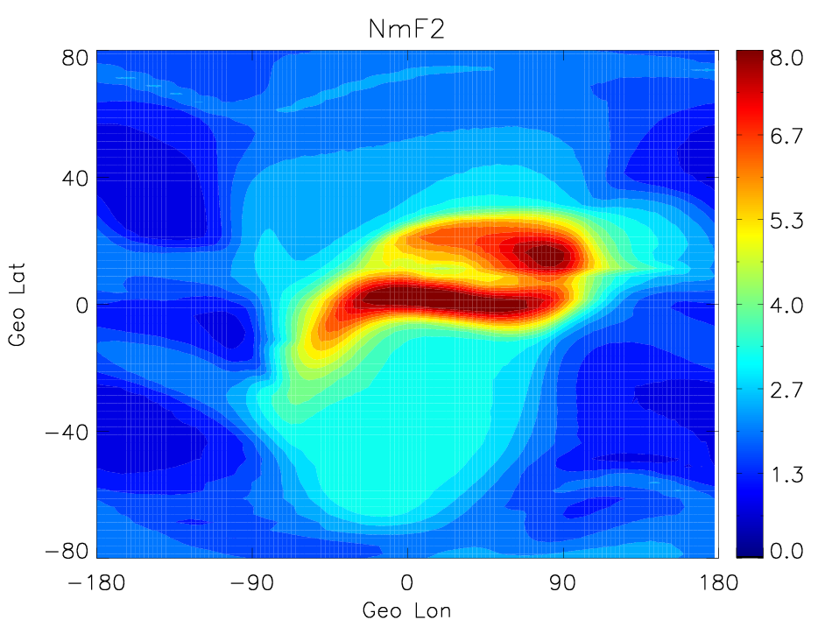
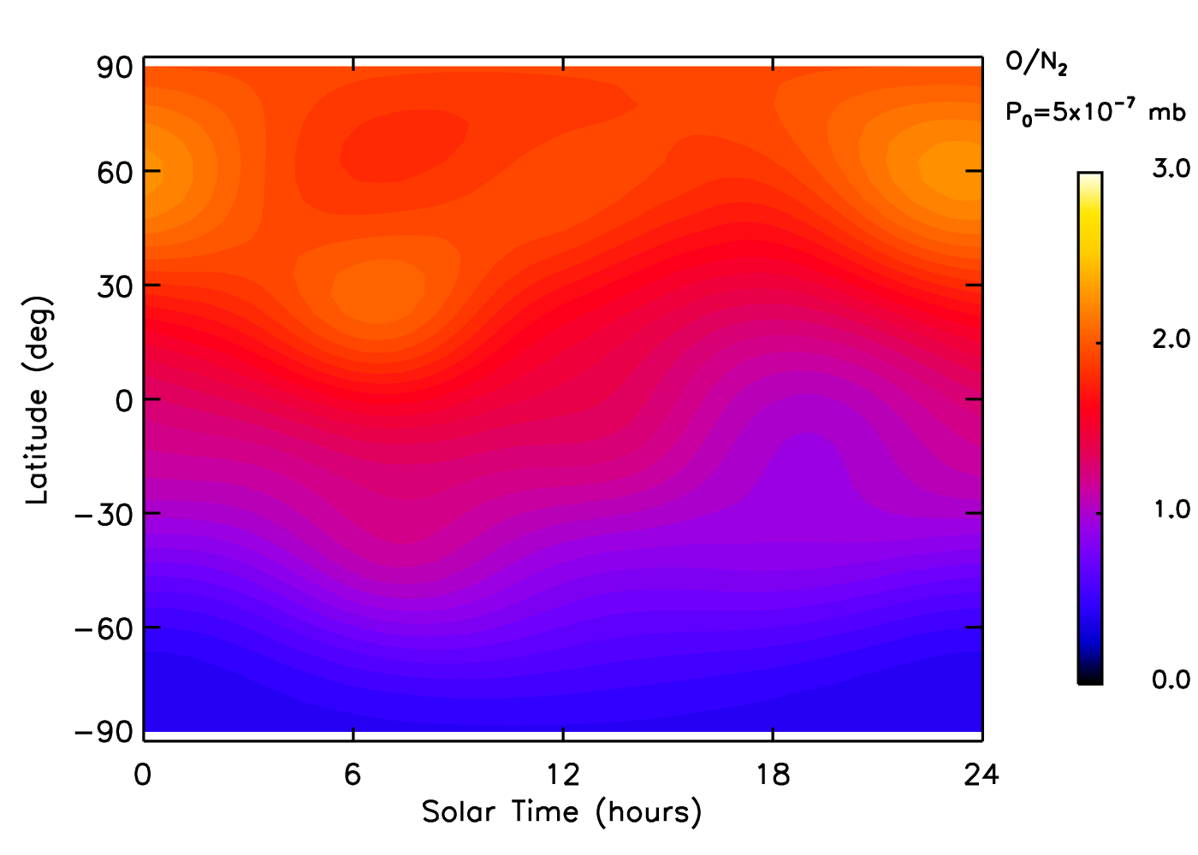
Observing System Simulation Concept — Models
TIE-GCM
MSIS-IRI
TIME-GCM
Other Empirical
WACCM-X

Slide 7
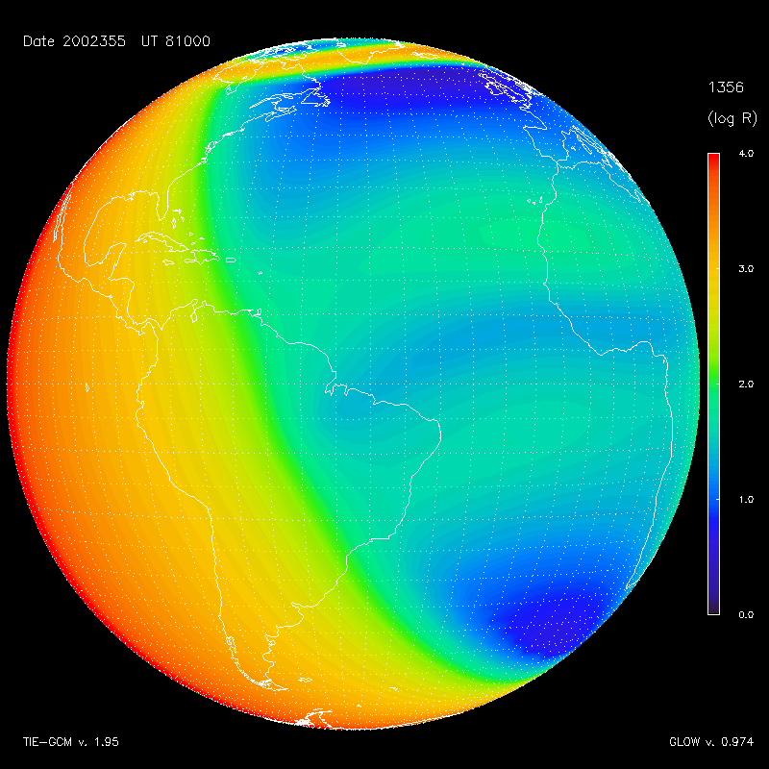
Observing System Simulation Concept — Airglow
Auroral Inputs
Solar Inputs
Neutral Atmos
Photo-electrons
GLOW
Electron Transport
Chemistry
Emissions

Slide 8
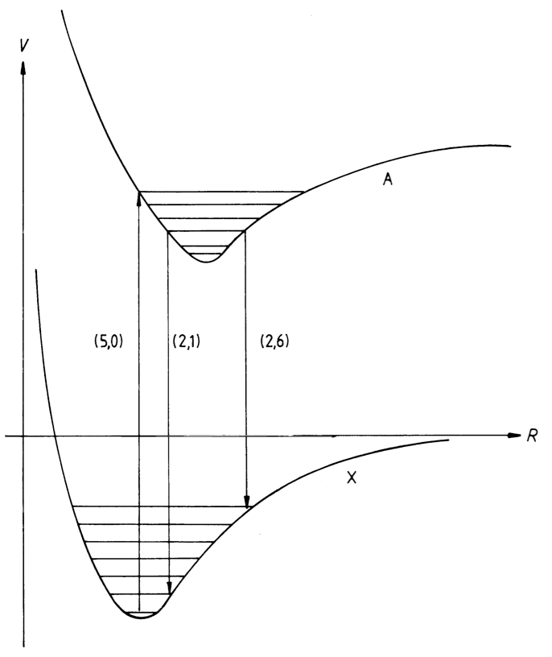
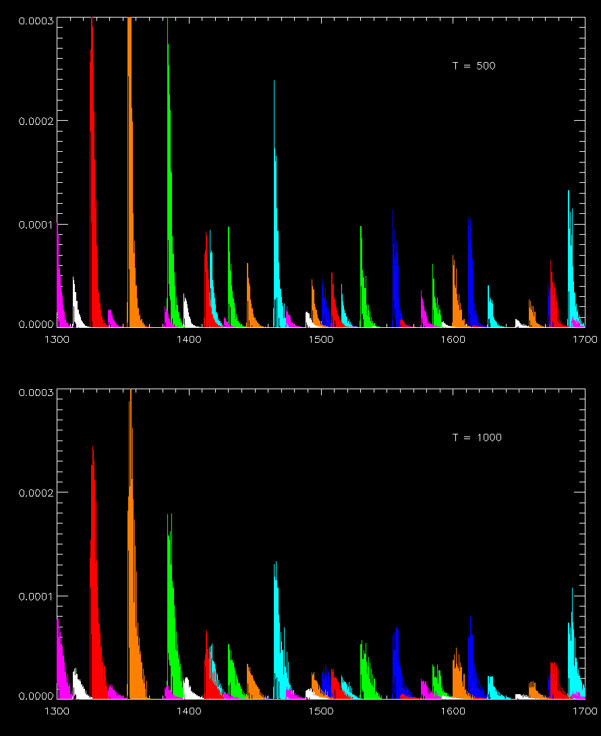
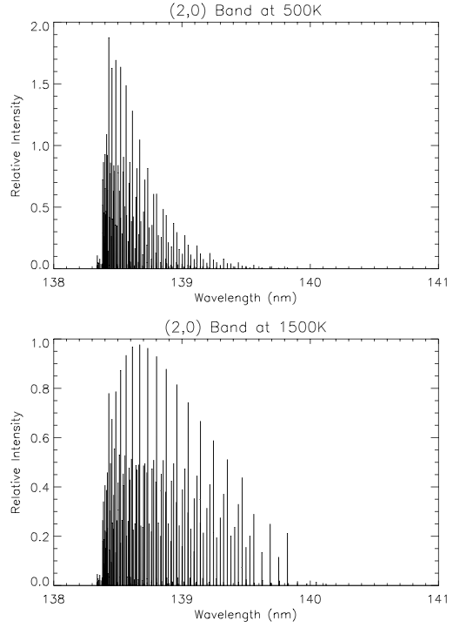
Observing System Simulation Concept — LBH Bands
LBH VRB

Slide 9
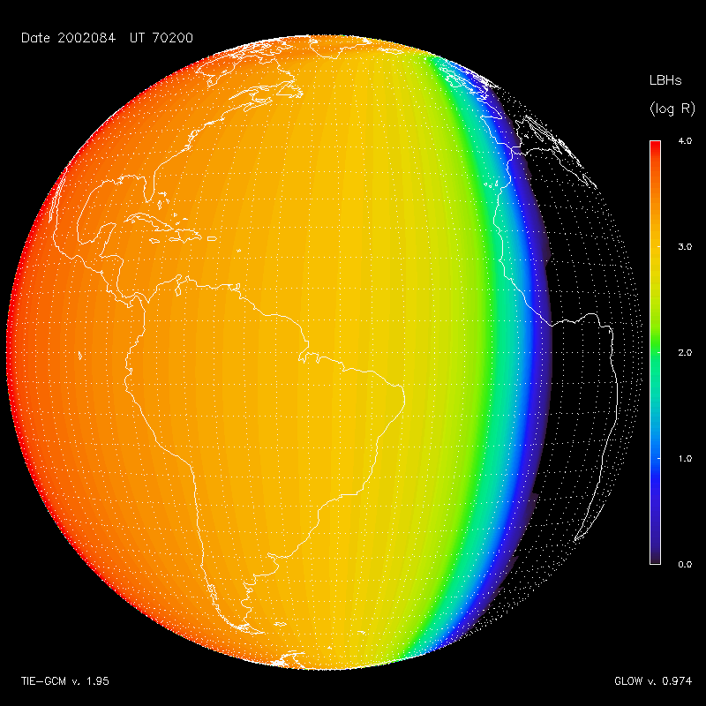
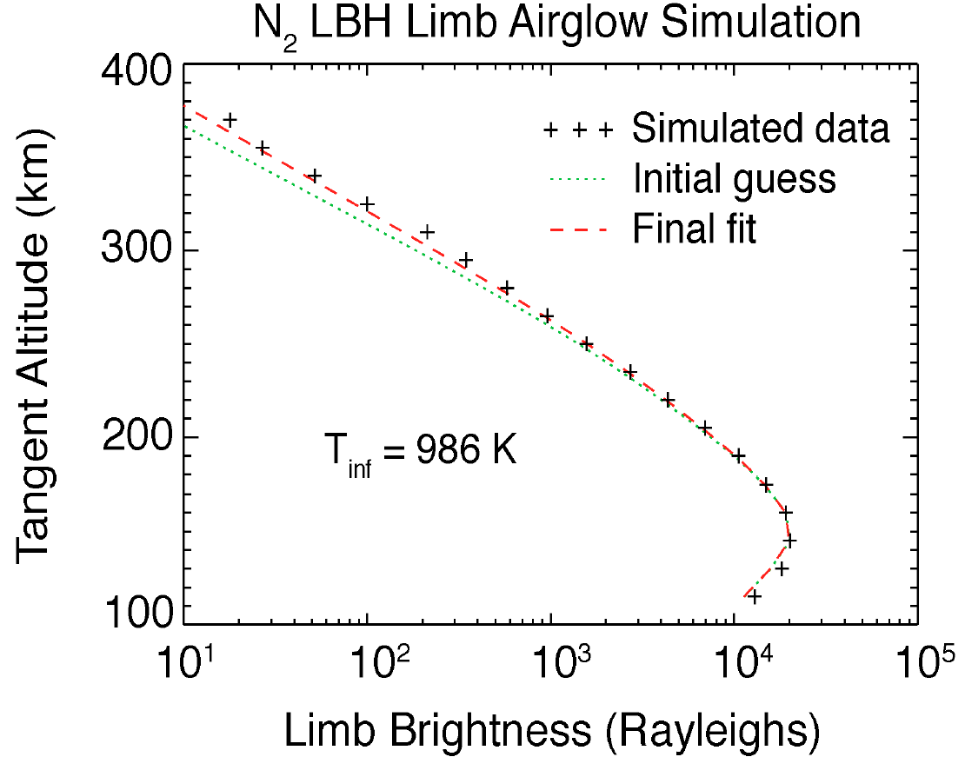
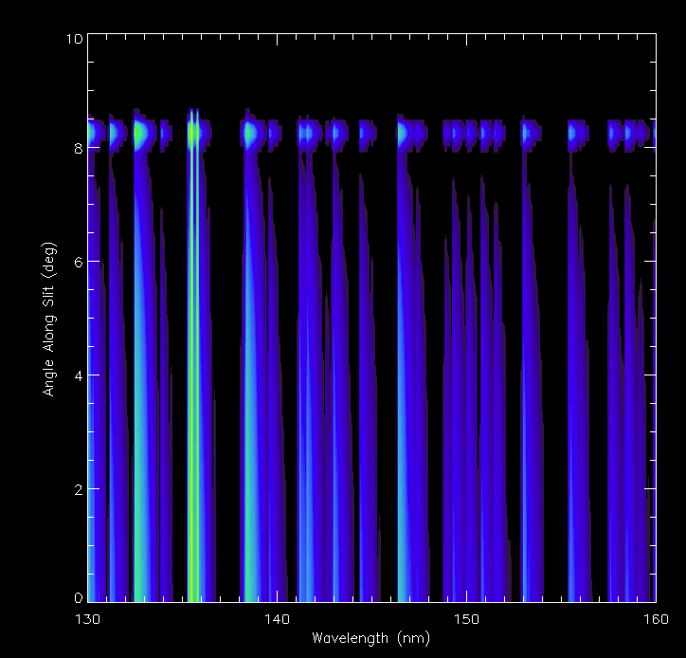
Observing System Simulation Concept — Line of Sight
LOS-RT
Disk
Limb

Slide 10
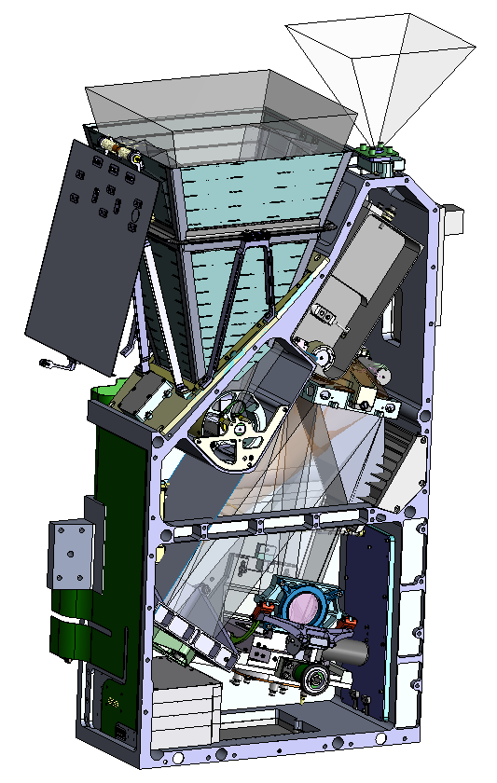
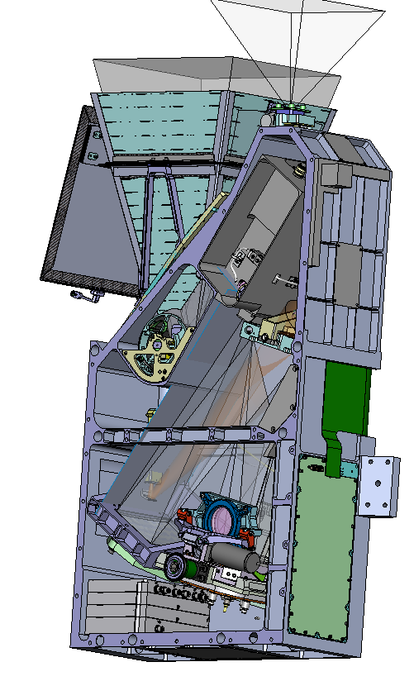
Observing System Simulation Concept — Instrument
Disk
Limb
INSTR

Slide 11
Airglow Simulations

Slide 12
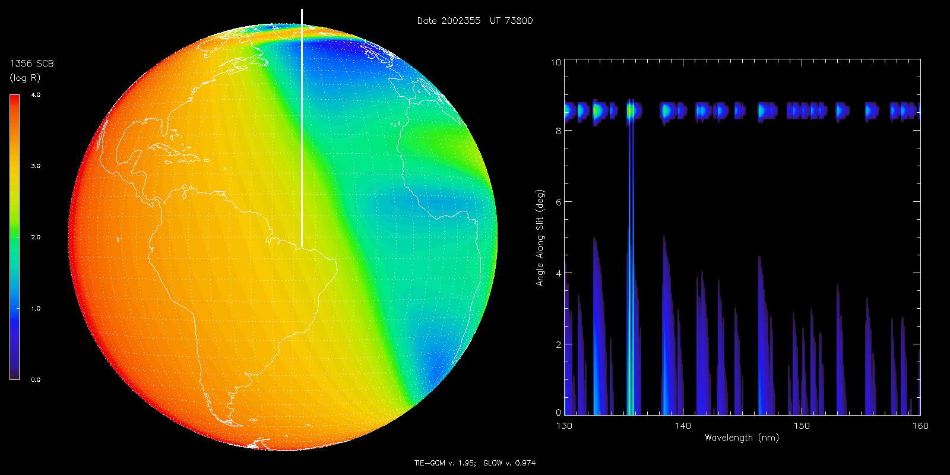
Image Cube Simulation
Disk Image Detector Image

Slide 13
Image Cube Simulation
Disk Image Detector Image

Slide 14
December Solstice Case
O (⁵S) 135.6 nm doublet N₂ LBH “short” (138–148 nm)

Slide 15
December Solstice Case
O(⁵S) / N₂ LBH ratio

Slide 16
The December 2006 “AGU Storm”
O (⁵S) 135.6 nm doublet N₂ LBH “short” (138–148 nm)

Slide 17
The December 2006 “AGU Storm”
O(⁵S) / N₂ LBH ratio

Slide 18
Conclusions
• We have a comprehensive observational simulation system for the GOLD mission.
• The methodology can be adapted to the ICON mission.
• The methodology can be adapted to any other mission as well.
• Based on community models; open-source code.
• Can use this system for algorithm development and data analysis.
• Still work to do:
— Oi 130.4 nm triplet; Ni 149.3 line; limb sims; instrument simulator; WACCM-X

Slide 19
Backup on Viewing Geometry and Coordinate Systems

Slide 20
Viewing Geometry and Coordinate Systems
• Simulation line-of-sight integrations are done in two ways:
— “Bottom-up”
— “Top-down”
• Bottom-up integrations are based on each model grid column:
— Slant column calculated considering spherical geometry
— Rigorous for disk, but approximate at limb due to tangent point singularity
— Doesn’t consider horizontal gradients in emission function
— Good enough for making pictures
• Top-down simulations are based on lines of sight defined by instrument viewing
— Each line-of-sight calculated using full spherical geometry
— Rigorous on disk or limb
— Interpolates each point along path from model grid
— computationally intensive
• In either case, absorption is considered along path, but scattering is neglected.
— Rigorous for LBH
— Reasonable approximation for 135.6 on disk
— Not valid for 130.4 triplet

Slide 21
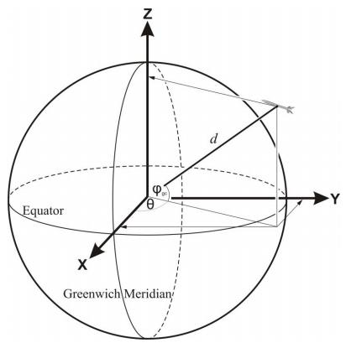
Coordinate Systems
• Earth Centered Inertial (ECI):
z-axis is north pole of Earth
x-axis is toward vernal equinox
y-axis = z X x
• Earth Centered Rotational (ECR or ECEF):
z-axis is north pole of Earth
x-axis is interect of prime meridian and equator
y-axis = z X x
• Geographic (GEO):
altitude relative to oblate ellipsoid surface
longitude ±180° from prime meridian
geodetic latitude:
angle between local vertical and equator
• Instrument Coordinates (CHIPSI)
χ is angle from S/C nadir to east
ψ is angle from S/C nadir to north
Earth Centered Rotational (ECR) coordinate system (a.k.a. Earth Centered Earth Fixed (ECEF), but this name is somewhat confusing, so ECR is preferred).

Slide 22
Notes on Coordinate Systems
• ECI is largely unnecessary for geostationary observations.
—Approximations due to motion of vernal equinox and pole wobble
— Typically surmounted by use of J2000 reference frame
• ECR is the most straightforward coordinate system for line-of-sight calculations.
• ECR can be defined in either cartesian or spherical coordinates, but...
— Note that polar angle θ ≠ geodetic latitude
— Angle from pole, not equator (simiar to polar angle v. declination problem)
— Defined in spherical coordnates, not on ellipsoid
• Models are in GEO coordinates, but ignore change in Earth radius.
— However, we consider Earth radius when transforming from GEO to ECR
— In essence, this warps the model onto the ellipsoid
— Note that I am using the WGS-84 Ellipsoid, but not the EGM-96 harmonics
— This results in an error of ~ ±0.1 km
• CHIPSI coordinates assume that the center of the detector is pointed at nadir.
— May need to consider alignment and pointing offsets
— S/C coordinate system for GOLD is x≈v; z toward nadir

Slide 23
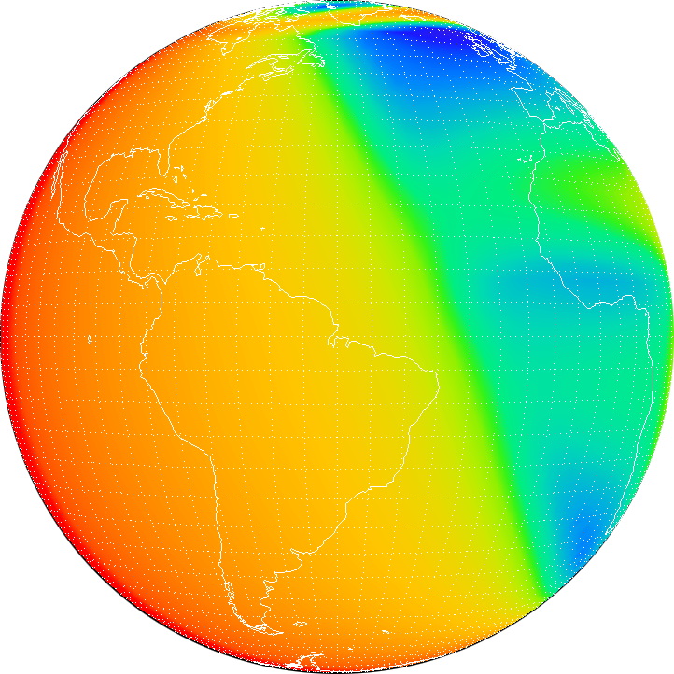
CHIPSI Coordinates
ψ
χ
χ, ψ are angles
degrees from nadir
typical simulation grid ±10° at 0.1° res.

