Slide 1
Hemispheric Asymmetry and Seasonal Variation of Thermospheric Composition
Stanley C. Solomon, Liying Qian, and Alan G. Burns
High Altitude Observatory
National Center for Atmospheric Research
Fall AGU • San Francisco • 2014

Slide 2
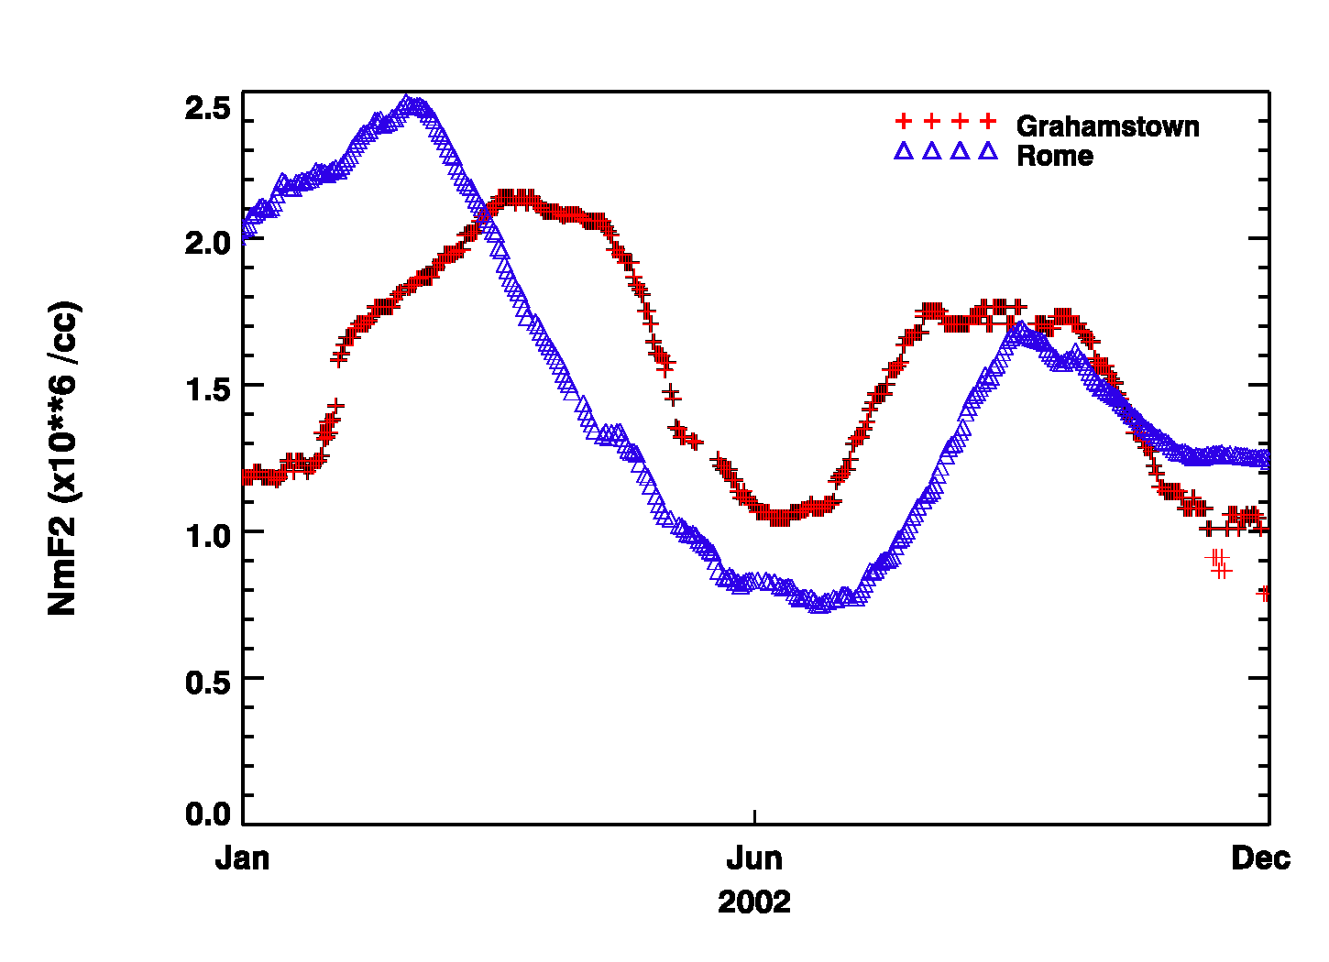
Why is there a winter anomaly in the ionosphere?
Winter
Anomaly
Annual Anomaly
Ionosonde measurements of N_{m}F₂ at solar maximum

Slide 3
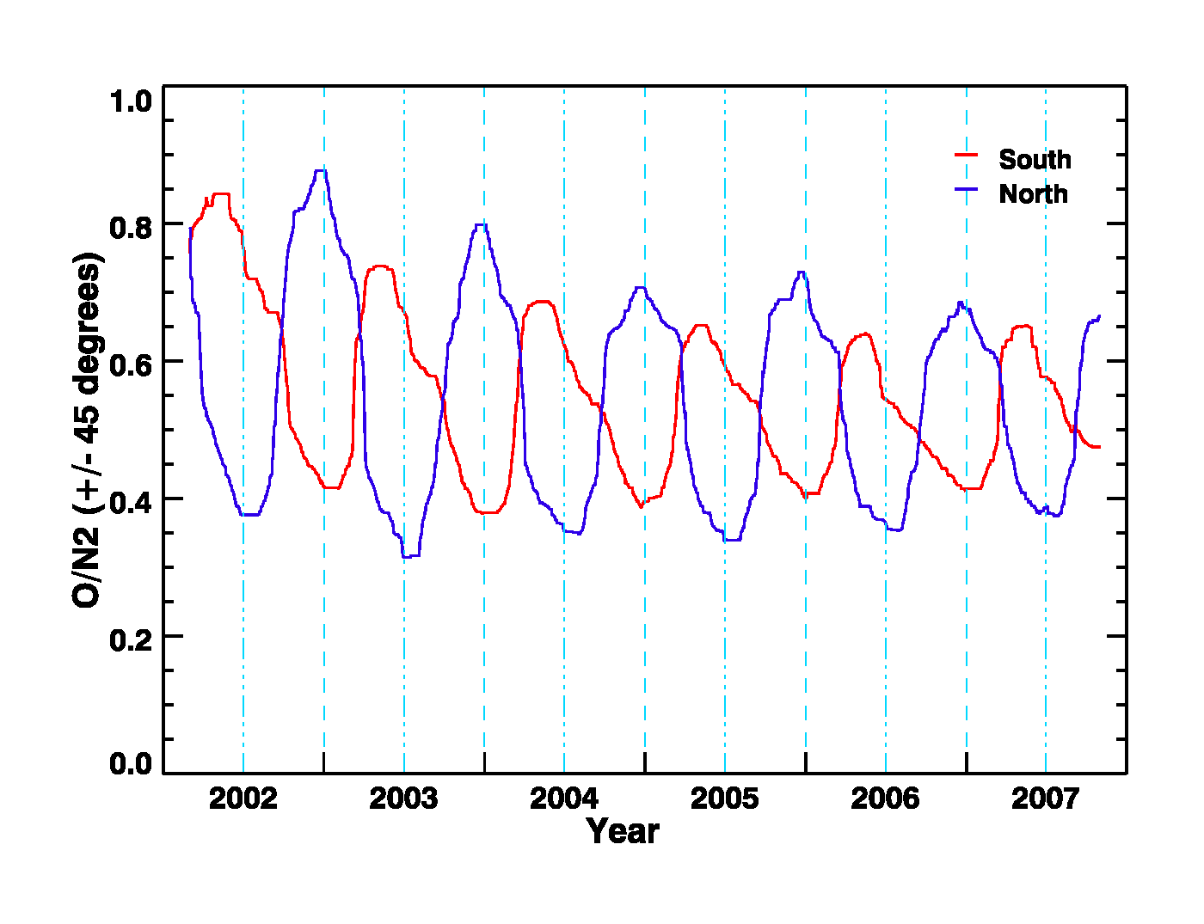
...because of the seasonal change in thermospheric composition
TIMED/GUVI measurements of the atomic oxygen to molecular nitrogen ratio at ±45 degrees latitude. There is a strong summer-to-winter asymmetry, and the amplitude varies with the solar cycle.

Slide 4
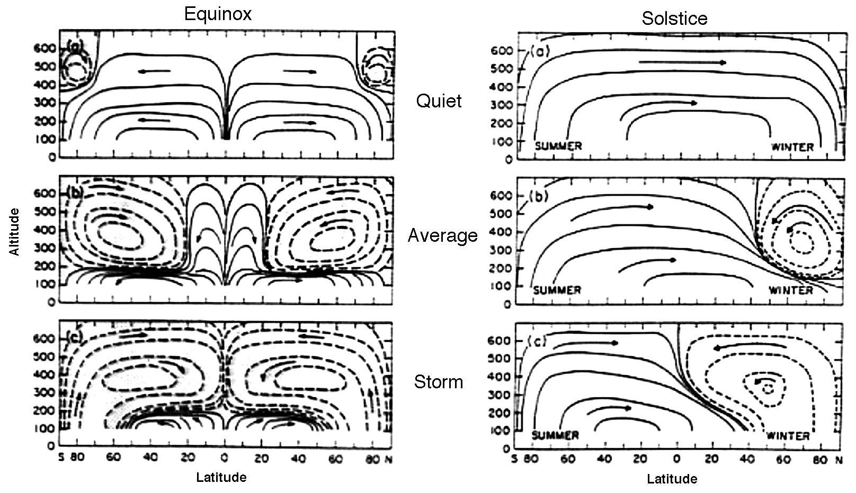
Why is there a seasonal shift in composition?
Sketch by Ray Roble representing meridional circulation patterns
...because of vertical winds driven by the general circulation

Slide 5
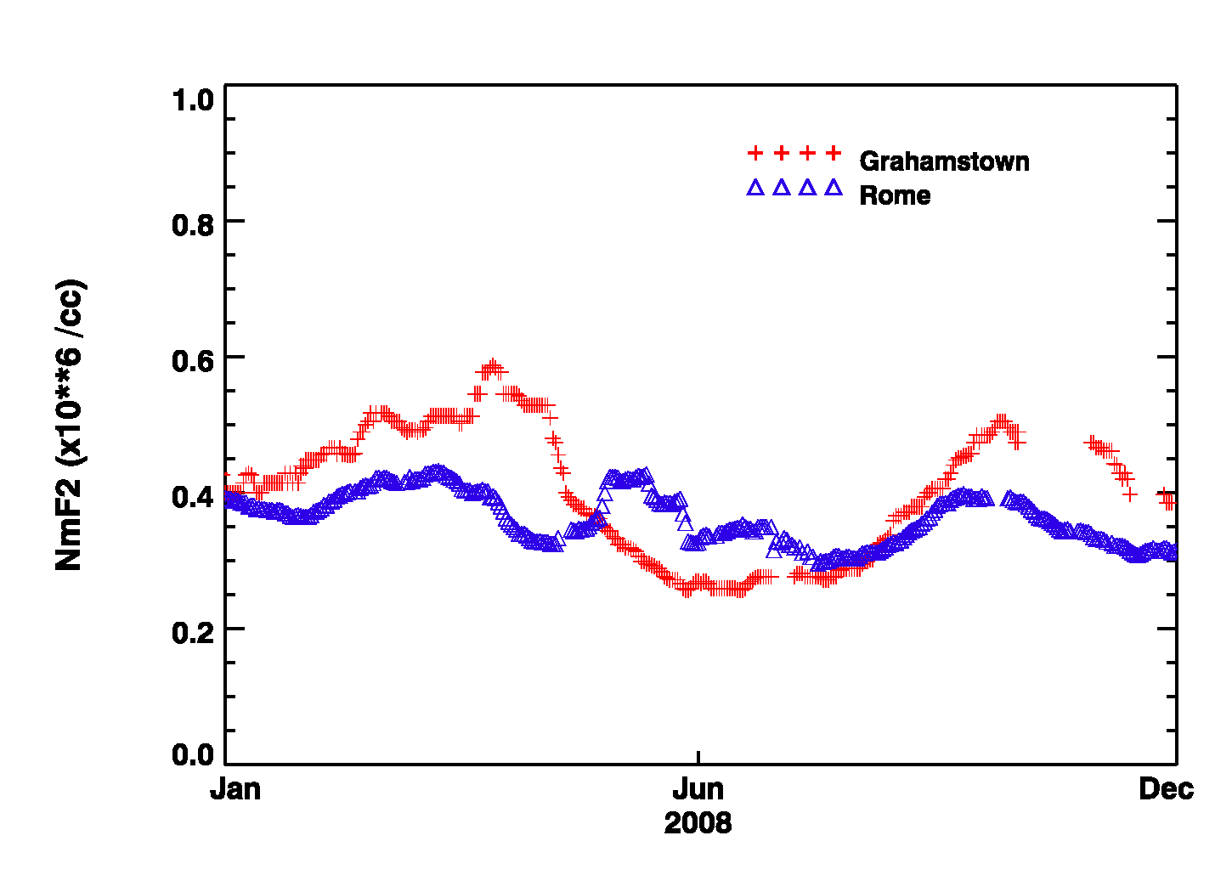
Why is the winter anomaly dependent on the solar cycle?
Ionosonde measurements of N_{m}F₂ at solar minimum.
Note that the winter anomaly has almost disappeared.

Slide 6
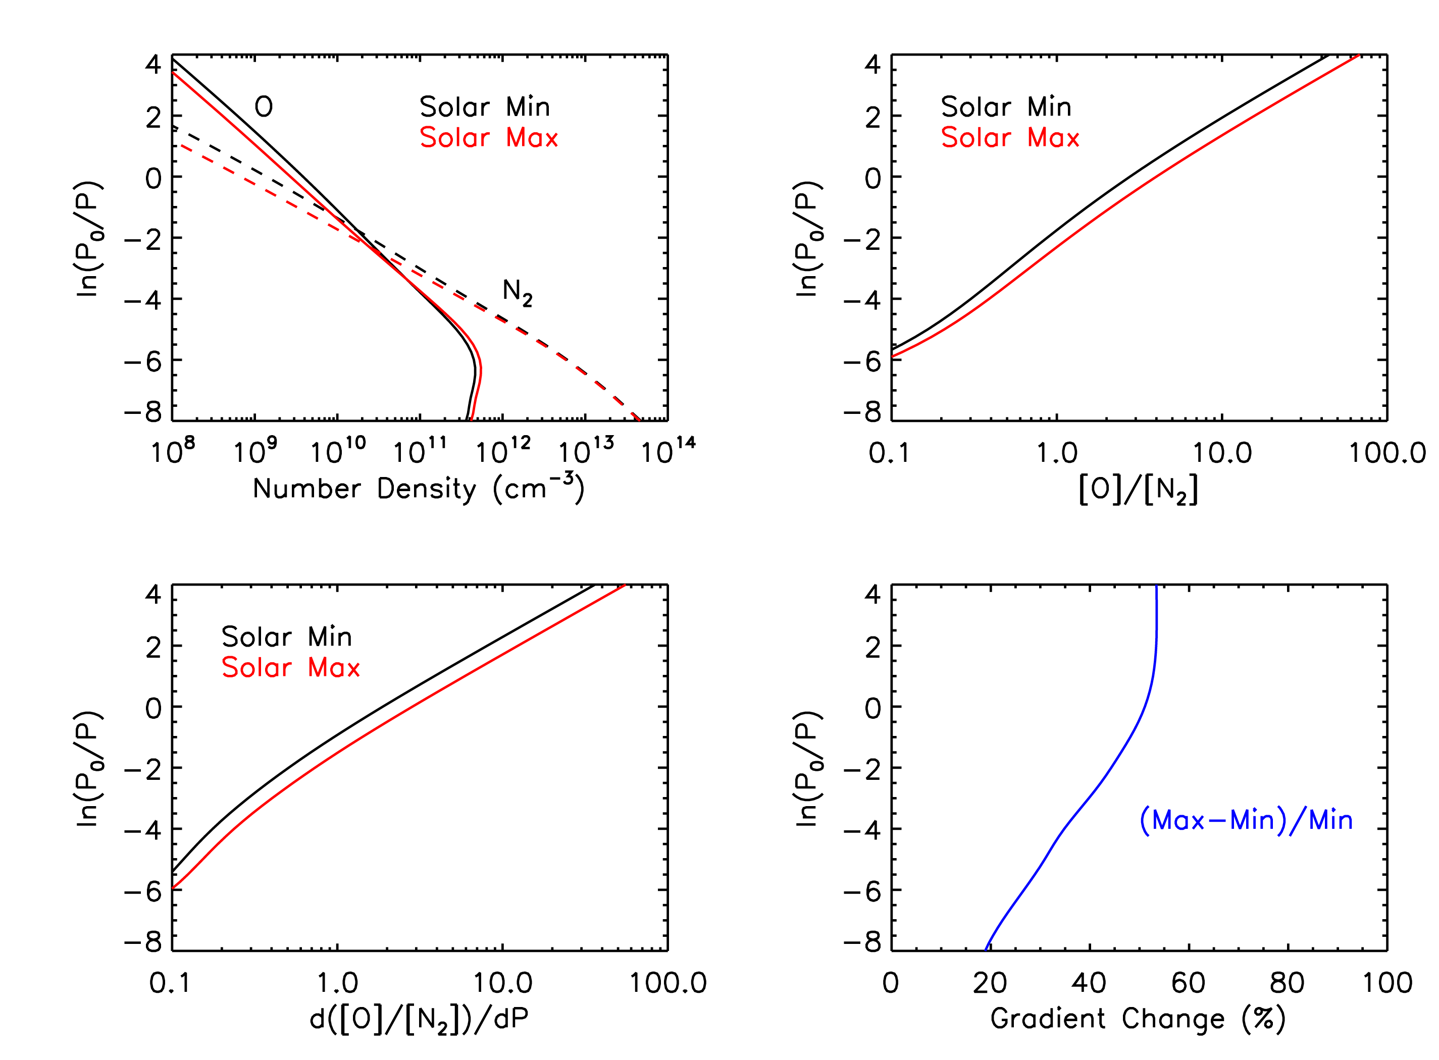
...because of the interaction between the composition gradient and the vertical wind
Results from the TGCM Global Mean model showing the variation of the vertical gradient of composition with the solar cycle.

Slide 7
Interaction of vertical winds with the mixing ratio gradient
Ionospheric Density in the F-region depends on the balance between production, loss, and transport:
Composition drives the balance between production and loss, and is primarily controlled by vertical winds and the gradient of mixing ratio:
Vertical winds don’t change very much over the solar cycle, but changes in the mixing ratio gradient cause changes in the amplitude of summer-to-winter variation. This is a basic consequence of hydrostatics and the ideal gas law.

Slide 8
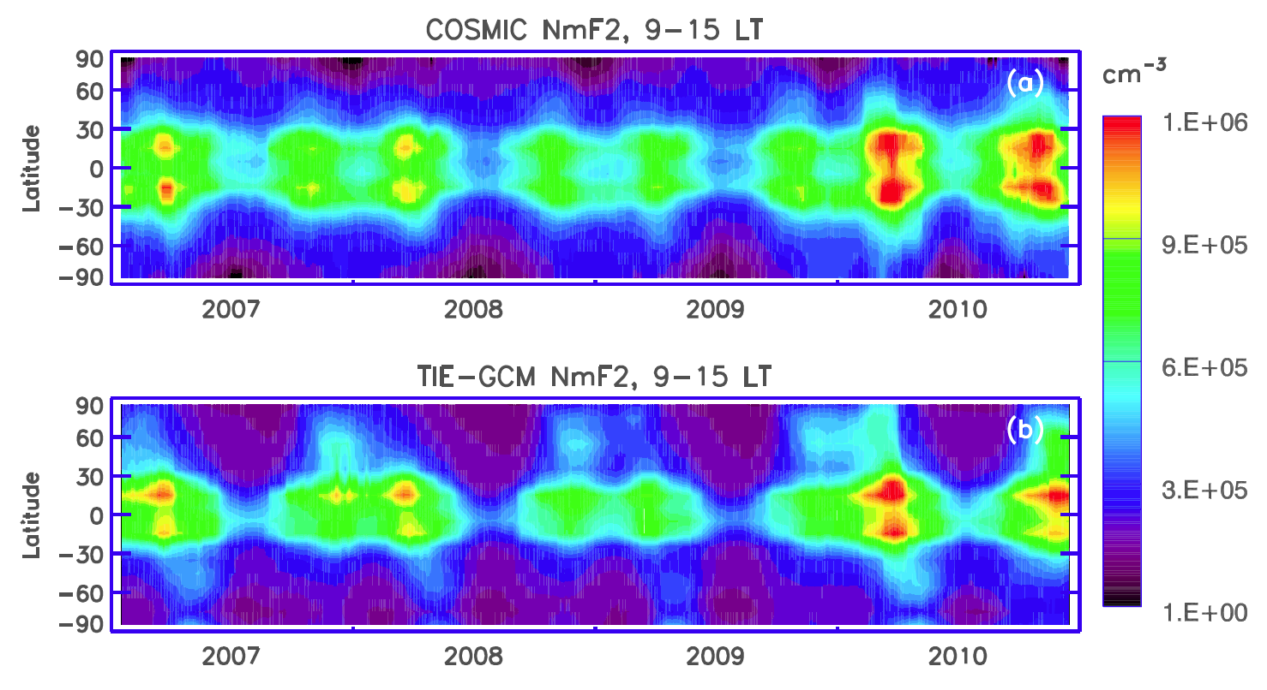
Why is there an annual anomaly in the ionosphere?
Climatology of N_{m}F₂ measured by the COSMIC satellites and
modeled by the TIE-GCM (using variable K_{zz}) [Qian et al., GRL, 2013].

Slide 9
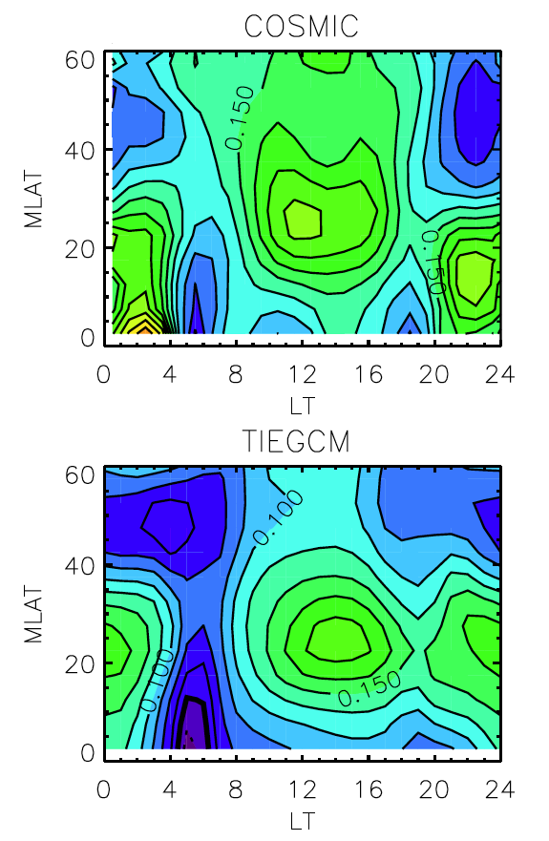
...because of the offset of the geomagnetic field ...because of the change in Sun-Earth distance ...because of the annual anomaly in thermospheric composition
The annual asymmetry index is a measure of how much higher NmF2 is during southern hemisphere summer compared to northern hemisphere summer.
Model analysis showed that the offset of the geomagnetic field was important for modulating the annual response, due to interaction of the equatorial anomaly with the solar zenith angle. Sun-Earth distance was also a factor.
Annual asymmetry index of N_{m}F₂ measured by the COSMIC satellites
and modeled by the TIE-GCM [Zeng et al., JGR, 2008]

Slide 10
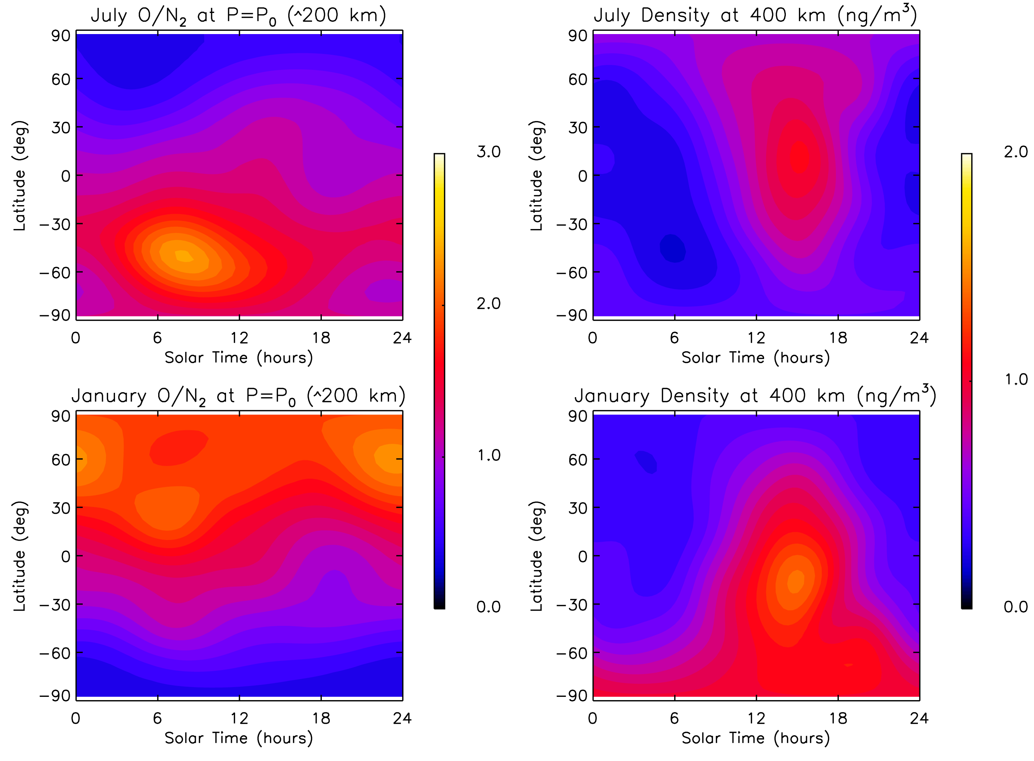
Why is there an annual anomaly in thermospheric composition and density?
MSIS-2K empirical model shows annual asymmetry at solar minimum
Left: O/N₂ ratio at P₀ = 5x10⁻⁴ dyne/cm² (~200 km). Right: Density at 400 km altitude
Top: Northern hemisphere summer. Bottom: Southern hemisphere summer

Slide 11
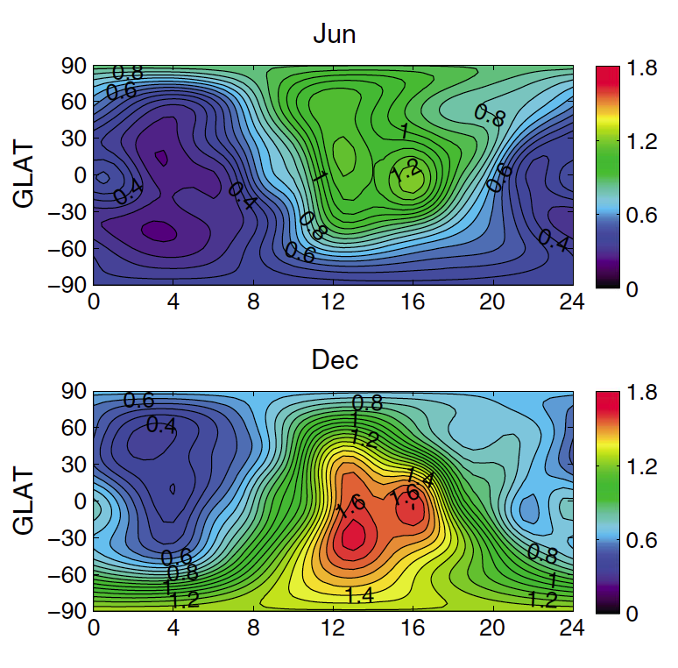
...because of the change in Sun-Earth distance...and...
Climatology of density measured by the CHAMP satellite near solar minimum
Top: Northern hemisphere summer. Bottom: Southern hemisphere summer
[Lei et al., JGR, 2013]

Slide 12
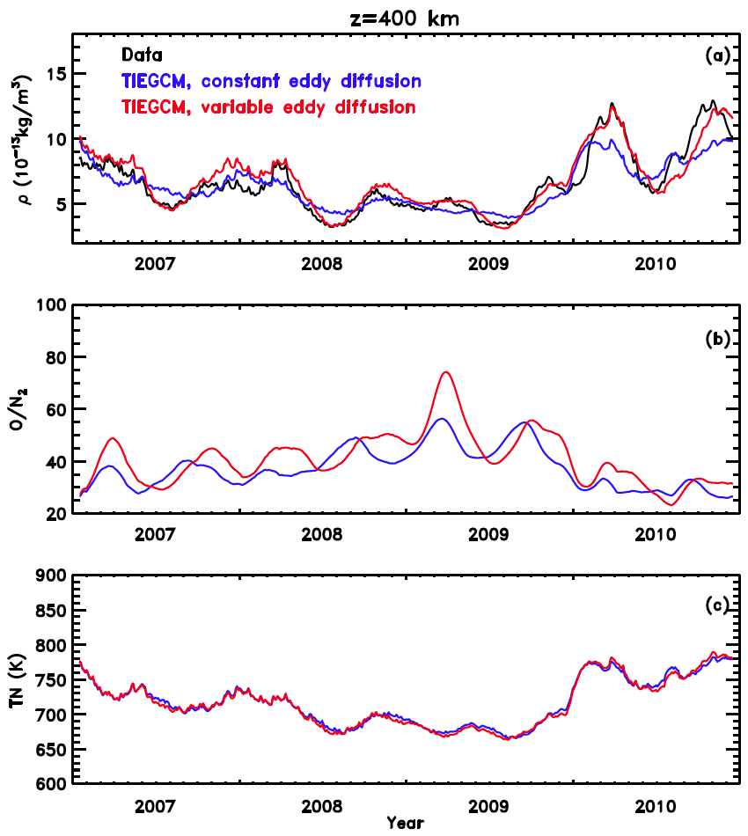
...because of something that the lower atmosphere is doing to the upper atmosphere
Plots of density and O/N₂ composition ratio from the TIE-GCM.
In order to obtain agreement with COSMIC data, and GUVI data,
variable K_{zz} at the lower boundary was required [Qian et al., JGR 2009, GRL 2013].

Slide 13
Bibliography
Rishbeth, H. (1998), How the thermospheric circulation affects the ionospheric F₂-layer, J. Atmos. Solar-Terr. Phys., 60, 1385.
Fuller-Rowell, T. J. (1998), The “thermospheric spoon”: A mechanism for the semiannual density variation, J. Geophys. Res., 103, 3951.
Rishbeth, H., and I. C. F. Muller-Wodarg (1999), Vertical circulation and thermospheric composition: a modelling study, Ann. Geophys., 17, 794.
Rishbeth, H., et al.(2000), Annual and semiannual variations in the ionospheric F₂-layer: II. Physical discussion, Ann. Geophys., 18, 945.
Mendillo, M., C.-L. Huang, X. Pi, H. Rishbeth, and R. Meier (2005), The global ionospheric asymmetry in total electron content, J. Atmos. Solar-Terr. Phys., 67, 1377, doi:10.1016/j.jastp.2005.06.021.
Rishbeth, H., and I. C. F. Muller-Wodarg (2006), Why is there more ionosphere in January than in July? The annual asymmetry in the F₂-layer, Ann. Geophys., 24, 3293.
Zeng, Z., A. Burns, W. Wang, J. Lei, S. Solomon, S. Syndergaard, L. Qian, and Y.-H. Kuo (2008), Ionospheric annual asymmetry observed by the COSMIC radio occultation measurements and simulated by the TIEGCM, J. Geophys. Res., 113, A07305, doi:10.1029/2007JA012897.
Qian, L., S. C. Solomon, and T. J. Kane (2009), Seasonal variation of thermospheric density and composition, J. Geophys. Res., 114, A01312, doi:10.1029/2008JA013643.
Lei, J., X. Dou, A. Burns, W. Wang, X. Luan, Z. Zeng, and J. Xu (2013), Annual asymmetry in thermospheric density: Observations and simulations, J. Geophys. Res. Space Physics, 118, 2503–2510, doi:10.1002/jgra.50253.
Qian, L., A. G. Burns, S. C. Solomon, and W. Wang (2013), Annual/semiannual variation of the ionosphere, Geophys. Res. Lett., 40, 1928, doi:10.1002/grl.50448.
Burns, A. G., W. Wang, L. Qian, S. C. Solomon, Y. Zhang, L. J. Paxton, and X. Yue (2014), On the solar cycle variation of the winter anomaly, J. Geophys. Res. Space Physics, 119, doi:10.1002/2013JA019552.

