Slide 1
Team Report on integration of FSAM to SWMF and on FSAM simulations of convective dynamo and emerging flux in the solar convective envelope
Yuhong Fan and Fang Fang
National Center for Atmospheric Research

Slide 2
Code Development and Integration of FSAM into SWMF
Convert and optimize the FSAM code
From original F77 to F90 version, compatible with SWMF.
Improve the efficiency in message passing and adopt routines from the SWMF.
Integrate FSAM into SWMF as its CZ component following standards and convections of other existing components such as EE
FSAM can run as a stand-alone mode
Multiple test cases are available in SWMF/CZ/FSAM/src/problems:
Test run from a solar convection zone background with seed fields: make test
Convective dynamo run from seed fields or from a restart file:
make prob PROBS=dynamo RUNDIR=rundirname
make prob_rst PROBS=dynamo RUNDIR=rundirname
A run of isolated rising flux tube in stable cz:
make prob PROBS=risetube_qcz RUNDIR=rundirname
A hydro run for comparison with ASH:
make prob PROBS=benchA RUNDIR=rundirname
New problems can be created by adding new SWMF/CZ/FSAM/src/problems/newprobdir with the necessary files following previous examples
FSAM can run as a CZ component of SWMF
Wrapper file available in SWMF/CZ/FSAM/srcInterface
Can be set by Config.pl –v=CZ/FSAM
Routine test available in SWMF: make test_cz

Slide 3
Finite-difference Spherical Anelastic MHD (FSAM) code solves the following anelastic MHD equations in a partial spherical shell domain:

Slide 4
A convective dynamo simulation
Convection is driven by the radiative diffusive heat flux as a source term in the entropy equation:
The boundary condition for s₁:
The velocity boundary condition is non-penetrating and stress free at the and the top, bottom and q-bondaries
For the magnetic field: perfect conducting walls for the bottom and the q-boundaries; radial field at the top boundary
Angular rotation rate for the reference frame , net angular momentum relative to the reference frame is zero.
Notes:
Iteration time step is about 10 min

Slide 6
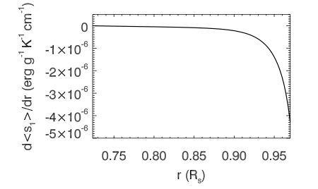
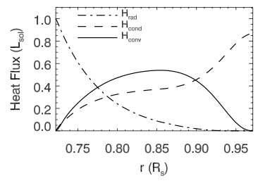
Consistent with Model S of JCD: the entropy gradient at 0.97R_{s} is ~10⁻⁵ erg g⁻¹ K⁻¹ cm⁻¹

Slide 7
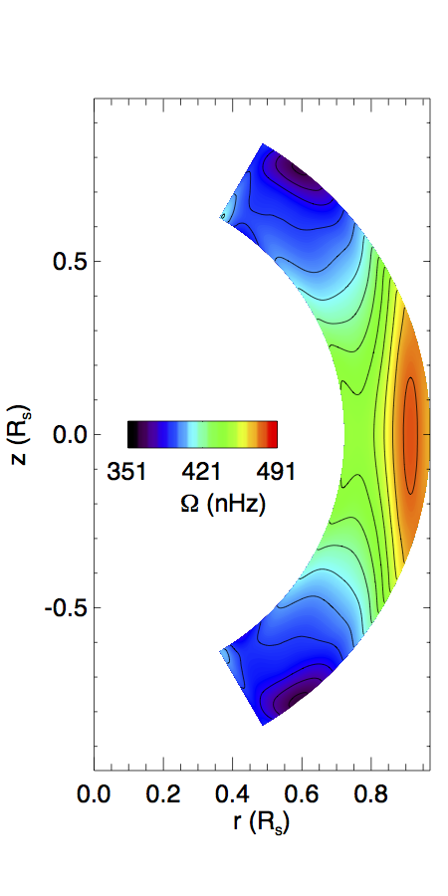
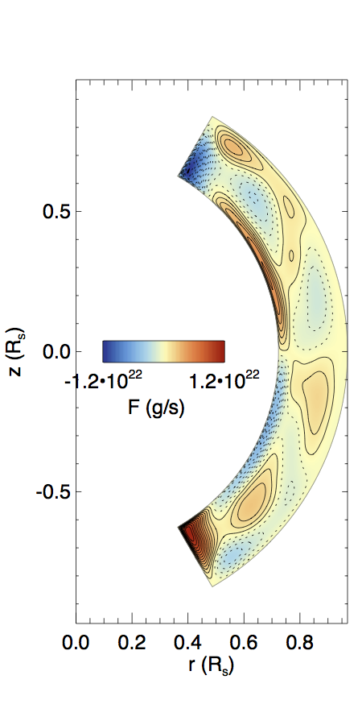
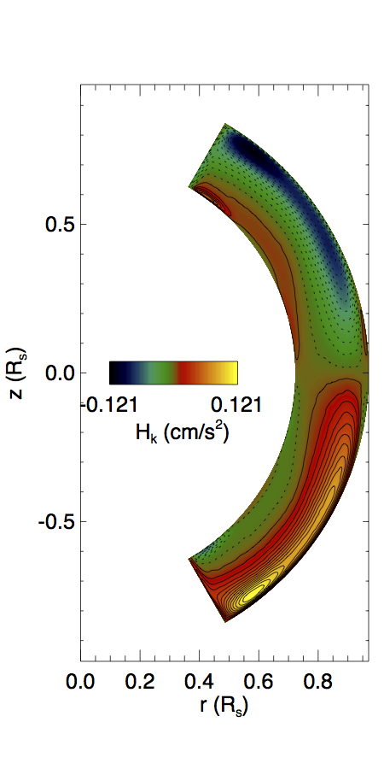
Mean flow properties

Slide 8
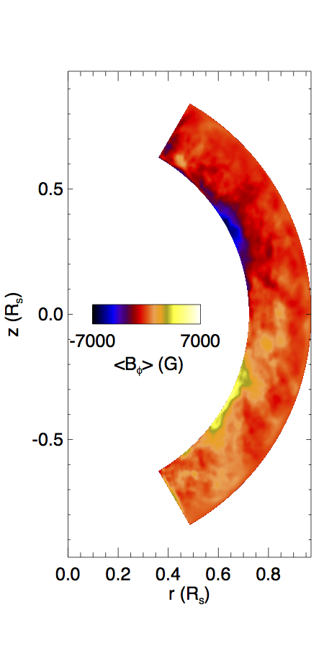
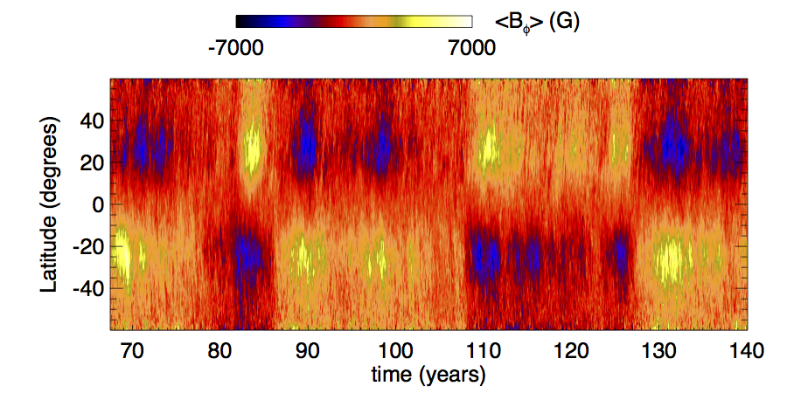
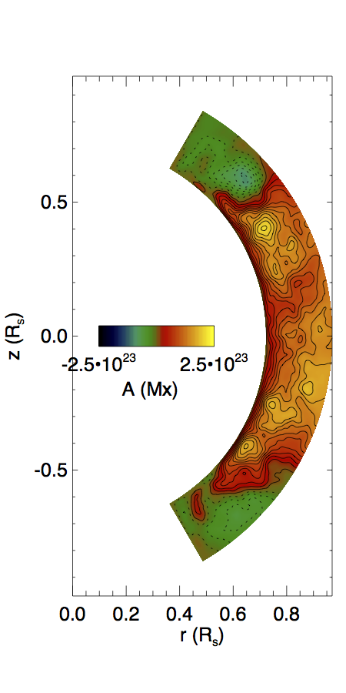
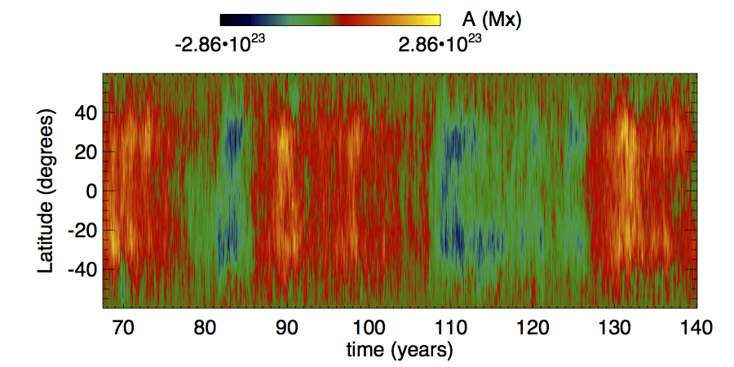

Slide 9
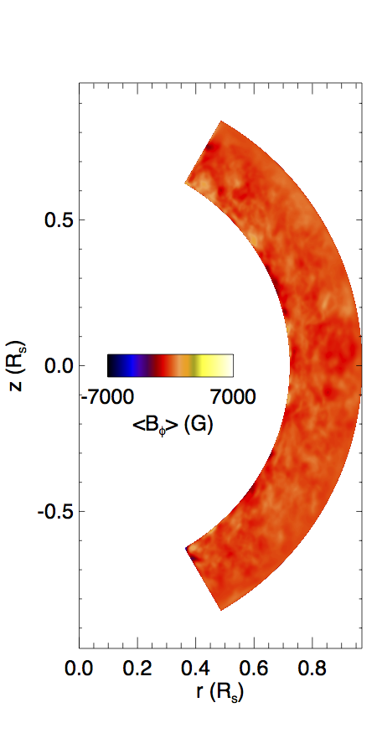
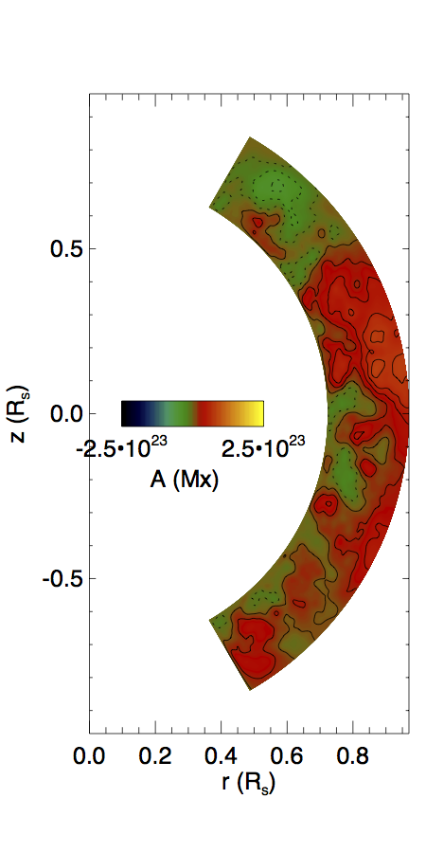
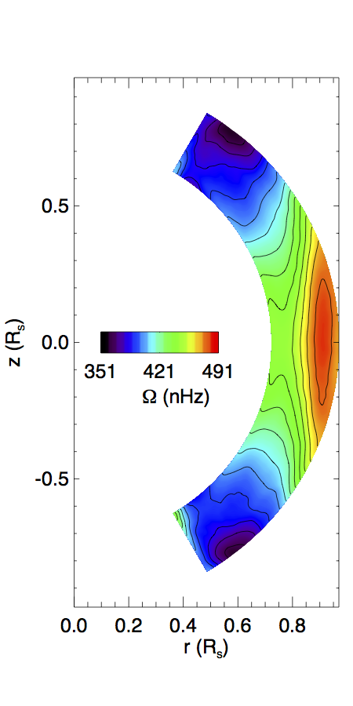
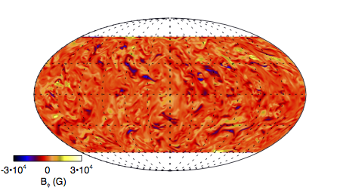
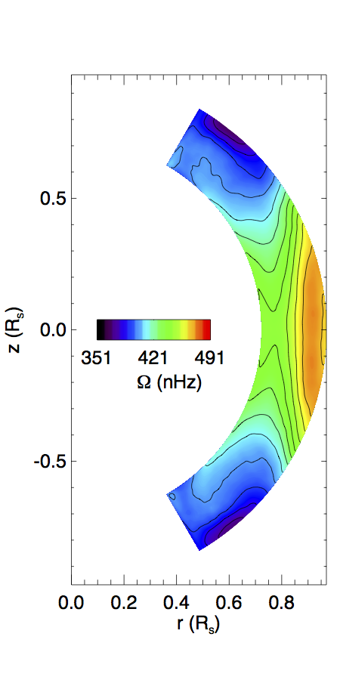
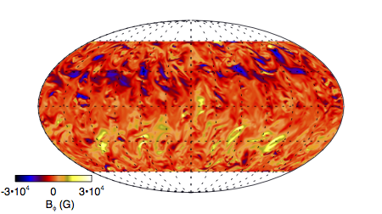
minimum
maximum

Slide 10
RS
MS
B=0
RS

Slide 11
Transition between solar-like and anti-solar differential rotation takes place at Ro ~ 1:
Gastine et al. (2014)
Presence of the magnetic field suppresses convection, making the flow more rotationally constrained, and changes the Reynolds stress transport of angular momentum:

Slide 13
Examples of strong flux emergence events

Slide 14
Conform to Hale’s rule by 2.4 to 1 in area
Tilt angle 7.5◦ ± 1.6◦

Slide 15
Summary
MHD simulation of rotating solar convection driven by the radiative heat flux in a partial spherical shell produces a large-scale mean magnetic field that exhibits irregular cyclic behavior with oscillation time scales ranging from about 5 to 15 years and undergoes irregular polarity reversals
The mean axisymmetric toroidal magnetic field peaks at the bottom of the convection zone, reaching a value of about 7000 G. Including the fluctuating component, individual channels of strong field reaching 30kG are present.
The presence of the magnetic fields appears to be important for maintaining the solar-like differential rotation. The magnetic fields make the convective flows more rotationally constrained and the resulting Reynolds stress produces a more outward transport of angular momentum needed for driving a solar-like differential rotation.
In the midst of magneto-convection, we found occasional emergence of strong super-equipartition flux tubes near the surface, exhibiting properties that are similar to emerging solar active regions.

