Slide 1
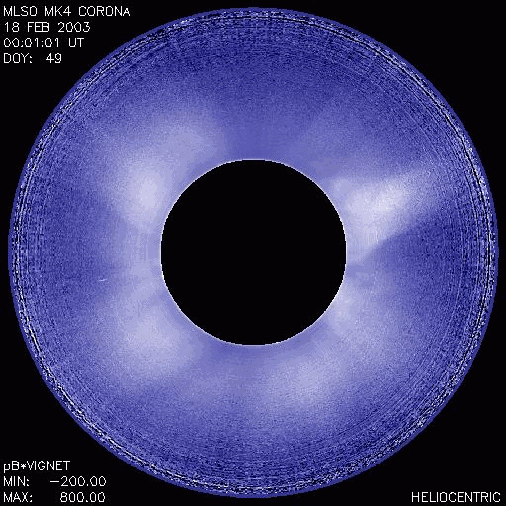
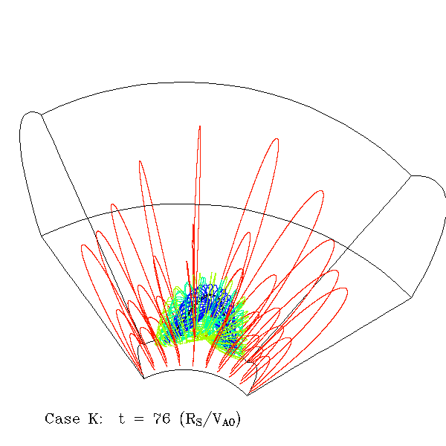
MHD simulations of coronal mass ejections
Notes:
Coronal mass ejections are large scale ejections of magnetic flux and plasma from the lower solar corona into interplanetary space, and are major drivers of space weather at earth. HAO scientist are using 3D MHD simulations to study the magnetic field evolution and the critical conditions for the onset of these eruptions. Shown here is an MHD simulations of the eruption of a twisted coronal magnetic flux rope due to the onset of the kink instability as the twist of the field reaches a critical level. Shown on right is a CME observed in white light by HAO’s MLSO MK4 where the erupting prominence under-goes large rotation consistent with the eruptiong of a twisted magnetic flux rope.

