Slide 1
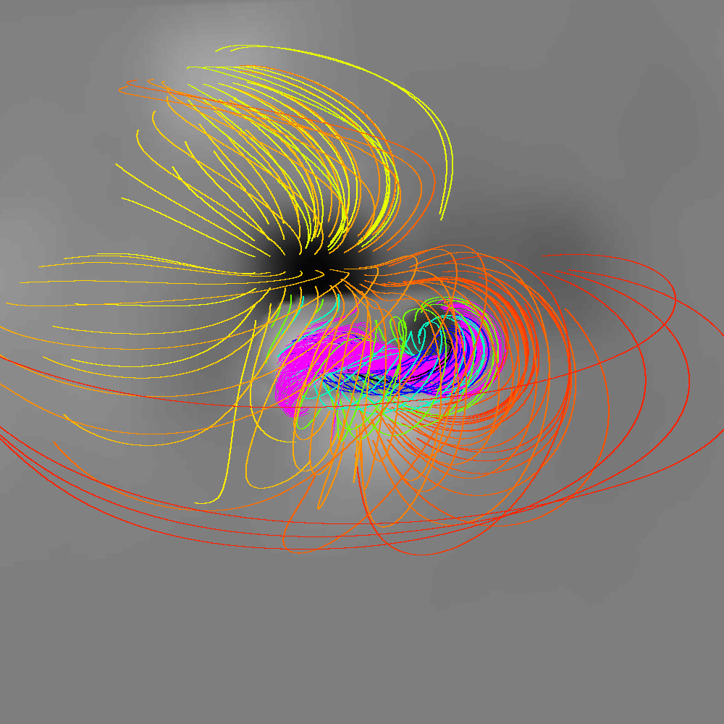
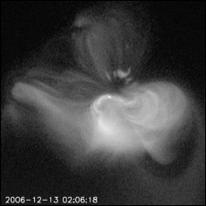
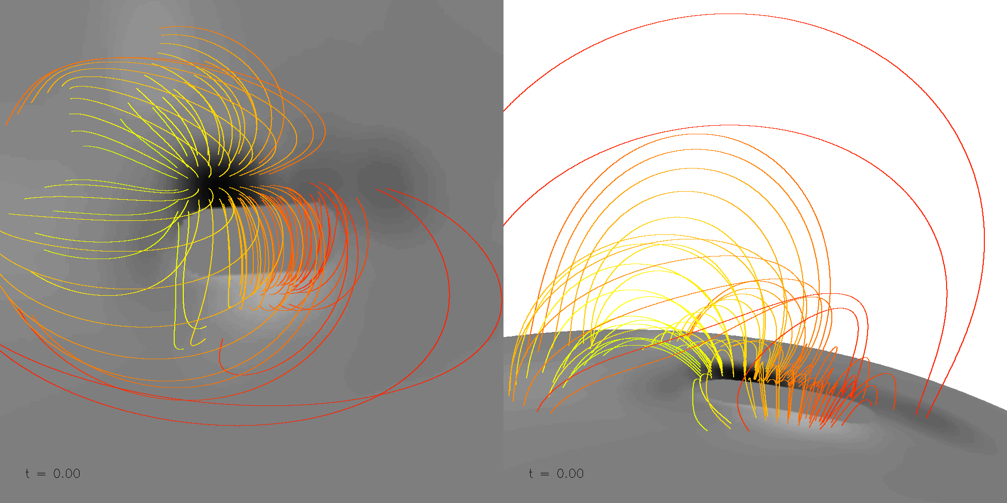
3D MHD simulation the coronal magnetic field evolution of Dec 13 2006 eruption
Pre-eruption coronal magnetic field with pink field lines indicating fields going through the current sheet
Hinode XRT
3D evolution of the coronal magnetic field from the simulation
Fan (2011, ApJ, 740, 68)
Notes:
An MHD simulation that qualitatively model the coronal magnetic field evolution associated with a CME event that occurred on 2006 December 13 in an emerging δ-sunspot region NOAA 10930. Top panels show pre-eruption coronal magnetic field from the model (left panel) and the X-ray observation of the pre-eruption field by the Hinode satellite. The pink field lines in the top left panel indicate fields going through the current sheet which would brighten up in soft X-ray. The simulation shows that the eruption (see the movie) can result from the emergence of an east-west-oriented twisted flux rope whose positive emerging flux borders the main pre-existing negative sunspot, consistent with the observed photospheric magnetic field.

