Slide 1
Simulating the Buoyant Rise of Active Flux Tubes in a Solar-like Convective Envelope
Notes:
In this project, we aim to model the formation and buoyant rise of active region flux tubes in the solar convective envelope, with the top boundary reaching about 20 Mm below the photosphere. In this example simulation, a toroidal flux tube of 100 kG, with a prescribed magnetic buoyancy pattern is inserted into the bottom of the rotating solar convective envelope with a statistically steady solution of giant-cell convection and solar-like differential rotation. It is found that with 100kG initial field, the magnetic buoyancy largely determines the rise of the tube although strong down flows produce significant undulation and distortion to the shape of the emerging Ω-shaped tubes. The convective flows significantly reduce the rise time it takes for the apex of the flux tube to reach the top (about 27 days). The apex portion rises nearly radially and produces an emerging region (see top panels, at a depth of about 30 Mm below the photosphere) with an overall tilt angle consistent with the active region tilts, although the emergence pattern is more complex compared to the case without convection (see next slide). Near the top boundary at a depth of about 30 Mm, the emerging flux shows a retrograde zonal flow of about 345 m/s relative to the mean flow at the latitude of emergence. In the lower panels, which show the volume rendering of B, the emerging apex first reaching the top is located to the right.

Slide 2
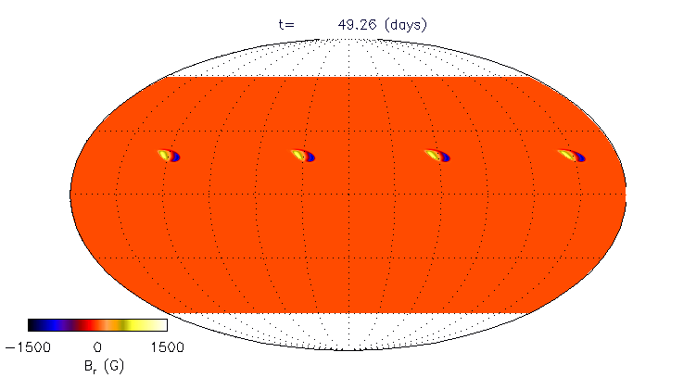
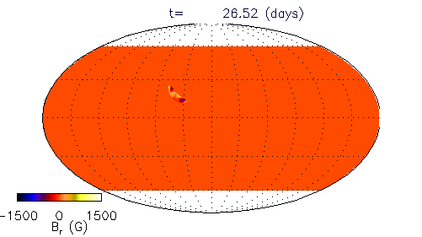
no convection
with convection
no convection
with convection
Notes:
A comparison of the buoyant rise of the same initial toroidal tube of 100kG with and without convection.

