Slide 1
FSAM update following last TIM
Completed converting the FSAM code to SWMF format and have put it into the SWMF as its CZ (Convection Zone) model running on Yellowstone of NCAR/NWSC. The CZ model is now set up to run stand-alone for several problems:
Isolated buoyant flux tubes with and without rotating convection
Convective dynamo
Implemented the overshoot upper boundary layer (by enforcing a stable entropy gradient in this top layer) to allow flow through the top boundary of the useful physical domain.
Tested this for the isolated rising flux tube simulations, which seem to improve the tilt angles of the rising tubes.
Still need to test this for convective dynamo and understand its effect on differential rotation
Also set up for adding the lower overshoot region and tachocline
Continue with convective dynamo simulations:
Mean field with irregular cyclic behavior
Presence of the magnetic field is important for maintaining a solar like differential rotation
There are strong flux emergence events that may be used to couple to near surface layer models.

Slide 2
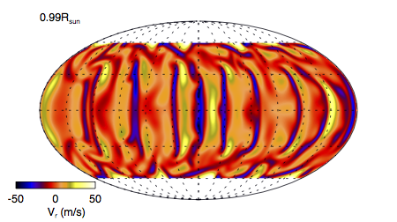
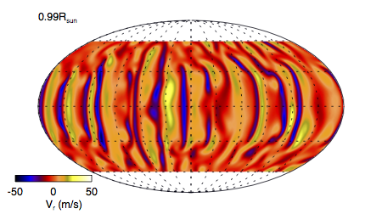
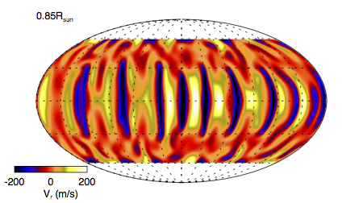
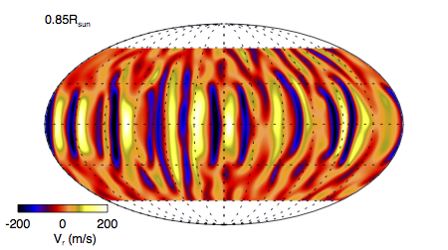
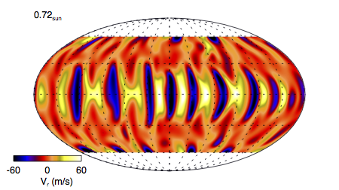
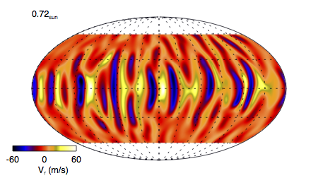
A comparison between FSAM and ASH of a hydro simulation of rotating convection
FSAM
ASH

Slide 3
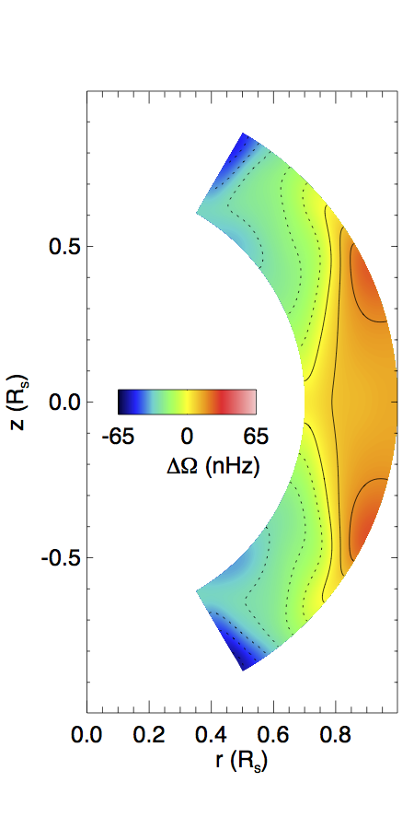
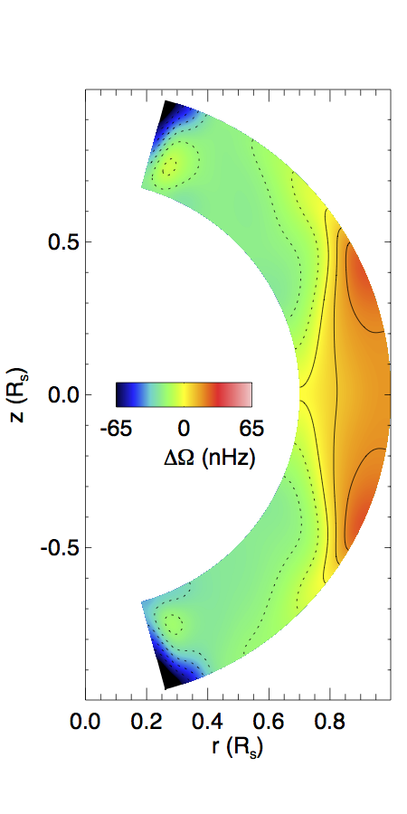
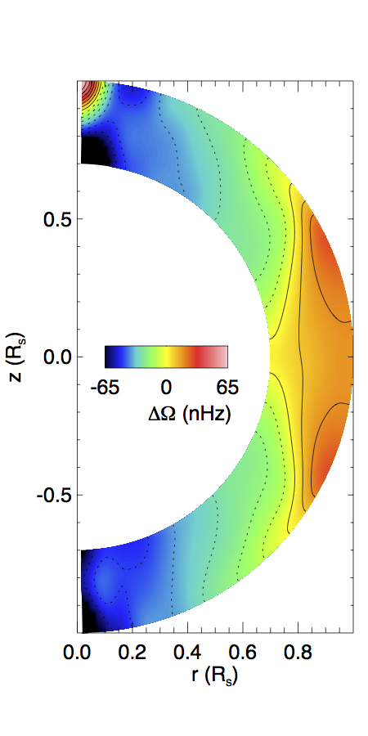
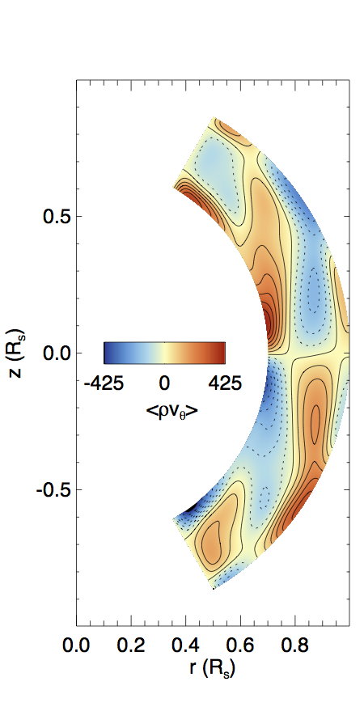
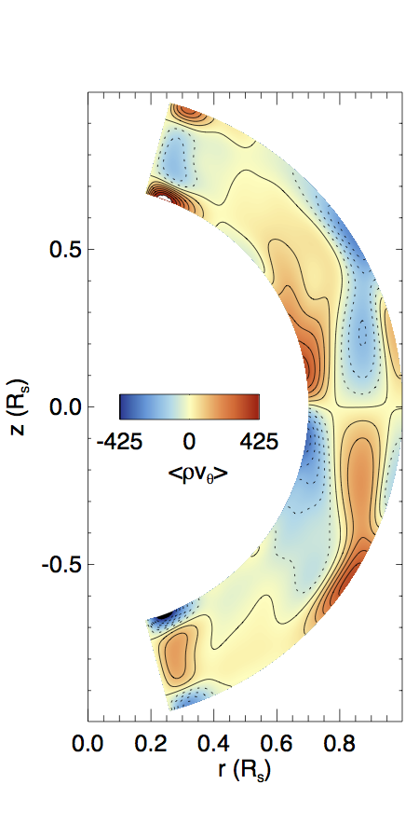
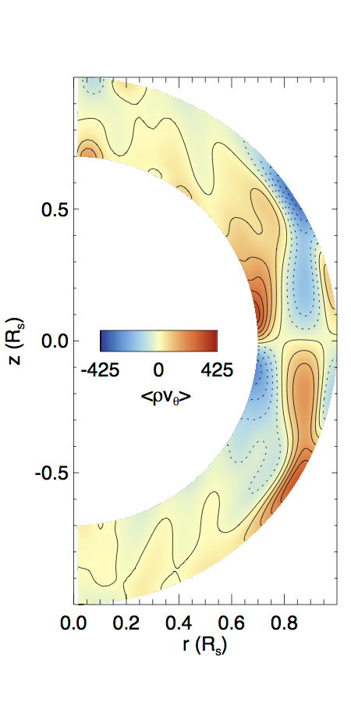
FSAM
ASH

Slide 4
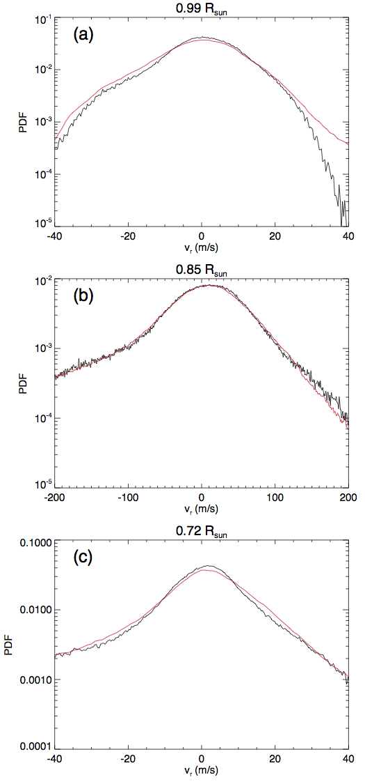
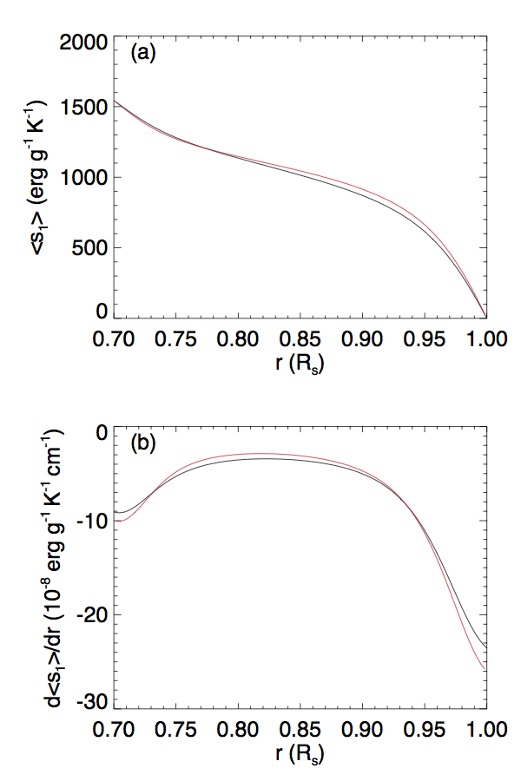
A comparison between FSAM and ASH of a hydro simulation of rotating convection

Slide 5
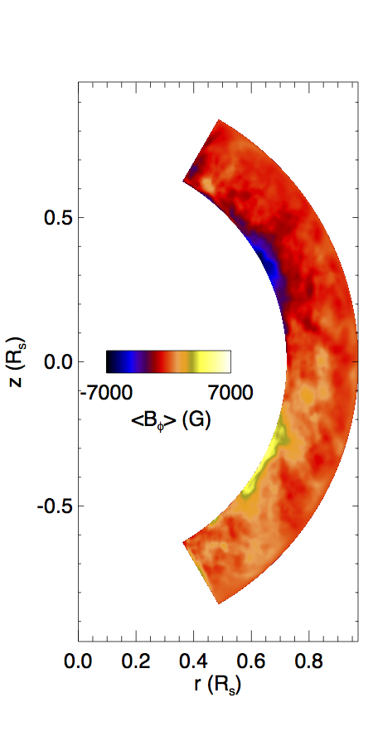
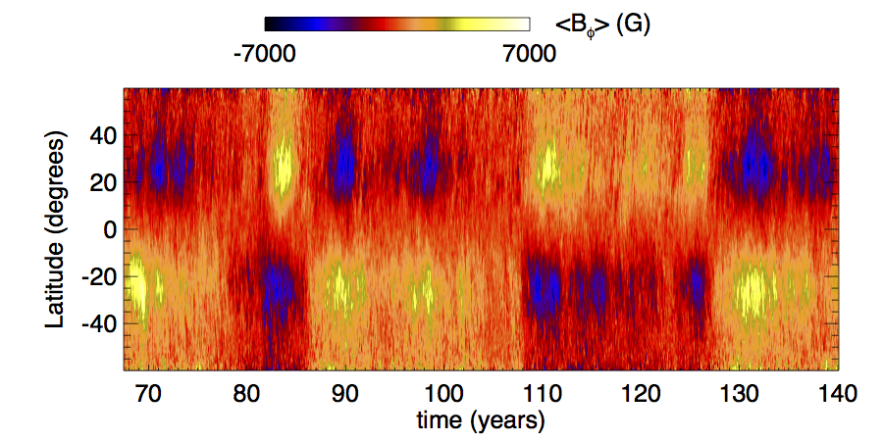
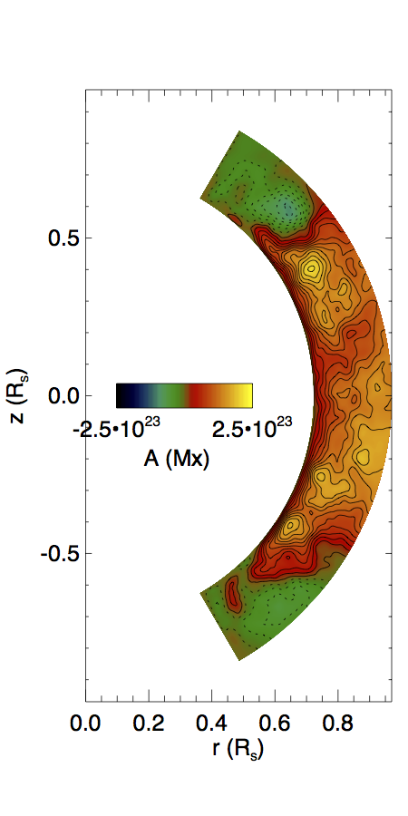
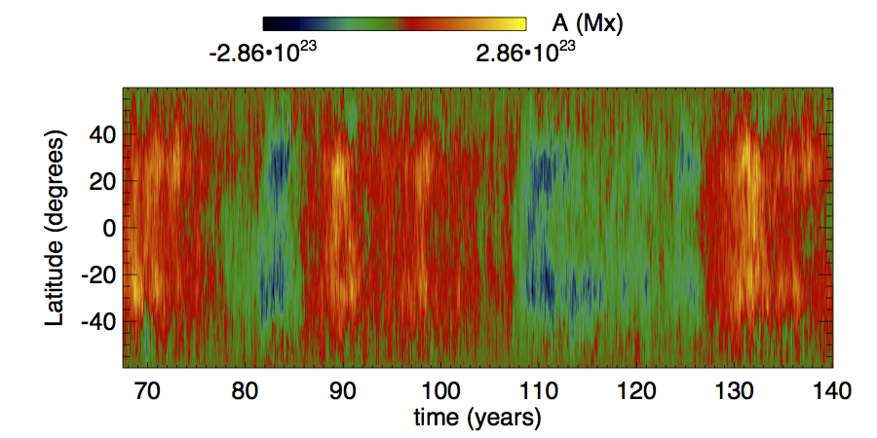
convective dynamo simulation showing irregular cycles

Slide 6
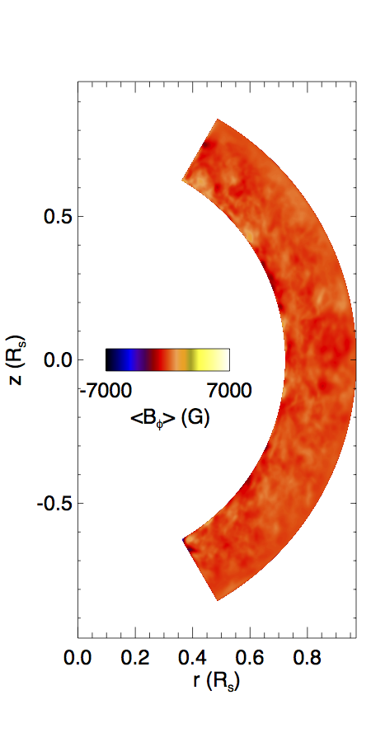
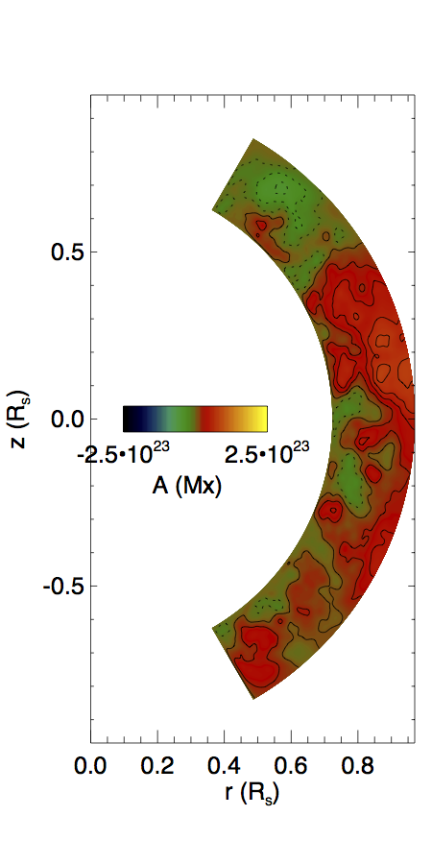
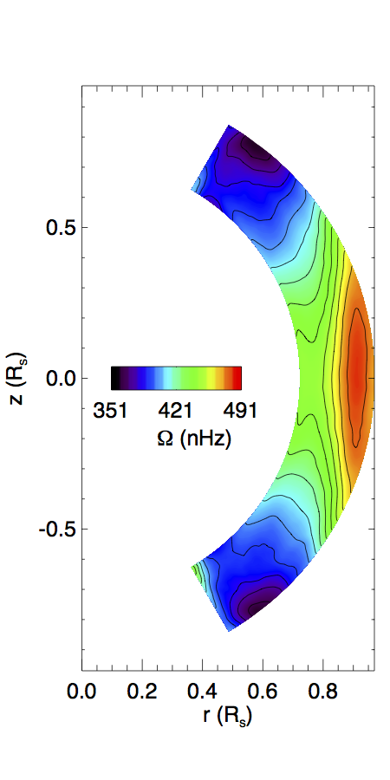
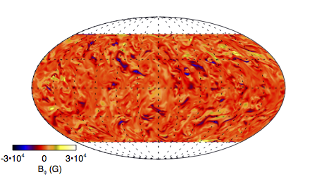
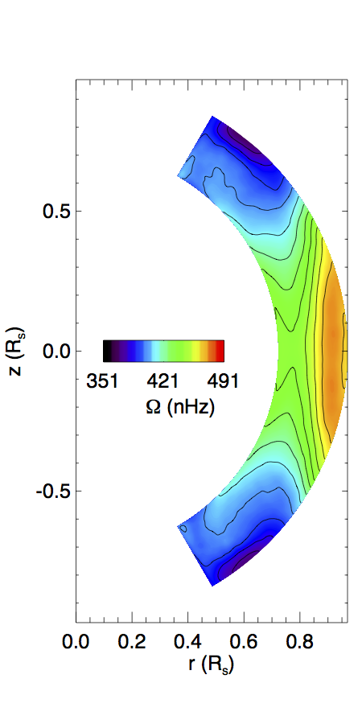
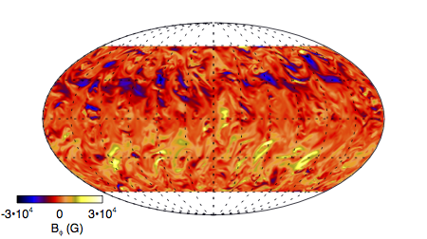
minimum
maximum

Slide 7
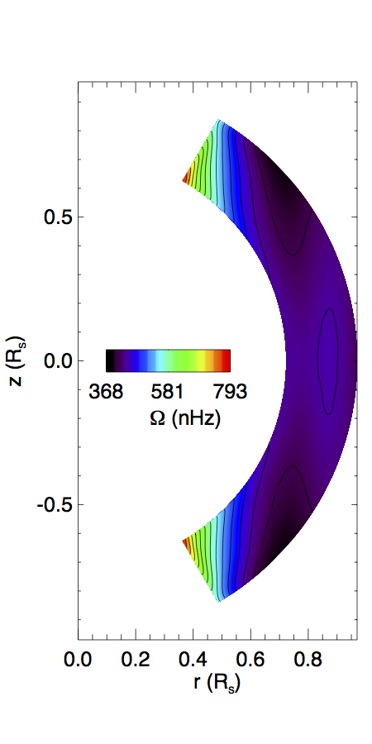
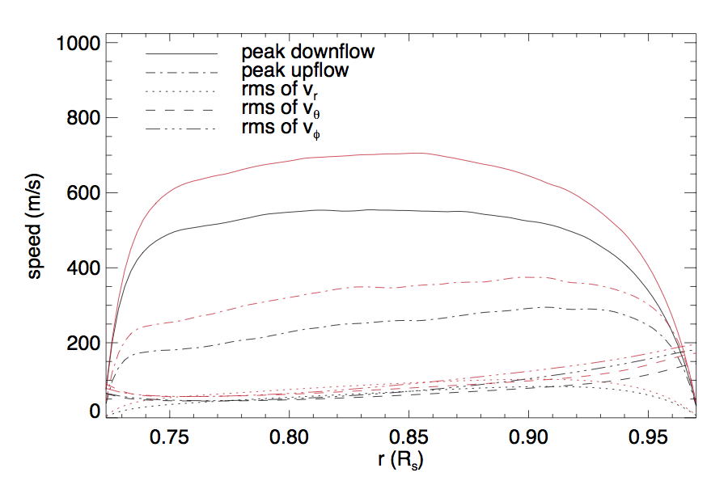
Effect of magnetic fields on differential rotation
Set B to zero →

Slide 9
Examples of strong flux emergence events

